Slide 1









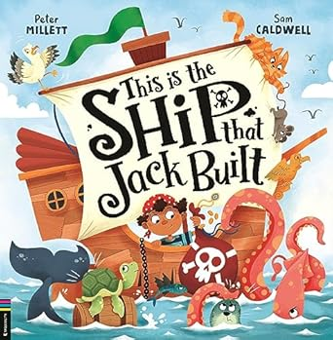









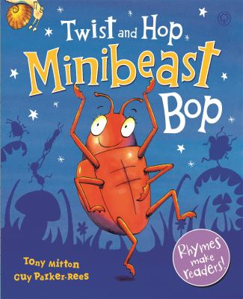







Reception Spring 2026
Our learning this term
In Spring 1, our theme will be ‘travelling to different places’.
We will be focusing on these texts:
Spring 1 key learning
Understanding the world
What different transport can we use to travel to different places?
Exploring trains, planes, cars, bikes, buses and boats.
Changes over time (steam trains and first planes).
Making 3D trains and boats.
What is it like at the seaside?
Exploring coastal regions.
Using microscopes to look at sand.
Creating maps.
How can we move different vehicles?
Programming beebots.
Using maps to move from one place to another.
Exploring forces – push, pull, stretch, etc.
What different places have I been to?
Where have I travelled to on holiday?
Will the boat float or sink?
Floating and sinking with predictions.
How can we make a boat?
Using different materials to make a boat, including natural materials.
Boat races with friends.
Expressive art and design
Observational drawings of sunflowers and daffodils.
Looking at artwork inspired by Vincent Van Gogh.
Designing and modelling boats.
Printing onto tiles.
Maths
Numbers to 10, measuring, patterns, 3D shapes.
Phonics
Phase 3 ai, ee, igh, oa, oo, oo, ar, or, ur, ow, oi, ear, air, er, dd, mm, tt, bb, rr, gg, pp, ff.
In Spring 2, our theme will be ‘minibeasts’.
These will be our focus texts:
Spring 2 key learning
Understanding the world
What are minibeasts?
What do they look like?
Using microscopes.
Drawing of different minibeasts.
Make minibeast puppets/spoon characters.
Where do they live?
Bug hotels.
Adding different materials into the hotel and exploring why they are used.
Minibeast hunt.
Wormery.
How do they grow?
Life cycles – ladybirds and bees.
How do bees help us?
Bee hives.
Honey.
Moving pollen to different plants.
How are we helping the minibeasts?
Create maps of our outdoor area.
Expressive art and design
Junk modelling with different materials – making bird feeders/ houses.
Making puppets to tell stories.
Maths
Composition to 10, shape work, capacity, doubles, position and direction.
Phonics
Phase 3 review spring 1 sounds, words with double letters, words with two or more digraphs, words ending in ‘-ing’, words with ‘s’ /z/ in the middle, words with ‘es’ /z/ at the end.
Understanding the world
Special events
Chinese New Year Easter
Ramadan and Eid Mother’s Day

Slide 2





Reception Spring 2026
.
Phonics workshop
We will be holding a phonics workshop for parents to attend after school during the week commencing… There will be more details on this to follow.
PE
Our PE day is Monday.
On these days, your child should come to school in their PE kit: a plain white t-shirt, black joggers or leggings and a school jumper or fleece.
Weekly homework tasks
After October half term, we will share written phonics tasks. These will be given out on a Monday and returned on a Friday.
Instagram
We have a new class Instagram page which you can follow. We’ll be sharing and celebrating our learning with you at:
OakfieldHyde_Reception
Supporting your child at home
Reading
Your child will bring home two reading books every Friday. One will be a Little Wandle phonics book and one will be a library book.
Little Wandle phonics book:
This book will be carefully matched to your child’s reading level. Initially, your child will have a wordless book and, when they have begun to learn graphemes and how to blend them together to read words, they will then have books with words. If your child is reading it with little help, please don’t worry that it’s too easy – your child needs to develop fluency and confidence in reading and to develop their storyteller voice! Listen to them read the book daily, if possible. Give them lots of praise – celebrate their success! If they can’t read a word, remind them to sound it out and if they still struggle, read it to them.
Library book:
This book has been chosen by your child from the school library. This will contain tricky words that your child will not be able to read by themselves. It is a book to enjoy together.
Reading aloud
Encourage your child to read daily and:
Sound out and blend
Use their storyteller voice (reading with expression)
Talk about the book together and ask questions:
Discuss the pictures. Can you find a…? What can you see…?
Make a prediction. What do you think will happen next?
Make links with the story and their own experiences. For example, if the book is about a birthday, can they tell you about a birthday party they have had or been to?
Play ‘I spy’ games. Can you find words beginning with…? Can you find a picture of something beginning with…?
.

