Slide 1









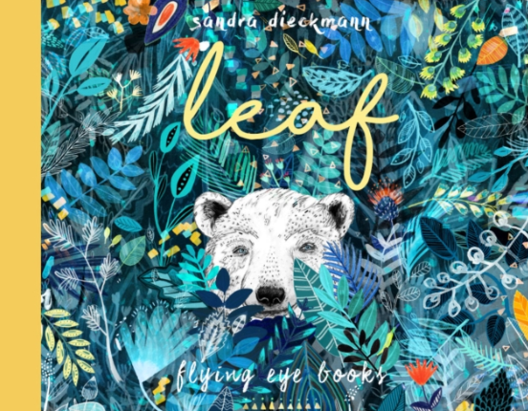











Tawny Bees at The Hive Spring 2 2026
Our learning this term
This half term our theme is ‘In the Garden’. This is a science based unit of work where the children will be learning about the natural world.
We will be focusing on this text:
Spring key learning
My Communication
We will be exploring characters, setting and the theme of belonging.
We will be looking at sensory storytelling, sequencing activities, sentence writing using feelings and description, and creative tasks.
The children will follow their phonics program.
My World
We will be learning about different plants and how to grow and keep plants healthy.
We will look at plant life cycles and will be growing our own plants in the garden.
We will look at seasonal changes from Autumn to Winter and then into Spring. We will be looking at how weather changes and what clothing we wear as the seasons change.
Look out for our sunflowers growing over the next few weeks!
In RE we will be learning about stories from the bible.
My Personal Development
We will be focussing on our social and emotional development through things such as turn taking with our friends, enjoying games such as cards and snakes and ladders.
We will be learning about healthy lifestyles and people who help us to stay healthy.
We will be developing agility, balance, throwing, catching, and jumping skills through fun games and activities.
Our fine motor will be developed through handwriting, dough disco and cutting skills
Special events
Mothers Day
Red Nose Day
World book day
Easter
My Creativity
We will be learning about Vincent Van Gogh and how he creates his paintings. The children will be using different sketching pencils, colour mixing and will create different interpretations of his work.
In DT we will be looking at different vegetables and how soup is made. We will be tasting and making our own tasty soup following simple recipes. We will be practising cutting using different tools and using the kitchen appliances.
We will be learning about rhythm and beat using percussion instruments.
My Thinking
We will be looking at early number skills, place value, addition and subtraction, multiplication and division, time and money, linking learning to our key chosen texts.
Phonics
In phonics, we will continue in our groups, with some pupils looking at Phase 3 sounds and some pupils looking at Phase 5.

Slide 2




Tawny Bees at The Hive Spring 2026
Talk about the book together and ask questions:
Discuss the pictures. Can you find a…? What can you see…?
Where/when is the story set?
Who are the main characters in the story?
Can you tell me what happened to them?
What was the first thing that happened in the story?
What happened after ____ (choose a part of the story)?
PE
Our PE days are Thursday and Friday.
On these days, your child should come to school in their PE kit: a plain white t-shirt, black joggers or leggings and a school jumper or fleece.
Weekly homework tasks
Every Friday, your child will be given a maths task. These will be sent home as paper copies and returned to school by Friday.
.
Supporting your child at home
Reading
Your child will bring home two reading books every Friday. One will be a Little Wandle phonics book and one will be a library book.
Little Wandle phonics book:
This book will be carefully matched to your child’s reading level. Initially, your child will have a wordless book and, when they have begun to learn graphemes and how to blend them together to read words, they will then have books with words. If your child is reading it with little help, please don’t worry that it’s too easy – your child needs to develop fluency and confidence in reading and to develop their storyteller voice! Listen to them read the book daily, if possible. Give them lots of praise – celebrate their success! If they can’t read a word, remind them to sound it out and if they still struggle, read it to them.
Library book:
This book has been chosen by your child from the school library. This will contain tricky words that your child will not be able to read by themselves. It is a book to enjoy together.
.
Instagram
We have a new class Instagram page which you can follow. We’ll be sharing and celebrating our learning with you at:
OakfieldHyde_TawnyBees

