Slide 1










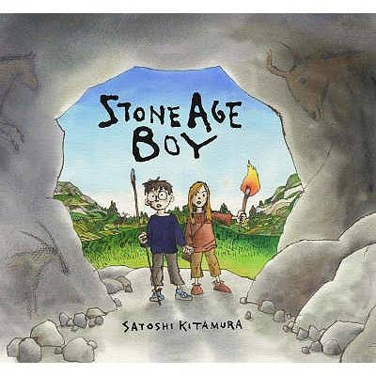
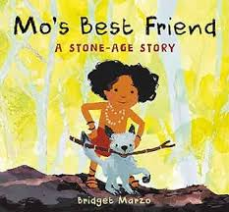
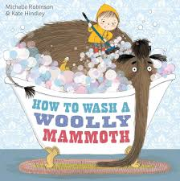
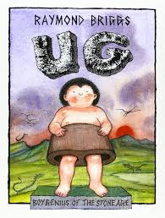











The Tawny Bees at The Hive Autumn 2025
Our learning this term
This term, our theme will be ‘Life in the Past’.
We will be focusing on these texts:
Autumn key learning
My Communication
We will be exploring characters, setting and the theme of friendship. We will be looking at time travel texts.
We will be looking at sensory storytelling, sequencing activities, sentence writing, and creative tasks.
My World
We will be learning about how the Stone Age people lived- their homes, tools, food, art and travel.
We will also explore rocks, soils and materials- investigating different rock types, soil textures and how materials are used.
We will look at seasonal changes in the Stone Age and compare to the present day.
My Personal Development
We will be focussing on settling in, making new friends, working together and looking after our classroom
We will be developing agility, balance, throwing, catching, and jumping skills through fun games and activities.
Our fine motor will be developed through clay modelling, weaving, and threading.
Special events
Bonfire Night
Diwali
Halloween
Christmas
My Thinking
We will be looking at early number skills, place value, addition and subtraction, shape and measure, and patterns and fractions. We will be linking our learning to our Stone Age theme using natural resources such as stones, sticks and leaves.
Phonics
In phonics, we will continue in our groups, with some pupils looking at Phase 3 sounds and some pupils looking at Phase 5.
My Creativity
We will be making cave paintings, modelling Stone Age Jewellery, clay pots and role plating in our Stone Age camp.
We will be learning about rhythm and beat using sticks, stones and body percussion to make our own Stone Age soundscapes

Slide 2




Tawny Bees at The Hive Autumn 2025
Talk about the book together and ask questions:
Discuss the pictures. Can you find a…? What can you see…?
Where/when is the story set?
Who are the main characters in the story?
Can you tell me what happened to them?
What was the first thing that happened in the story?
What happened after ____ (choose a part of the story)?
PE
Our PE days are Wednesday and Friday.
On these days, your child should come to school in their PE kit: a plain white t-shirt, black joggers or leggings and a school jumper or fleece.
Weekly homework tasks
Every Monday, your child will be given a maths and phonics/spelling task. These will be sent home as paper copies and returned to school by Friday.
.
Supporting your child at home
Reading
Your child will bring home two reading books every Friday. One will be a Little Wandle phonics book and one will be a library book.
Little Wandle phonics book:
This book will be carefully matched to your child’s reading level. Initially, your child will have a wordless book and, when they have begun to learn graphemes and how to blend them together to read words, they will then have books with words. If your child is reading it with little help, please don’t worry that it’s too easy – your child needs to develop fluency and confidence in reading and to develop their storyteller voice! Listen to them read the book daily, if possible. Give them lots of praise – celebrate their success! If they can’t read a word, remind them to sound it out and if they still struggle, read it to them.
Library book:
This book has been chosen by your child from the school library. This will contain tricky words that your child will not be able to read by themselves. It is a book to enjoy together.
.
Instagram
We have a new class Instagram page which you can follow. We’ll be sharing and celebrating our learning with you at:
OakfieldHyde_TawnyBees

