Slide 1






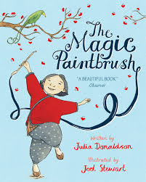
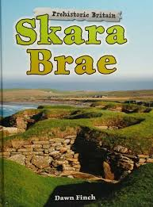




















Year 3 Autumn 2025
Our learning this term
In English, we will be focusing on these texts:
In science, we will be learning about the different types of rocks and their properties, and how fossils have formed over the years. We will also be learning about the different forces and magnets.
In Music, we will be writing down music and learning Long and short (rhythm) and high and low (pitch) sounds can be represented by musical symbols.
In PSHE we will be learning about how we can make healthy lifestyle choices to keep healthy and how we can look after our mental health.
In reading, we will be developing our comprehension skills: predicting, summarising, retrieving, clarifying, deducing and inferring and providing evidence to support our answers.
In history, we will be learning about the Stone age, Bronze age and the Iron age. We will look at how farming, settlements and life for people has changed over time.
In Computing, we will be learning how to use imovie to create content with photo, video and a voiceover. We will also be learning how to design and create content for a presentation.
In writing, we will be learning about types of nouns, subject and verbs and clauses. We will be writing as diary entries as characters from our class texts, adopting a formal style to write persuasive letters and poetry.
In Geography, we will learn more about Skara Brae and the importance of its location and also explore the location of the Stonehenge.
In P.E, we will be focusing on gymnastics, learning to develop balance. With the sports coach we will be learning the fundamentals where we will develop technique and agility.
In maths, we will be looking at place value, fractions, addition and subtraction, measurement, multiplication (and division), decimals and percentage, division, ratio and proportion, shape, angles and statistics.
In Art, we will be studying cave paintings and using different techniques and mediums to create our own Palaeolithic inspired final piece.
In R.E, we will be learning about what different people believe about God, and how this may look different in Christianity and Islam.

Slide 2






Year 3 Autumn 2025
.
PE
Our PE days are Monday and Wednesday.
On these days, your child should come to school in their PE kit: a plain white t-shirt, black joggers or leggings and a school jumper or fleece.
Homework tasks
Daily reading (reading book and library book)
Reading Plus/Reading eggs – 3x per week
TTRockstars 3x per week
A weekly maths and phonics/spelling task. These will be sent home as paper copies every Monday and returned to school by Friday.
Instagram
We have a new class Instagram page which you can follow. We’ll be sharing and celebrating our learning with you at:
OakfieldHyde_Year3
Supporting your child at home
Reading
Your child will bring home two reading books every Monday. One will be a Little Wandle phonics book, matched to their reading ability and the other will be a library book.
Encourage your child to read aloud daily and:
Use their storyteller voice (reading with expression)
Pause for punctuation
Use a different voice for when characters speak.
After reading the book, ask questions: to help to develop your child’s comprehension skills.
Vocabulary
Can you tell me what _______ (choose a word) means?
Can you find a word that means the same as …? e.g. quiet and your child finds timid in the text.
Inference
Choose one of the characters and tell me what you think about them.
What did the author write that made you feel this way? (Ask if they can find the evidence in the text and show you).
Retrieval
Who are the main characters in the text?
What can you tell me about each of them? (their appearance and what happens to them)
Prediction
When reading - What do you think might happen next? Tell me why you think this based on what you have read so far.
Summary
Can you tell the me the key event on one page or one chapter?
At the end of a book. Can you tell me what happened at the beginning, middle and end of the story?

