Slide 1





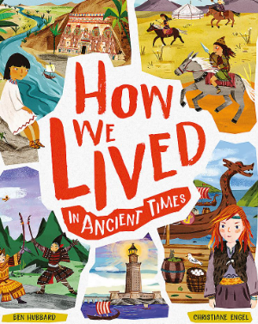
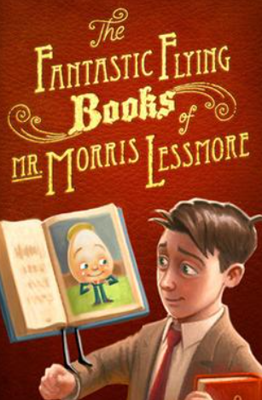
















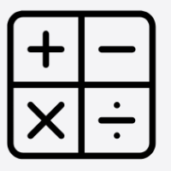




Year 5 Autumn 2025
Our learning this term
In English, we will be focusing on these texts:
This term computing is about digital literacy; discussing being safe online, how to protect yours and other’s identities and who to report to if you need help.
In Science, we are exploring animals including humans. This includes, how we grow and change as we get older, how fertilisation happens and mammal’s gestation periods.
In Music, we will be learning about melody and harmony through the songs: The Ghost Parade, Words Can Hurt and Joyful, Joyful.
In reading, we will be developing our comprehension skills: predicting, summarising, retrieving, clarifying, deducing and inferring and providing evidence to support our answers.
In History, we are delving into Ancient Greece. Looking at the different time periods, how they lived, their gods and goddesses and their enemies.
In PE, we will be focusing on gymnastics and dodgeball. Gymnastics includes balances, different rolls, travelling and sequencing. Dodgeball includes tactics, blocking, catching and throwing.
In PSHE, our overarching topic is Healthy Lifestyles and Mental Health where we will investigate whether mental health and physical health are the same and the importance of both.
In writing, we will be learning about types of nouns, subject and verbs and clauses. We will be writing as diary entries as characters from our class texts, adopting a formal style to write persuasive letters and poetry.
In Spanish, we will focus on Classroom instructions and opinions, sports and opinions, revise ‘Tener’ with negative/adjectival agreement, masculine and feminine forms and weather.
In Geography, we will look at the location of Greece and its islands as well as Athens and their physical and human features. This links to our History topic of Ancient Greece.
In RE, we will be learning about different gods, what people believe and debating about why people from different religions believe in God.
In maths, we will be looking at place value, fractions, addition and subtraction, measurement, multiplication (and division), decimals and percentage, division, ratio and proportion, shape, angles and statistics.
In Art, we will be looking at the artists Clarice Cliffe’s artwork and designing our own pottery work. We will focus on what mediums, materials and what skills are used to make pottery.

Slide 2






Year 5 Autumn 2025
.
PE
Our PE days are Wednesday and Friday
On these days, your child should come to school in their PE kit: a plain white t-shirt, black joggers or leggings and a school jumper or fleece.
Homework tasks
Daily reading (reading book and library book)
Reading Plus/Reading eggs – 3x per week
TTRockstars 3x per week
A weekly maths and phonics/spelling task. These will be sent home as paper copies every Monday and returned to school by Friday.
Instagram
We have a new class Instagram page which you can follow. We’ll be sharing and celebrating our learning with you at:
OakfieldHyde_Year5
Supporting your child at home
Reading
Your child will bring home two reading books every Monday. One will be a Little Wandle book/class reading book, matched to their reading ability and the other will be a library book.
Encourage your child to read aloud daily and:
Use their storyteller voice (reading with expression)
Pause for punctuation
Use a different voice for when characters speak.
After reading the book, ask questions: to help to develop your child’s comprehension skills.
Vocabulary
Choose a character. Which words in the text are used to describe them?
Discuss any words that your child is unsure of. Use a dictionary to look at definitions.
Inference
Choose one of the characters and tell me what you impression you get of them?
Find and show me the evidence in the story that made you think this.
Prediction
When reading - What do you think will happen next? What makes you think this?
Retrieval
Whose perspective is the story told from?
Who are the main characters in the story?
How are they connected?
Summary
Can you summarise the events of the story in three sentences?
How would you recommend this text to someone else, without giving away the story?

