Slide 1





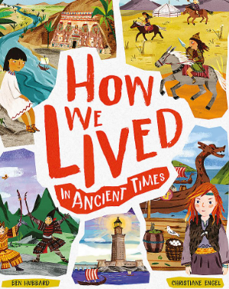
















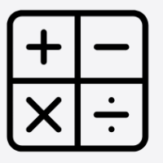



Year 5 Spring 2026
Our learning this term
In English, we will be focusing on these texts:
This term computing is about Microbits, we will be making a step counter, a score keeper and radio blocks. We will also look at how computer networks work.
In Science, we are exploring the planets and forces. This includes, gravity, the solar system, space, knowing what makes an object slow down and why different atmospheres are harder to move in.
In Music, we will be learning composing our own music and learning the chords. We will then look at different musical styles and compare them.
In reading, we will be developing our comprehension skills: predicting, summarising, retrieving, clarifying, deducing and inferring and providing evidence to support our answers.
In PE, we will be focusing on Basketball and Dance. In Basketball they will learn different tactics and how to move in different situations. In Dance, we will do dance by chance and rock and roll.
In PSHE, our overarching topic is relationships and keeping safe. We will look at risks and how to minimise them, how to keep information safe and basic first aid, bullying, consent and advice.
In Geography, we will look at natural resources and how humans have affected the planet. We will also look at biomes and the Amazon rainforest.
In writing, we will be learning about writing to create suspense, direct speech, parenthesis and different word classes. We will be writing an adventure story where the children create their own ending independently.
In DT, we will be looking at automata toys and creating our own using a cam, slider and follower using a frame. We will then evaluate our prototype.
In Spanish, we will focus on numbers 1-31, months and dates, transport, classroom items and school subjects.
In RE, we will be learning about what Jesus would do by focusing on his teachings and parables. We will then investigate the question: If God is everywhere, why go to a place of worship?
In maths, we will be looking at place value, fractions, addition and subtraction, measurement, multiplication (and division), decimals and percentage, division, ratio and proportion, shape, angles and statistics.

Slide 2






Year 5 Spring 2026
.
PE
Our PE days are Wednesday and Friday
On these days, your child should come to school in their PE kit: a plain white t-shirt, black joggers or leggings and a school jumper or fleece.
Homework tasks
Daily reading (reading book and library book)
Reading Plus/Reading eggs – 3x per week
TTRockstars 3x per week
A weekly maths and phonics/spelling task. These will be sent home as paper copies every Friday and returned to school by the following Friday.
Instagram
We have a new class Instagram page which you can follow. We’ll be sharing and celebrating our learning with you at:
OakfieldHyde_Year5
Supporting your child at home
Reading
Your child will bring home two reading books every Monday. One will be a Little Wandle book/class reading book, matched to their reading ability and the other will be a library book.
Encourage your child to read aloud daily and:
Use their storyteller voice (reading with expression)
Pause for punctuation
Use a different voice for when characters speak.
After reading the book, ask questions: to help to develop your child’s comprehension skills.
Vocabulary
Choose a character. Which words in the text are used to describe them?
Discuss any words that your child is unsure of. Use a dictionary to look at definitions.
Inference
Choose one of the characters and tell me what you impression you get of them?
Find and show me the evidence in the story that made you think this.
Prediction
When reading - What do you think will happen next? What makes you think this?
Retrieval
Whose perspective is the story told from?
Who are the main characters in the story?
How are they connected?
Summary
Can you summarise the events of the story in three sentences?
How would you recommend this text to someone else, without giving away the story?

