Slide 1
Parent Revision Evening 6th February
Aims for this evening
Mock Feedback from students
Look at the techniques the school will be promoting for revision
What to expect from the exam series and what resources can help
How to support students with their stress levels on the lead up to the exams

Slide 2
2) Look at the techniques the school will be promoting for revision
3) What to expect from the exam series and what resources can help
4) How to support students with their stress levels on the lead up to the exams
1) Mock Feedback

Slide 3
Looking at your results, which statement below best reflects yours initial reactions?

Slide 4
Approximately how much time did you spend revising for the mock exams?

Slide 5
Between 15 to 20 hours a week is the desired focus.
Short bursts of revision of 30mins to 1 hour per session

Slide 6
Did you create a revision timetable?

Slide 7
Lets have a go!
Notes:
Talk parents though the process.
Add in time slots…
Box off anything that is a commitment first
Add in subjects
Add in breaks
Stars when done!

Slide 8
Did you attempt practice exam questions?

Slide 9
Did you attempt practice exam questions?
WARNING. Students need the knowledge first before attempting the exam questions! It can become very disheartening….

Slide 10
2) Look at the techniques the school will be promoting for revision
3) What to expect from the exam series and what resources can help
4) How to support students with their stress levels on the lead up to the exams
1) Mock Feedback

Slide 12
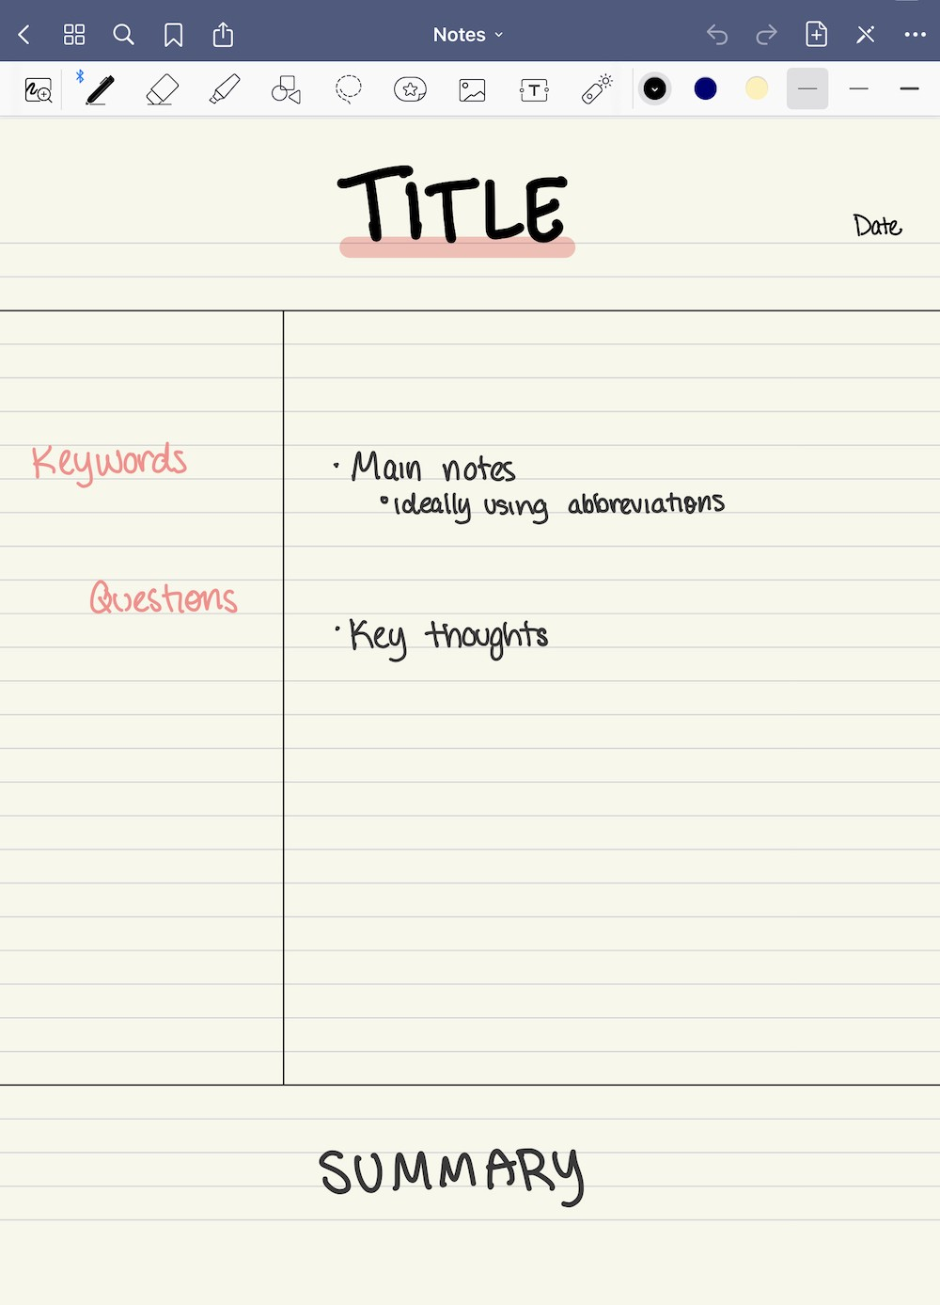
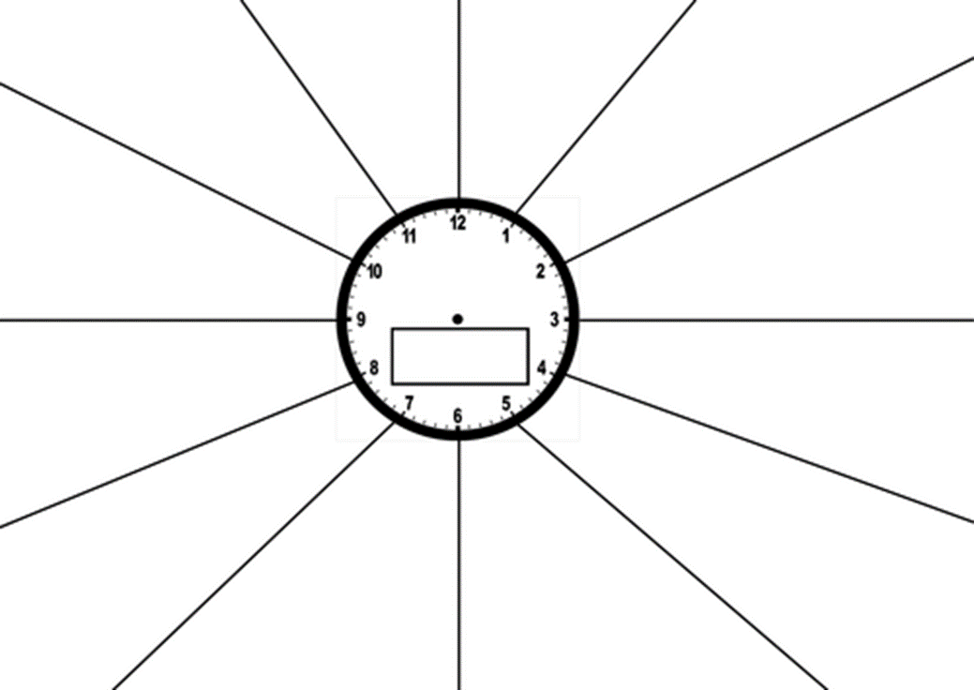
Notes:
O

Slide 13
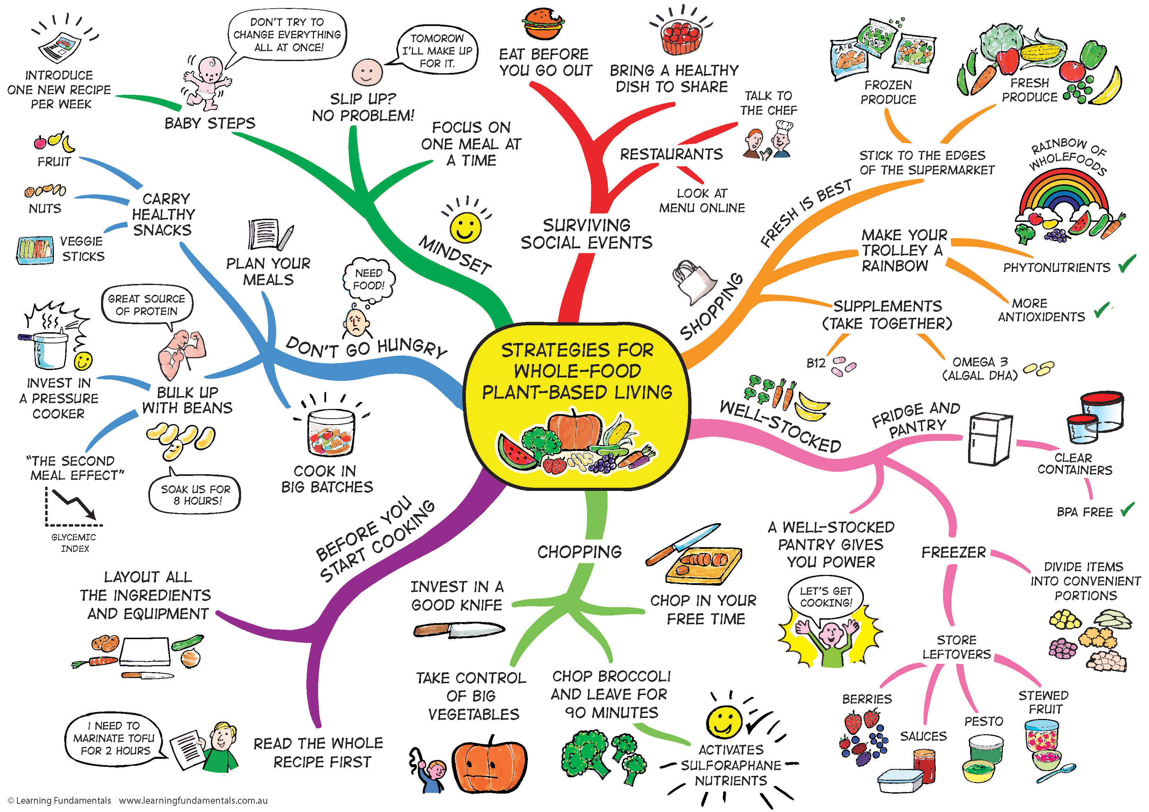
The People’s Choice- The Mind Map
By far the most popular choice the students gave when asked what revision technique they used the most

Slide 14
Revision Clocks

Slide 15
Revision Cards
Parent Task
A good revision card should;
Be homemade
Involve pictures and words
Test knowledge
Have a question on one side, answer on the other
Be easy to read
Have the correct information
Be used frequently but spaced out
Notes:
Prepare some capital cities? Have a go…

Slide 16
2) Look at the techniques the school will be promoting for revision
3) What to expect from the exam series and what resources can help
4) How to support students with their stress levels on the lead up to the exams
1) Mock Feedback

Slide 17
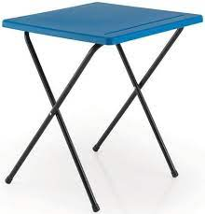
Exam Countdown
Notes:
Green are school holidays.
Pupils really need to focus over the next half term. 10 School weeks until exams start!
15th May Exam season starts, there may be language speaking exams earlier than that

Slide 18
Revision Loyalty Card
To support our push for Prom (6th July), we will want students to collect signatures of the revision they are completing.
Completed cards will result in prizes and possible free prom tickets. It will also aim to give a sense of completion to revision that can link to the exam timetable.

Slide 19
Look at the techniques the school will be promoting for revision
What to expect from the exam series and what resources can help
How to support students with their stress levels on the lead up to the exams
Mock Feedback

Slide 20
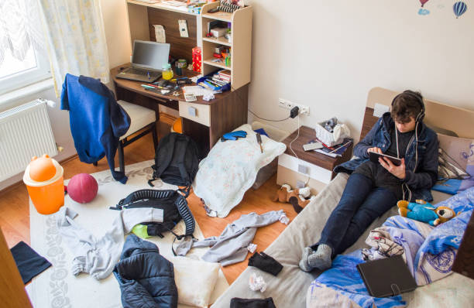
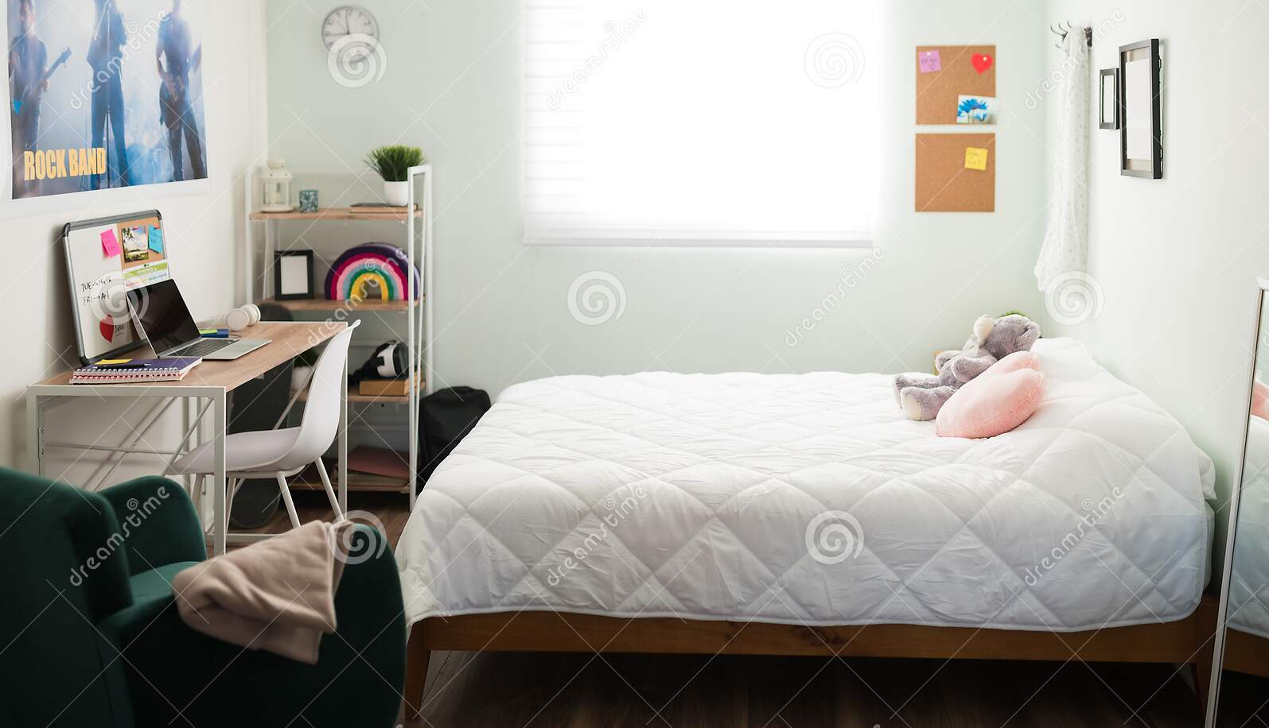
Simple Ways to Help #1

Slide 21
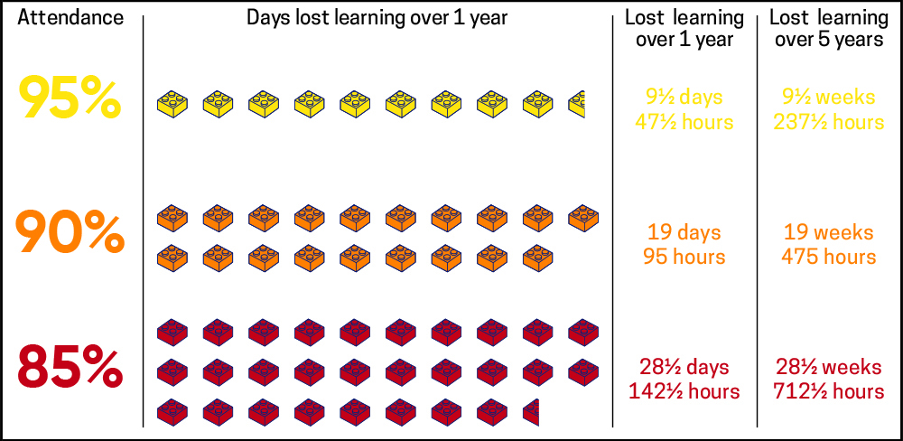
Simple Ways to Help #2

Slide 22
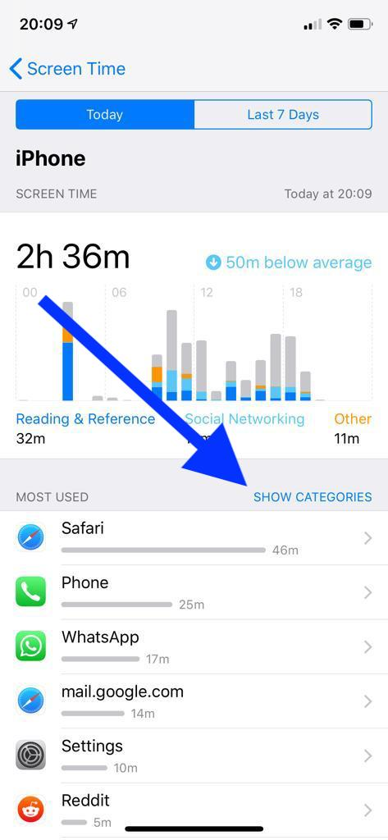
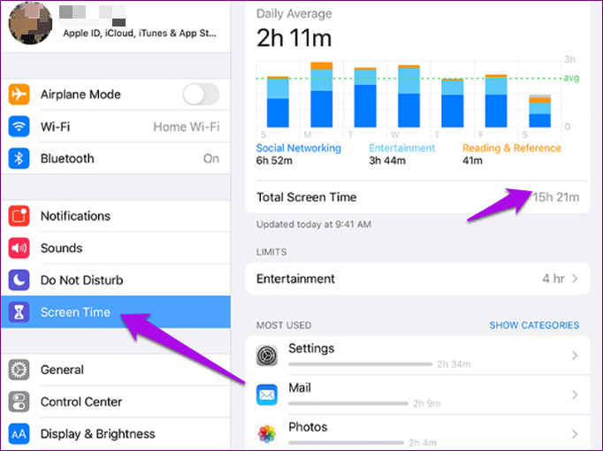
5 Simple Ways to Help #3
Notes:
https://www.bbc.com/ownit/the-basics/managing-family-screen-time
Video is 2 mins 33 seconds

Slide 23
Ormskirk Sixth Form - Subjects
English Literature | English Language | Maths | Further Maths | Spanish | French
Theatre studies | Sociology | Computer Science | Economics | Geography | History
Psychology | Sociology | Biology | Physics | Chemistry | Graphic Art
Fine Art
A levels
Carefully selected, highly valued, can be combined in any way
BTECs
Business | IT | Music | Health and Social Care
Sport
‘A successful, supportive Sixth Form with a real family feel’
Notes:
Subjects
Pathways
Experienced and dedicated staff
Facilities
Any degree they want to study they will be able to get onto from here.
Carefully selected BTEC suite to ensure we are delivering those that are valued by universities
Quote from uni + destination of last years BTEC students.

Slide 24
Parent Task
Can anyone remember the information from before??
No cheating!
Notes:
Could we have a prize?!

Slide 25
NHS Guidance
Stress can make you feel:
irritable
anxious
like you cannot enjoy yourself
worried a lot of the time
You may start to:
have sleep problems
find it hard to concentrate
bite your nails, pick your skin or grind your teeth
snap at people
feel short of breath or breathe very fast

Slide 26
NHS Guidance
Tips for dealing with stress
Try to have a healthy lifestyle. Eat well, get enough sleep, be physically active, cut down on alcohol, and take time to relax as well as working and studying.
Avoid drugs, including lots of caffeine - this can have a negative impact on your stress levels and wellbeing.
Try not to worry about the future or compare yourself with others.
Try relaxation and breathing exercises.
Try to plan your time to help you keep track of your work. Break it down into manageable chunks so you can keep up with deadlines.
Try talking to a friend, tutor or someone in your family about your stress.

