Slide 1
Parental Revision Evening Monday 9th October
Aims For This Evening
What to expect from the exam series and resources to help
Look at the techniques our school will be promoting for revision
How to support students with their stress levels on the lead up to the exams

Slide 2
Key Dates 2023 - 2024
9th October Exam Support Information Evening
6th – 17th November Trial Examinations
Week starting 11th December 2023 Autumn Term Report
14th December 2023 Subject Parents Evening
19th -23rd February 2024 Trial examinations (Maths, English & Science only)
Week starting 18th March 2024 Spring Term Report
21st March 2024 Subject Parents Evening
Week starting 22nd April 2024 Summer Term Report
6th May – 28th June Formal GCSE examinations
Notes:
Quick overview of the year – Rationale for timings etc.
For most pupils REAL exams are too far away so need to look short term. i.e Nov Mocks

Slide 3
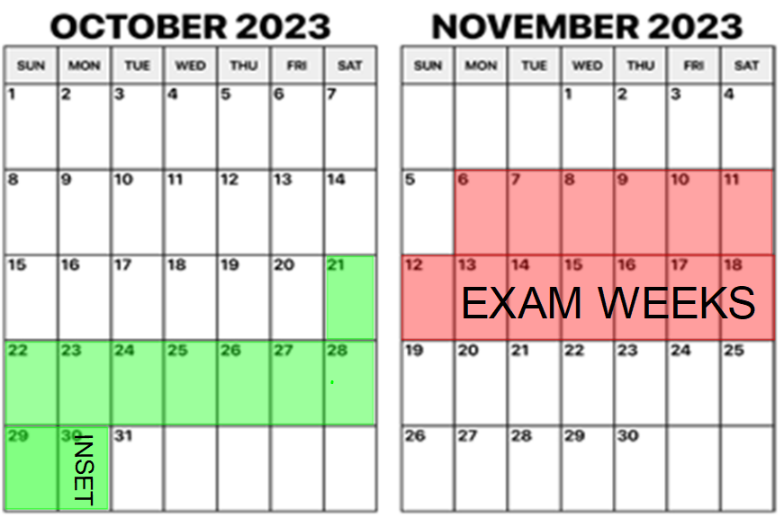
Mock Exam Weeks: 6th – 17th Nov

Slide 4
WORK
REST
MATHS
MathsWatch Past Paper
ENGLISH Macbeth Quotes Flashcards
SCIENCE Past Paper
SCHOOL PICK UP
PE
Mind-map
Respiration
ROAST DINNER
SCIENCE EDUCAKE
MATHS
MathsWatch Fractions
RUGBY
OUT WITH FRIENDS
History
Mind Map/Seneca
Elizabethan
Notes:
Talk parents though the process of creating a revision timetable.
Add in time slots…
Box off anything that is a commitment first
Add in subjects
Add in breaks
Stars when done!
Focus on the “Future You” aspect of mock week. More work now = Confidence in Summer.
Time varies from pupils to pupil.
Breaks important!! Cant do 3hrs flat out.

Slide 5
Aims For This Evening
What to expect from the exam series and resources to help
Look at the techniques our school will be promoting for revision
How to support students with their stress levels on the lead up to the exams

Slide 7
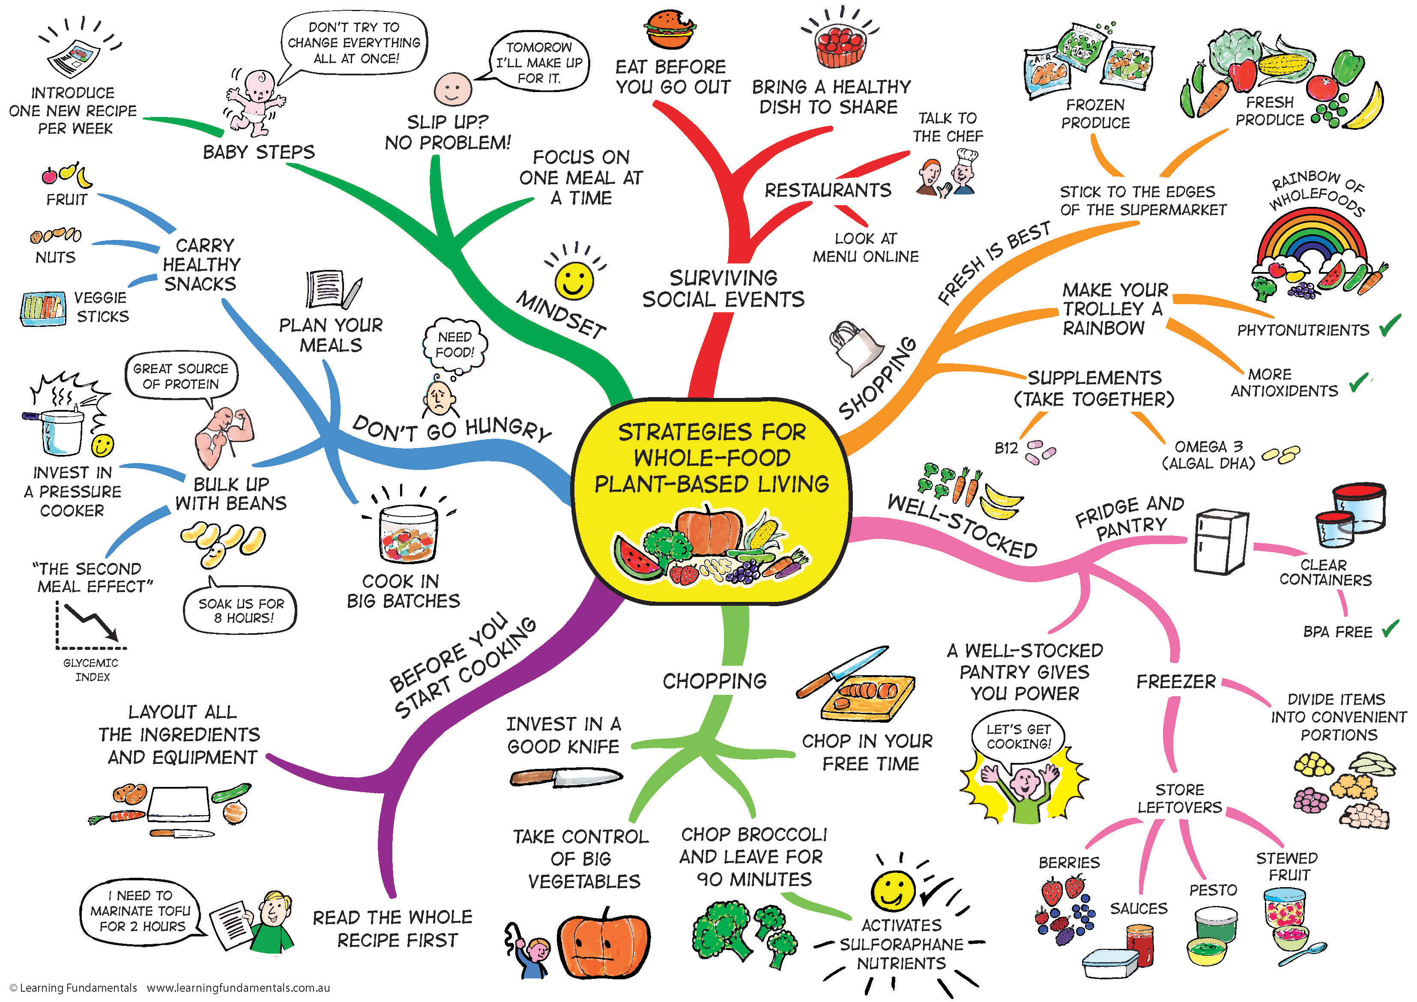
1) Mind Maps
A very popular choice amongst pupils!

Slide 8
2) Flash Cards
A good revision card should;
Be homemade
Involve pictures and words
Test knowledge
Have a question on one side, answer on the other
Be easy to read
Have the correct information
Be used frequently but spaced out
Notes:
Explain to parents this could be an activity they can help their child with.

Slide 9
Notes:
https://www.youtube.com/watch?v=C20EvKtdJwQ

Slide 10
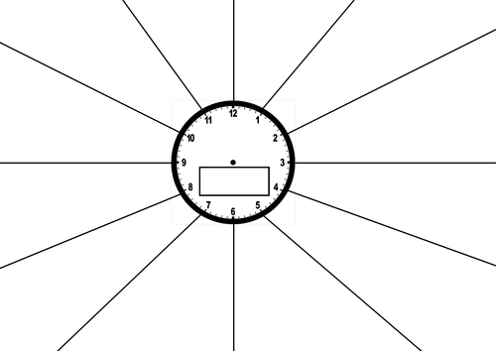
3) Revision Clocks

Slide 11
Aims For This Evening
What to expect from the exam series and resources to help
Look at the techniques our school will be promoting for revision
How to support students with their stress levels on the lead up to the exams

Slide 12
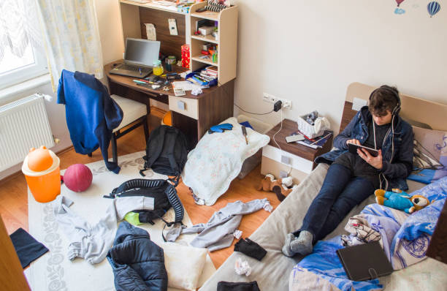
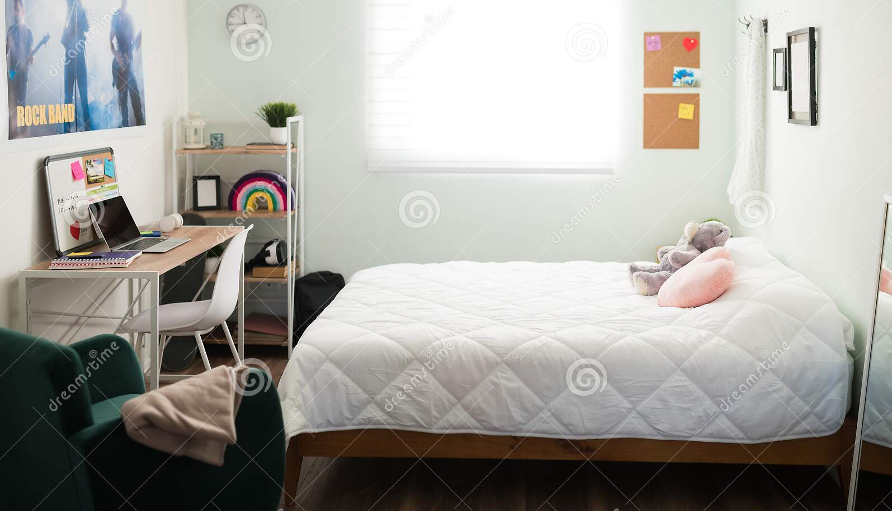
Simple Ways to Help #1

Slide 13
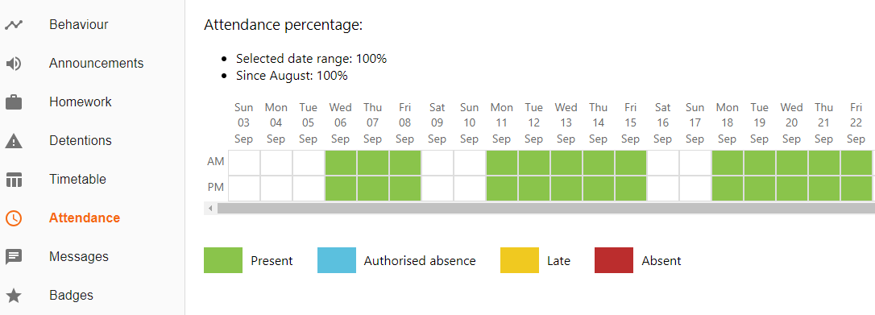
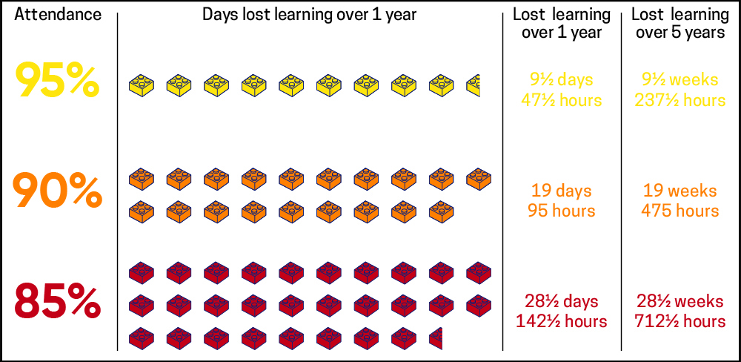
Simple Ways to Help #2
Notes:
Don’t forget to check classcharts for attendance and homework updates.
Could discuss with parents the change to comments, reinforce the positives at home.

Slide 14
Simple Ways to Help #3
Notes:
Calculators? Maths equipment.
Clear pencil case.

Slide 15
Simple Ways to Help #4
Notes:
Discuss the physiological impacts on teenagers, slow sleep drive means they start to feel tired later. Melatonin produced much later in the day than adults.
If teenagers were allowed to sleep on their own rhythm then they would probably get enough sleep.

Slide 16
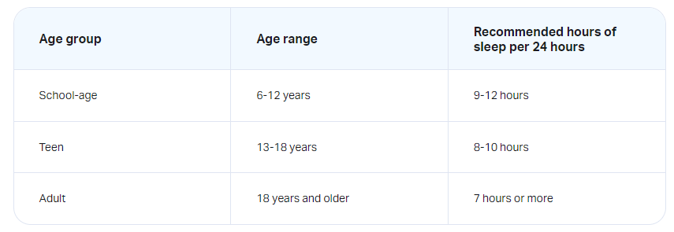
Simple Ways to Help #4 SLEEP

Slide 17
Simple Ways to Help #4 SLEEP
Budgeting eight hours of sleep into your daily schedule and keeping that same schedule on both weekdays and weekends.
Creating a consistent pre-bed routine to help with relaxation and falling asleep fast.
Avoiding caffeine and energy drinks, especially in the afternoon and evening.
Putting away electronic devices for at least a half-hour before bed and keeping them on silent mode to avoid checking them during the night.
Keeping your bedroom cool, dark, and quiet.

Slide 18
Simple Ways to Help #5
Use the Library
Our School
Staffed afterschool until 4:15pm
Ormskirk
Edge Hill
Notes:
Emphasise that using this resource means pupils can switch off when they come home.
Also breaks up the pupils environment, eg always studying in their room becomes tedious.
Could they meet a friend a revise together?

Slide 19
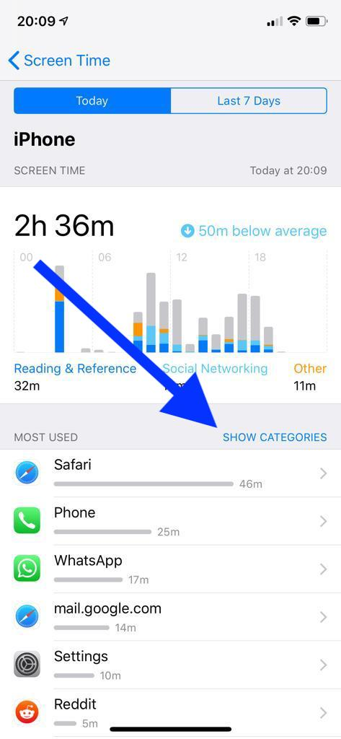
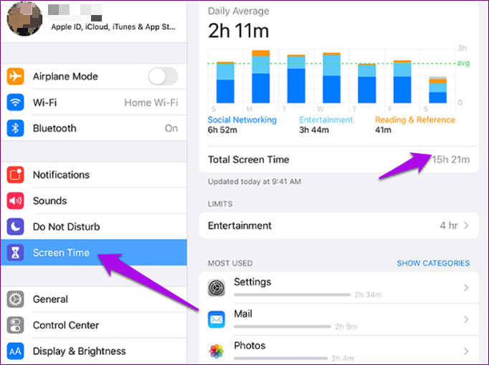
Simple Ways to Help #6
Notes:
https://www.bbc.com/ownit/the-basics/managing-family-screen-time
Video is 2 mins 33 seconds

Slide 20
Notes:
Thank parents for their attendance, support etc etc
Any questions?

Slide 21
ANY Feedback would be much appreciated

Slide 22
BACK UP SIXTH FORM SLIDES

Slide 23
What do you know about our Sixth Form?
How many subjects do we offer?
We offer 25 different subject in our Sixth Form
How many students do we have?
We currently have 111 students in our Sixth Form
What % of our students are happy?
On the 14th September 100% of our year 12 and 13 students told us that they were happy they chose to come to study with us
How many BTEC’s do we offer?
We offer 5 BTECs this year. BTEC Sport, Music, Health & Social Care, IT and Business. We want this to grow next year
How many A levels do we offer?
We offer 19 A level subjects this year
Notes:
Ask them to guess the stats before revealing them

Slide 24
What do you know about our Sixth Form?
What’s our most popular BTEC?
BTEC Business – we have 19 in our year 12 class this year
What’s our most popular A level?
History – we have 17 in our year 12 History class this year
What’s our vending machine best seller chocolate bar?
Dairy milk
Least favourite – Picnic bar
Notes:
Guess, discuss and reveal
Please discuss class sizes – these are the largest. Some have 4 students

Slide 25
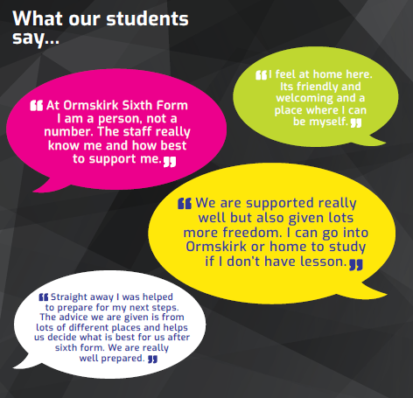
What our students say about us…

