Slide 1
Welcome to our Class of 2030!
Ormskirk School
Meet the Headteacher Evening
2025
Notes:
JBU

Slide 2
Notes:
JBU- Thank families for ‘choosing us’, discuss Ofsted etc

Slide 3
Our Trust Values
Truly Collaborative
People Centred
Inclusive
Unique
Aspirational
Notes:
Key mention that we are part of an academy trust and what it means for our school

Slide 4
Transition from Primary to Secondary
We are dedicated to making the process as smooth as possible:
School Visits - Throughout the year
Transition Days - 3rd and 4th July 2025.
(Alternative date for ATG Wed 9th July)
Transition Evening (Parents and Carers)- 3rd July 2025
SEND support
Summer School- 18th-19th August 2025
Welcome to Key Stage 3 Evening - September 2025
Notes:
SAS- We recognise that this can be both a daunting and exciting experience for children and parents/carers.
Shared approach, schools, parents/carers and children

Slide 5
SEND Support
We are dedicated to actively addressing and fulfilling the diverse needs of every student, with a whole school approach to SEND.
Notes:
SAS If you have a child with SEND, before beginning Year 7 we will make contact with primary schools, talk to you and your child, arrange time with our SENDCO and provide additional transition opportunities- if needed.
Explain- The Hub

Slide 6
Year 7 Team
Mrs Connelly
Assistant Head of Year 7
Mr Asgharyzadegan
Assistant Headteacher
Head of Key Stage 3 ( DSL)
Mr Jones
Head of Year 7 & Teacher of PE
Notes:
SAS- As well as teachers and form teachers, we have a dedicated year 7 team- very experienced in transition and provide nurturing approach.
You will meet this team on the transition days.

Slide 7
Summer School
We are delighted to offer a free Summer School programme for our new Year 7 starters.
Monday 18th & Tuesday 19th August 10-3pm
Please apply via our website
Notes:
SAS Great opportunity to have fun in the sun (hopefully!), make new friends and get to know our space.
Activities planned around teambuilding, crafts, sports and we also have a specialist Mental Health support worker coming along on one of the days to support our young people with the leap from primary to secondary. This is then part of a follow up later in the year.

Slide 8
What happens next?
Transition packs have either been delivered to your child’s primary school or posted to home addresses.
You will receive an email asking you to join ‘Arbor’- please follow the link to register and then complete the personal information and permissions. We anticipate that this will be after Easter.
no-reply@mail.arbor-education.com
Notes:
By registering today, we are assuming that you have accepted your place.
Please note the email may come from ‘Arbor’ rather than Ormskirk School so please keep an eye on your junk folder and socials for a reminder.

Slide 9
Final Thoughts
Proud To Belong
Notes:
JBU

Slide 10
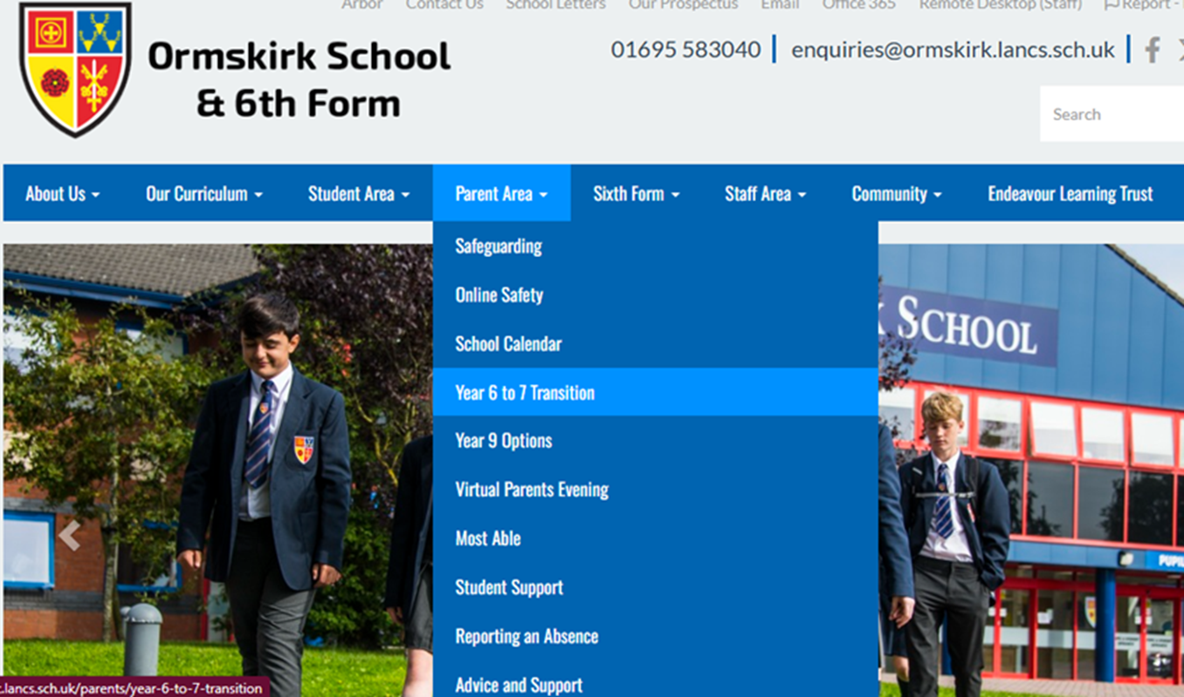
Contact us
Email : enquiries@ormskirk.lancs.sch.uk
Phone : 01695 583040
School Website: https://www.ormskirk.lancs.sch.uk/
Social Media for updates: Facebook & Instagram
@OrmskirkSchool
Notes:
JBU

