Slide 1
Teach reading: change lives
Parent workshop: Phonics and early reading

Slide 2
A love of reading is the biggest indicator of future academic success.
OECD (The Organisation for Economic Co-operation and Development)

Slide 3


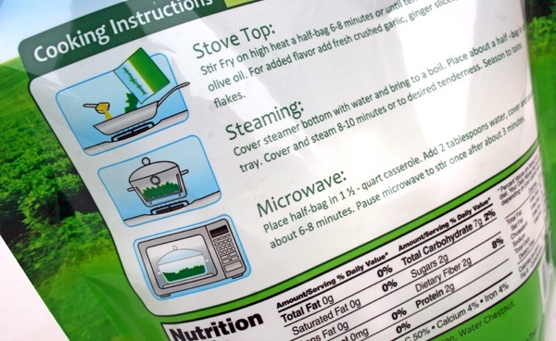
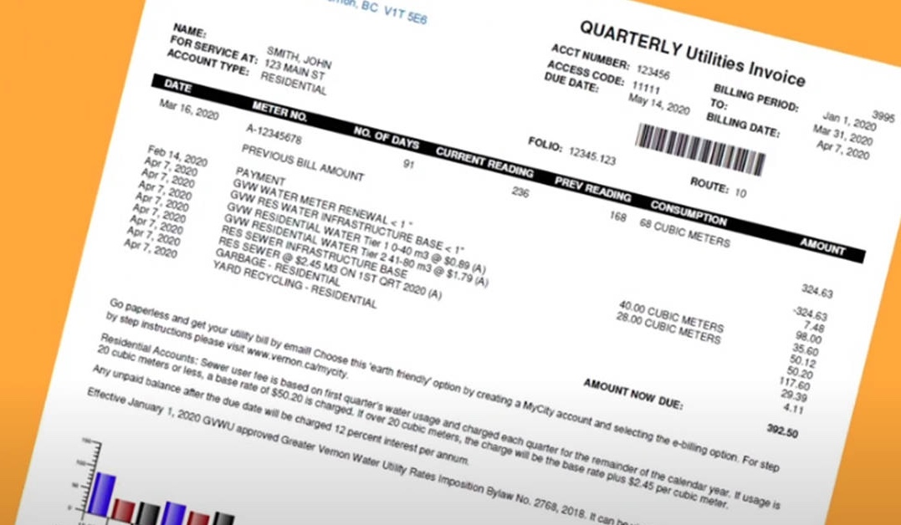
How many times have you already read today?
Notes:
Just think about how many times you have already read things today. It really is a vital skill.

Slide 4

Phonics

Slide 5
Why Little Wandle?
To teach a full programme with a consistent approach which includes phonics, reading books and classroom resources.
To use a programme that has integrated research about the science of learning.
To build on what we already know about teaching early reading at Oulton.
To use child friendly, challenging and interesting books.
To support teachers with training, lesson templates, sequences and assessments including a keep up programme.

Slide 6
Phonics is:
making connections between the sounds of our spoken words and the letters that are used to write them down.
Notes:
It sounds complicated but it really isn’t!

Slide 7
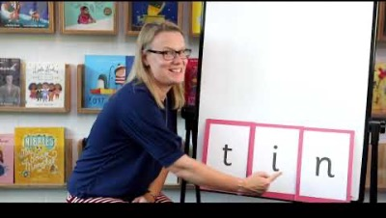
Blending to read words
Notes:
Some children learn to blend really quickly, and others take a little longer. If your child is finding it difficult, ask your child’s teacher for ways to help at home – playing blending games at home is so helpful!
Show parents this video from the website: https://www.littlewandlelettersandsounds.org.uk/resources/for-parents/

Slide 8
Terminology
Phoneme The smallest unit of sound that can be identified in words. We sometimes simply call this a ‘sound’, although it is helpful for children to use the term ‘phoneme’ from the beginning of our programme.
Phoneme
A letter or group of letters used to represent a particular phoneme when writing. With children, we sometimes call this ‘a sound written down’, although, as with ‘phoneme’, it is helpful for children to learn to use the correct term from the beginning.
Grapheme
A grapheme using two letters to represent one phoneme. With children, we frequently reinforce it with the mantra ‘two letters, one sound’. At the appropriate stage, it is useful for children to learn to use the term and to understand what it means.
Digraph
Trigraph
A grapheme using three letters to represent one phoneme. With children, we frequently reinforce it with the mantra ‘three letters, one sound’.
Notes:
Explain what each word means – use our glossary to help: https://www.littlewandlelettersandsounds.org.uk/resources/my-letters-and-sounds/getting-started/

Slide 9
Terminology
Split vowel digraph
A digraph representing a vowel sound where its two letters are split by an intervening consonant (for example, ‘a_e’ in ‘take’). Despite having a consonant in between them, the two letters involved (here ‘a’ and ‘e’) still count as one digraph, making one sound. The vowel sound is pronounced at the position of the first of the two letters of the digraph (that is, in the middle of ‘take’). At early learning stages, a split digraph is often highlighted with a short line joining the two halves of the digraph above the intervening consonant.
To identify each of the individual phonemes in a word, working all the way through from left to right. This is an important first stage of writing (spelling) a word but needs to be practised orally first. Counting the phonemes is often helpful in reinforcing this process.
Segment
To combine individual phonemes into a whole word, working all the way through from left to right. Once the GPCs involved have been learned, blending is the key process involved in reading words effectively. It is a skill that needs extensive practice.
Blend

Slide 10
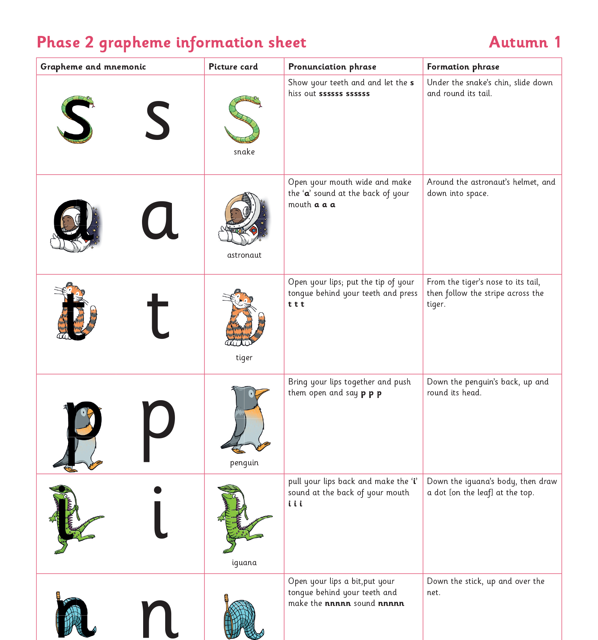
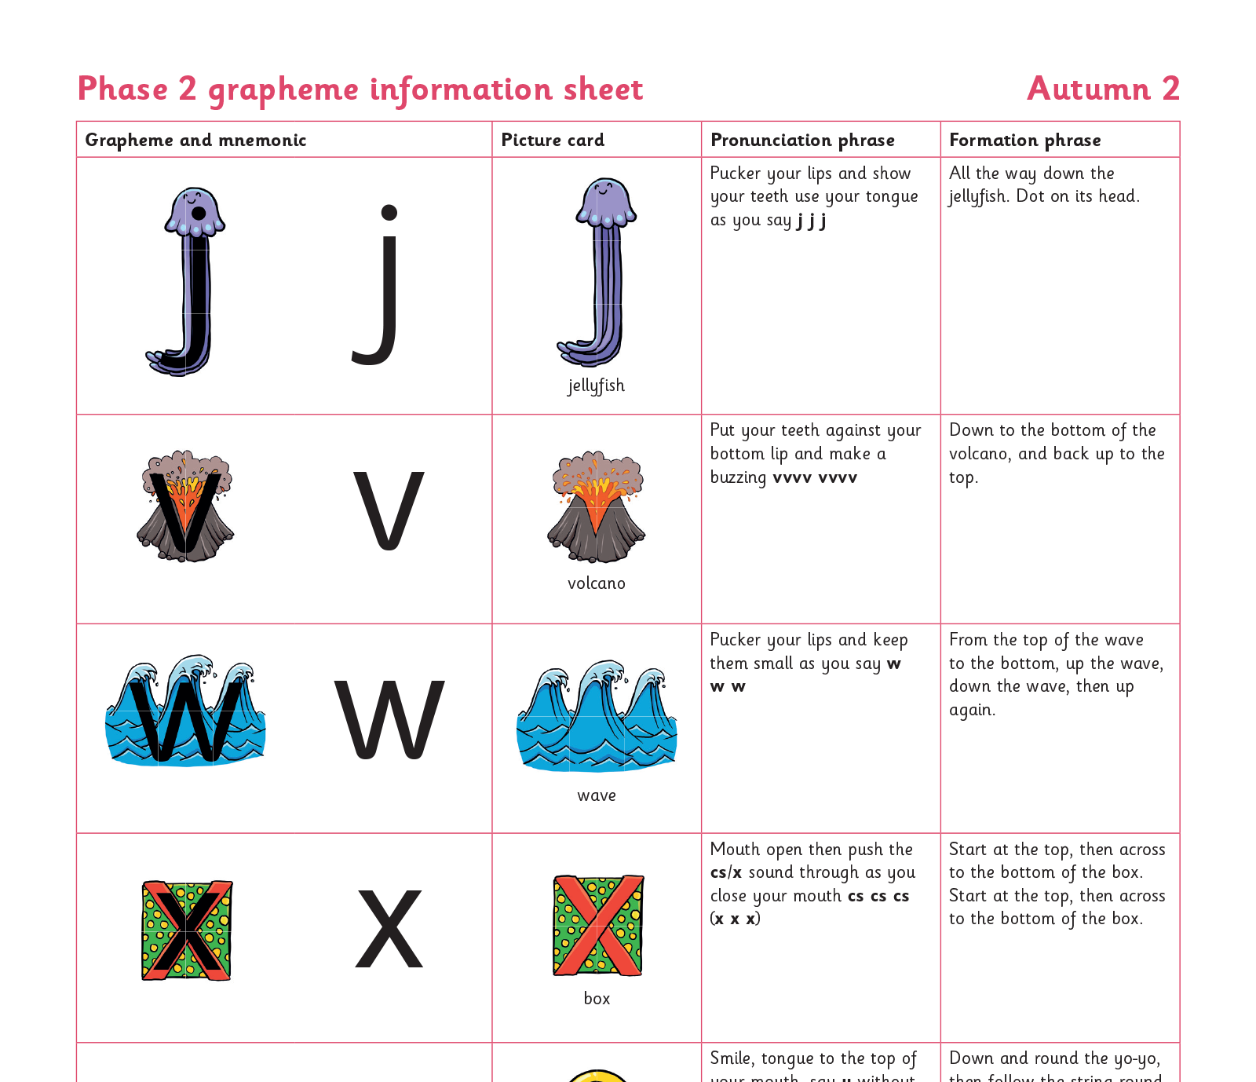
Teaching order
Notes:
We usually teach four new sounds a week and have a review lesson on a Friday. You will get a list of the sounds that we are learning to have at home. This will help you with formation and pronunciation.

Slide 11
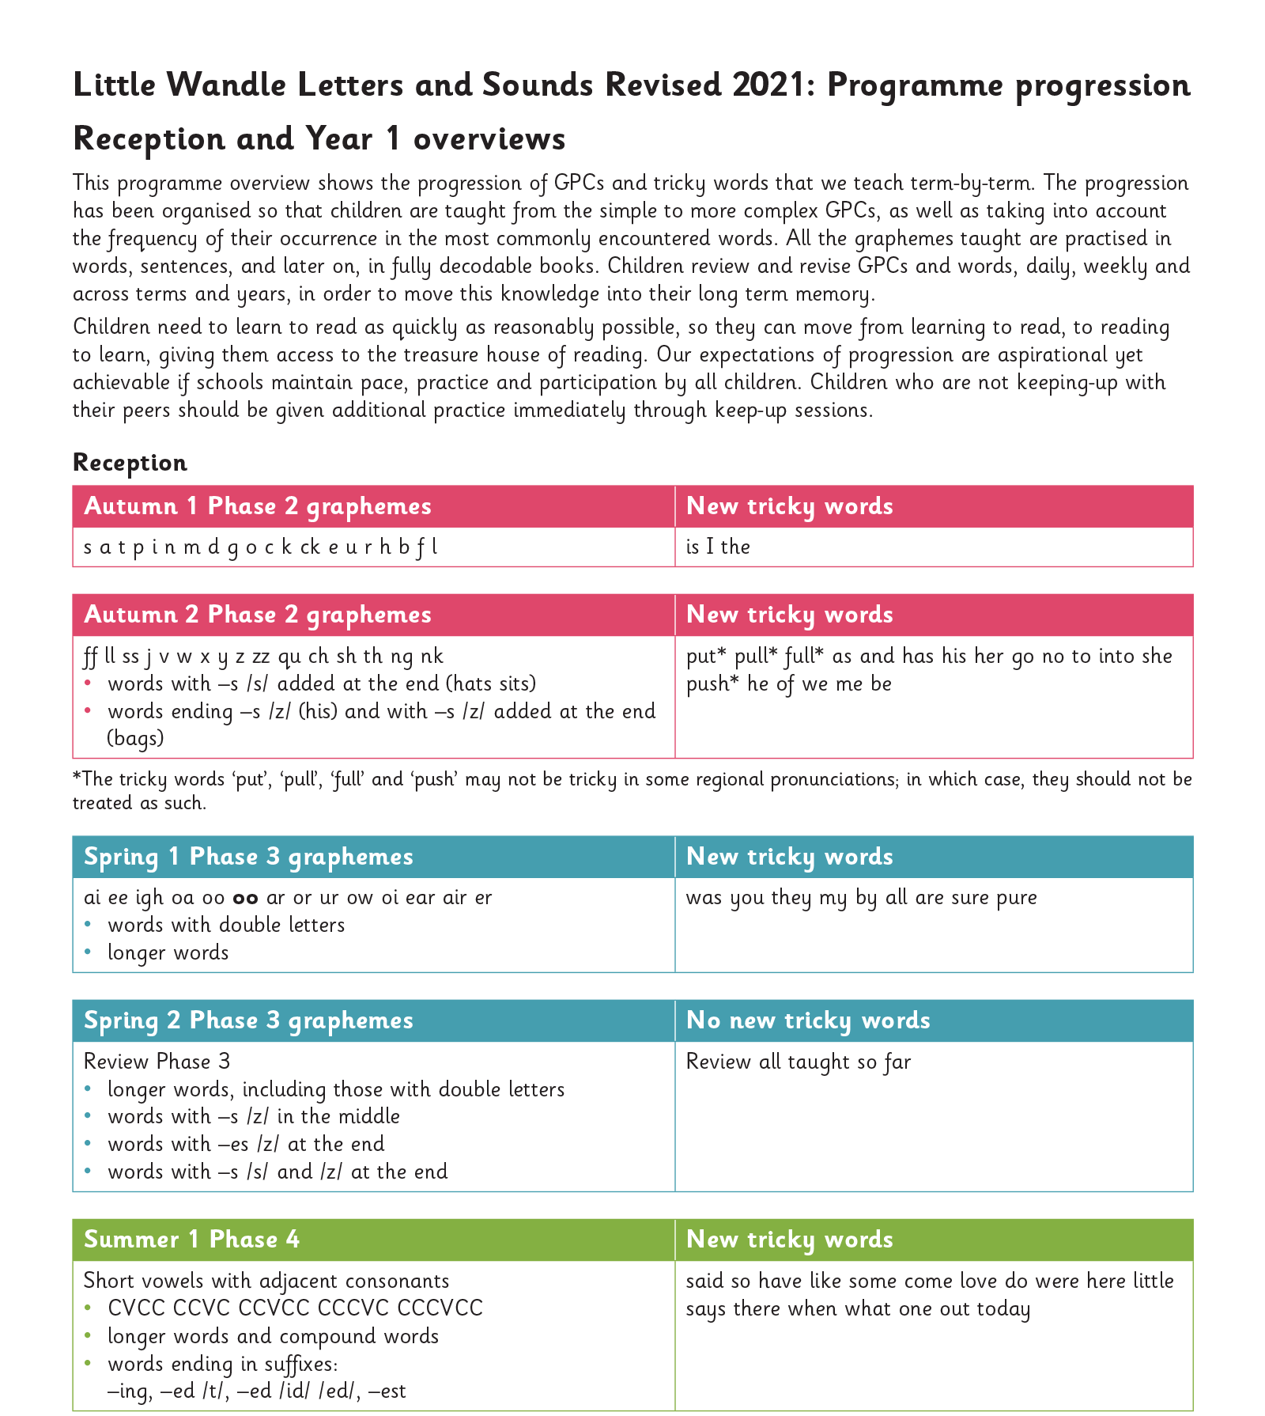
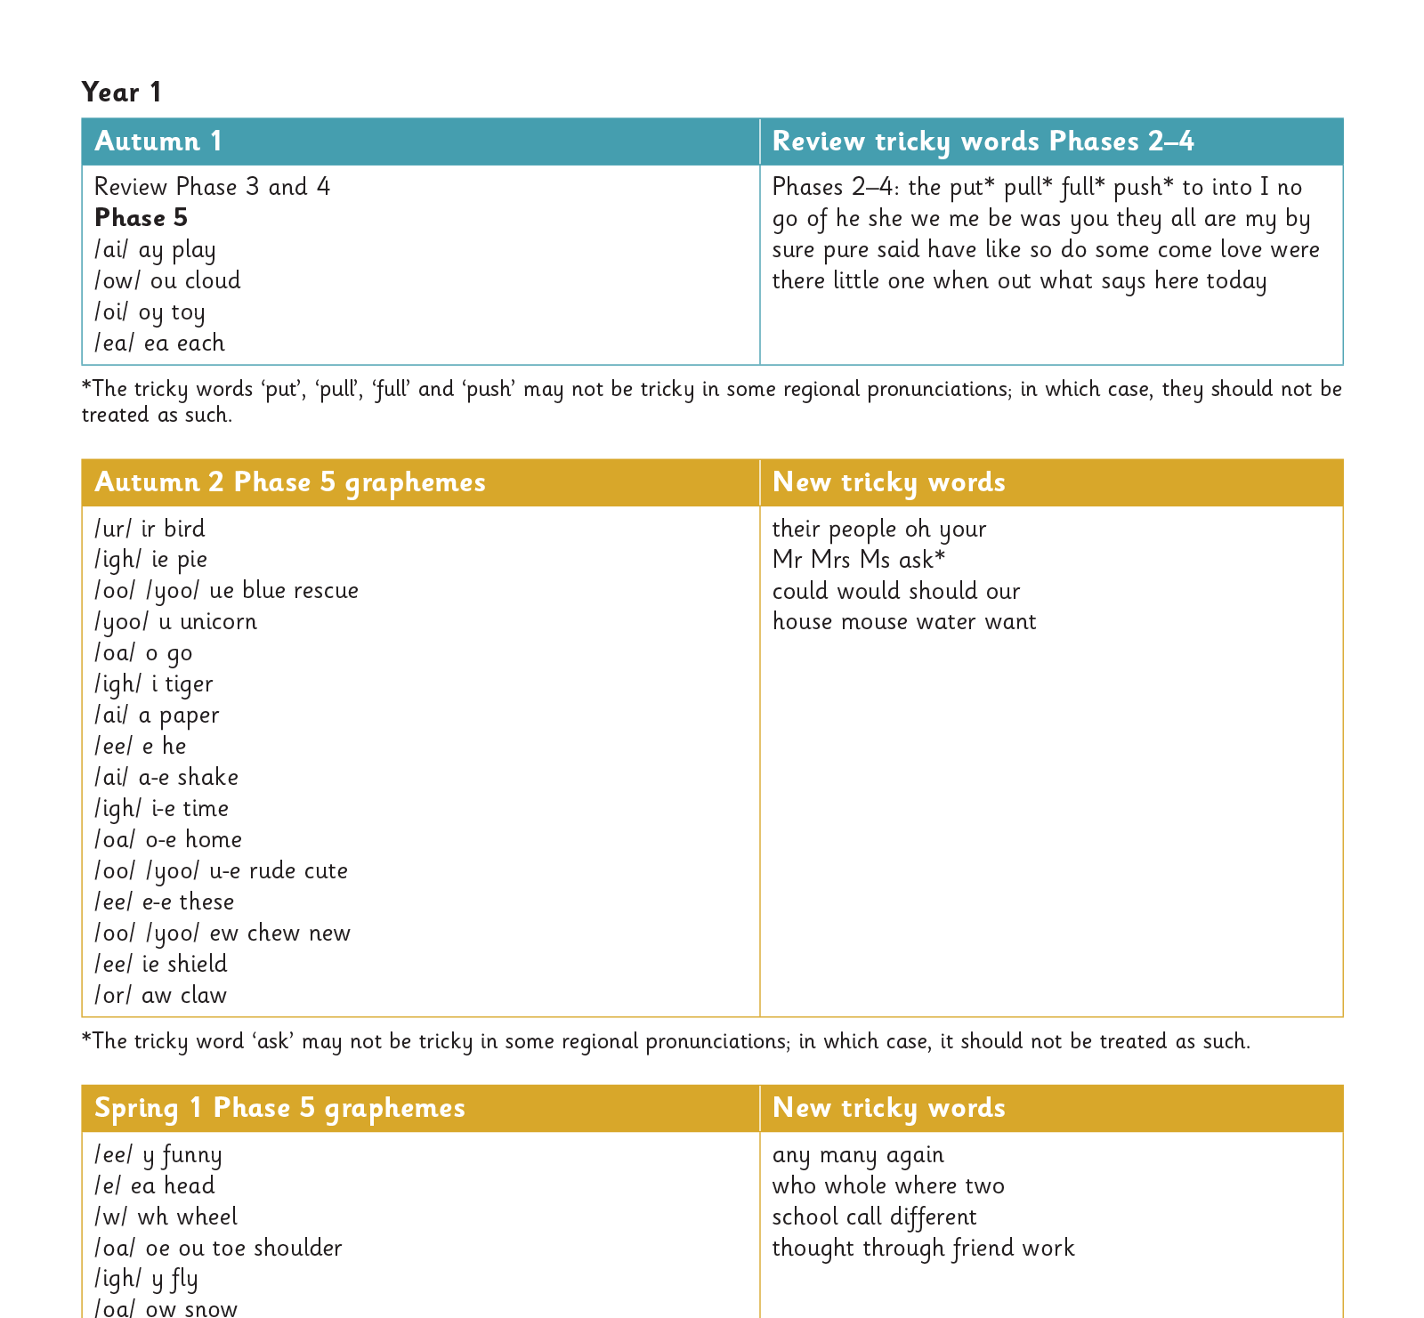
Gradually your child learns the entire alphabetic code:
Notes:
We will work our way through the whole Little Wandle Programme until your child can read fluently.

Slide 12
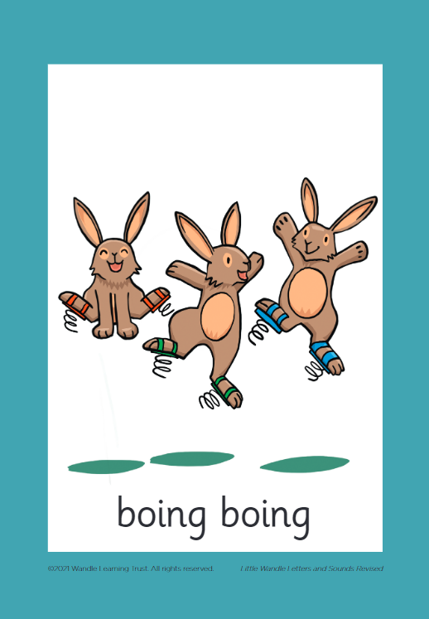

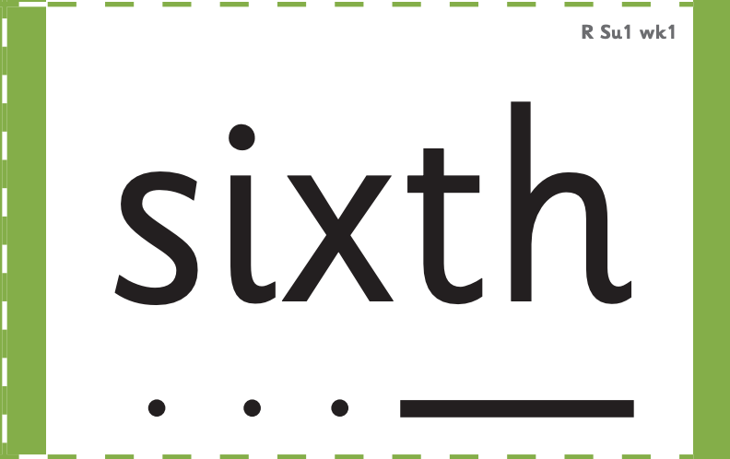

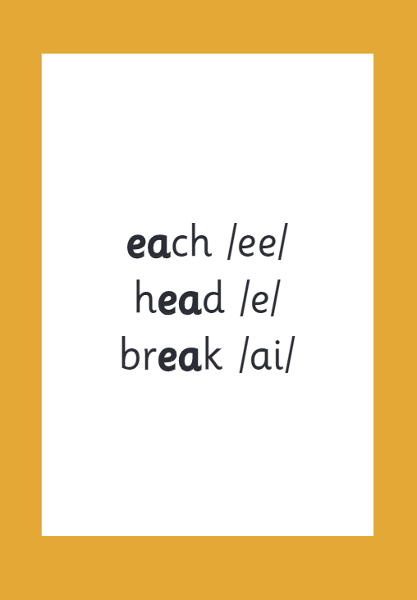

How we make learning stick:
Notes:
There are specific resources for the Little Wandle Programme which the children will be very familiar with. Each sound that we teach to begin with has either a mnemonic (like the astronaut that you can see here) or a phrase like boing-boing for ‘oi’. This helps the children recognise and remember the graphemes. Every time we teach a new sound, we also read words during the phonics lesson that contain that new sound so that the children practise what they have learned. We then go on to reading a sentence containing some of those words. We have displays in the classroom and on the tables to support the children throughout the day.

Slide 13
How we teach phonics:
Daily – 30 mins per session
Monday – Thursday – four days of new learning
Friday Review and revise lesson
GPC cards, friezes and grapheme charts
Repeated consistent language and mantras
Keep-up programme

Slide 14
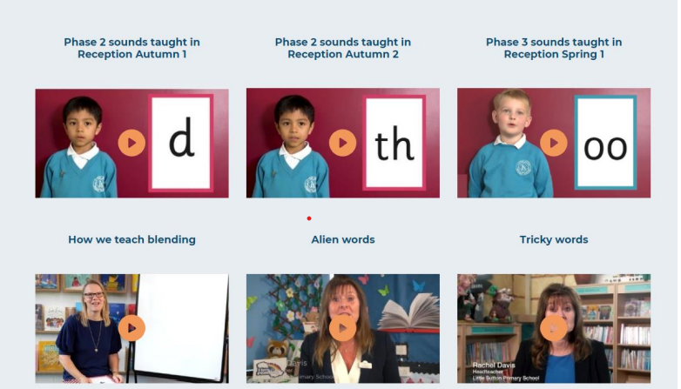
Supporting your child with phonics https://www.littlewandlelettersandsounds.org.uk/resources/for-parents/
Notes:
It is really important that you pronounce the sounds correctly at home if you are supporting your child. These videos are on the website for you to refer to and if you are unsure, please ask your child’s teacher.
Show the parents where to access the videos on the website and play them!
https://www.littlewandlelettersandsounds.org.uk/resources/for-parents/

Slide 15
Reading and spelling
Notes:
This is an example of what the children learn in Year 1.
Children learn that there are graphemes that can have different sounds and sounds that can be made with different letters.
Use the backs and fronts of Phase 5 cards to show ‘ea’ and ‘ow’.

Slide 16
And all the different ways to write the phoneme sh:
shell
chef
special
caption
mansion
passion
Notes:
Example of a sh sound

Slide 17
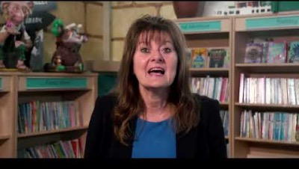
Tricky words
Notes:
Have a look at this video on the website: https://www.littlewandlelettersandsounds.org.uk/resources/for-parents/

Slide 18

Spelling
Say the word.
Segment the sounds.
Count the sounds.
Write them down.
Notes:
Model the process on a flipchart for the parents to see.

Slide 19
Reading

Slide 20
How we teach reading
Reading practice sessions are:
Timetabled at least three times a week
Taught by a trained teacher/teaching assistant
Taught in small groups
Books are:
Matched to children’s secure phonics knowledge at word reading
Used three times
Then sent home.
Notes:
The children read the same book three times in a week. The first time we work on decoding (sounding out) the words, the second time we work on prosody which is reading with expression – making the book sound more interesting with our story-teller voice or our David Attenborough voice – and the third time we look at comprehension. We read the books three times at school because we want to develop the fluency. The more they see words the more they begin to read them automatically without having to sound them out.

Slide 21
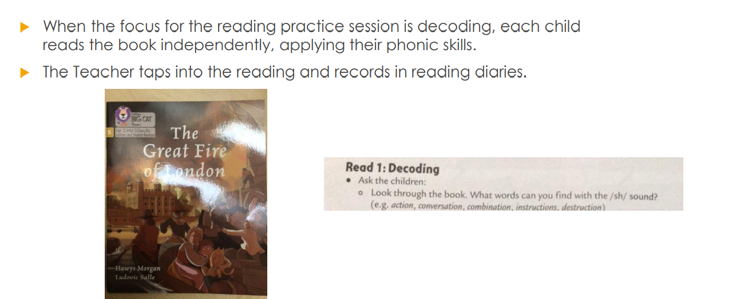
Decode

Slide 22
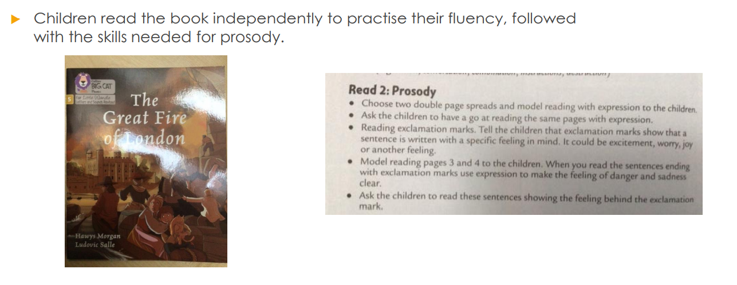
Prosody

Slide 23
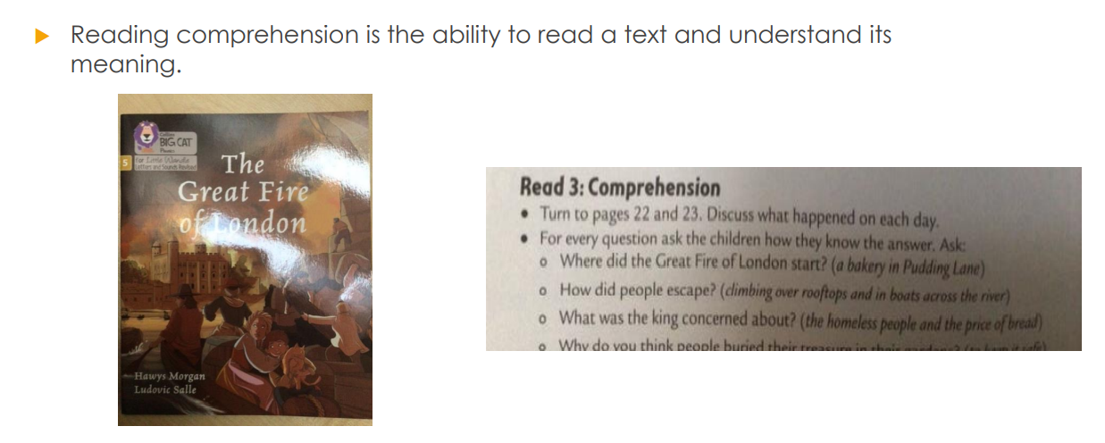
Comprehension

Slide 24
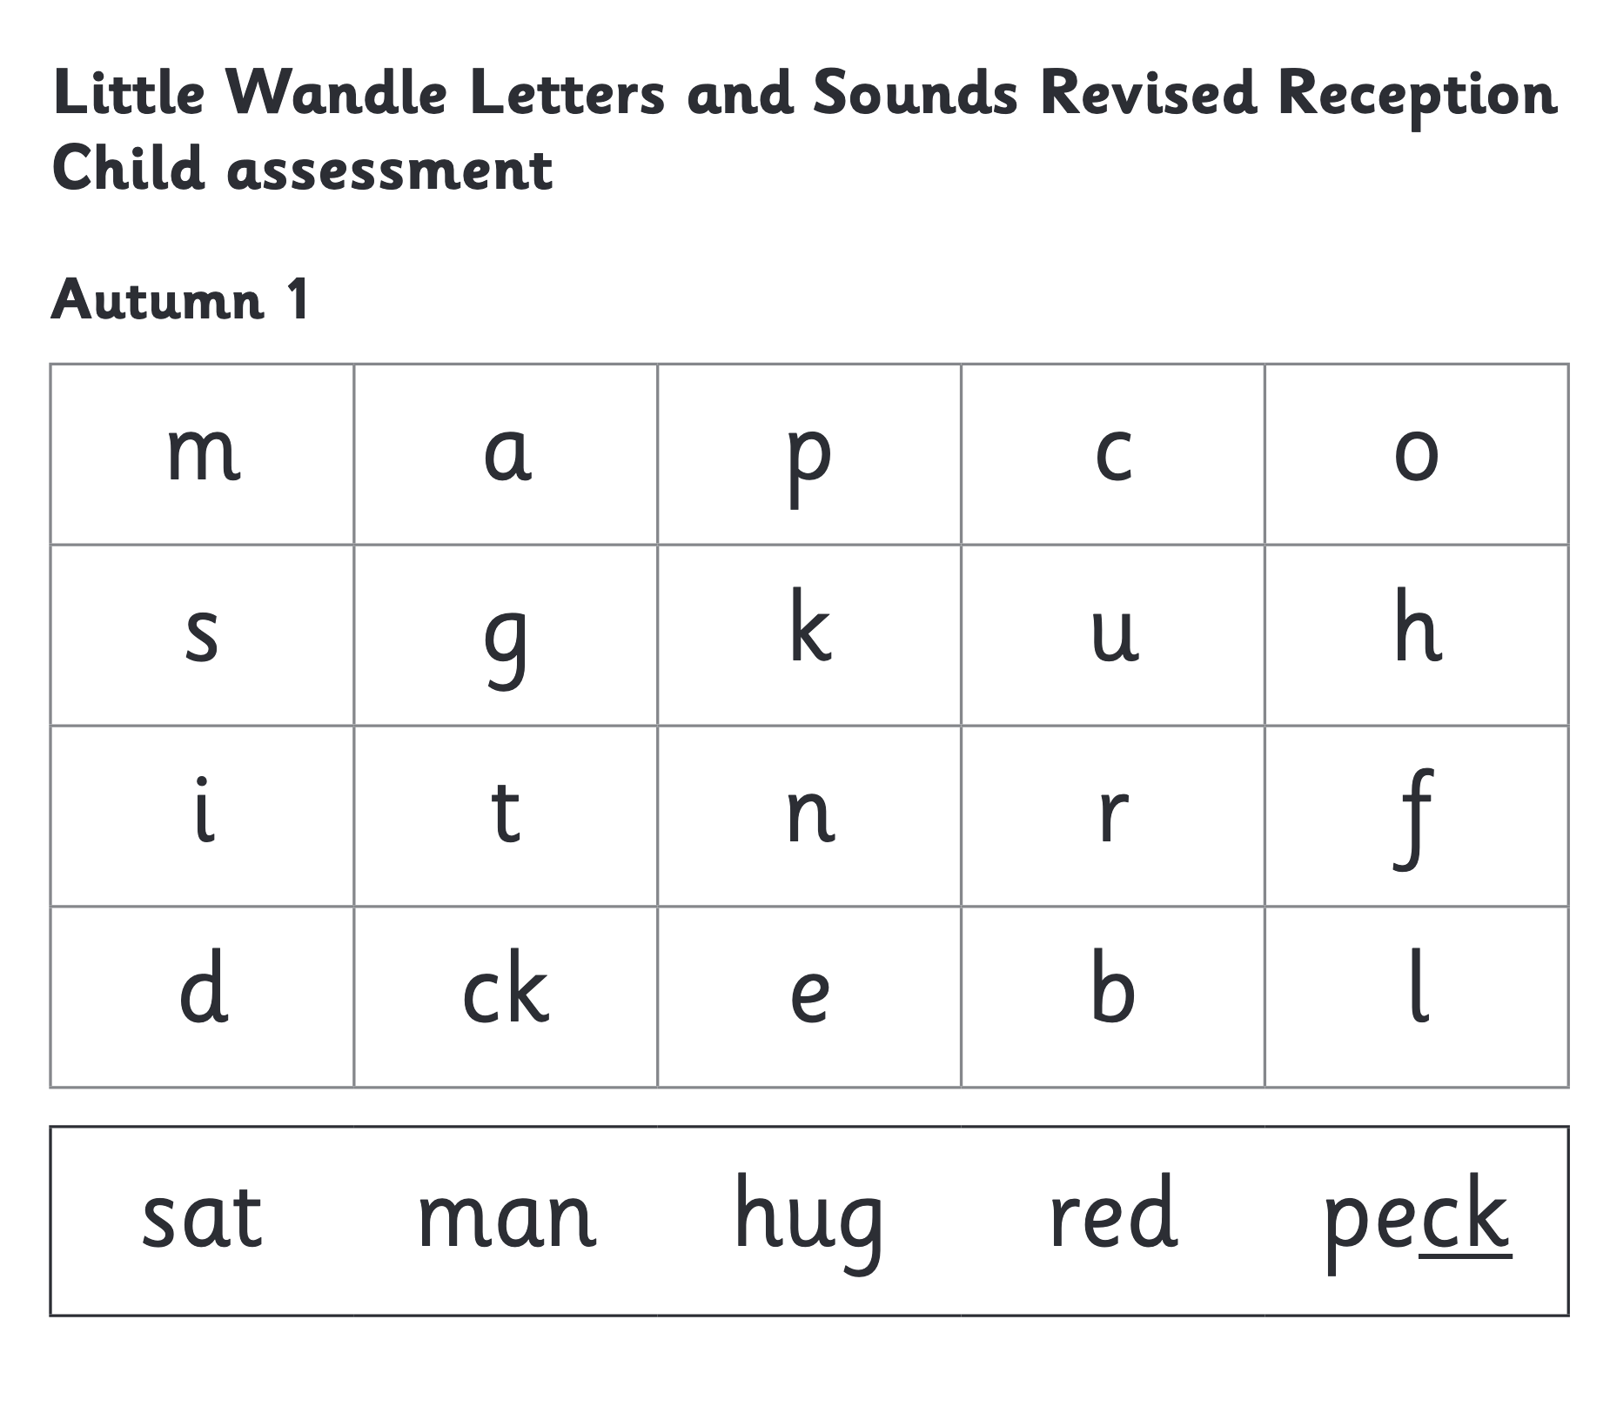
We use assessment to match your child to the right level of book
Notes:
We assess your child every six weeks to check progress. Any child who needs extra support has daily keep-up sessions planned for them. But because class 2 are having twice daily they will be assessed every 3 weeks. I will be indicate what new reading book they will require and if they need any keep up sessions to close the gaps.

Slide 25
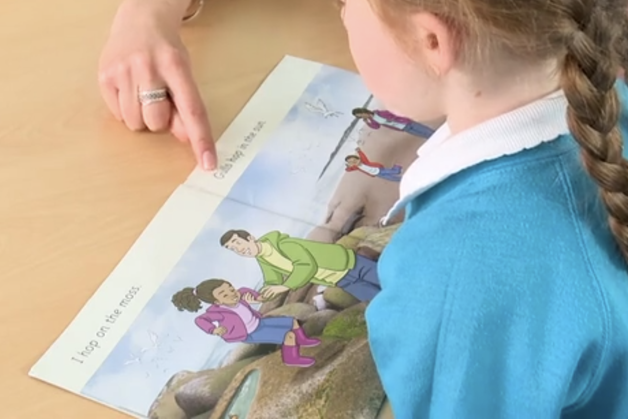
Reading a book at the right level
This means that your child should:
Know all the sounds and tricky words in their phonics book well
Read many of the words by silent blending (in their head) – their reading will be automatic
Only need to stop and sound out about 5% of the words by the time they bring the book home – but they should be able to do this on their own.

Slide 26
Reading at home

Slide 27
Reading at school and at home
Staff will read with your child three times a week.
Your child will bring their book home on either a Wednesday or a Friday.
Please allow time for your child to read this as their celebration read and record this in their diary.
On the days that your child does not have their phonics book they will just read their sharing book.
Bring their diary every day to ensure a stamp is given.
Notes:
When your child brings their phonic book home they should read it that evening and return it the next day. These books need to be kept in their book bag and brought into school everyday. If there is no phonic book then sharing books will be brought home. A new sharing book can be taken home everyday regardless if they have a phonic reader.
Explain about stamps

Slide 28
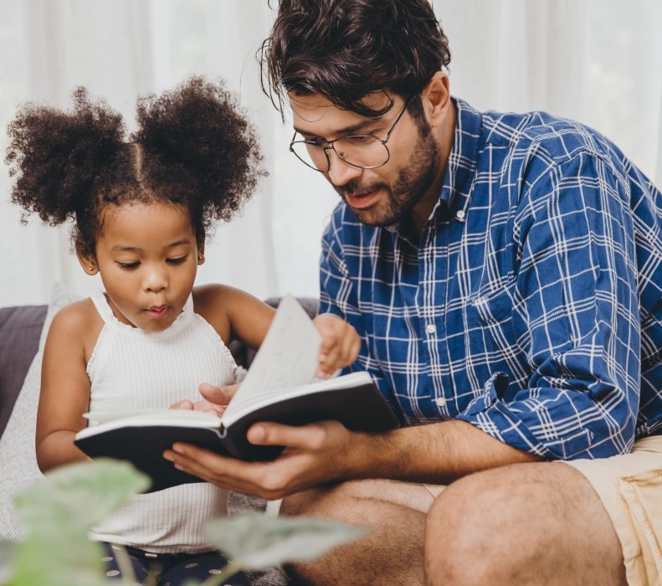
The most important thing you can do is read with your child
Reading a book and chatting had a positive impact a year later on children’s ability to…
understand words and sentences
use a wide range of vocabulary
develop listening comprehension skills.
The amount of books children were exposed to by age 6 was a positive predictor of their reading ability two years later.
Parental involvement in the development of children’s reading skills: A five-year longitudinal study (2002) Senechal, M. and Lefvre, J
Notes:
Celebrate child’s success at school, make time for reading at home!

Slide 29

Books going home
Notes:
As well as the ‘reading practice’ book that your child will bring home they will also bring home a book for sharing with you, we are calling a sharing book. This book is SO important. This is how we are going to give them the WILL to read. Please read with your child as often as you can – at least once a day if possible.

Slide 30
Listening to your child read their phonics book
Your child should be able to read their book without your help.
If they can’t read a word read it to them.
Talk about the book and celebrate their success.

Slide 31

Read to your child
The sharing book is for YOU to read although some children will be bringing books home that they can read or share reading with you:
Make the story sound as exciting as you can by changing your voice.
Talk with your child as much as you can:
  Introduce new and exciting language
  Encourage your child to use new vocabulary
  Make up sentences together
  Find different words to use
  Describe things you see.
Notes:
Please note early chapter readers need to re allowed to develop confidence, fluency and prosody. It will also enable the adult to ask questions about the text, discuss the book together and develop comprehension skills.

Slide 32
One of the greatest gifts adults can give is to read to children
Carl Sagan

Slide 33
Finally…
Thank you attending
Further information on the Little Wandle scheme can be found either be found on our website
www.Oulton.staffs.sch.uk
Or accessing the Little Wandle website
www.littlewandlelettersandsounds.org.uk
Any Questions?
Notes:
You can either ask a question now or speak to a member of staff

