Slide 1

Year 6
Meet the Teacher
(While you’re waiting, please can you fill in a photo consent form from the back of the hall. Thank you!)

Slide 2
Mrs Murphy
(Class Teacher)
Mrs Owen
(Teaching Assistant)
Mrs Goldie
(Teaching Assistant)
Year 6 Team

Slide 3


Schools’ Designated Safeguarding Leads
Mr Peter Duffy (Headteacher)
Mrs Fiona Ormerod (Deputy Head)

Slide 4

Safeguarding and SEND
Graduated approach-APDR
Quality first teaching-adaptive teaching
Termly reviews for children already on SEND register
Mrs Ormerod-SEND coordinator
Notes:
Follow the graduated approach – Quality first teaching with adaptations , initial point of contact is class teacher first concerns – an intervention or adaptation will be made and monitored if after several rounds of Assess plan do review is complete and there are still concerns SENCO will attend meeting and possibly refer to outside agencies.
If your child is already receiving SEND support and on the SEND register termly review meetings will take place.
Mrs Ormerod is our school special education needs and disability coordinator if you have any questions or concerns regarding your child please see the me first.

Slide 5
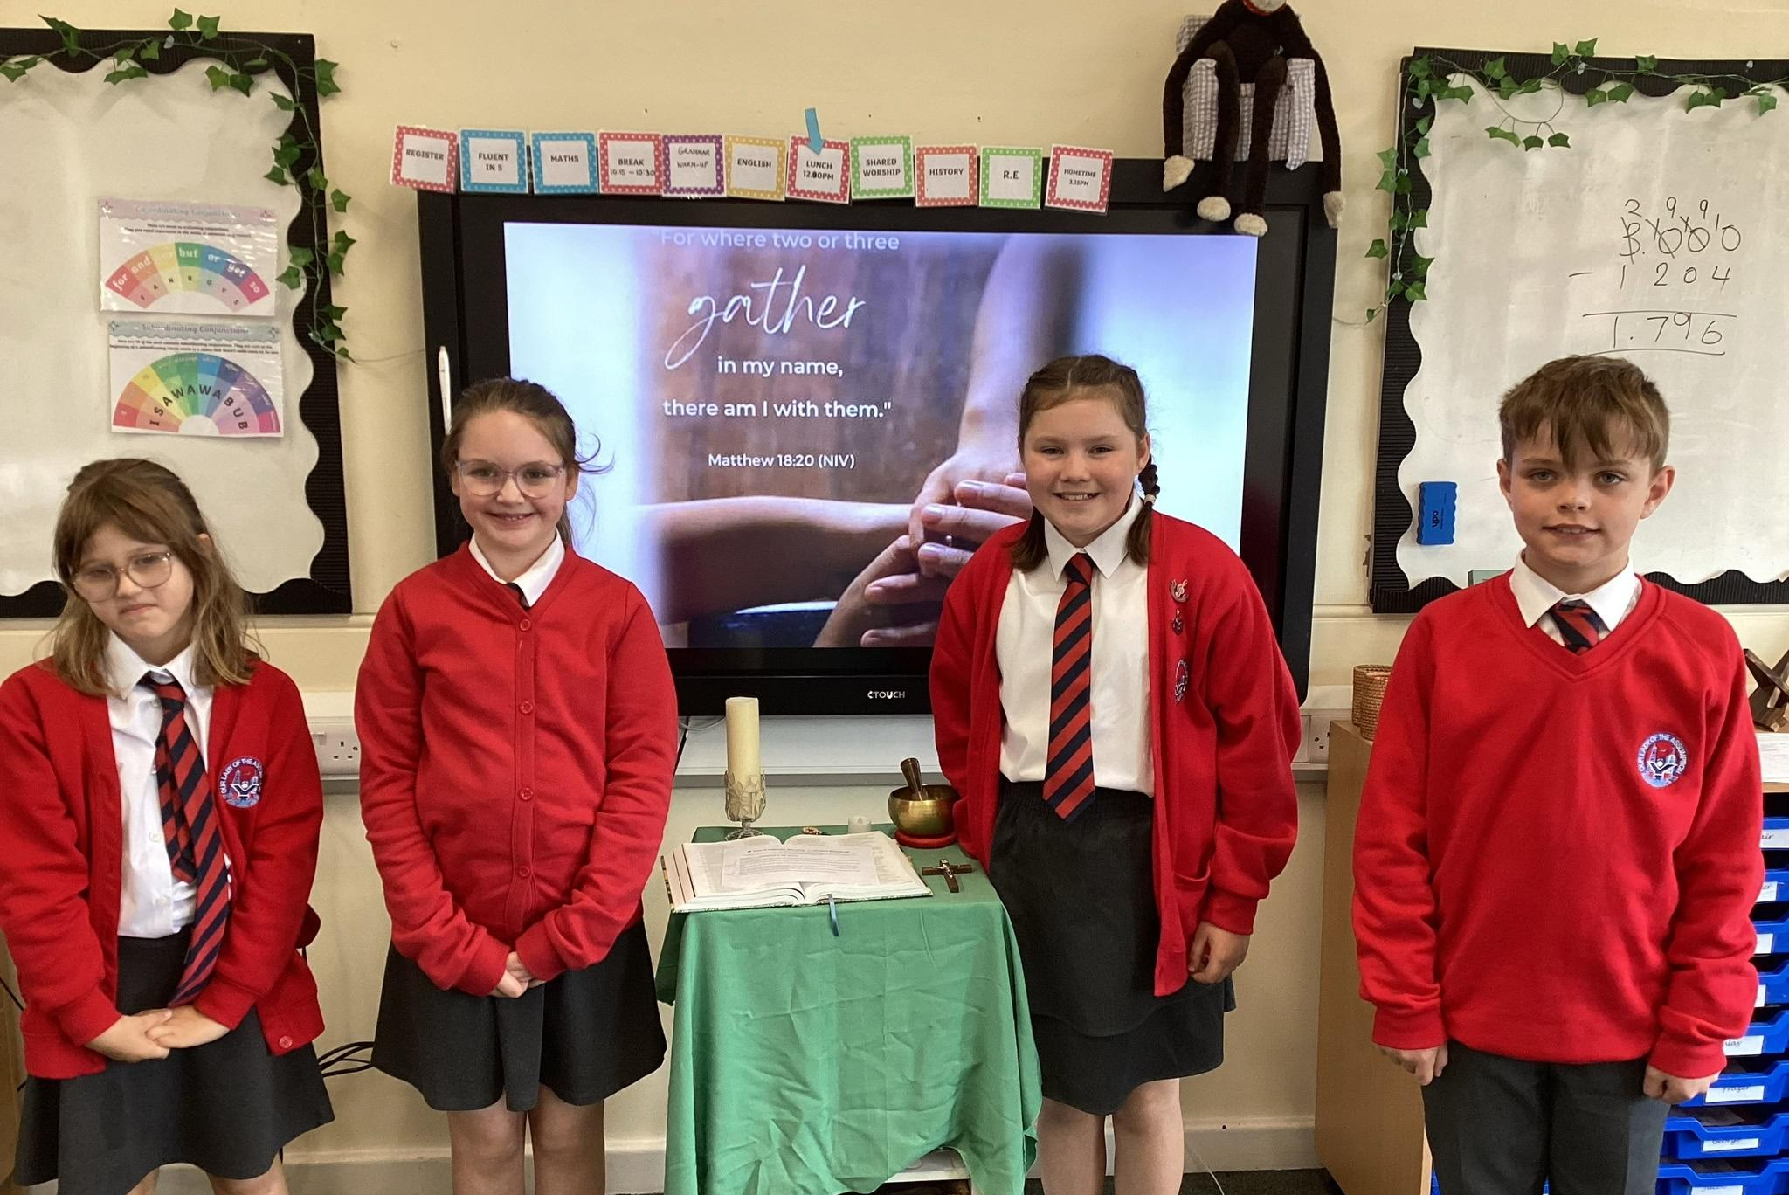

Religious Education and Catholic Life
Year group masses
Class liturgies (Friday 25th Sept)
Child-led worships
Teacher-led worships
Liturgical celebrations-parents welcome
Fr Frank!
Notes:
As a Catholic School – our Faith is at the forefront of all that we do, and we place Jesus Christ at the heart of your child’s education!
Year Group Masses-had it today
Parent Liturgies – where parents are invited in. We will invite you to attend in November, led by yr6 & yr5
Liturgical year celebrations – such as Advent, Nativity of Our Lord, Easter where parents will be invited to join

Slide 6


Communication
01253
762833
Speak to me with any concerns.
We communicate via emails from the school office and Class Dojo.
Messaging on Dojo is not monitored so please do email admin or call the school office and they will forward any messages that are intended for me.
Contact us by phone.
admin@our-lady.blackpool.sch.uk
Communication
We can be reached by email, directly to the office.
Notes:
Open door policy where we welcome communication - speak to teachers first with any concerns. If you cannot catch me at the door, give the school a ring.
We communicate via our blog and emails. May also use the text system.

Slide 7





Online Learning Platforms
& Homework
TTRS
LbQ
Spellings
I upload Homework to both Class Dojo and the school website on Fridays. Online homework is always due for the following Wednesday (I check on Thursday morning). Spelling tests are on Thursdays and Times Table tests on Fridays.
Notes:
TTRS-engage in competitions with BEBCMAT. Results publish on blog and celebrated in assemblies.
IXL
Bedrock
Used for homework, as it was in Year 5

Slide 8



Behaviour and Rewards
Dojo Points/house points
Weekly certificates (Shining Light Award, Maths Award and Writing Award)
Reading bookmarks-golden tickets
Notes:
Housepoints, certificates (weekly)
Headteacher’s award-receive a book for going ‘above and beyond’
Reading bookmarks-golden tickets for home reading. PTFA funding the prize for this which it half-termly.

Slide 9

Uniform and PE Days
Wednesdays this half term
Please no jewellery on PE days
PE kit to be worn on PE days
Long hair tied up
Uniform-shirt, tie, jumper/cardigan, black shoes
Notes:
Shirt, tie, cardigan/jumper, black shoes
PE days-Wednesdays this term, will be Wednesdays and Fridays after half term. No earrings for PE and hair tied back.
Earrings-studs only

Slide 10

Reading
Reading is SO important!
ZPD-linked to books taken home
STAR Reading test taken half termly
Whole class reads
Golden tickets: every third reading record signed
Children who read – and are read to – regularly have better understanding, communication, writing and concentration skills.
Notes:
Reading is vitally important!
STAR reading, they have their ZPD and their home readers are within this range. Can take a book not in range if they really want to read it. Take quizzes
STAR reading half termly-monitor progress.
Please do get your child to read to you too-they’re never too old!
20 mins a day

Slide 11
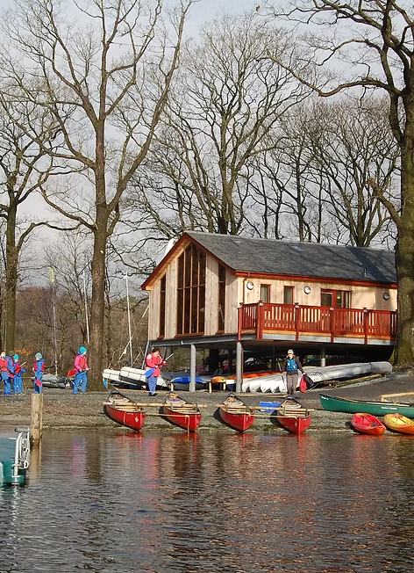
Extra Curricular and Trips
Waterpark-April 26th-April 30th
Dance club (Wednesdays)
Football (Wednesdays)
Notes:
Water Park-April
Next half term, I will be teaming up with Mrs Mc Vey for ‘Coding Club’
Sports clubs this half term-dance club, football club

Slide 12
Year Group Priorities
Please DO NOT do any past SATs papers at home from 2018 onwards. We do these in school. If you did want any practice papers, I can provide you with some.
SATs (Maths, Reading & GPS)
Mon 10th May-Wed 13th May
Writing
Preparation for high school
Being Leaders: taking on more responsibility
Notes:
Year 6- SATs

