Slide 1
The Annunciation
Lo: - To know and understand Mary’s role in the Christmas Story

Slide 2
One day Angel Gabriel visited Mary and said:"God has chosen you to have a baby, and you must call him Jesus".
"The Holy Spirit shall come upon you and the power of the Father shall Go over you. And therefore also the Holy which shall be born of thee shall be called the Son of God. He told her that the child would be called the Son of God. Mary bowed before angel Gabriel and told him she would be obedient to God and that she wanted to do as God wished.
Annunciation means the announcement to Mary by the angel Gabriel that she would be the mother of Jesus.
Task: Spend 3 minutes writing as many things that you can see on the picture as you can.
(Can you spot where the Father, the Son and the Holy Spirit are on the picture?)

Slide 3
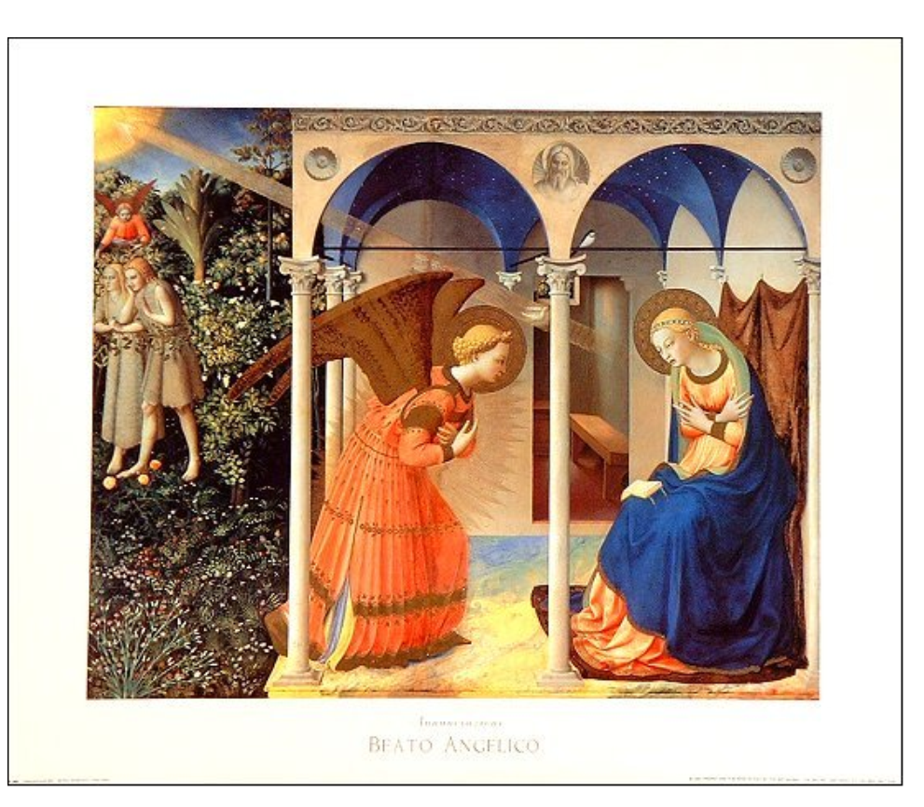
The Annunciation, by Fra Angelico, c.1432

Slide 4
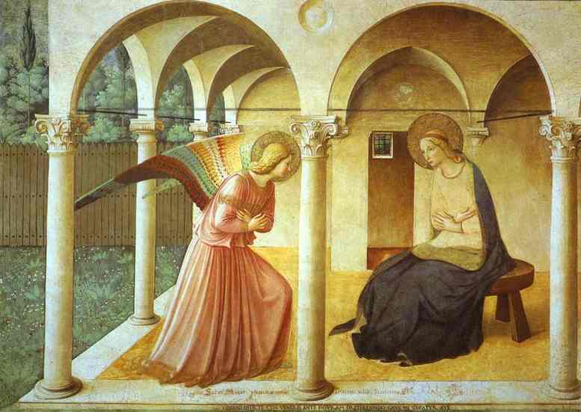
The San Marco fresco

Slide 5

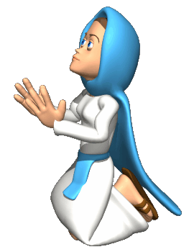
Hail Mary
Read the Hail Mary and the carol.
Copy down words or phrases that you most like.
Why do you like them?
What do these prayers tell you about what the Church believes about Mary?
C Annunciation
Read Luke 1:26-38 - The Annunciation of the Lord
What is Luke's message about Jesus?
What is Luke's message about Mary?
What is Luke's message about God?

