Slide 1


Art and Design
Colour Chaos: Robert and Sonia Delaunay
Year One
Art and Design | Colour Chaos | Robert and Sonia Delaunay | Lesson 5

Slide 2


Robert and Sonia Delaunay

Slide 3
Aim
I can create a painting using warm and cool colours.
I can talk about the artists Robert and Sonia Delaunay.
Success Criteria
I can paint half of my picture in warm colours.
I can paint half of my picture in cool colours.
I can tell you an interesting fact about Robert and Sonia Delaunay.
I can tell you about one of Delaunay’s paintings.

Slide 4
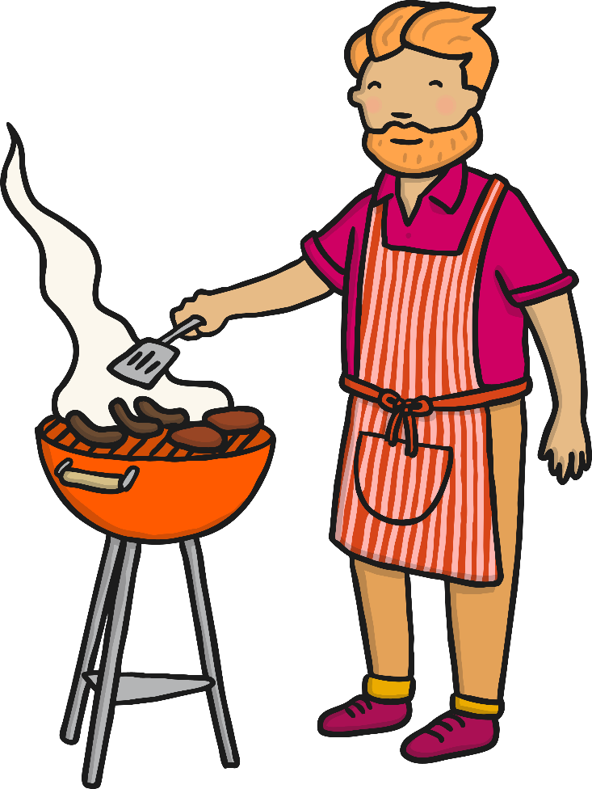

Warm and Cool Colours

Slide 5
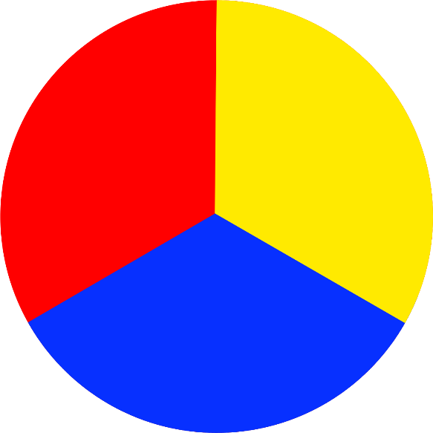
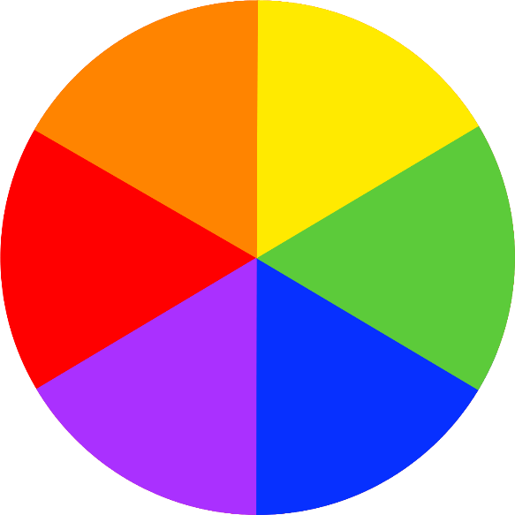
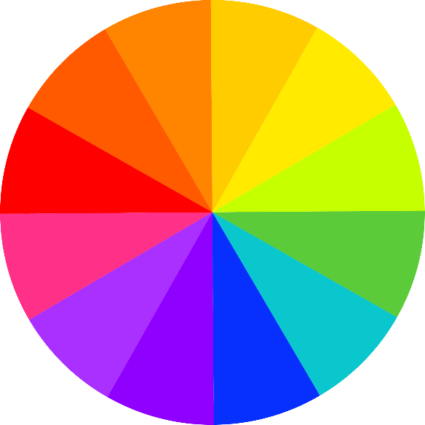
Colour Mixing
We have been learning about colour mixing.

Slide 6

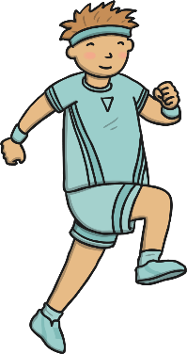
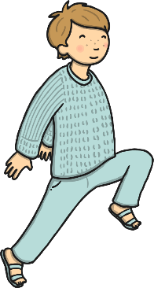

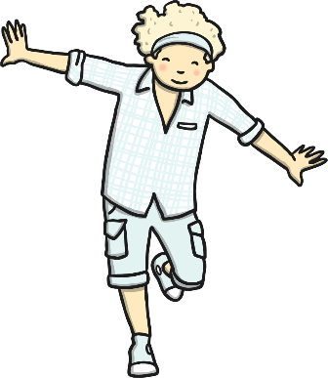


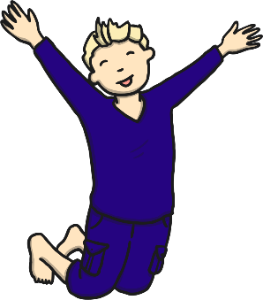

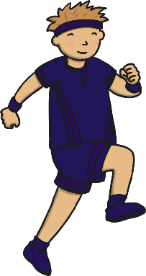
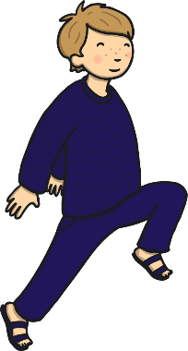
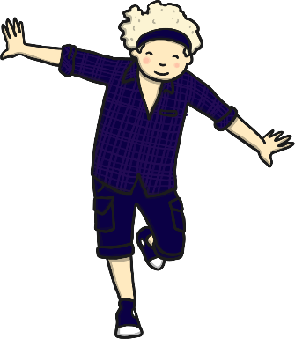
Neutral Colours, Tints and Shades
We have learnt about neutral colours, and how to mix tints and shades.

Slide 7
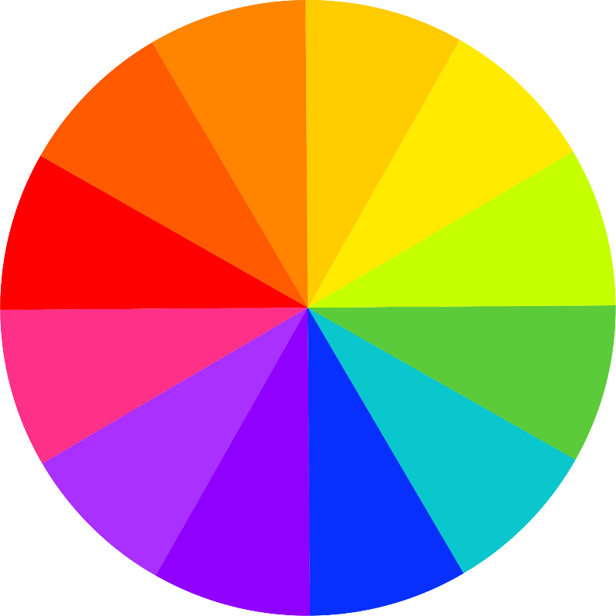
Warm and Cool Colours
This week we are learning about warm and cool colours.
warm colours
cool colours
-----------------------------

Slide 8
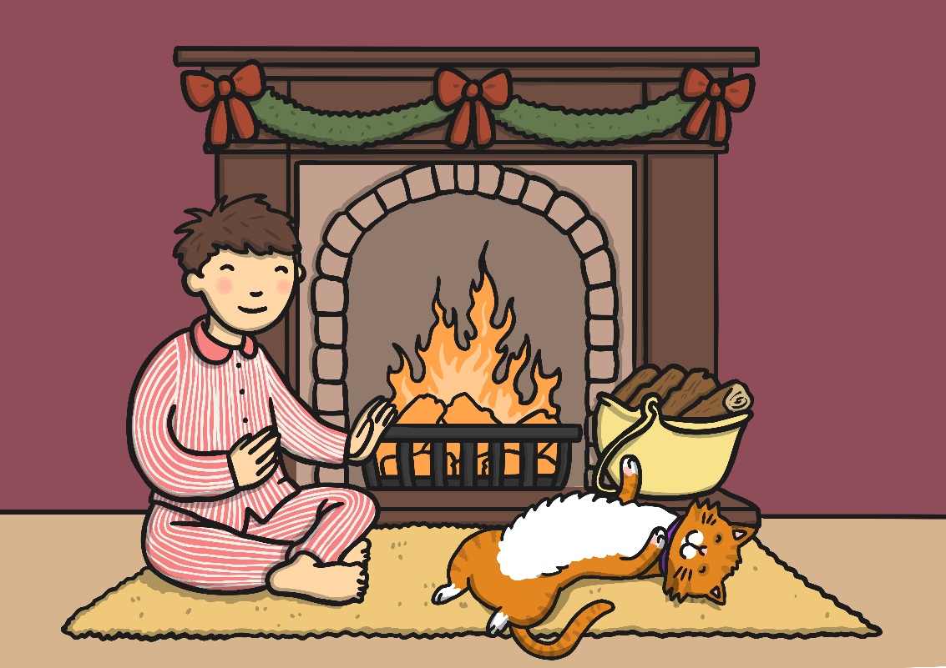
Warm Colours
Red, orange, and yellow are warm colours. They make us think of sunny, warm and cosy things.

Slide 9
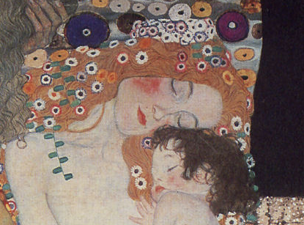
Warm Colours
Warm colours are often used to paint happy pictures.
The Three Ages of Woman (Detail)
by Gustav Klimt
Photo courtesy of freeparking :-| (@flickr.com) - granted under creative commons licence – attribution

Slide 10
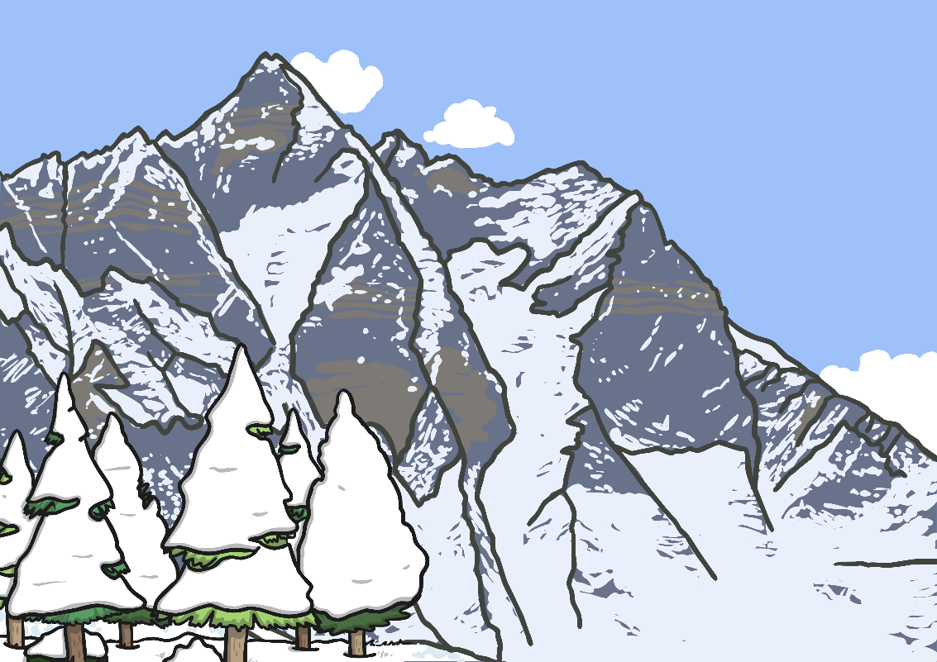
Cool Colours
Green, blue and purple are cool colours. They make us think of fresh, calm and chilly things.

Slide 11
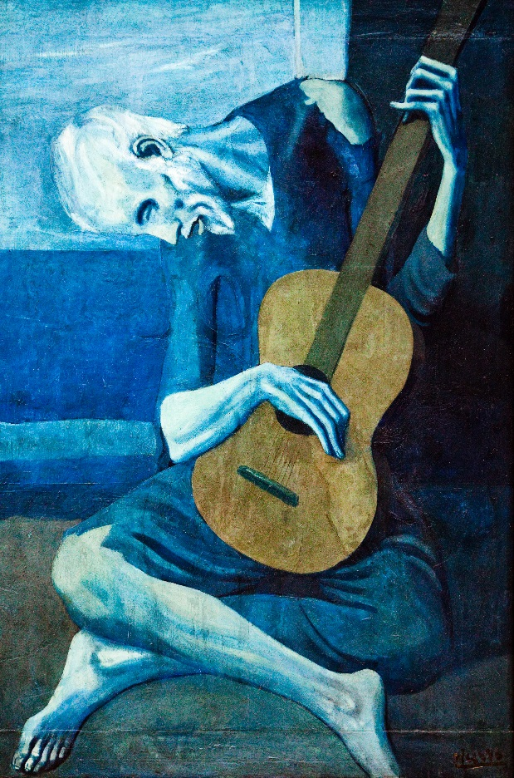
Cool Colours
Cool colours are often chosen to paint sad pictures.
The Old Guitarist
by Pablo Picasso
Photo courtesy of Thomas Hawk (@flickr.com) - granted under creative commons licence – attribution

Slide 12
Neutral Colours
Neutral colours can be used with warm or cool colours.
Photo courtesy of Peter (@flickr.com) - granted under creative commons licence – attribution

Slide 13
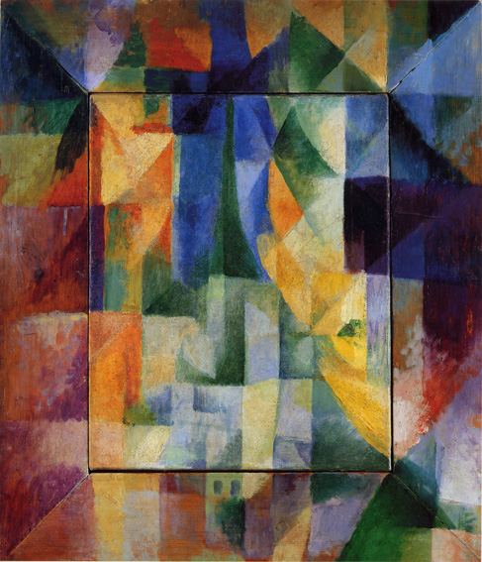
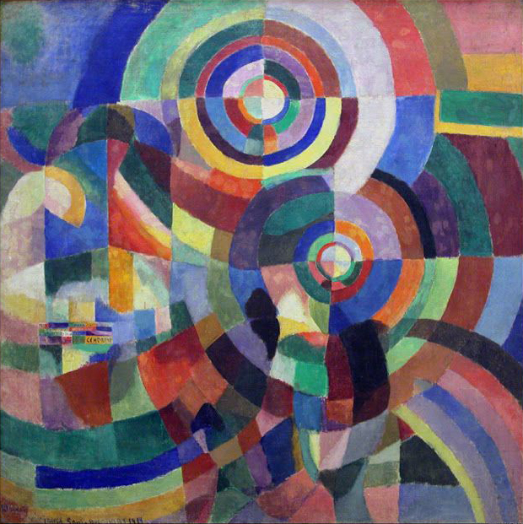
Robert and Sonia Delaunay
Robert and Sonia Delaunay were important artists who invented a new style of art.
Simultaneous Windows on the City (1912)
by Robert Delaunay
Prismes Électriques (1914)
by Sonia Delaunay
Photo courtesy of Ras Marley (@flickr.com) - granted under creative commons licence – attribution

Slide 14
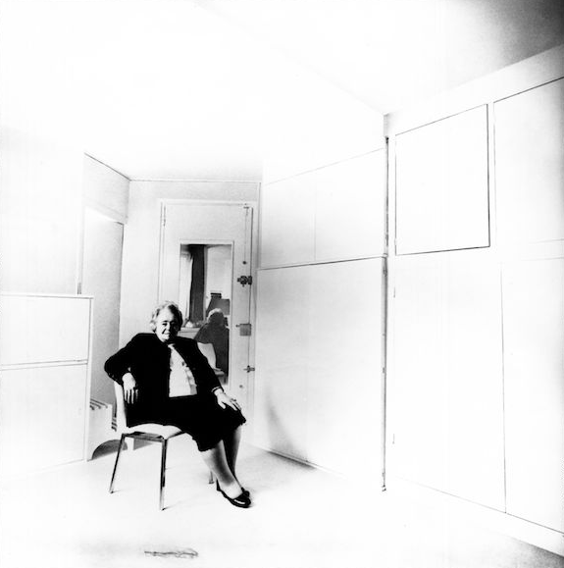
All About Robert and Sonia Delaunay
(1885 – 1941)
(1885 – 1979)
Robert Delaunay was born in Paris to a rich and important family. His family were happy that he wanted to be an artist and gave him money to help him on his way.
Sonia Delaunay was born, Sara Élievna Stern, in Ukraine to a poor family. At age 5 her family sent her to live in Russia with her rich uncle and aunt. Her talent for art was noticed at school and she went on study in Germany and France.
In 1909 Robert and Sonia met and got married in 1910. Together they travelled around Europe and met lots of other artists.
Sonia Delaunay
Photo courtesy of lothar woolleh (@flickr.com) - granted under creative commons licence – attribution

Slide 15
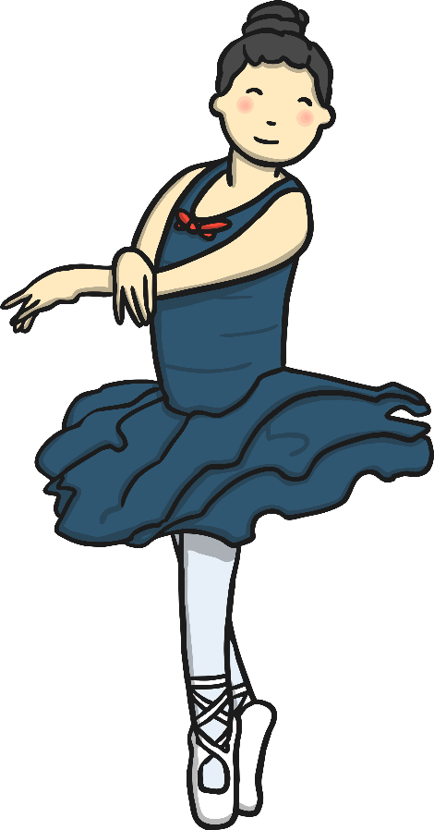
All About Robert and Sonia Delaunay
(1885 – 1941)
(1885 – 1979)
Robert and Sonia Delaunay supported each other and often worked together. They developed a new style of painting that uses very bright colours and lots of simple shapes like circles, triangles and squares.
The Delaunays wanted their work to express joy, movement and music.

Slide 16
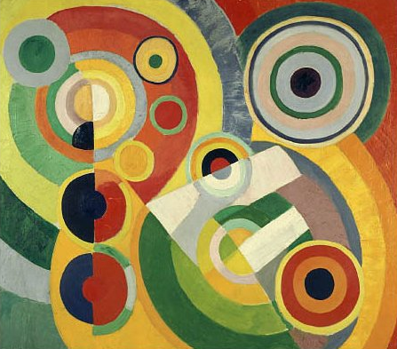
Joy of Life (1930)
by Robert Delaunay

Slide 17

Looking at Abstract Art: The Joy of Life (1930)
What do you see when you look at this painting?
How has the painting been made?
What kind of colours have been used?
How would you describe these colours?
What shapes can you see?
What kind of lines can you see?
How do you think the artist was feeling when they painted this?
How does the painting make you feel?
Do you like it? Why?

Slide 18


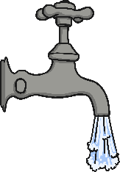
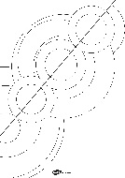


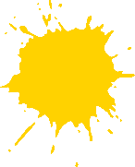


Painting with Warm and Cool Colours
You will need…
Painting template
Paint in warm
and cool colours
Brushes
Water
A rag
Paint the shapes on one side of the template in warm colours.
Remember to swish, wipe and blot your brush each time.
Paint the shapes on the other side of the sheet in cool colours.
Don’t forget you can use black, white or grey as a warm or a cool colour.

Slide 19

What a good painting looks like…

Slide 20




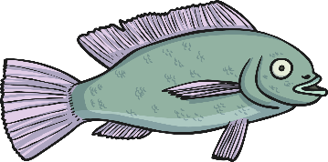
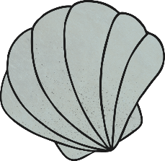

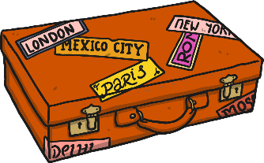
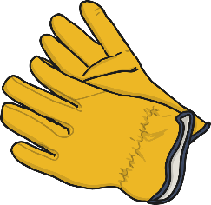
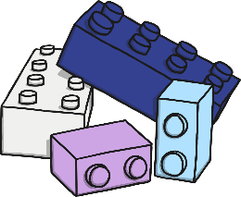
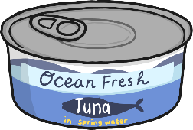
Can you sort the objects?
Click here to reveal the answers!
Warm
Cool

Slide 21

Aim
I can create a painting using warm and cool colours.
I can talk about the artists Robert and Sonia Delaunay.
Success Criteria
I can paint half of my picture in warm colours.
I can paint half of my picture in cool colours.
I can tell you an interesting fact about Robert and Sonia Delaunay.
I can tell you about one of Delaunay’s paintings.

