Slide 1


Art and Design
Colour Chaos: Jackson Pollock
Year One
Art and Design | KS1 | Colour Chaos | Jackson Pollock | Lesson 4

Slide 2


Jackson Pollock

Slide 3
Aim
I can create a drip painting using shades I have mixed.
I can talk about the artist Jackson Pollock.
Success Criteria
I can mix shades.
I can use my shades to paint a drip painting.
I can tell you an interesting fact about Jackson Pollock.
I can say what kind of paintings Jackson Pollock made.

Slide 4
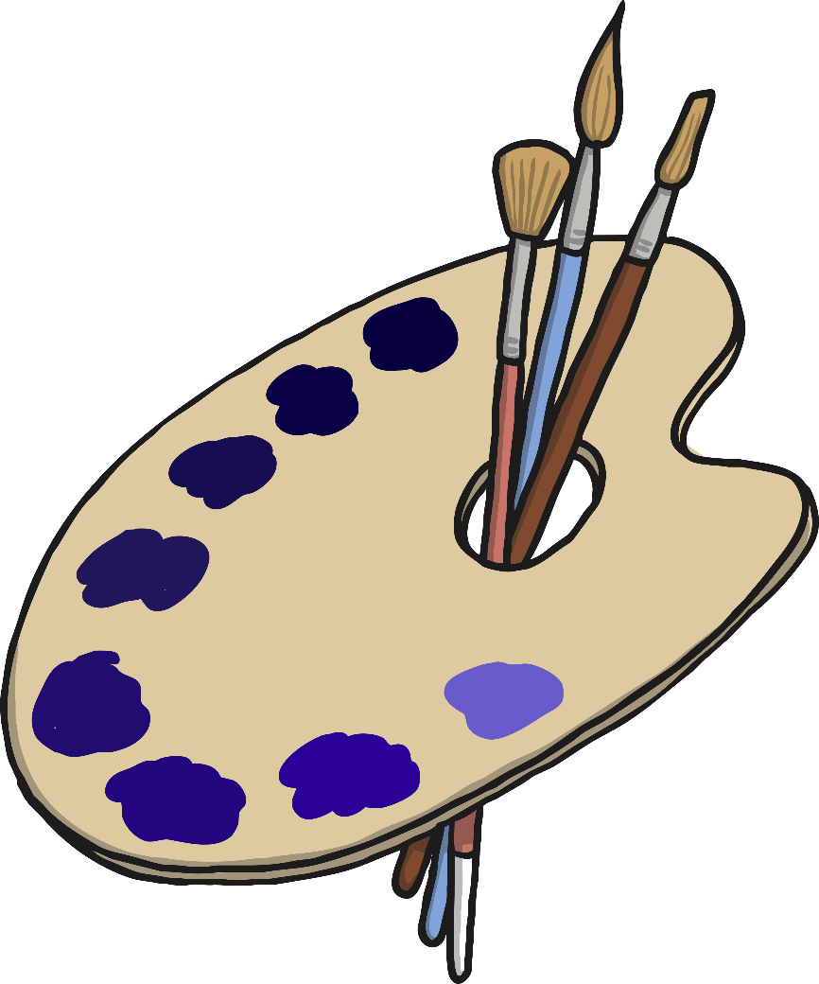
Mixing Shades

Slide 5


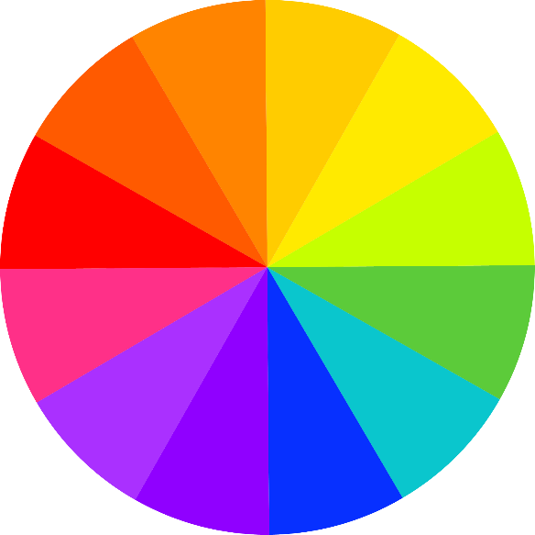
Colour Mixing
We have been learning about colour mixing.

Slide 6
Neutral Colours
Last week we learnt about neutral colours.

Slide 7





Making Tints
We practised mixing white with other colours to make tints.

Slide 8





Making Shades
This week we are going to make shades.

Slide 9



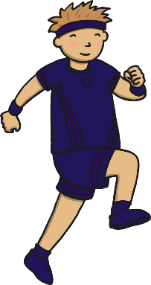
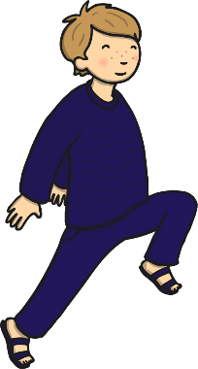
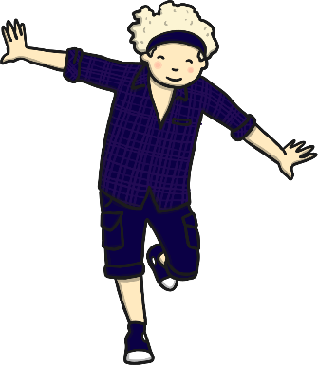
Making Shades
Shading changes a colour from bright to dark.

Slide 10
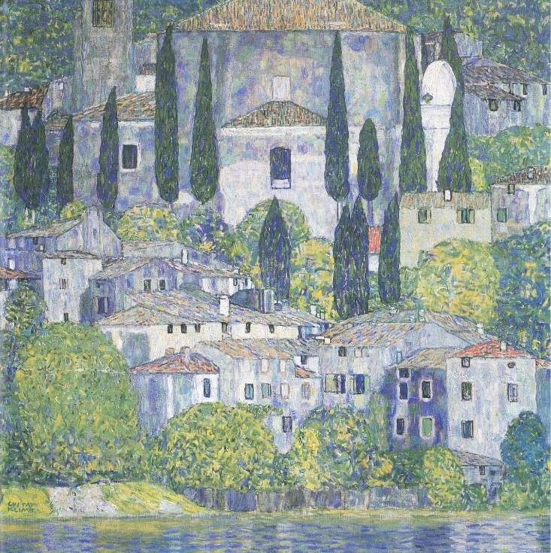
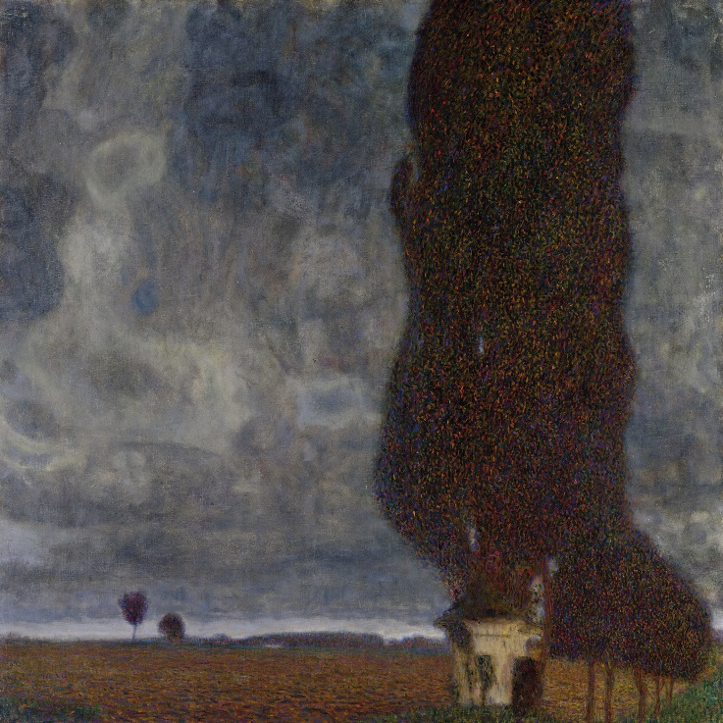
Changing the Feeling
Shading can make your painting seem sad, serious or even angry.
Look at these two paintings by Gustav Klimt.
Tints
Shades
Photo courtesy of bm.iphone and freeparking:-l (@flickr.com) - granted under creative commons licence – attribution

Slide 11
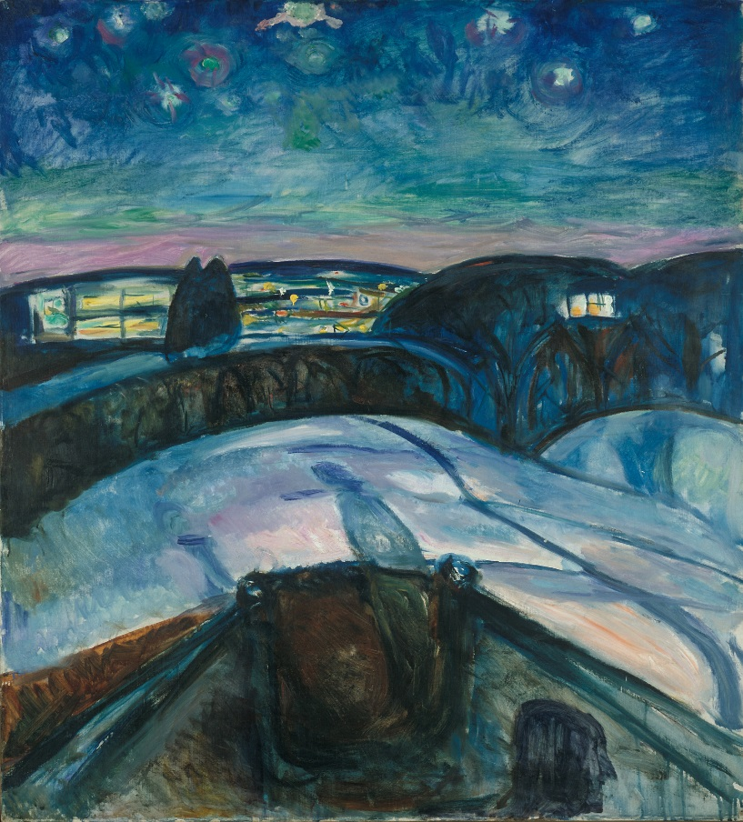
Painting with Tints
Shades are also good for painting shadows and night time.
Starry Night (1922-24)
by Edvard Munch
Photo courtesy of Peter (@flickr.com) - granted under creative commons licence – attribution

Slide 12
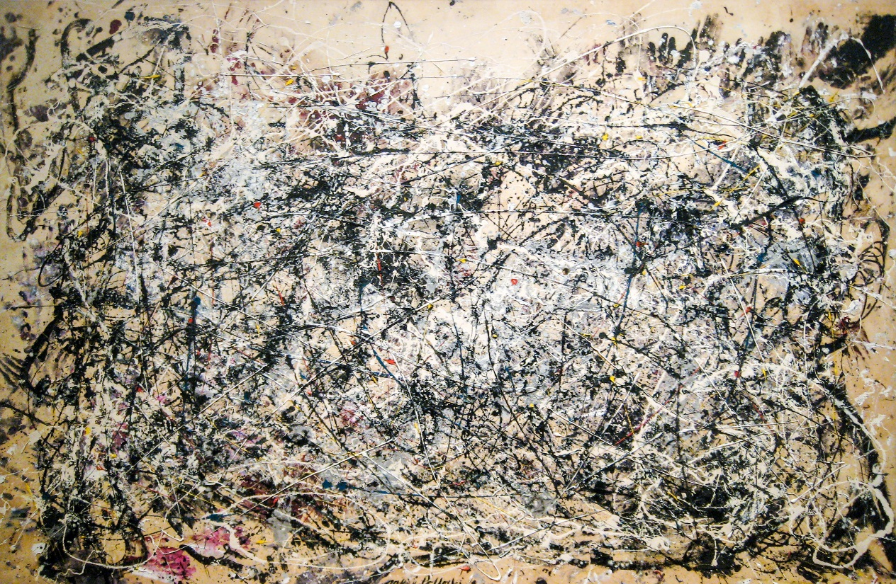
Jackson Pollock
Jackson Pollock was an abstract artist who invented ‘Drip Painting’.
Number 1A (1948)
by Jackson Pollock
Photo courtesy of wallyg (@flickr.com) - granted under creative commons licence – attribution

Slide 13
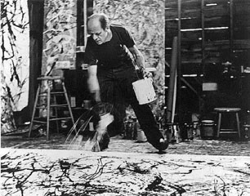
All About Jackson Pollock
(1912 - 1956)
American
Jackson Pollock was born in 1912. He got into a lot of trouble at school and was expelled twice.
Pollock didn’t paint on an easel like most painters, he put his canvases on the floor. He said it made him feel closer to the painting.

Slide 14

All About Jackson Pollock
(1912 - 1956)
American
Pollock invented ‘drip painting’. He would use different tools to drip, pour and splatter paint onto the canvas from above. These paintings became very famous.
Pollock was often very unhappy and he used his art to express his feelings. This is why many of his paintings use dark, gloomy colours.

Slide 15
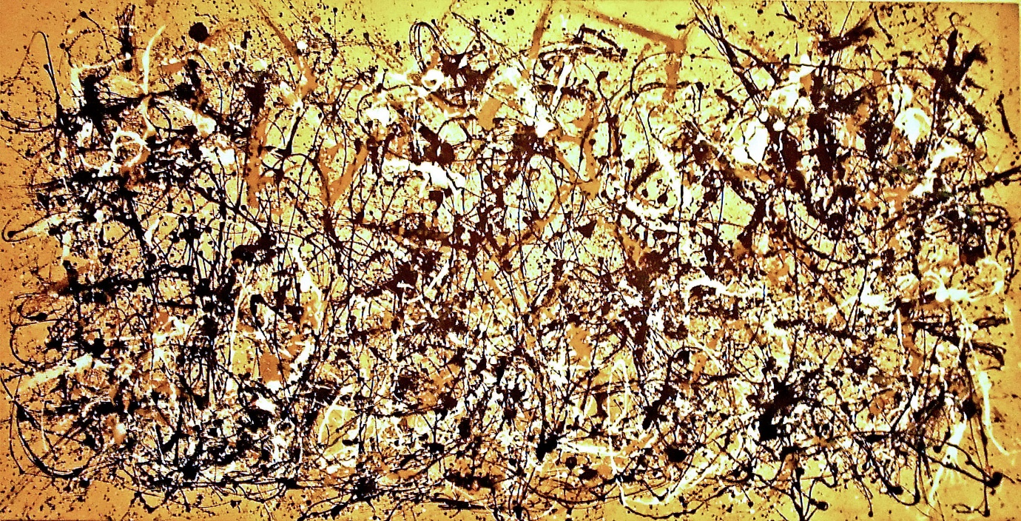
Autumn Rhythm (Number 30) (1950)
by Jackson Pollock
Photo courtesy of Matthew Mendoza (@flickr.com) - granted under creative commons licence – attribution

Slide 16


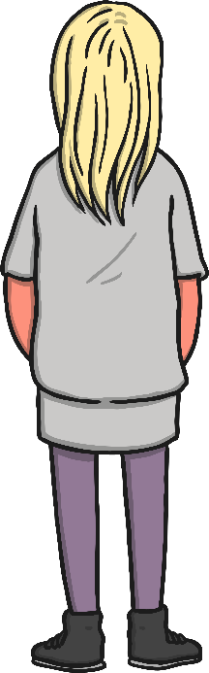
Looking at Abstract Art:
Autumn Rhythm (Number 30) (1950)
What do you see when you look
at this painting?
How has the painting been made?
What kind of colours does Pollock use?
How would you describe these colours?
What shapes can you see?
What kind of lines can you see?
How do you think Pollock was feeling when he painted this?
How does the painting make you feel?
Do you like it? Why?

Slide 17


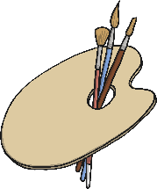
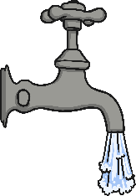






Drip Painting
You will need…
Tools for
dripping paint
Paint in black and
three other colours
Use your black paint to mix several shades of each colour paint that you have.
Remember to swish, wipe and blot your brush each time.
Drip, squirt and spatter your paint onto the card. Remember to use all the shades you have mixed.
A3 card
A clean palette
Water
A rag

Slide 18
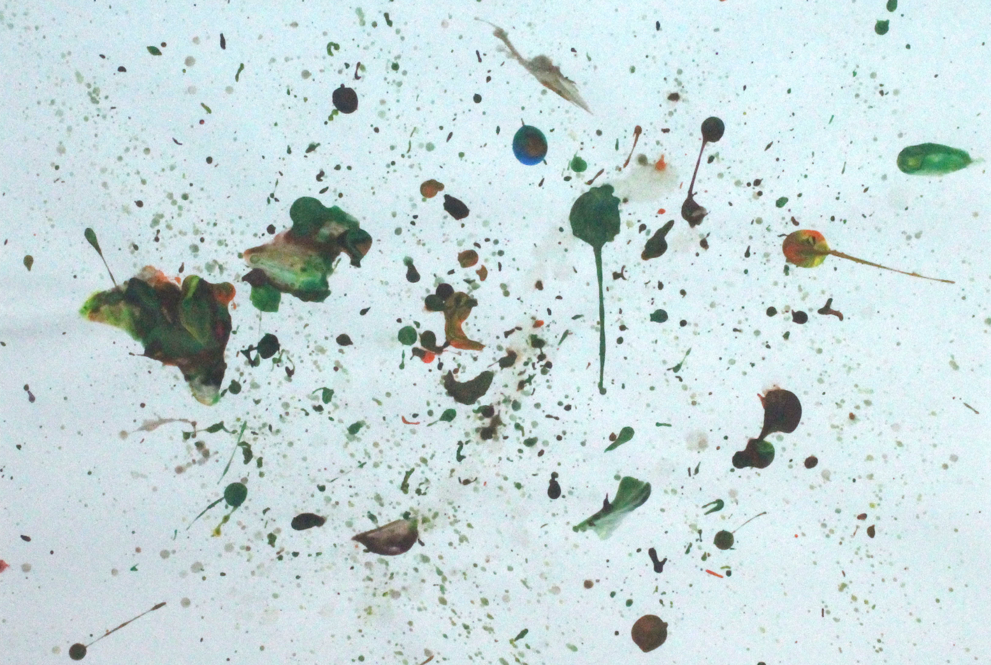
What a good drip painting looks like…

Slide 19




Sharing and Celebrating
Our Artwork!
Walk around the classroom and look at the
paintings that everyone has created.
Think about your painting.
What feeling do you think that
your painting shows?

Slide 20

Aim
I can create a drip painting using shades I have mixed.
I can talk about the artist Jackson Pollock.
Success Criteria
I can mix shades.
I can use my shades to paint a drip painting.
I can tell you an interesting fact about Jackson Pollock.
I can say what kind of paintings Jackson Pollock made.

