Slide 1


Art and Design
Colour Chaos: Mark Rothko
Year One
Art and Design | KS1 | Colour Chaos | Mark Rothko | Lesson 2

Slide 2
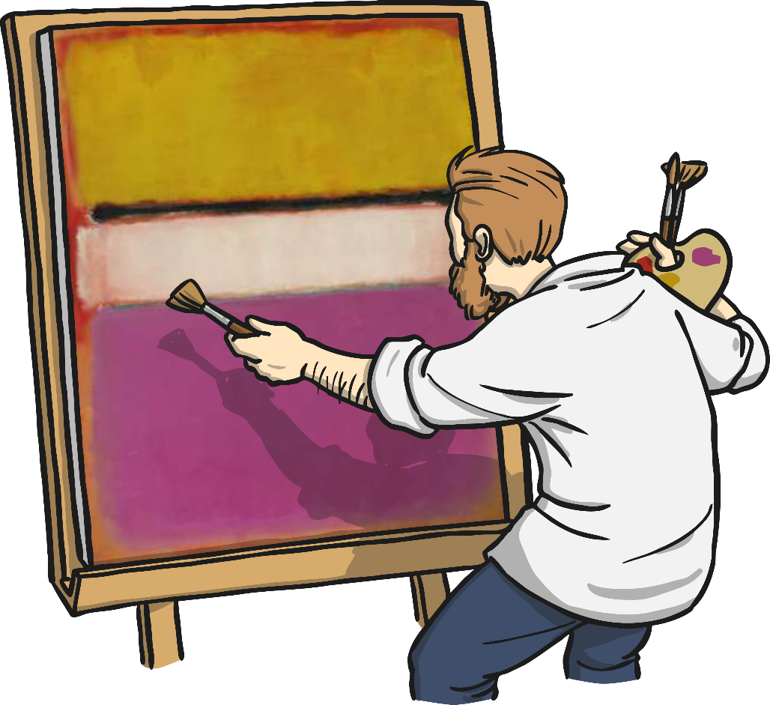

Mark Rothko
Photos courtesy of Luis Tamayo and eggneckface33 (@flickr.com) - granted under creative commons licence – attribution

Slide 3
Aim
I can create a colour field painting using colours I have mixed.
I can talk about the artist Mark Rothko.
Success Criteria
I can mix my own colours.
I can use my colours to paint a colour field painting.
I can tell you an interesting fact about Mark Rothko.
I can say what kind of shapes Rothko used in his paintings.

Slide 4
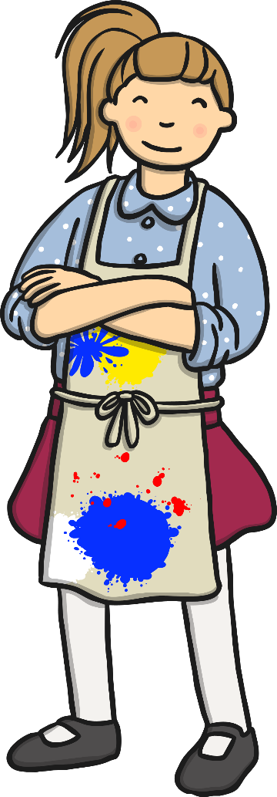
Colour Mixing
What can you remember about the primary colours?

Slide 5
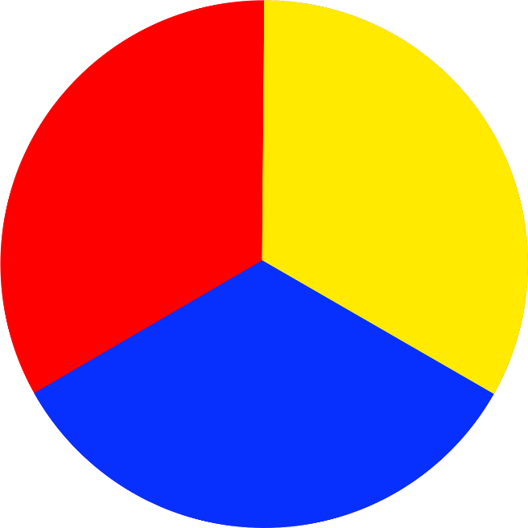
Primary Colours
Red, yellow and blue are the primary colours.
Primary means first.
Primary colours can’t be made by mixing any other colour.

Slide 6
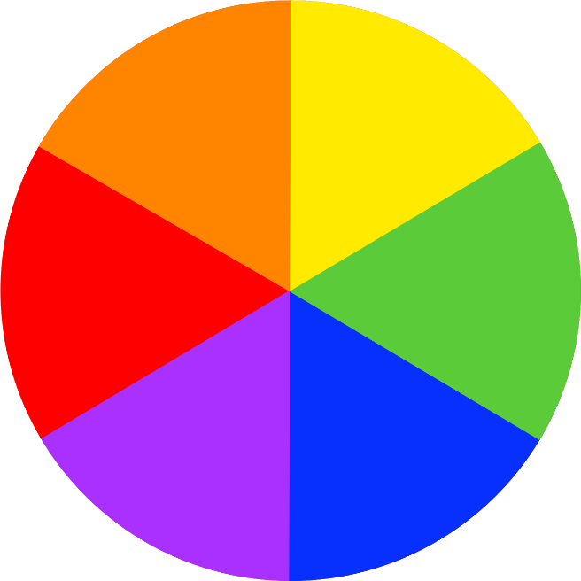
Secondary Colours
You can mix the primary colours together to make new colours.
These colours are called secondary colours

Slide 7

Mixing Secondary Colours
Red and yellow makes orange.

Slide 8
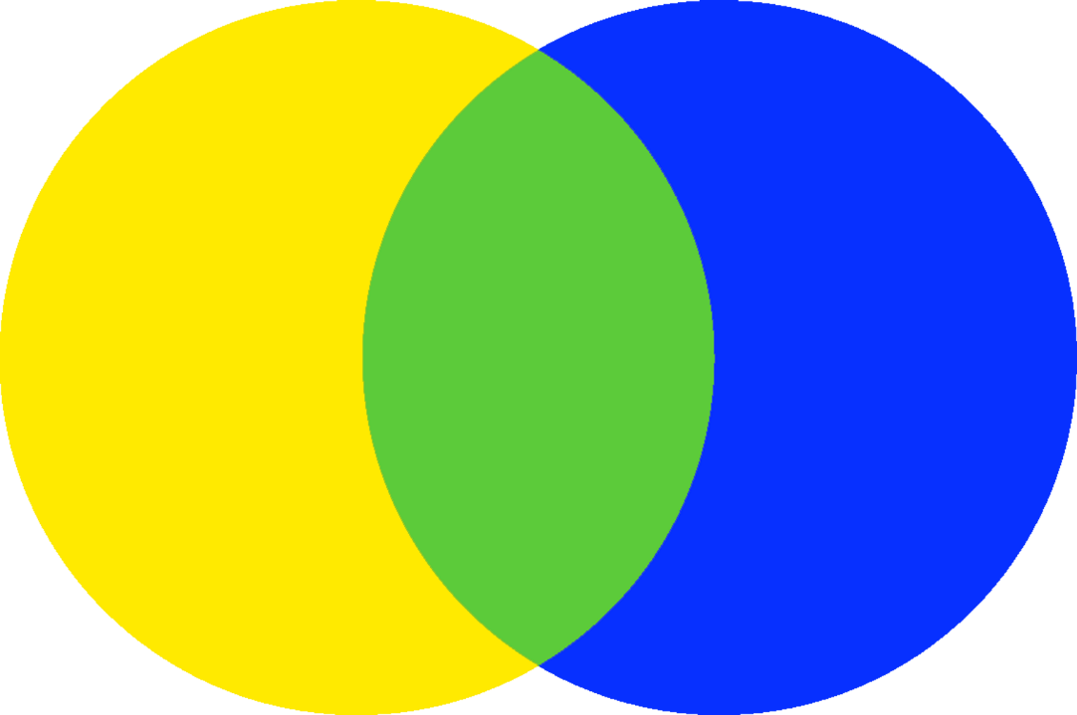
Mixing Secondary Colours
Yellow and blue makes green.

Slide 9
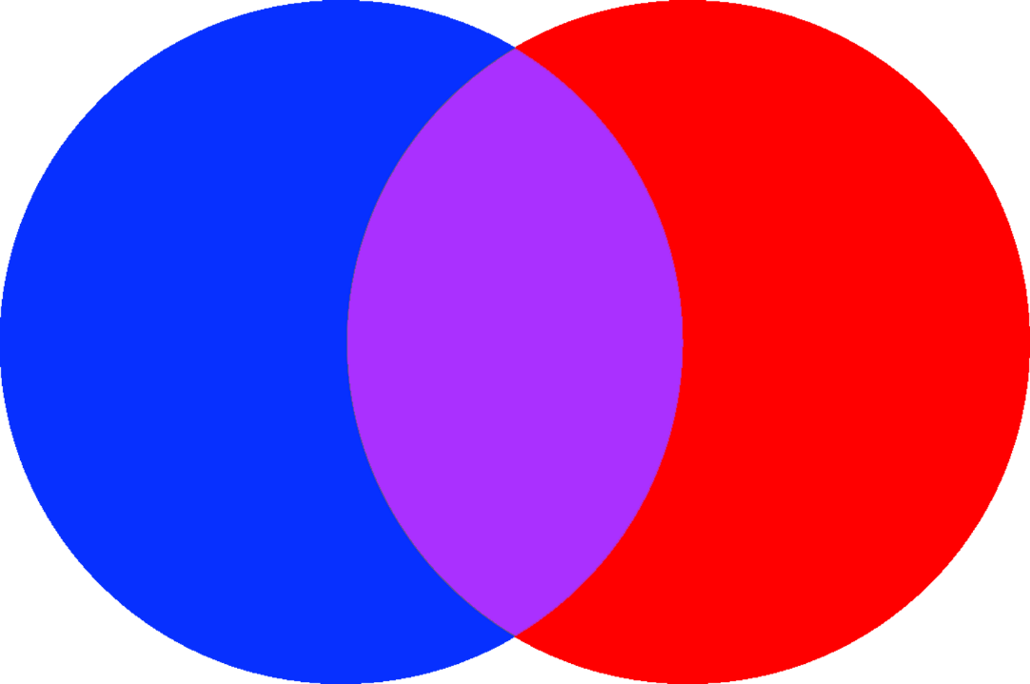
Mixing Secondary Colours
Blue and red makes purple.

Slide 10




Mixing Secondary Colours

Slide 11



Mixing Secondary Colours

Slide 12
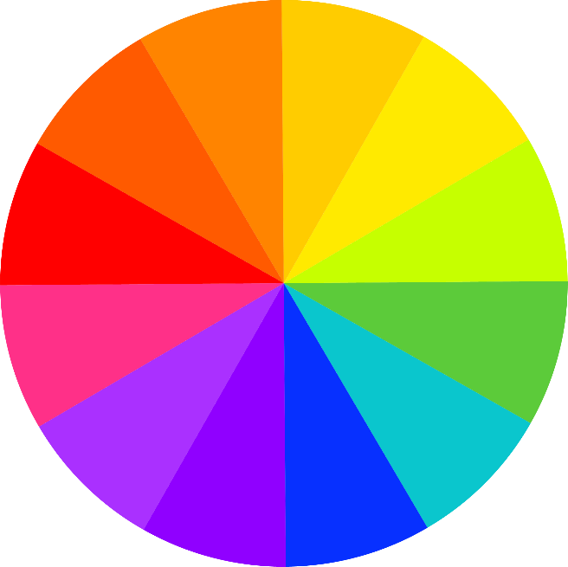
Mixing Secondary Colours
You can mix the secondary colours
together to make new lots more colours!

Slide 13
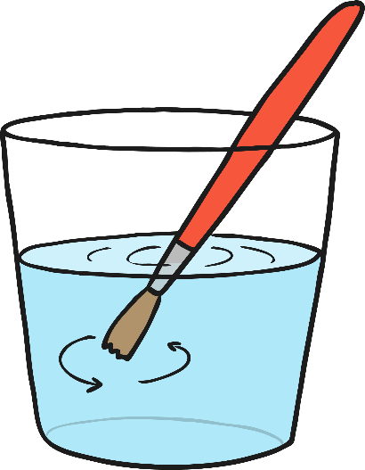
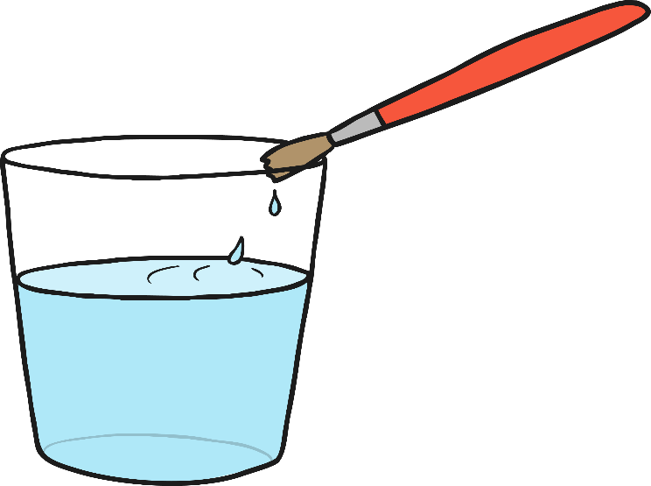

Mixing Paint to Make New Colours
1
2
3
Swish
Wipe
Blot
When we paint with different colours it
is important to keep our brush clean.

Slide 14


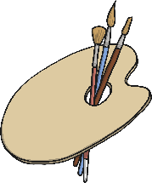
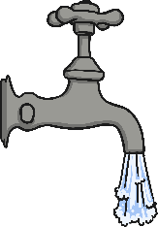
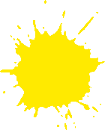



Colour Mixing
You will need…
A4 paper
2 paint palettes
Water
Red, yellow
and blue paint
Brushes in
different sizes
Use your brush to pick up a colour at a time and paint a circle between the primary colours.
Swish, wipe and blot your brush before you pick up the next colour.
Add the next colour, mixing the two together to make a secondary colour.
Now make the other secondary colours.
Now you have six colours! See what other colours you can make by mixing these together.
Use your paper to experiment with the colours you have mixed. Use different sized brushes to create thick and thin, soft and hard lines.

Slide 15
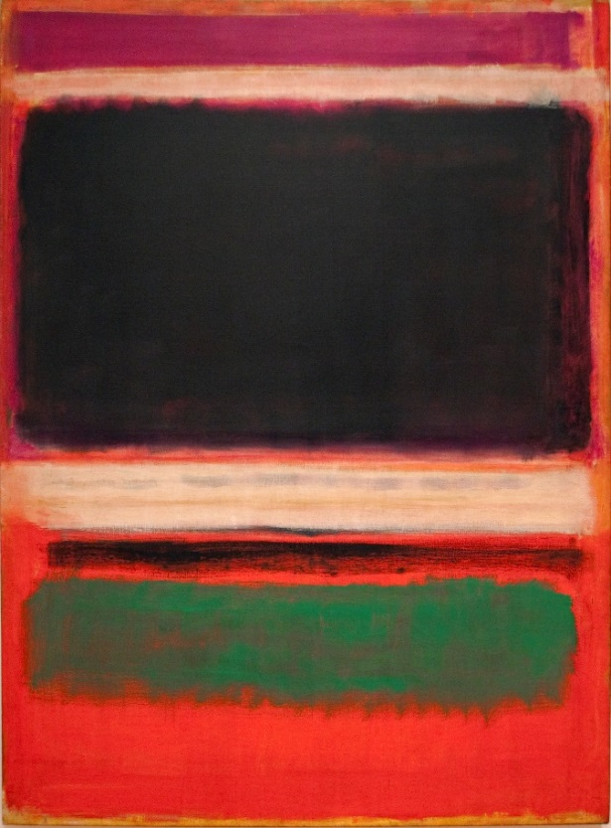
Mark Rothko
Mark Rothko was a painter who loved mixing colours.
No.3/No.13 (1949)
by Mark Rothko
Photo courtesy of Tony Hisgett (@flickr.com) - granted under creative commons licence – attribution

Slide 16
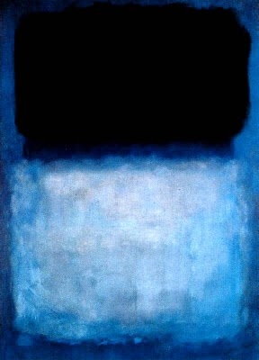
Green Over Blue (1956)
by Mark Rothko
Photo courtesy of .morro (@flickr.com) - granted under creative commons licence – attribution

Slide 17
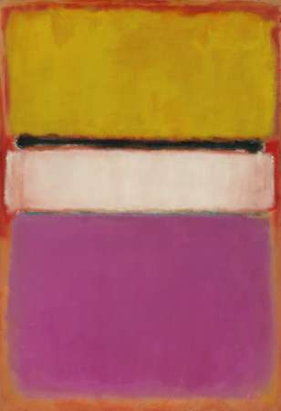
White Centre (Yellow, Pink and Lavender on Rose) (1950)
by Mark Rothko
Photo courtesy of eggneckface33 (@flickr.com) - granted under creative commons licence – attribution

Slide 18
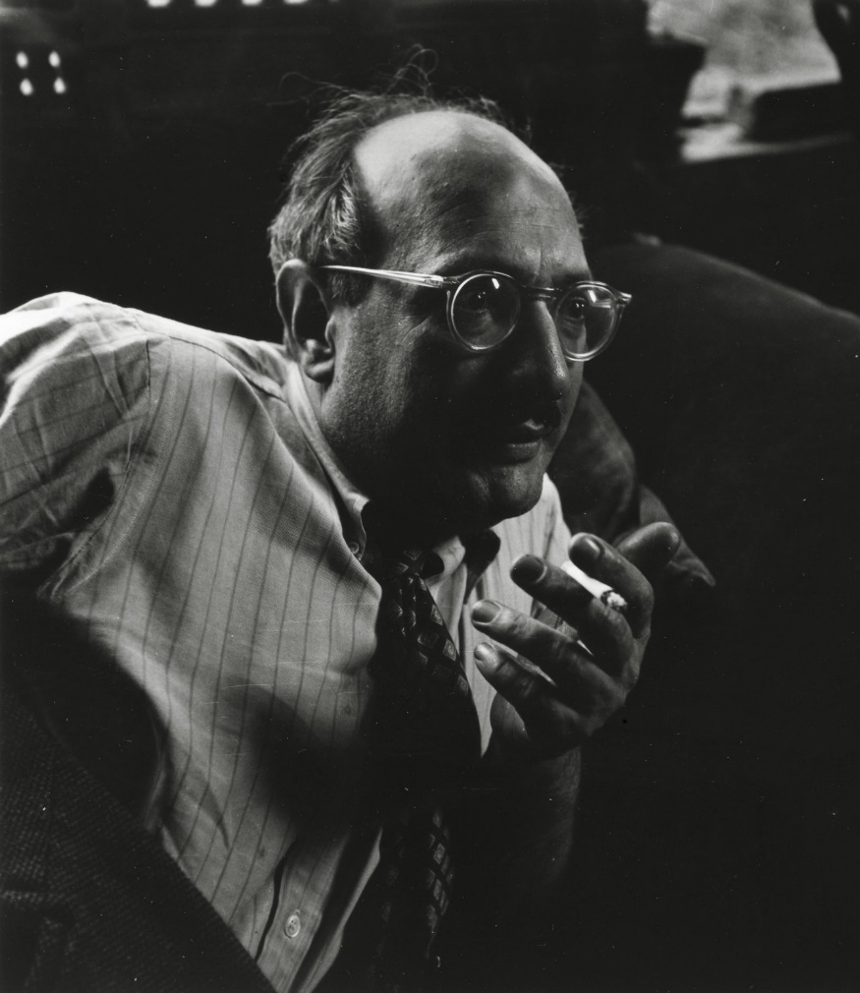
All About Mark Rothko (1903 - 1970) Russian
Rothko was born in Russia in 1903 and moved to America when he was 10. Like Piet Mondrian his first paintings were of things he could see, like buildings, people and landscapes.
Later, he decided that using colour was the best way to show how he was feeling. He used carefully mixed colours painted in simple blocks and lines on very big canvases. This kind of painting was called ‘Colour Field’.

Slide 19

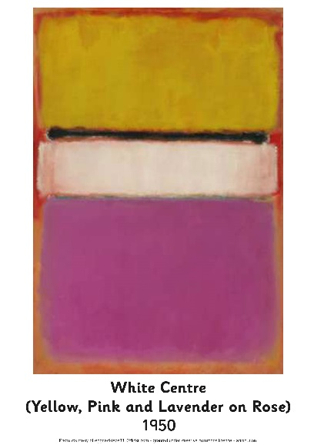
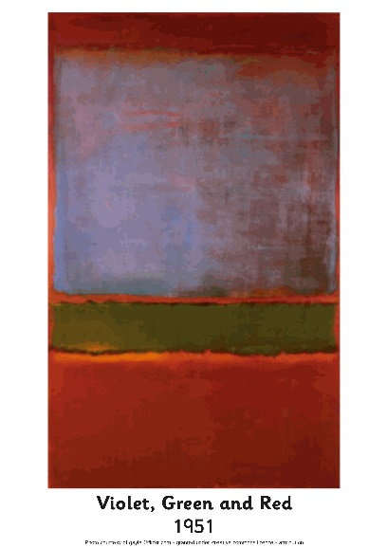
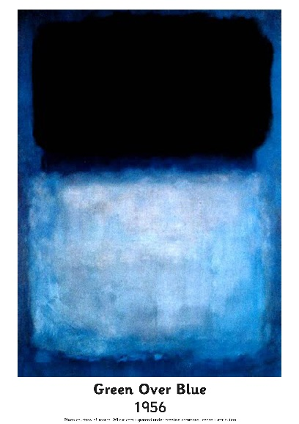
Looking at Abstract Art: Mark Rothko Photopack
What do you see when you look at this painting?
How has the painting been made?
What kind of colours does Rothko use?
How would you describe these colours?
What shapes can you see?
What kind of lines can you see?
How do you think Rothko was feeling when he painted this?
How does the painting make you feel?
Do you like it? Why?

Slide 20
Colour Field Painting
You will need…
A3 card
2 paint palettes
Water
Brushes in
different sizes
Look at the colours you mixed earlier. Think about which ones you like and how they make you feel.
Choose a few of your favourite colours to use in your painting. Think about how you will use them. Which colours will you paint in big blocks? Which colours will you paint in thin lines?
Now you are ready to start painting. Don’t overlap the colours too much or they will all run together.
Try not to leave any white space on the page.

Slide 21
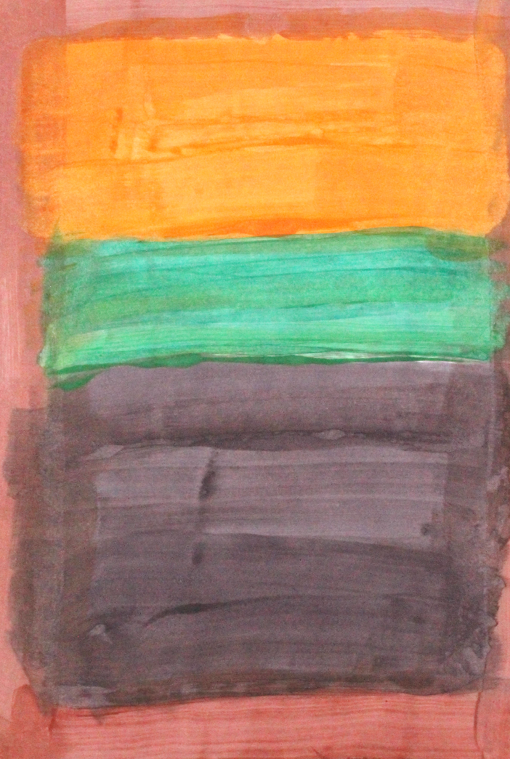
What a good Colour Field painting looks like…

Slide 22
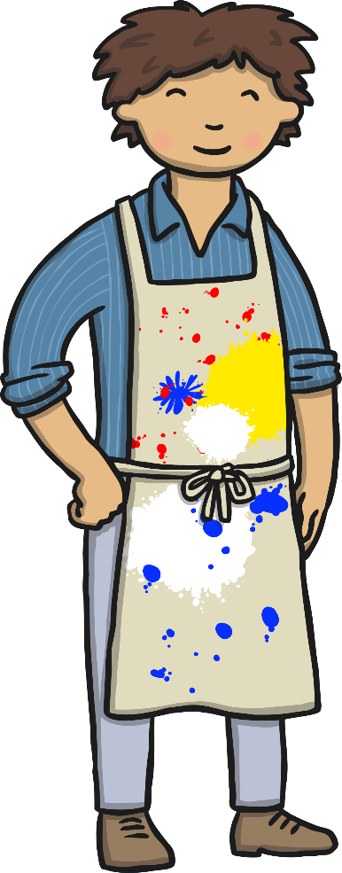
Colour Sums!
What happens when you mix the primary colours?

Slide 23

Colour Sums!

Slide 24
Colour Sums!

Slide 25
Colour Sums!

Slide 26



Colour Sums!

Slide 27

Aim
I can create a colour field painting using colours I have mixed.
I can talk about the artist Mark Rothko.
Success Criteria
I can mix my own colours.
I can use my colours to paint a colour field painting.
I can tell you an interesting fact about Mark Rothko.
I can say what kind of shapes Rothko used in his paintings.

