Slide 1

Advent
Preparing to celebrate the birthday of Jesus

Slide 2


Slide 3

Four weeks before Christmas
We make an Advent Wreath

Slide 4
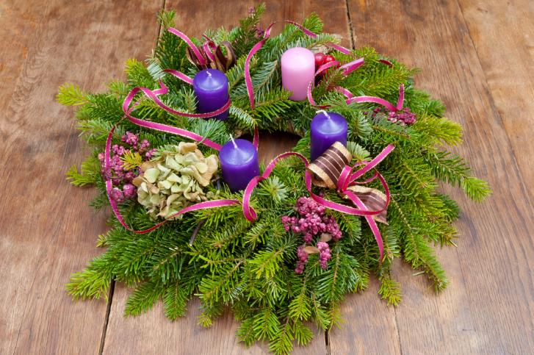
We put 4 candles in the wreath.

Slide 5
One candle is for
Hope
What do we hope Jesus will give to us?

Slide 6

I hope Jesus will make us feel happy.

Slide 7
The second candle is for
love
We show love to Jesus by being kind to others.

Slide 8
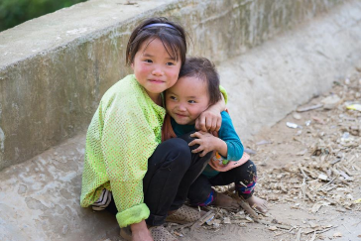

Ways to show
Love to others.

Slide 9
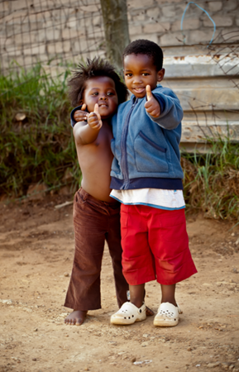
Savio and Sam show love by being good friends.

Slide 10
The third candle is for
joy
We give joy to Jesus when we say thank you to those who help us.

Slide 11


We give joy when we say …

Slide 12

How is Sally giving joy to her Mum?

Slide 13
The fourth candle is for
peace
Jesus gives us peace when we help others.

Slide 14

We look out for ways to help.

Slide 15

What is happening here?
How does grandpa feel?

Slide 16


Slide 17
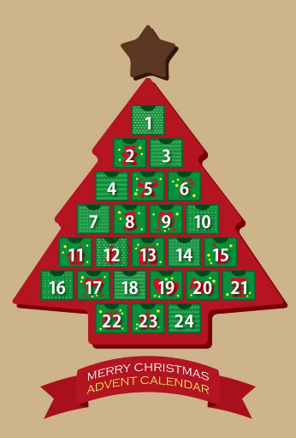
Each day we hope we can give love, joy and peace to others.

Slide 18



Each day, we tell Jesus how we are preparing for his big Birthday.

Slide 19


Slide 20
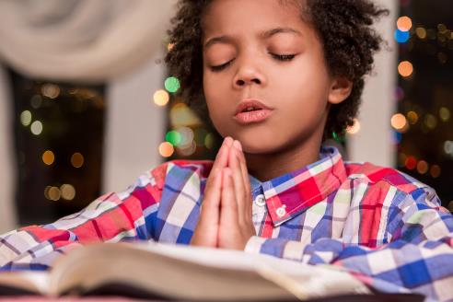


Slide 21


Slide 22
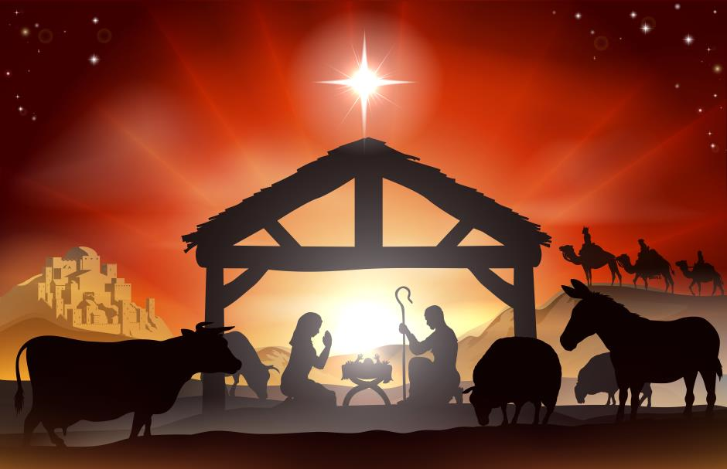

Slide 23
