Slide 1


Slide 3

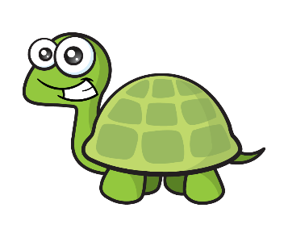

Tiny is having a party!
I can help you with the decorations!
I have 20
balloons!
Can you help make
groups of 5 balloons?
1
3
1
2
3
5
2
2
4
2
4
1
4
4
5
3
1
3
5
5

Slide 4
Can you help Tiny make
groups of 5 balloons?
How many groups?
There are 4 equal groups!

Slide 5






Make equal groups
Have a think
I can put them in groups of 4
I have 20
flowers!
There are 5 groups of 4 flowers.

Slide 6
Can you find 10 objects and make equal groups of 2 and 5?

Slide 7


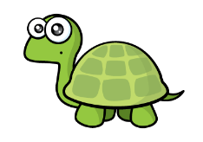

Make equal groups
Have a think
Have a think
I am going to try and make groups of 3
I am going to make groups of 2

Slide 8







Make equal groups of 3
How many plates
do I need?
There are 4 equal groups of 3

Slide 9
Make equal groups of 4
How many plates
do I need?
There are 3 equal groups of 4

Slide 10
Find 12 objects.
How many different equal groups can you make?

