Slide 1


Slide 4
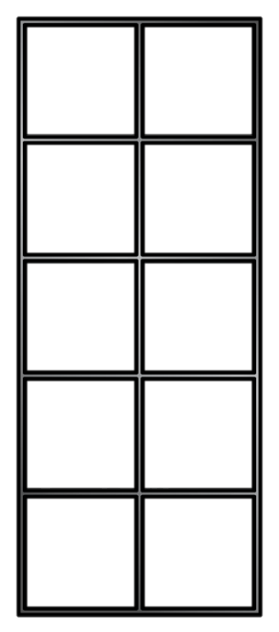
Make equal groups - sharing
Let’s share 4 counters into two groups.
4 counters shared equally into two groups is
2

Slide 5

Have a think
Make equal groups - sharing
Let’s share 6 counters into two groups.
6 counters shared equally into two groups is
3

Slide 6
Can you share 8 counters into 2 equal groups? What if you had 10 counters?

Slide 7







Have a think
How many smarties?
How can I share these equally?
20 smarties shared equally between 4 is
5
5
20
10
15

Slide 8
Can you find 20 items and share them equally into 2 groups? How about 5 groups?

