Slide 1
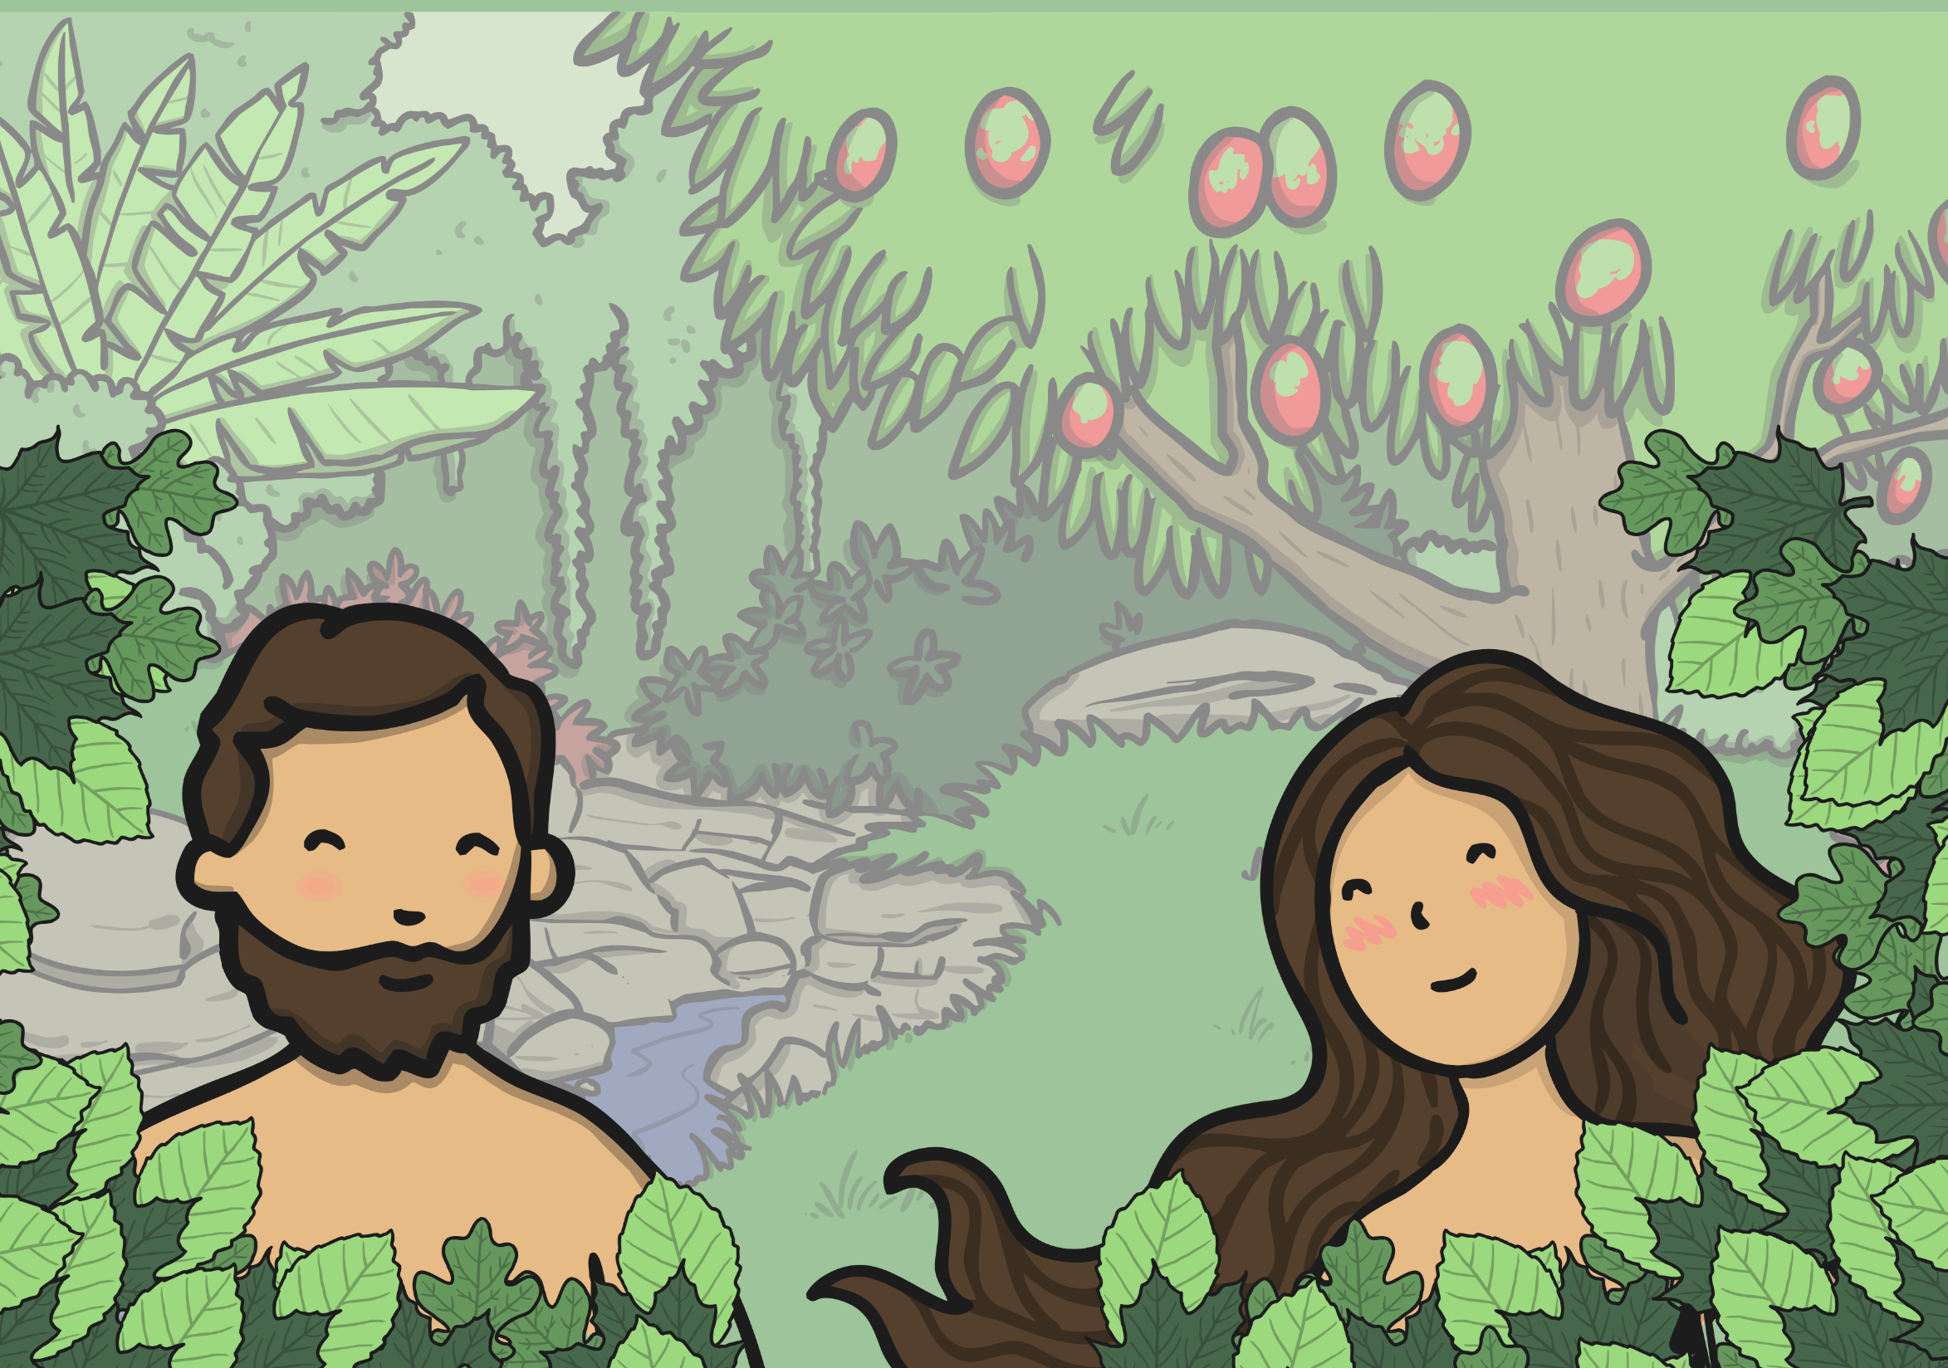

The Story of Adam and Eve

Slide 2


God said:
“Let there be light!”

Slide 3
God said:
“It is good!”

Slide 4
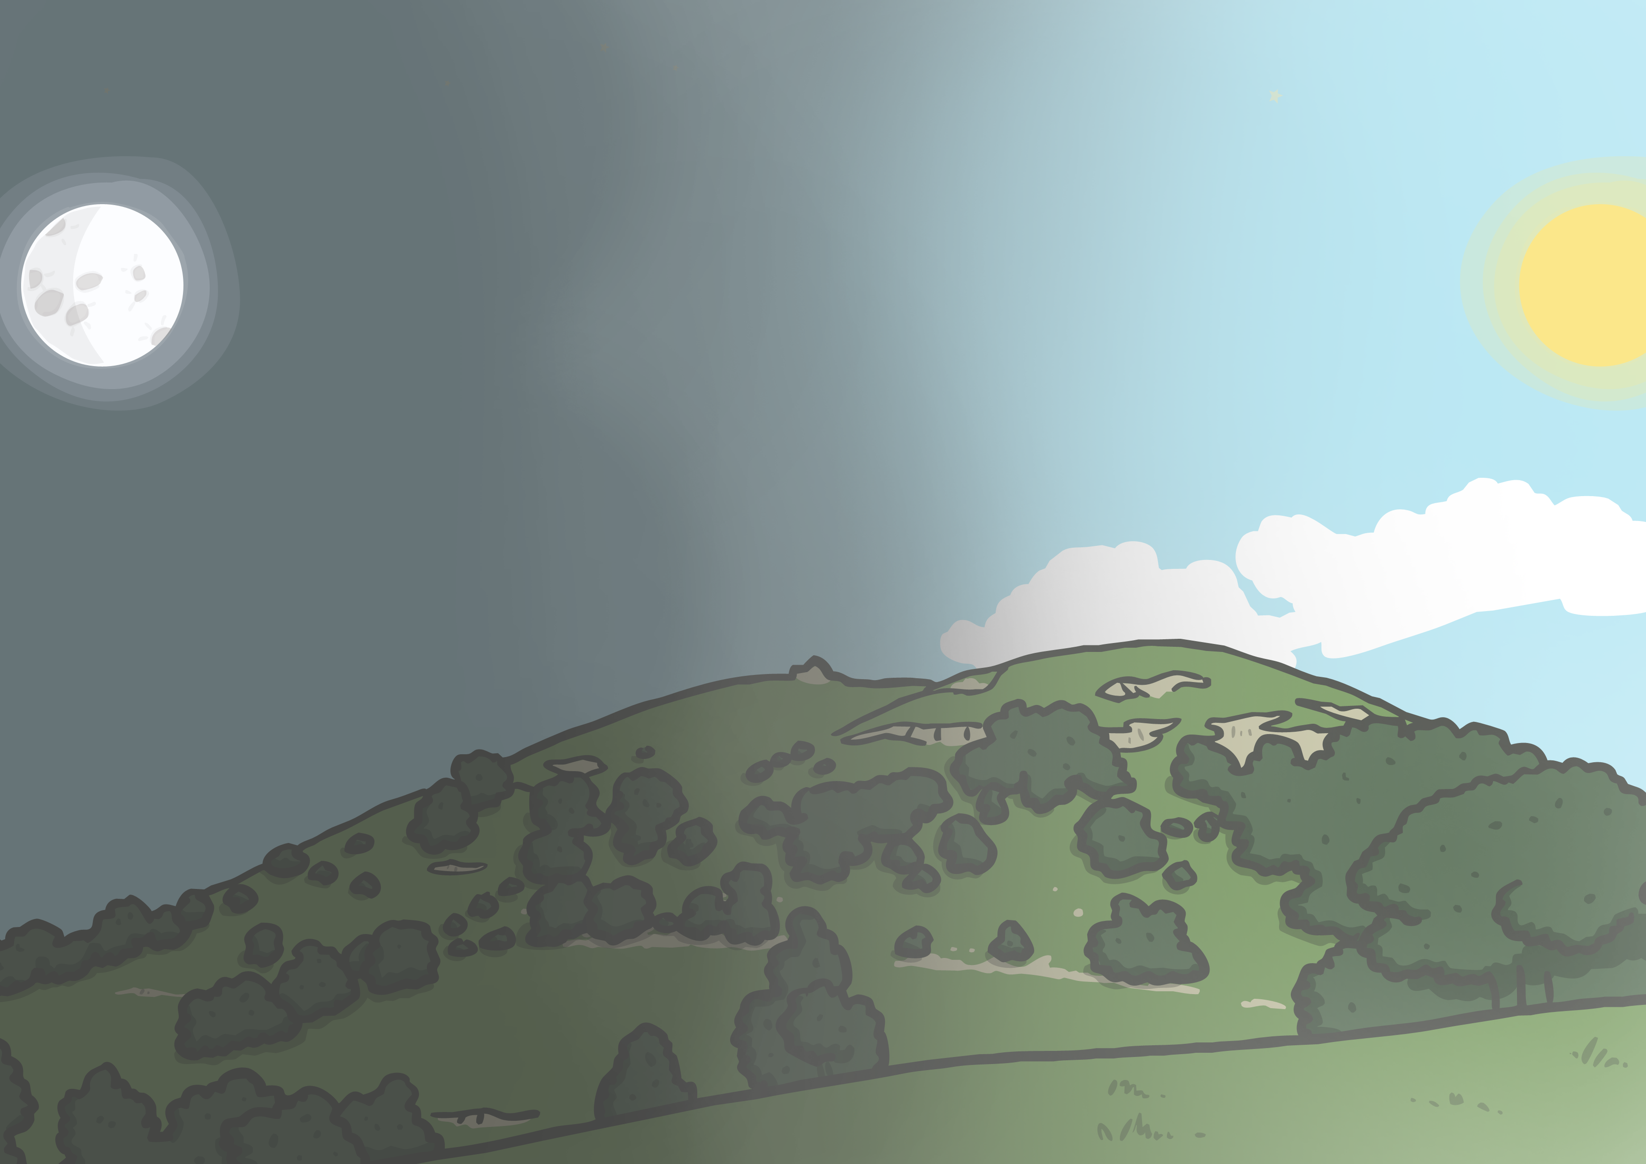
God separated the light from the darkness. He called the light “day” and the darkness “night”.

Slide 5

On the second day, God made the Earth and the sky.

Slide 6
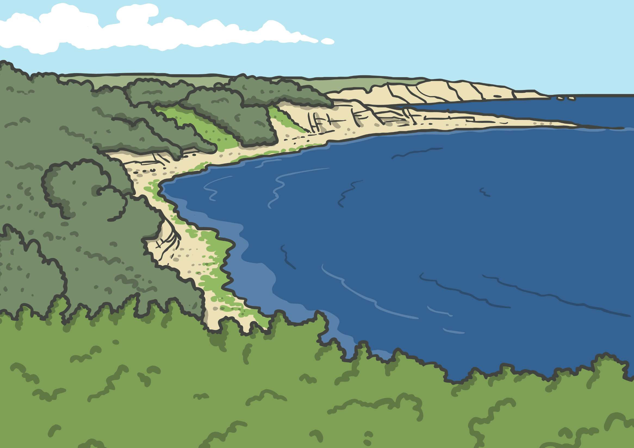
On the third day God created the land and the seas. He also created plants and trees.

Slide 7

On the fourth day God created the Sun, the Moon and the stars.

Slide 8
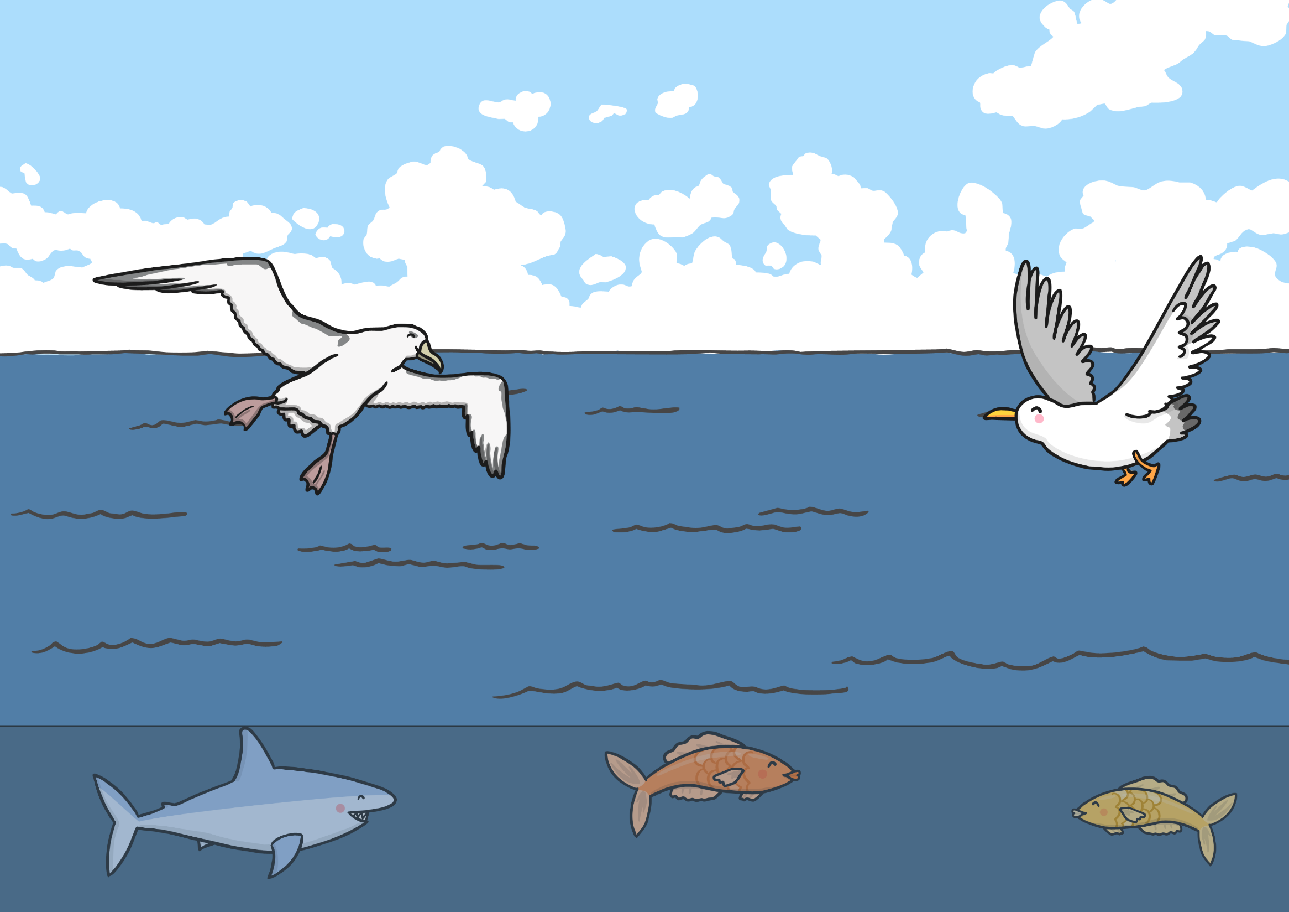
On the fifth day God created birds and sea creatures.

Slide 9
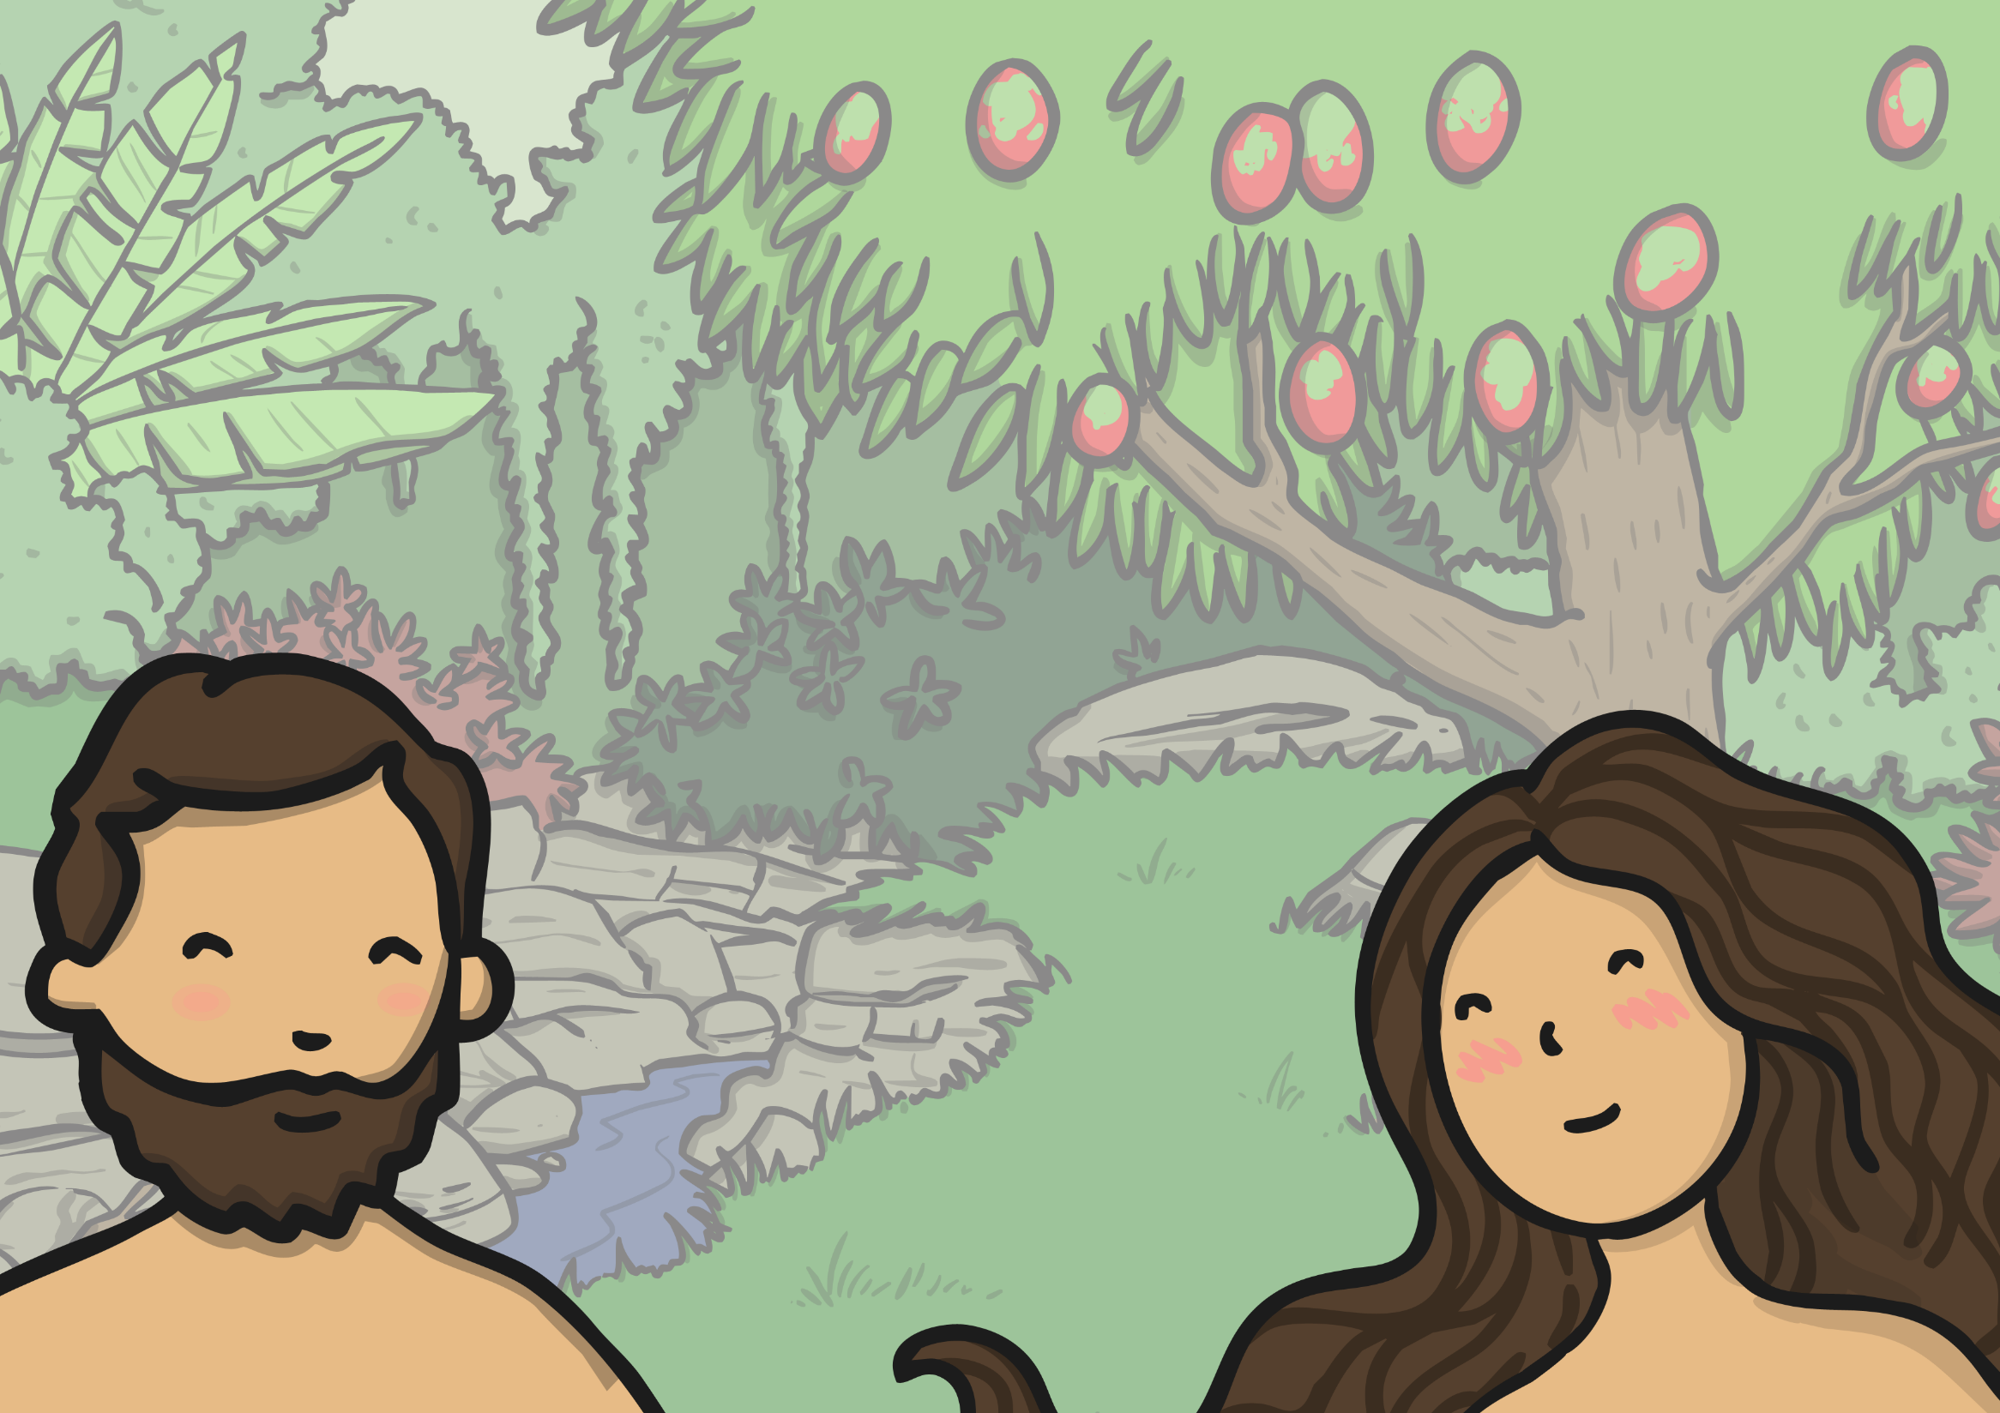
On the sixth day, God created animals to fill the Earth. God also created humans to enjoy and care for all that He had made.

Slide 10
On the seventh day God rested. God was happy with all He had made.

Slide 11
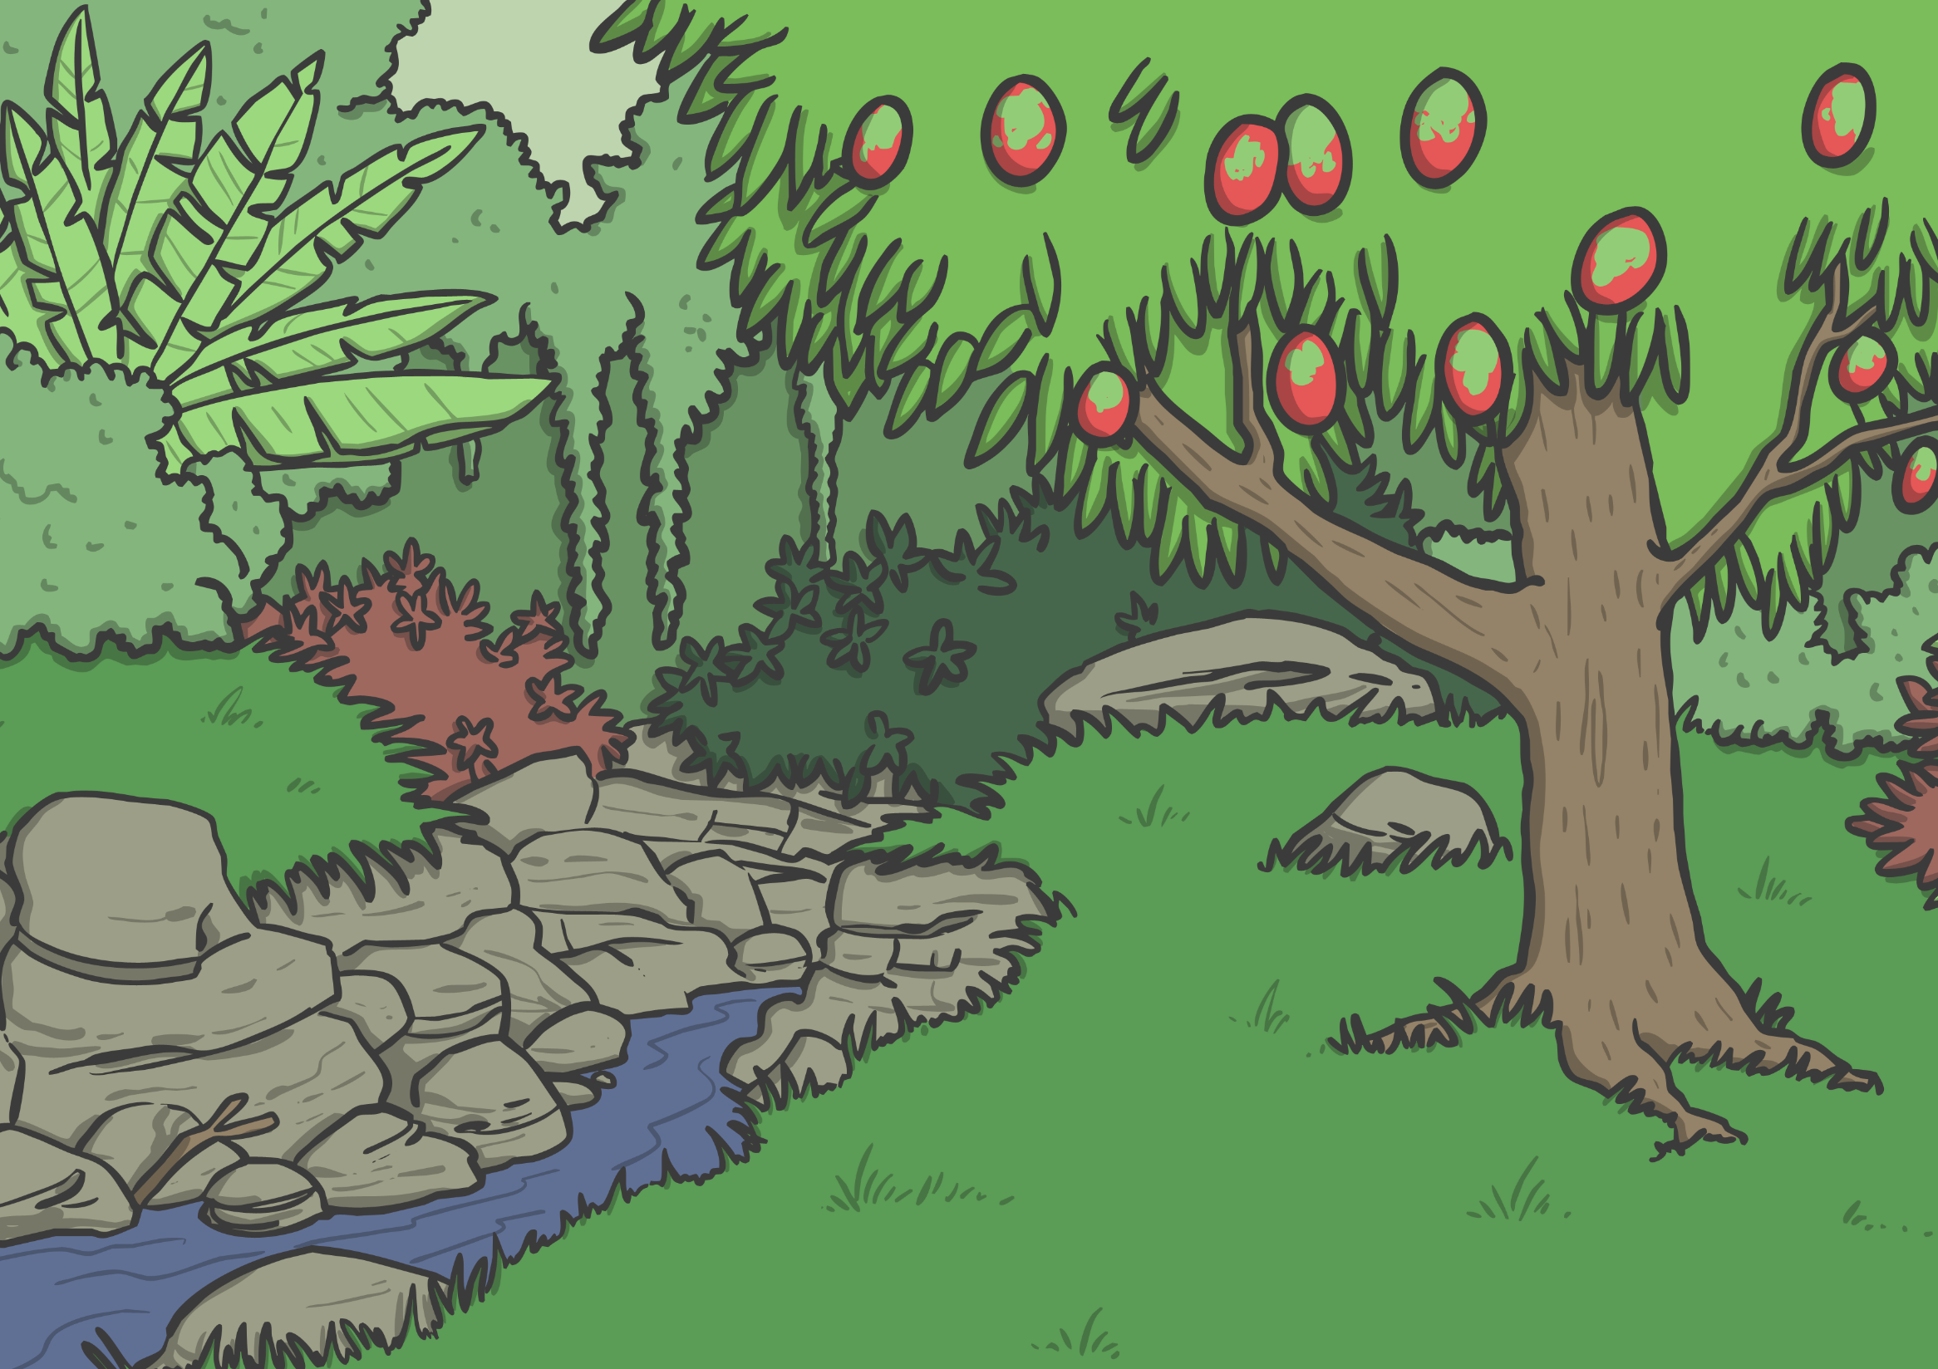
God made a garden in Eden for Adam. It was beautiful.

Slide 12
God did not want Adam to be alone, so He created woman, Eve. Now they could enjoy all that God had made together.

Slide 13
God told Adam and Eve they could eat fruit from all the trees in the garden except the Tree of Knowledge of Good and Evil.

Slide 14
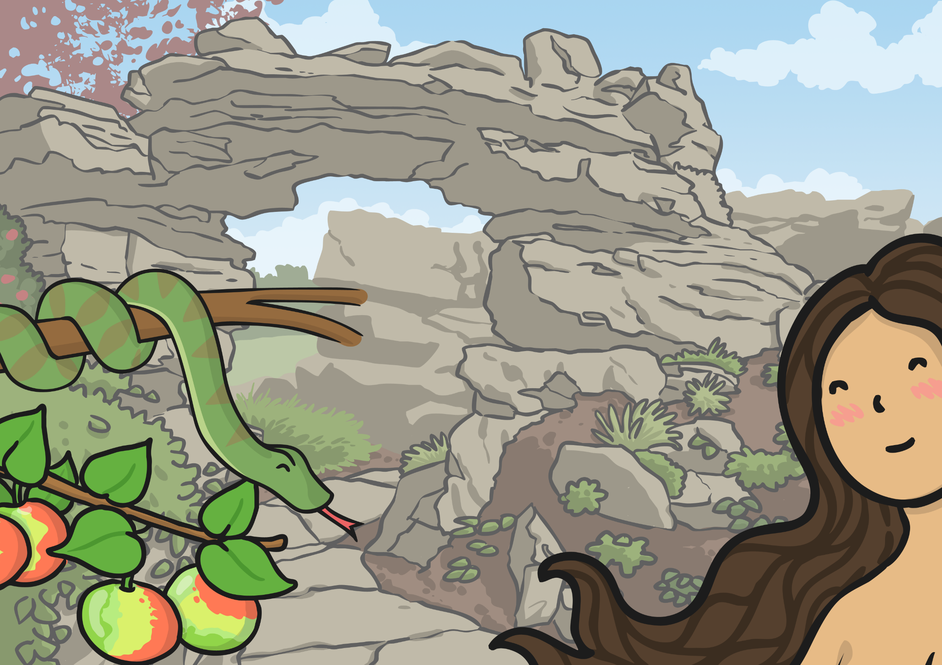
Eve saw how beautiful the tree in the middle of the garden was and its fruit looked very good to eat. The serpent lied to Eve and she ate the fruit from the Tree of Knowledge of Good and Evil. She gave some to Adam and he also ate the fruit.

Slide 15
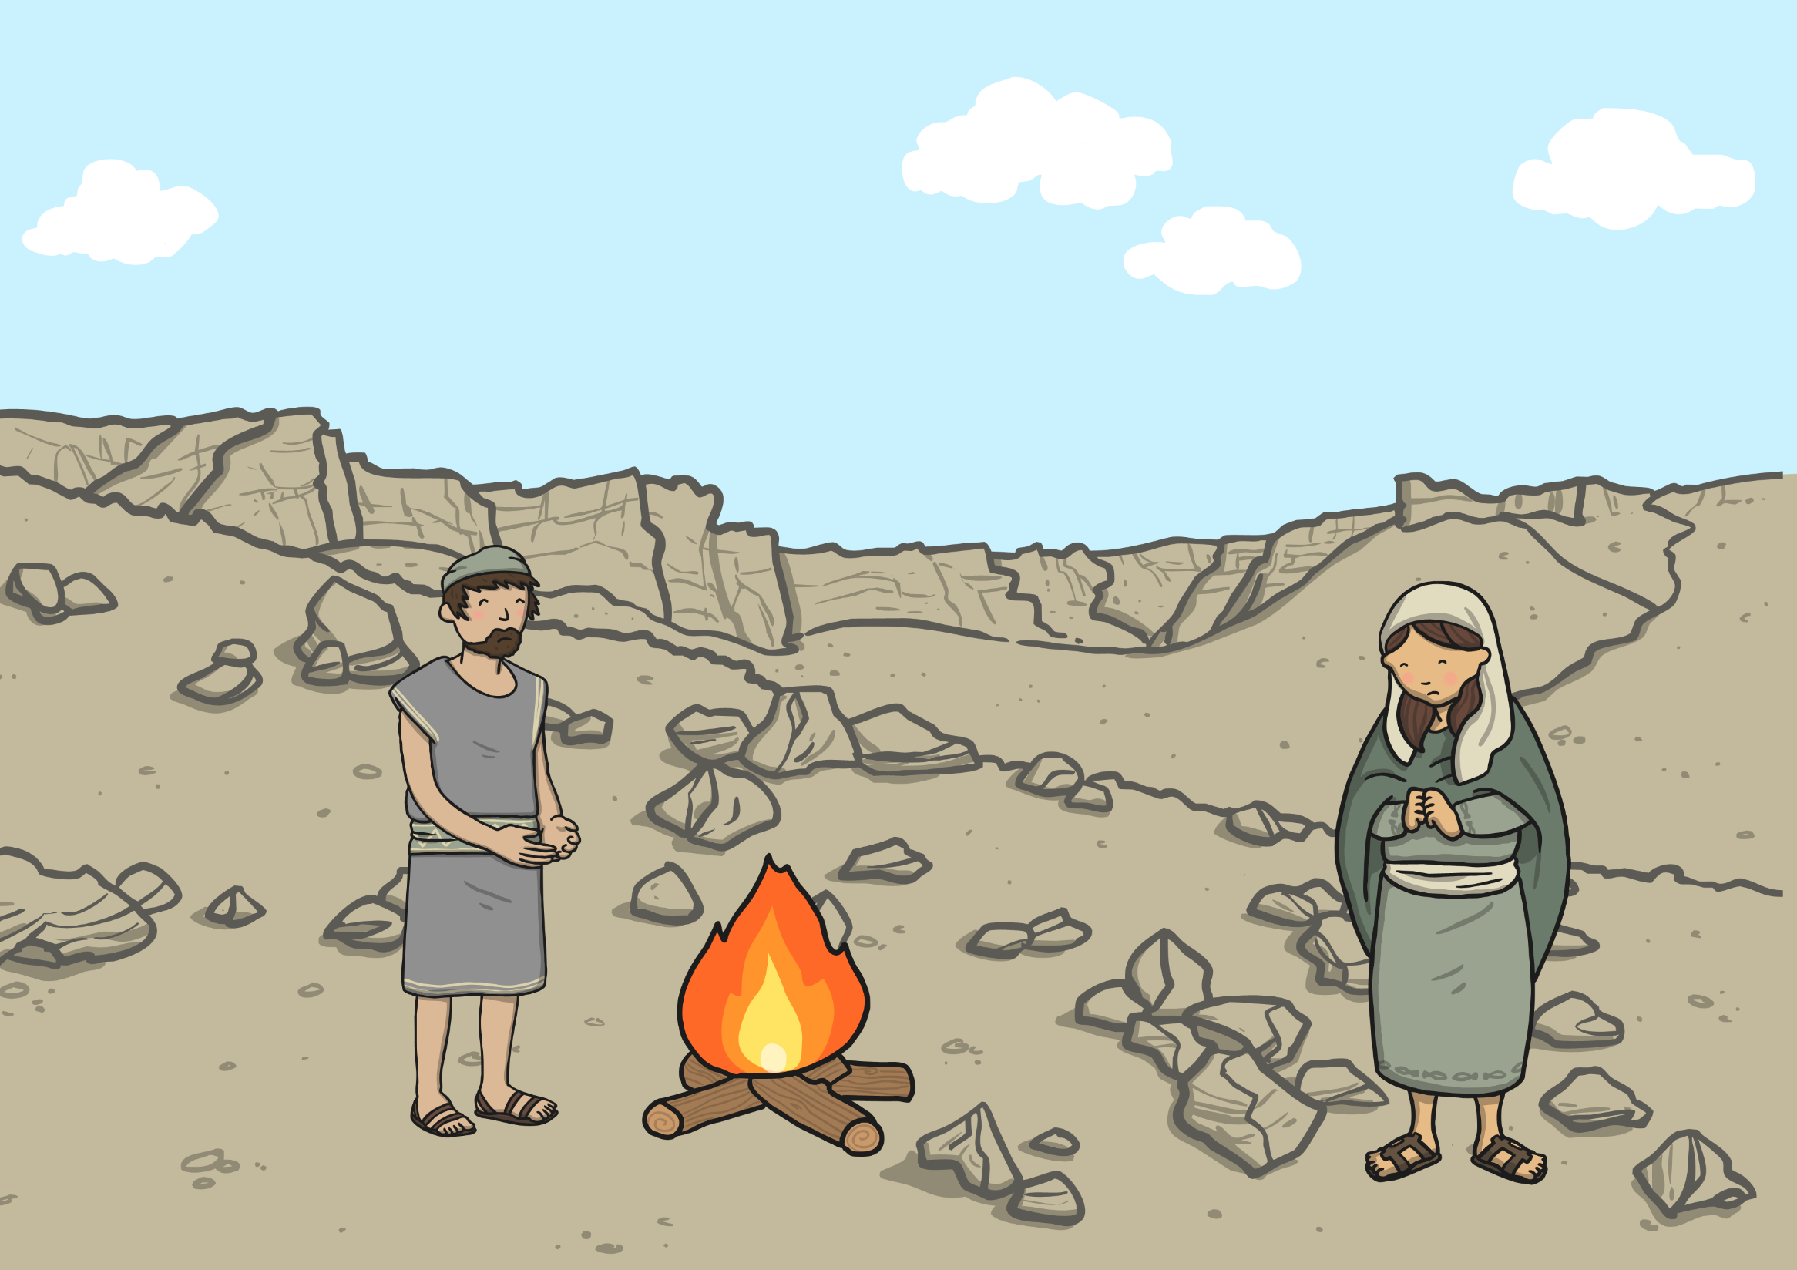
Adam and Eve had to leave their beautiful home because they had not been obedient. After that they had to work hard and had many troubles.

