Slide 2
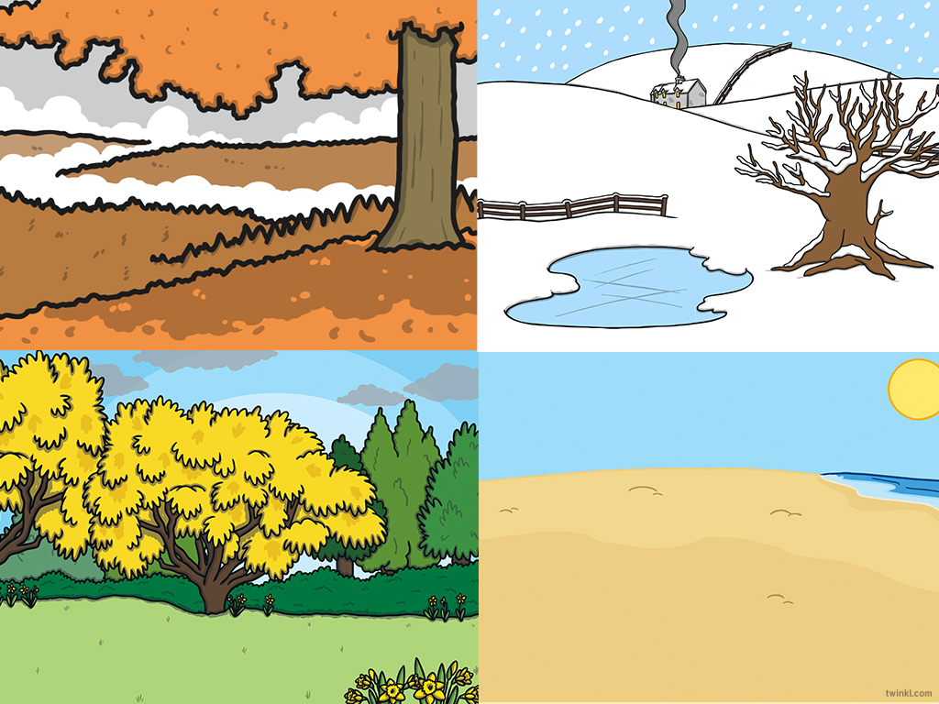
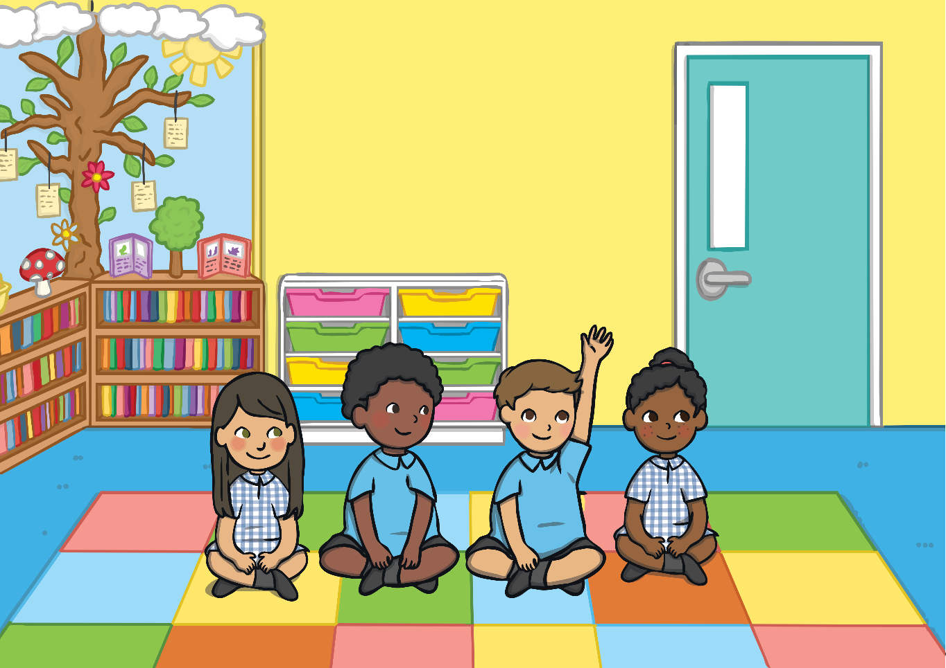
The Four Seasons
It was the first day of school and James, Bisma, Lily and Felix were all very excited! Their teacher asked them what they had been doing over the summer.
I had a barbecue in the garden.
I went to the beach. It was really sunny and I had an ice cream.
I went for a picnic in the park.

Slide 3
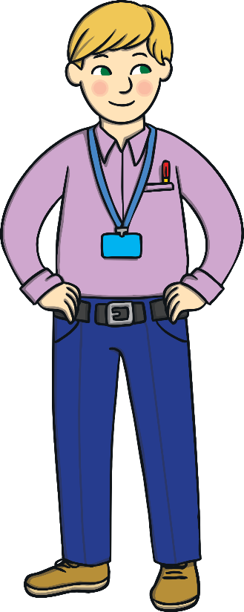
The Four Seasons
The teacher explained that this year, the children would be learning about seasons.
Our seasons are autumn, winter, summer and spring. Each season is very different.
This year, the children are going to look for changes in the weather and in the world around them. What do you think they will notice?
Their teacher gave them a special camera so the children could take pictures of all four seasons.

Slide 4
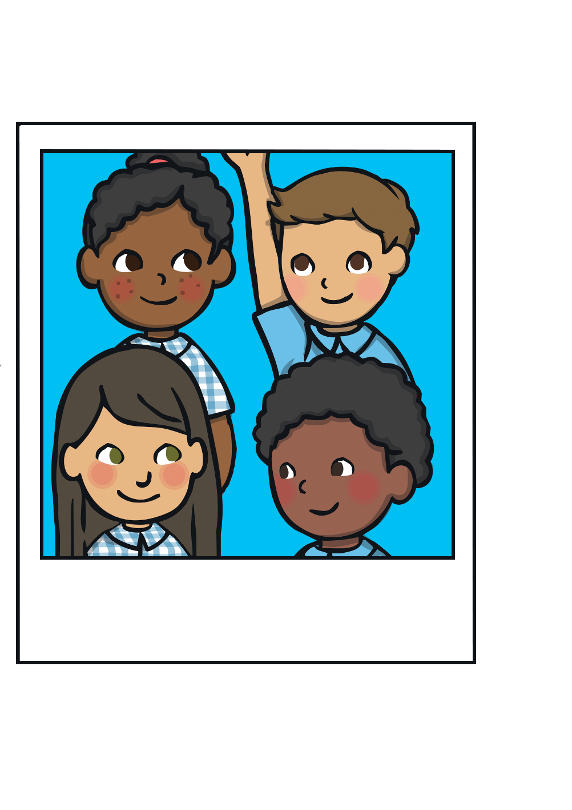
The Four Seasons
They took a picture together to celebrate starting school. They were very excited!

Slide 5
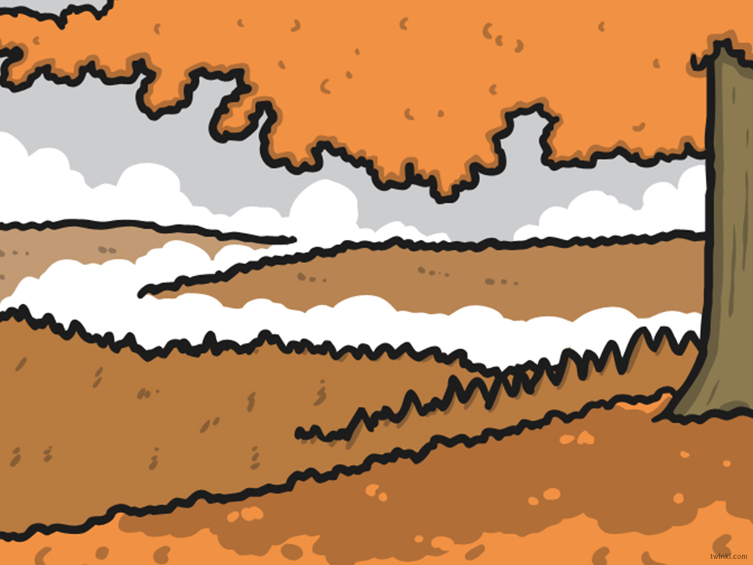
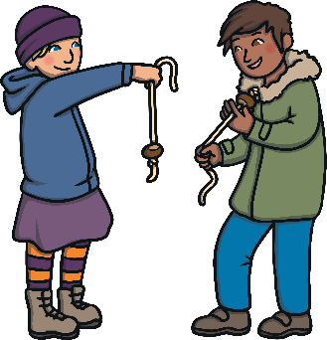
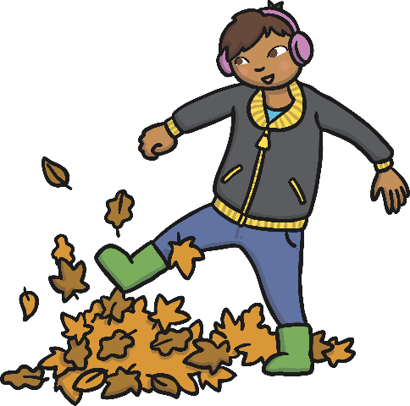
Autumn
As the weeks went by, the children started to notice changes.
The weather was getting colder and it got darker much earlier. The sun rose later on in the morning.
The children had a Harvest Festival at school to celebrate all of the food that had grown and been harvested.
I saw leaves falling from the trees. They had changed colour too!
I collected conkers on the way to school.

Slide 6
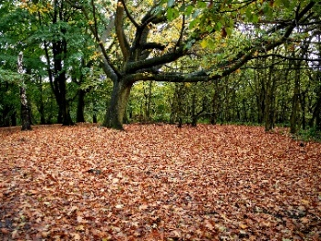
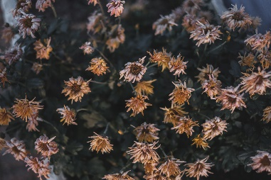
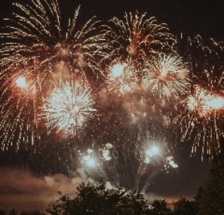
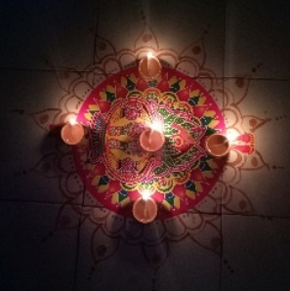
Here are some of the photos that the children took during the autumn.
They loved playing with the leaves that had fallen from the trees.
One of the children realised that some of the plants and flowers had died. Why do you think that happened?
In November, some of the children celebrated Bonfire Night and watched some fireworks in
the dark!
Some of the children celebrated Diwali. They decorated their homes with colourful rangoli patterns and special candles, called diva lamps.

Slide 7


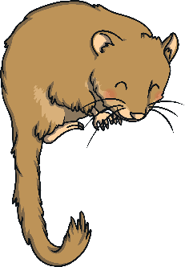
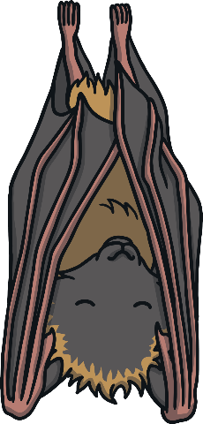
Autumn
In autumn, some animals hibernate. This means that they go into a very deep sleep until the spring. Click on the leaves to find the animals.
Why do you think these animals hibernate?
hedgehog
dormouse
bat

Slide 8
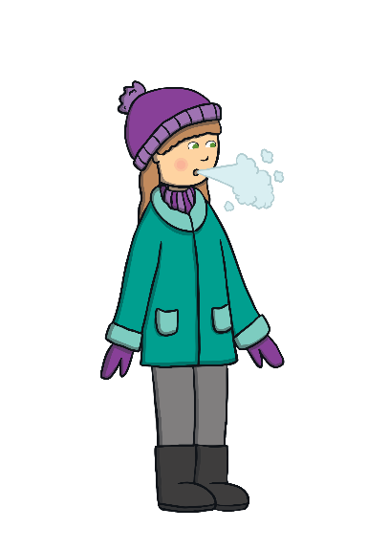
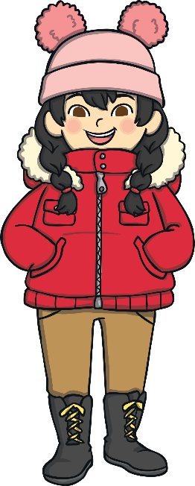
Winter
The next season was winter. It started getting dark very early.
The children could see that in winter, we have the least daylight. Lots of the trees lost their leaves and had bare branches.
Wow! I can see my breath in the air when I walk to school on frosty mornings.
I’m so cold, I have to wear my hat, scarf and gloves at playtime. They help to keep me warm.

Slide 9
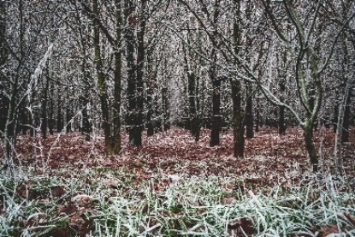
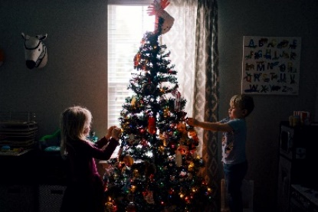
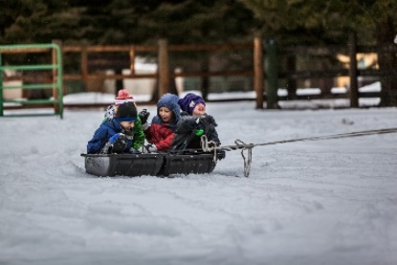
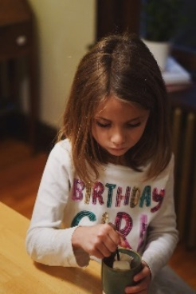
During the winter months, the children took these photos.
They saw frost on the ground and trees with no
leaves. How does frosty grass sound when you walk on it?
Lots of the children celebrated Christmas with their families. Some of them decorated a Christmas tree at home.
When it snowed, they went sledding with
their friends.
As a special treat, the children made delicious hot
chocolate to warm them up after a cold playtime.

Slide 10
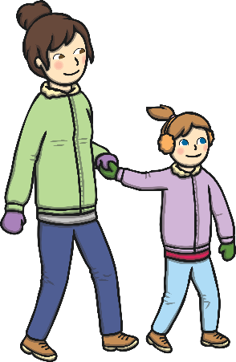




Winter
Sometimes, it snows in the winter. Evie wanted to build a snowman with her Mum. Which hat do you think she should wear?
Click on the hat that you think will keep Evie warm in winter.

Slide 11
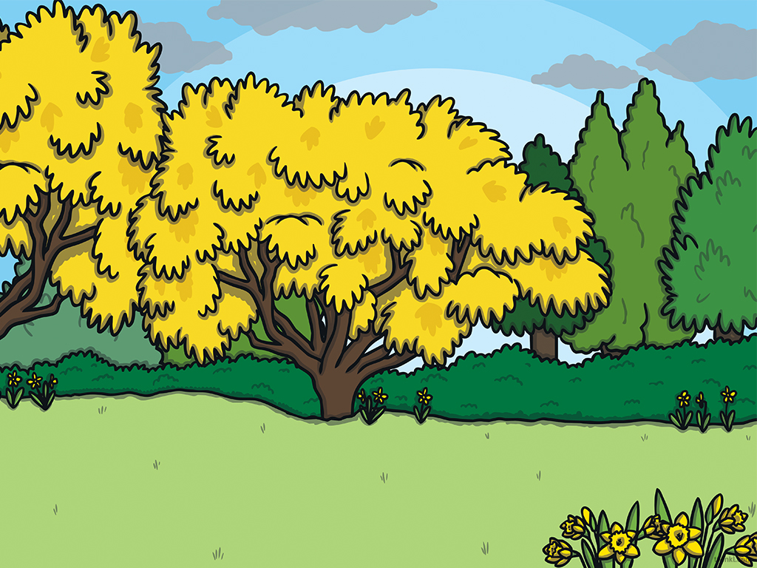
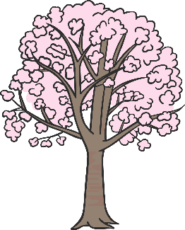
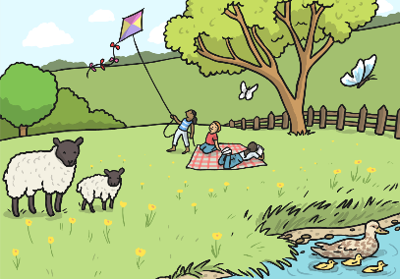
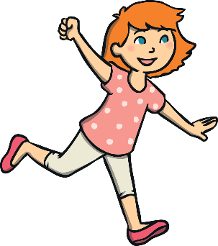
Spring
The season after winter is spring. The children noticed that the sun was rising earlier in the morning and it was starting to get dark later, so the evenings were lighter than in autumn and winter.
I love flying my kite on windy days!
I can see all of the blossom twirling and swirling in
the wind!

Slide 12
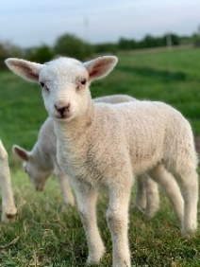
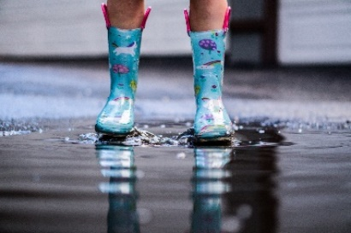
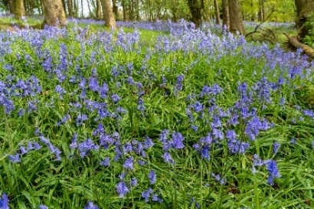
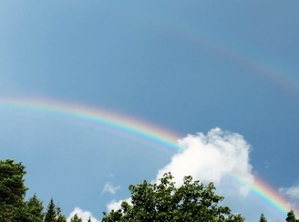
Here are some of the photos the children took in spring.
Lily went to the farm with her family. She took the school camera with her. She saw lambs, chicks, calves and foals.
The children wore their wellies so that they could splash in the puddles.
They spotted bluebells growing in the woods.
Do you know the names of any other spring flowers?
When they were playing outside, the sun was shining and it began to rain. The children spotted a rainbow.

Slide 13
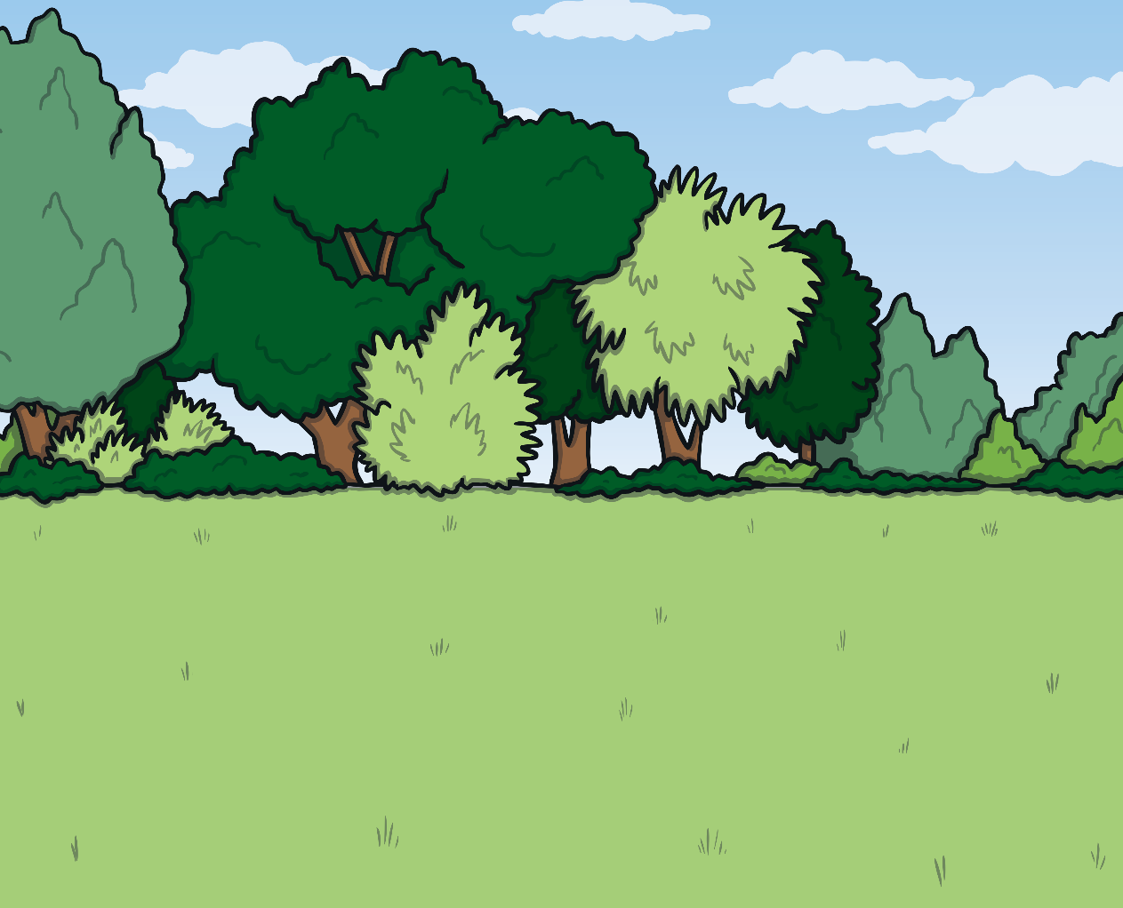
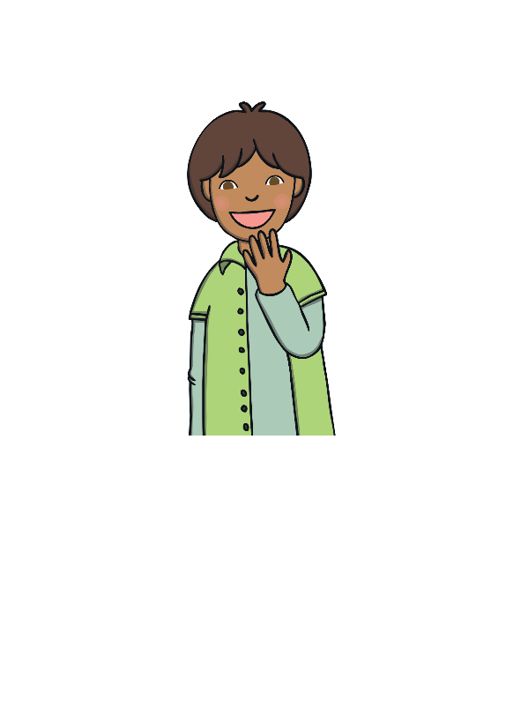

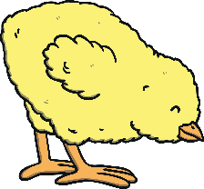


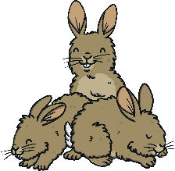

Spring
Lots of baby animals are born in spring. Can you help the children find the chicks?
We have lost some chicks! Click on the picture to help us find them.

Slide 14
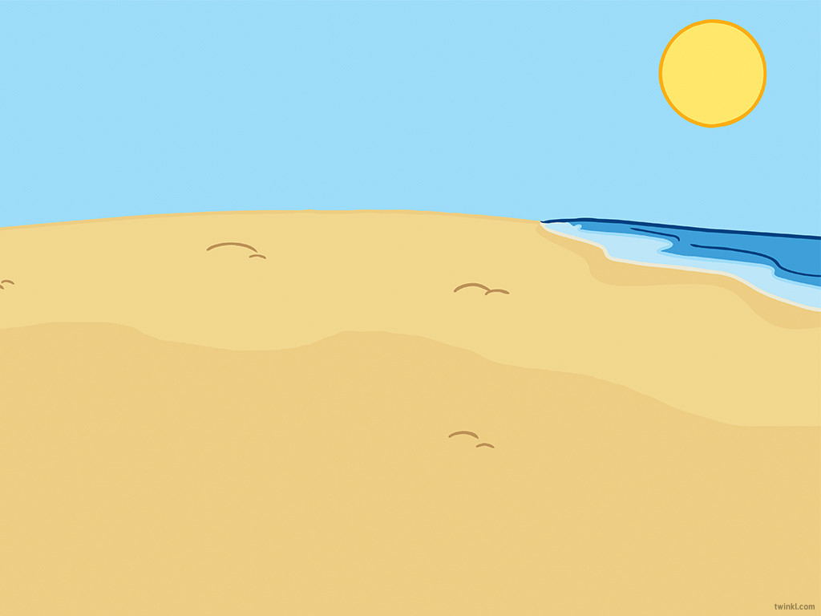
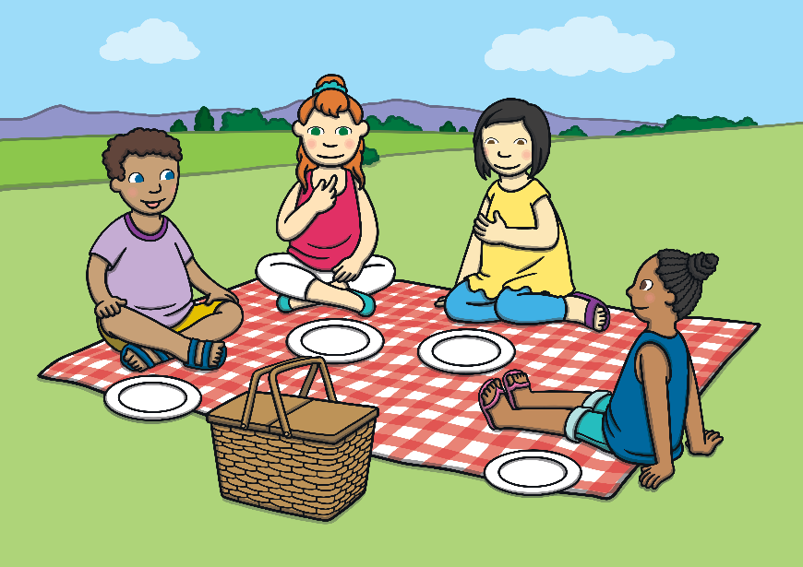
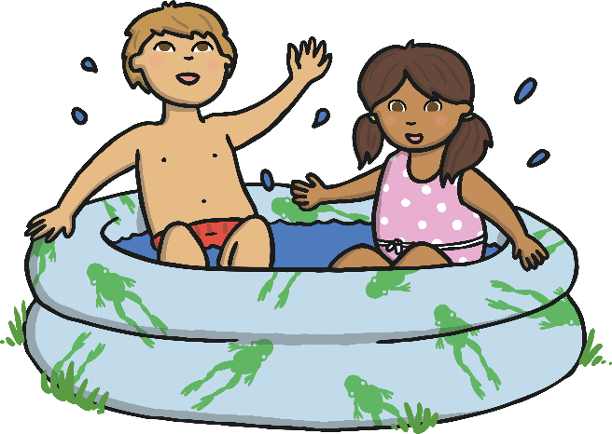
Summer
After spring, it is summer. It got dark very late and it was still light when the children went to bed.
The weather was much warmer, although not every day in summer was sunny!
We had a picnic in the park. It was really sunny and warm!
I kept cool in the paddling pool. I had to wear sun cream and drink lots of water too!

Slide 15
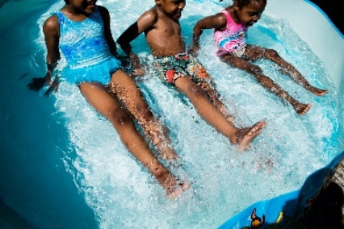
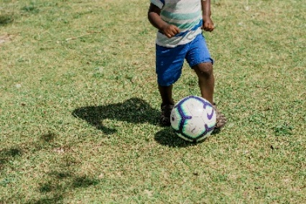
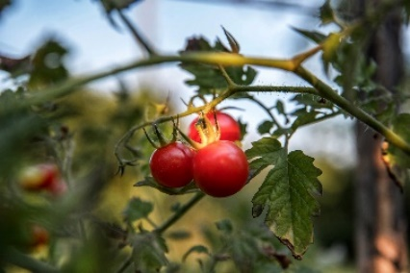
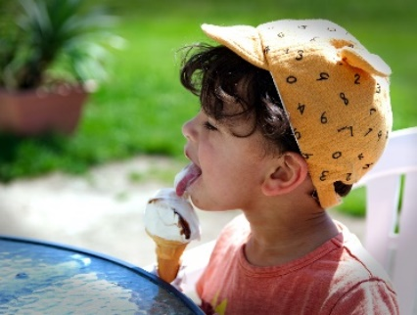
Here are some of the photos the children took in the summer.
One of the children played in the paddling pool with his sisters.
One played football at the park.
The children grew tomatoes at school. They
tasted delicious!
On sunny days, the children had ice cream as a special treat.

Slide 16
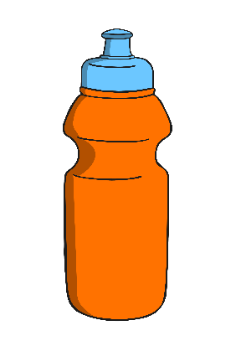
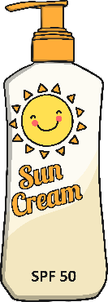

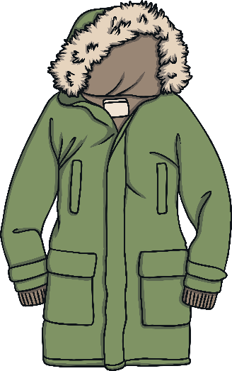
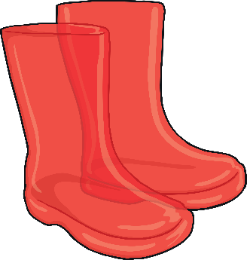

Summer
The children had Sports Day at school. They went outside to have races and play games. Can you click on the things they needed on a hot, summer’s day?

Slide 17
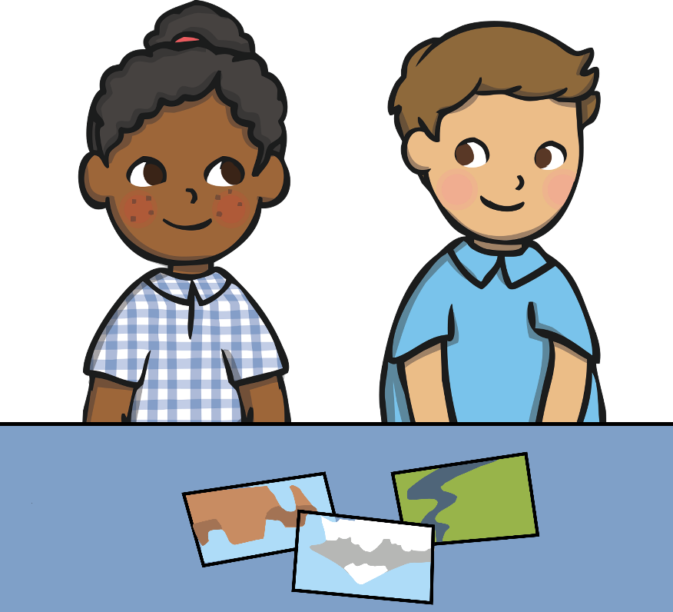
The Four Seasons
At the end of the year, the children and their teacher looked back at all of the photographs they took. They stuck them into a special book along with things that had they collected through the year.
Let’s stick these crunchy leaves onto the page about autumn.
I’m going to put the flag from my sandcastle on the summer page.
The children realised that the next season would be autumn again.

Slide 18
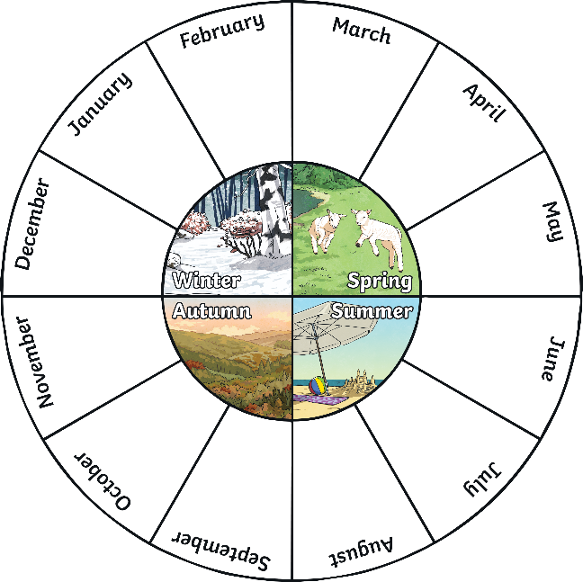
The Four Seasons
Which season is your favourite and why?
What happens in autumn?
Which season is the coldest?
What did the children see in spring?
How did the trees change through the year?

