Slide 1



Mrs Murphy’s

Slide 2
The Rules
Each round has 10 questions. The questions will appear on the board and only be read once.
At the end of the round, the winning team gets to choose the next category.
A tie break situation will be decided any way your teacher sees as fit.
No shouting out. This spoils the fun.
The teacher’s word is final.
See rule 5.

Slide 3
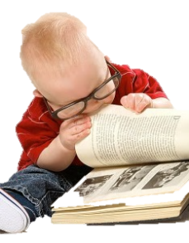
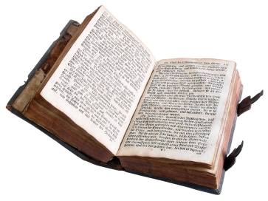

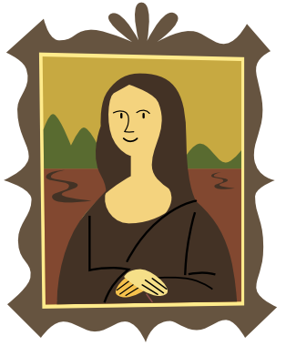
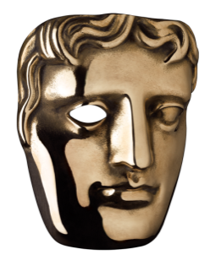
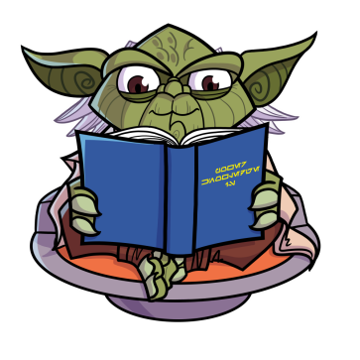
The Rounds
Click on the image for the round
Children’s
Classics
Lucky Dip
Picture Round
Film Adaptations
Fantasy and Sci-Fi

Slide 4
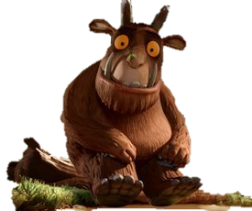
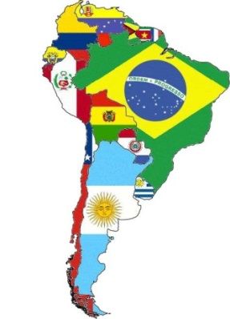
Children’s Literature
Eric Carle wrote about a very hungry insect. What was it?
What animal is the Gruffalo scared of?
Who wrote the Mr Men and Little Miss books?
Which South American country is Paddington Bear from?

Slide 5
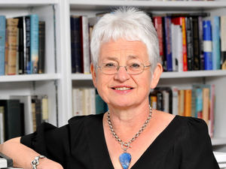
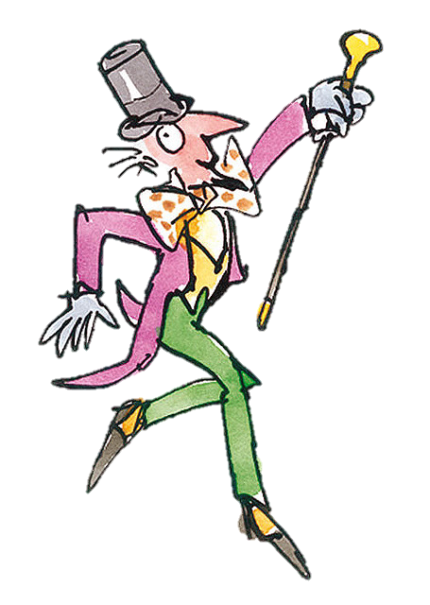
What kind of animal is Beatrix Potter’s ‘Jeremy Fisher’.
Who created Tracy Beaker?
In Roald Dahl’s ‘Charlie and the Chocolate Factory’, how many golden tickets were there?
Who wrote the Twilight series of novels?

Slide 6
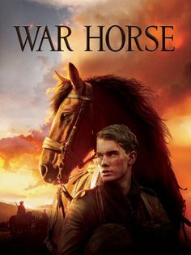
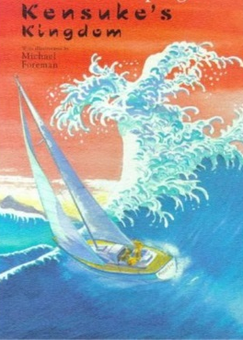
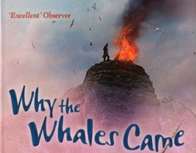

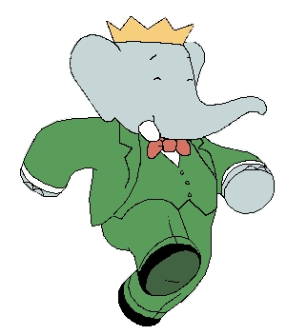
‘Warhorse’, ‘Kensuke’s Kingdom’ and ‘Why The Whales Came’ are all novels by which bestselling children’s author?
Jean de Brunhoff wrote a story about a very famous elephant, but what was its name?
Back to the category board.

Slide 7
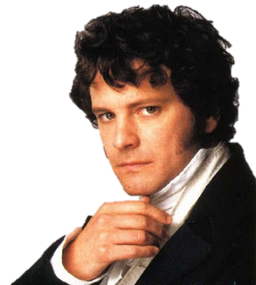
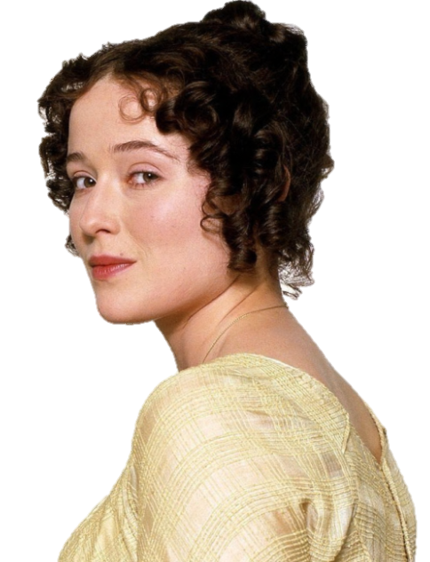
Classics
Who wrote ‘The Little Princess’?
What type of animal was Moby Dick?
Elizabeth Bennett and Mr Darcy are key characters in which Jane Austen novel?

Slide 8
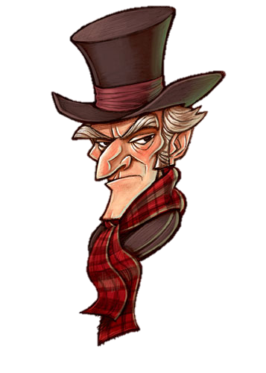
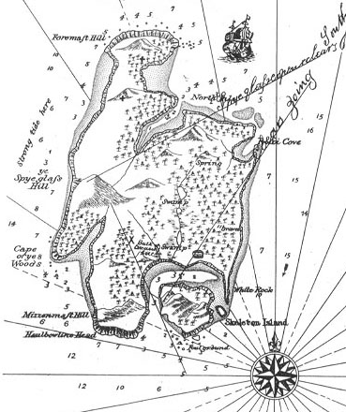
‘Oliver Twist’, ‘Nicholas Nickleby’ and ‘A Christmas Carol’, are all novels by which Victorian author?
‘Prospero’, ‘Miranda’, ‘Ariel’ and ‘Caliban’ are all characters from which Shakespeare play?
Who wrote ‘Treasure Island’?
What shape was the table in the story of King Arthur and his Knights?

Slide 9
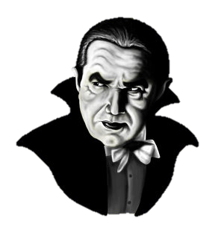
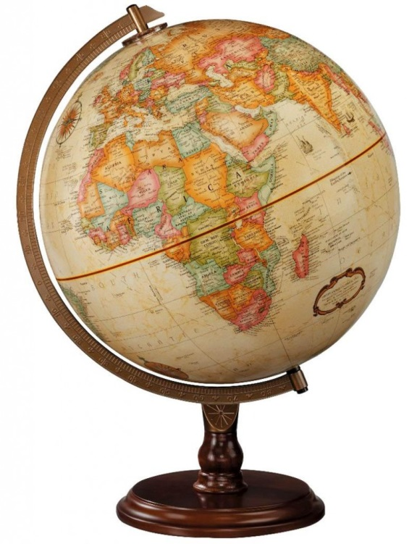
In Bram Stoker’s ‘Dracula’, what seaside town in Yorkshire is Dracula supposed to have visited?
Athos, Porthos and Aramis are better known as the three what?
What was Phileas Fogg challenged to do?
Back to the category board.

Slide 10

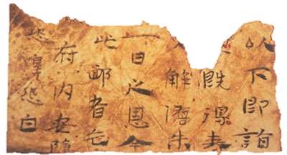
Lucky Dip
What is the most widely distributed, most translated and best selling book of all time?
Which ancient civilisation is believed to have invented paper?
According to the Forbes ‘Rich List’, which British writer is the richest author in the world?

Slide 11
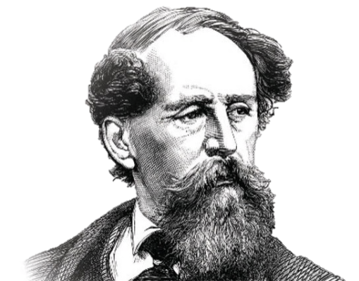
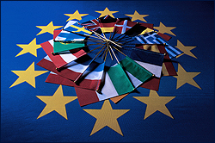
What was the profession of the man who invented Thomas the Tank? a) Vicar b) Teacher c)Politician
Charles Dickens was a writer in which period of history?
What was the first book series to be turned into Lego following its film success?
Which European country produces the most paper annually?

Slide 12

Who wrote the classic fiction ‘The Wonderful Wizard of Oz’?
Which famous Prime Minister won the Nobel Prize for Literature?
Which author is also a judge on Britain’s Got Talent?
Back to the category board.

Slide 13
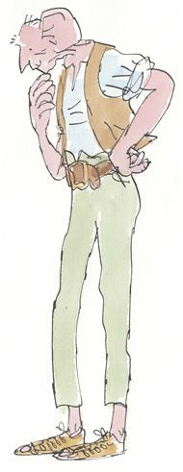
Picture Round
1. Name this character and the illustrator.

Slide 14
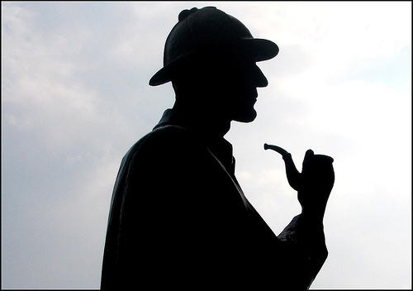
Picture Round
2. Name this character and his companion.

Slide 15
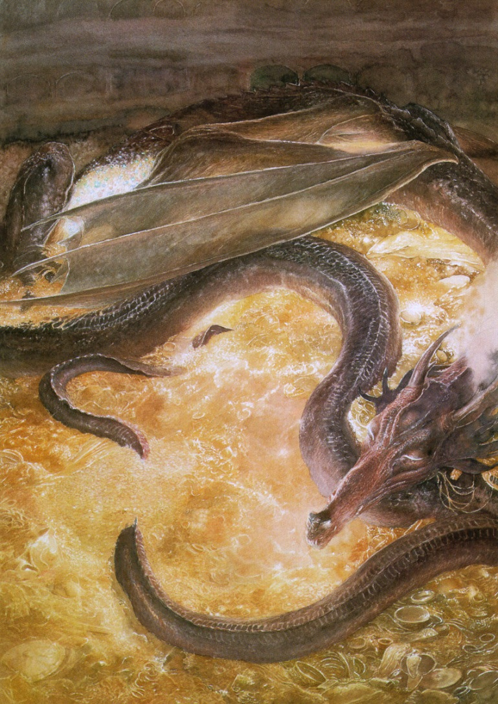
Picture Round
3. Name this dragon and the book that he is from.

Slide 16
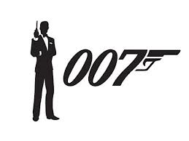
Picture Round
4. Name this spy and the author who created him.

Slide 17
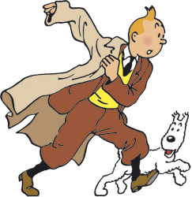
Picture Round
5. Name this reporter.

Slide 18
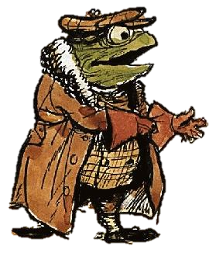
Picture Round
6. Name this character and the book that he is from.

Slide 19
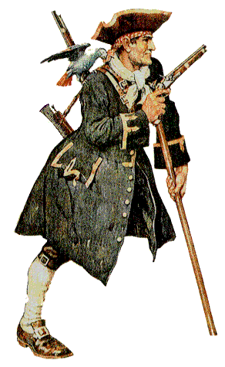
Picture Round
7. Name this pirate and the book that he is from.

Slide 20
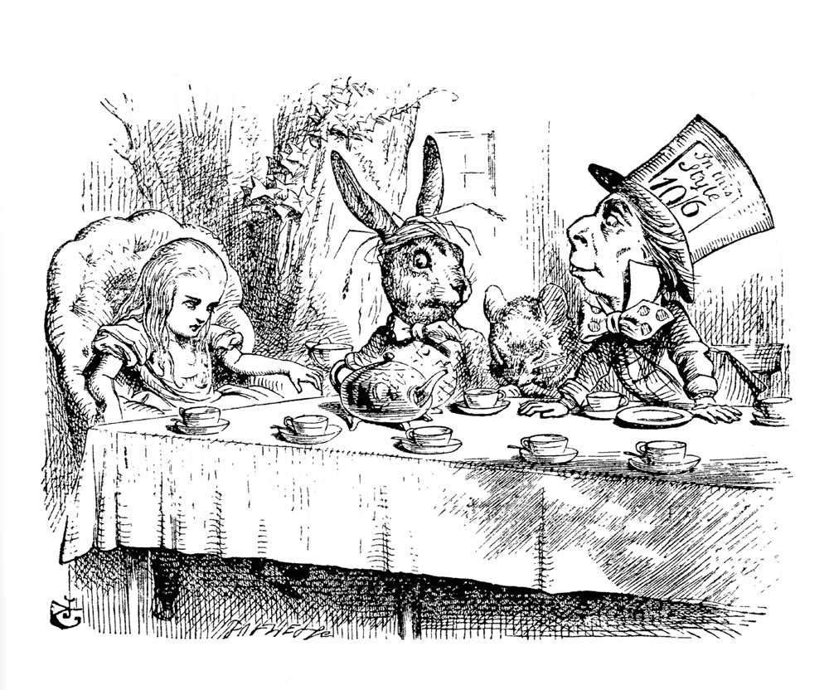
Picture Round
8. What is taking place and which book is it from.

Slide 21
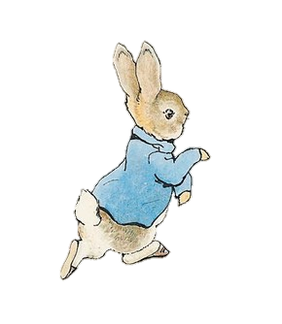
Picture Round
9. Name this rabbit and the author who created him.

Slide 22
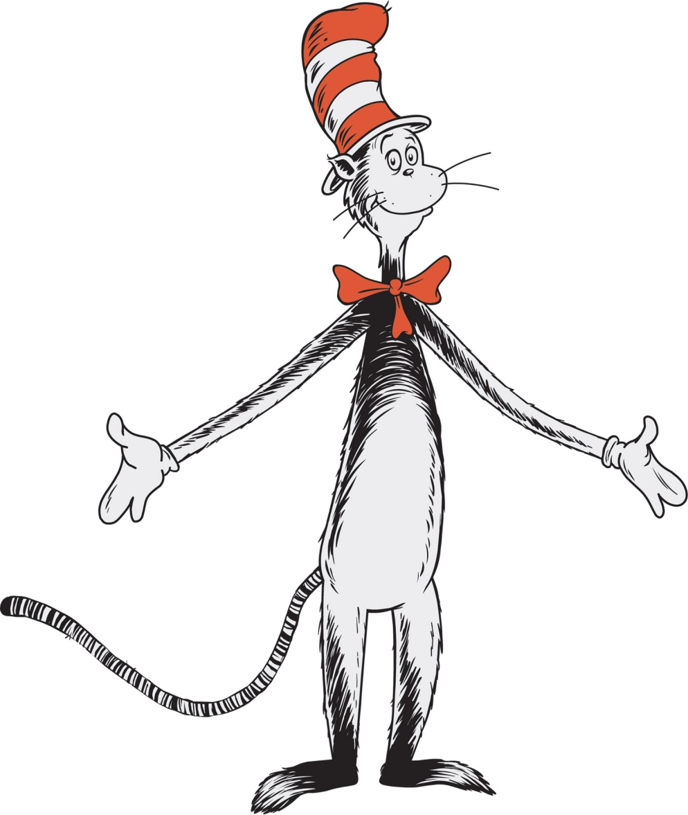
Picture Round
10. Name this character and the author of its book.
Back to the category board.

Slide 23
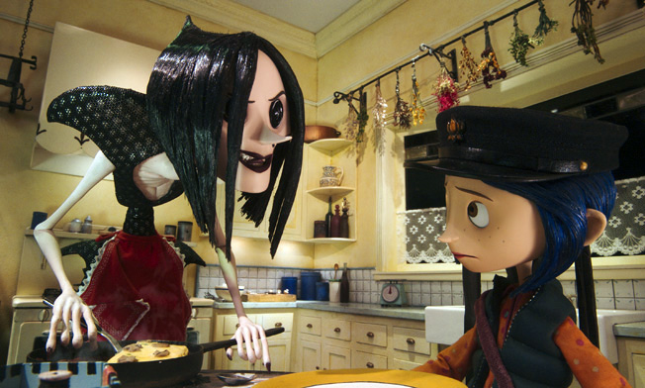
Film Adaptations
This is a scene from the film adaptation of which book?

Slide 24
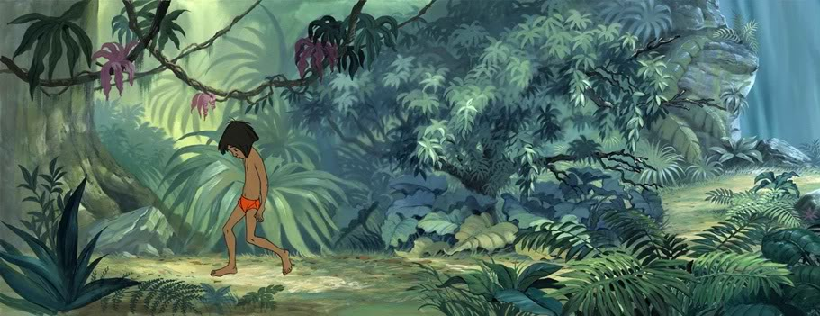
Film Adaptations
2. Mowgli ‘the man cub’ was a character in Disney’s adaptation of which classic novel?

Slide 25
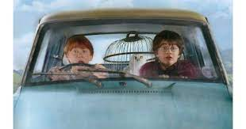
Film Adaptations
3. This scene from Harry Potter is from which Harry Potter book?

Slide 26
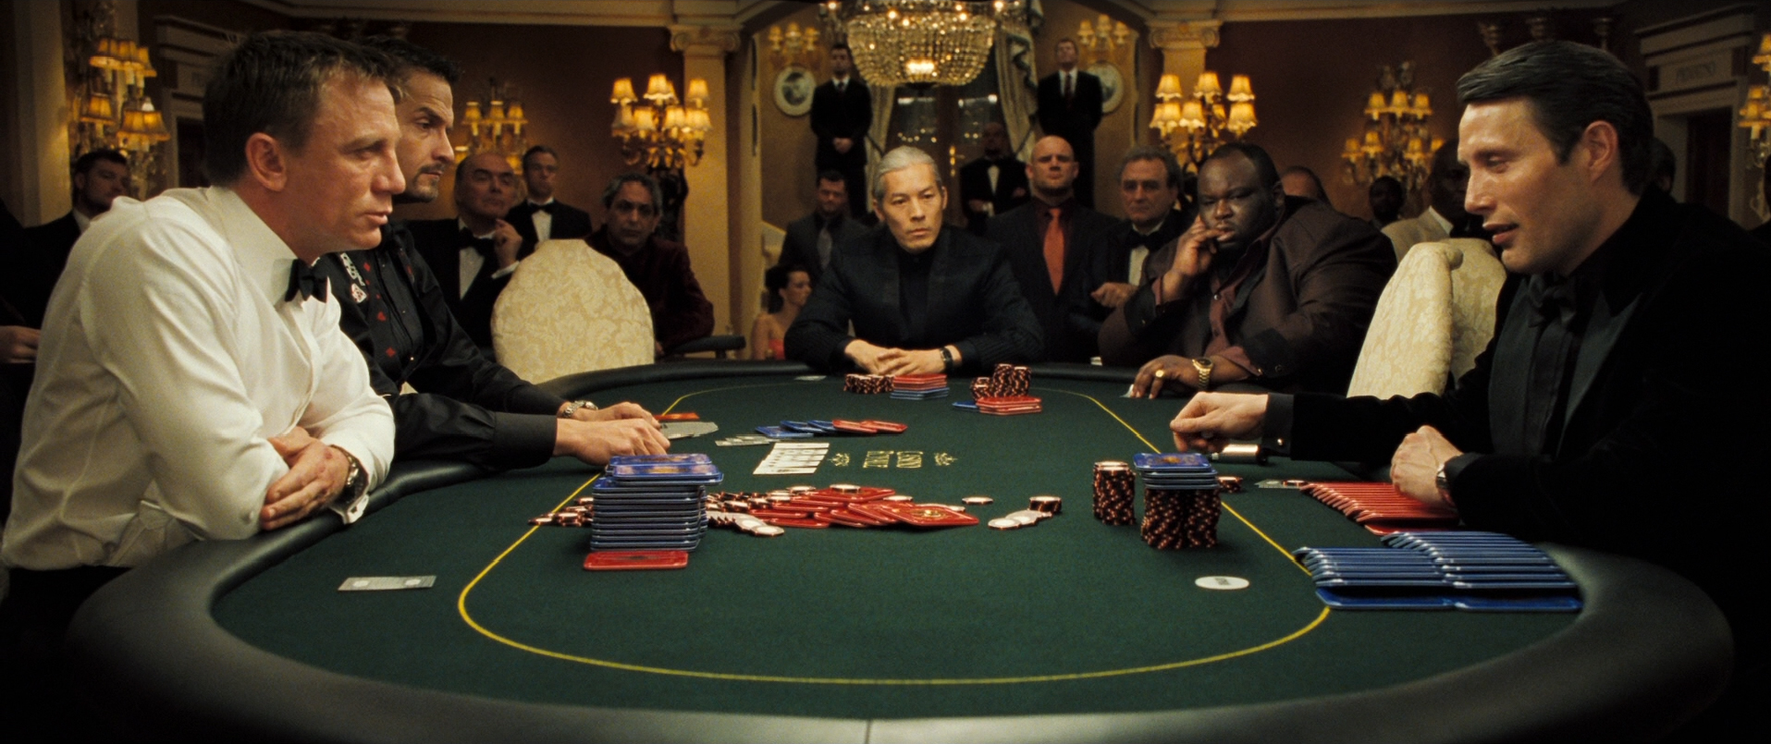
Film Adaptations
4. The first James Bond novel was turned into a film starring Daniel Craig but what was it called?

Slide 27
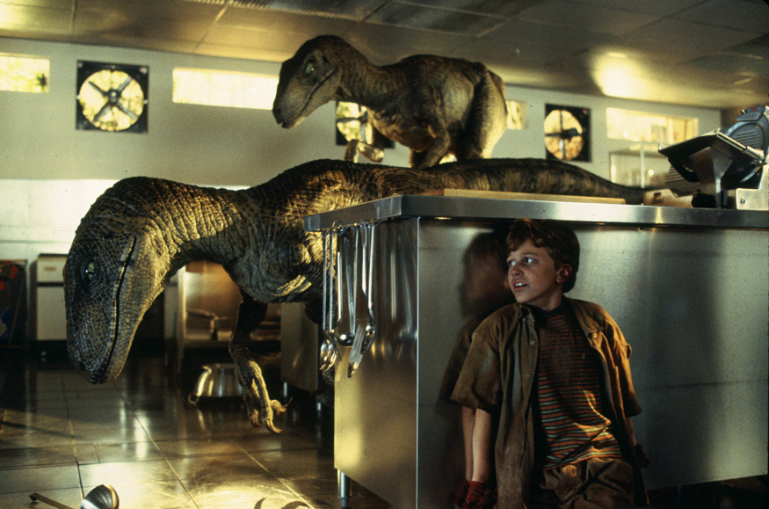
Film Adaptations
5. What 1990 novel by Michael Crichton was turned into a box office sensation by Steven Spielberg?

Slide 28
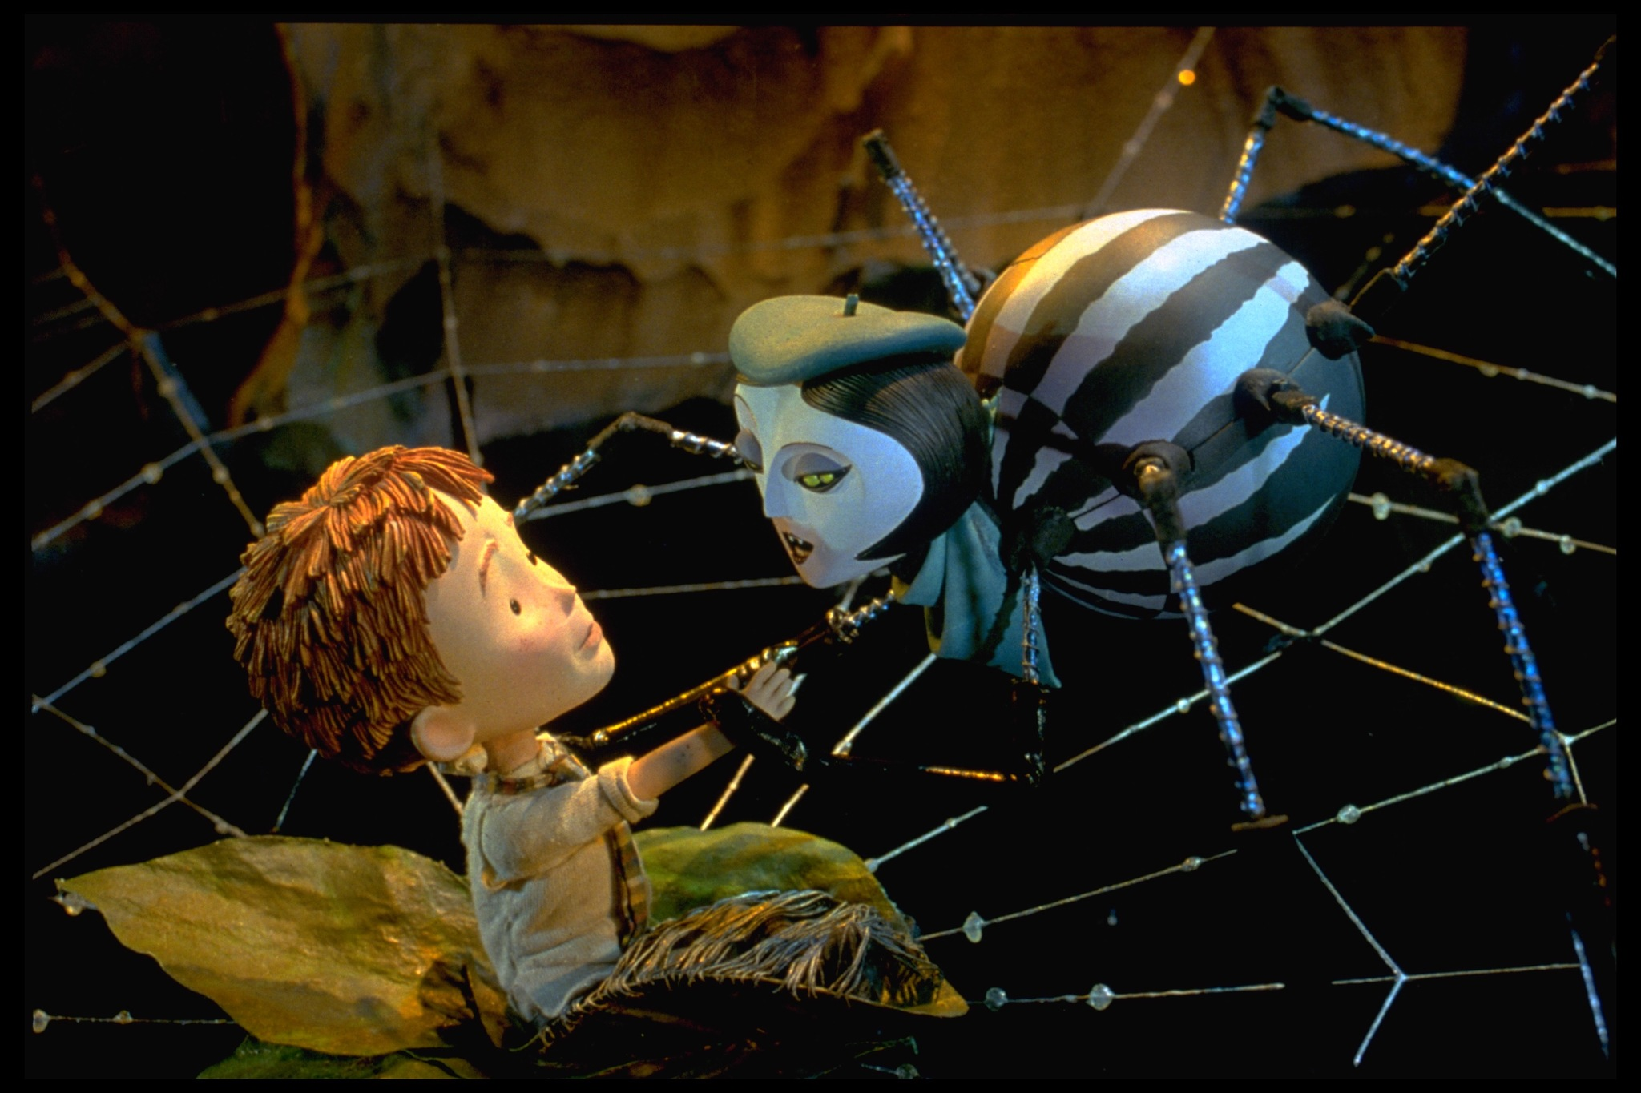
Film Adaptations
6. This scene is taken from film of which Roald Dahl book?

Slide 29
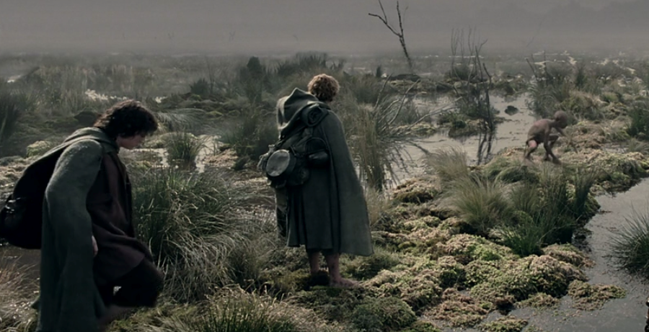
Film Adaptations
7. Which book in the ‘Lord of the Rings’ saga is this movie still taken from?

Slide 30
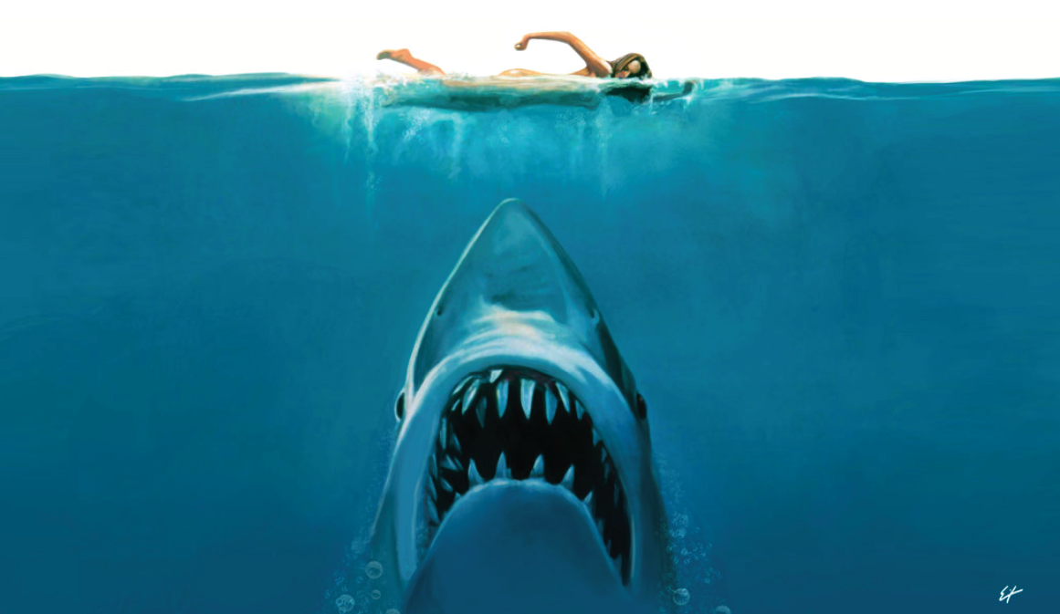
Film Adaptations
8. What was the novel that inspired this 1975 film?

Slide 31
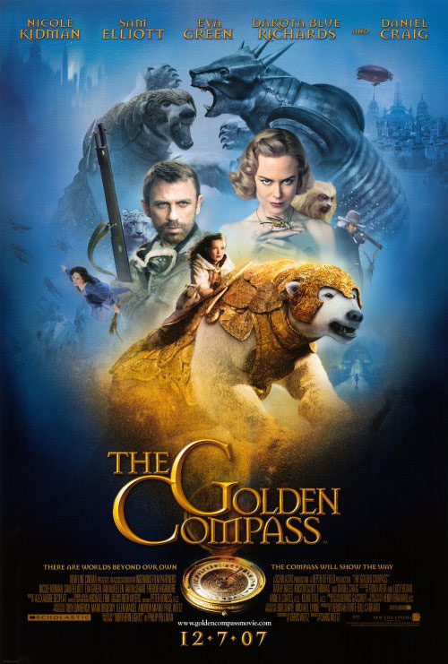
Film Adaptations
9. What was the name of the Phillip Pullman novel that was transformed into the fantasy film ‘The Golden Compass’?

Slide 32
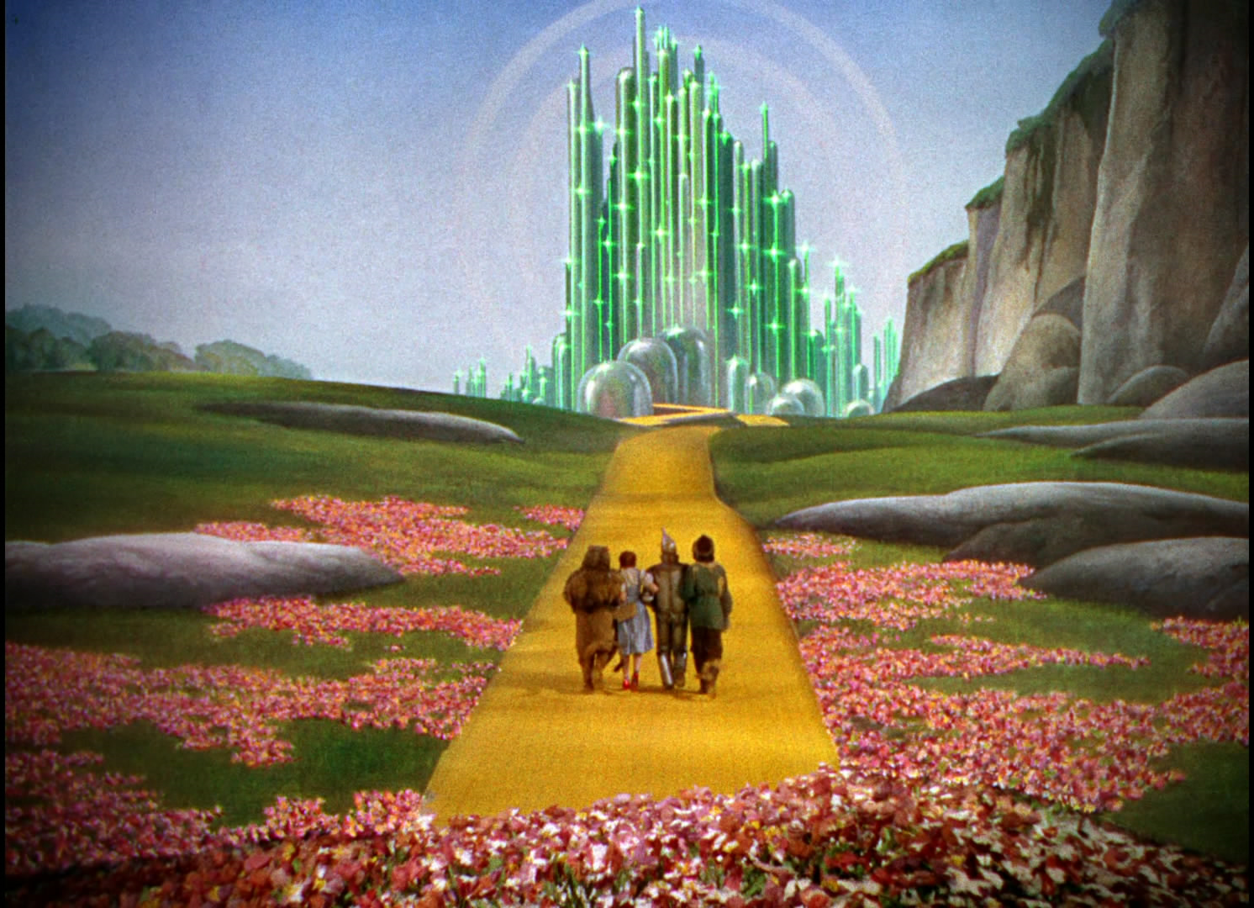
Film Adaptations
Back to the category board.
10. This famous film scene is taken from an adaptation of which novel?

Slide 33
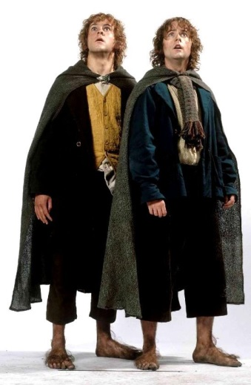
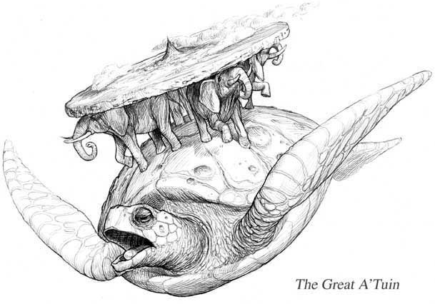
Fantasy and Sci-Fi
The hobbits Meriadoc Brandybuck and Peregrin Took are affectionately known as what?
Aslan is a character in which famous book series?
The Discworld is a world that was created by which famous author ?

Slide 34
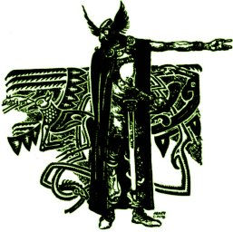
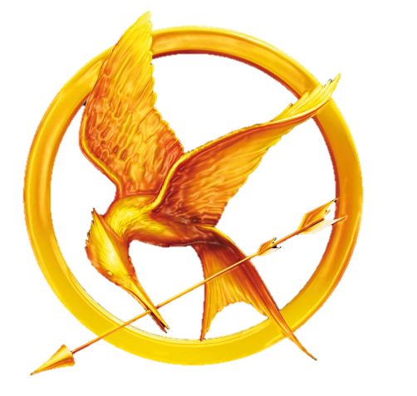
What is the name of the hero who slayed Grendel?
Tom Marvolo Riddle is the alter-ego of which evil wizard?
Suzanne Collins is the author of famous book series where children are selected to take part in a televised death match. What is it called?

Slide 35
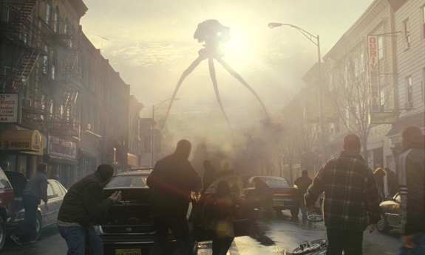
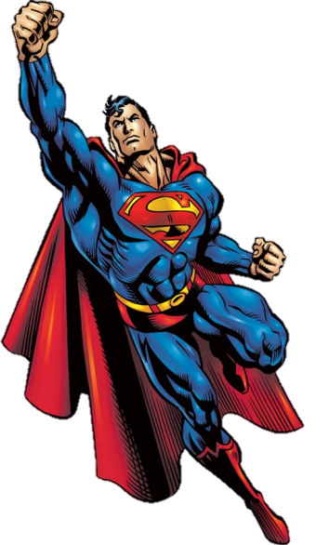
What is the name of Han Solo’s Wookie friend?
Tony Stark was a billionaire created by Marvel Comics, but what is the name of the superhero he became?
Tom Cruise and Dakota Fanning starred in a film adaptation of which H.G. Wells novel?
10. DC Comic’s Superman is an alien from which planet?
Back to the category board.

