Slide 1
Which factors affect an object's ability to float?
Science - Forces
Miss Hummel
Notes:
Hi everyone! My name is Miss Hummel and in this lesson we will be answering the question: Which factors affect an object's ability to float?

Slide 2
Think task:
Can you think of items which you know float?
How about some items which you know sink?

Slide 3
Think task:
Can you think of items which are very dense?
(These are items that may look small but are heavy!)
Can you think of some items which are not very dense? (These are items that look large but are actually light!)

Slide 4
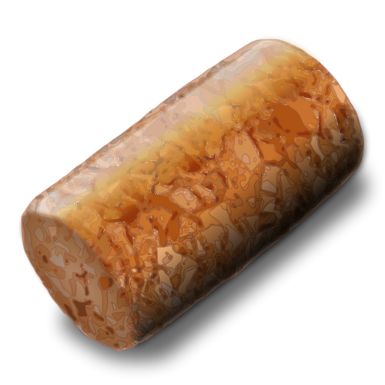
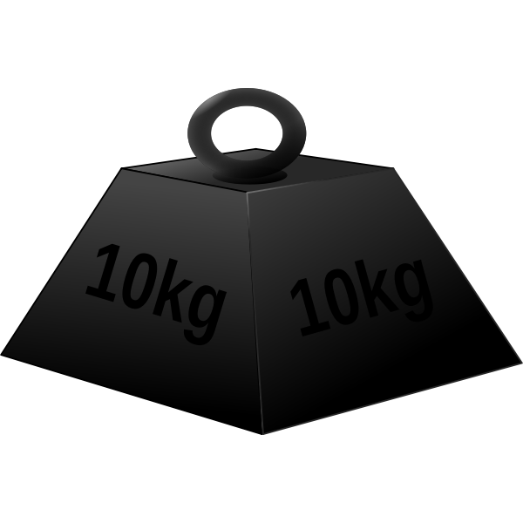
Explain why the cork is floating and the metal is sinking.
🥛
Activity:
Free SVG

Slide 5
Activity:
Object | Prediction – will it float or sink? | Explanation – say why you think this. | Were you correct?
Coin |  | I think this is because...
Paperclip
Small piece of paper
Blue tack
Pencil

