Slide 1
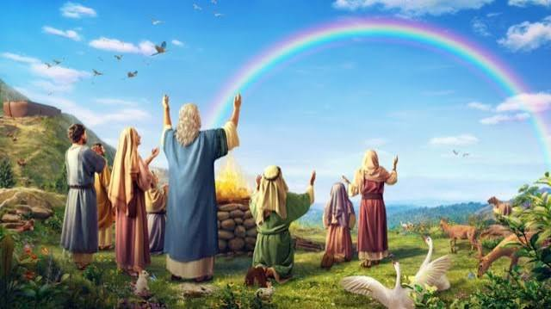

R.E.(Y2) –Creation and Covenant
Prior Knowledge
The story of Creation is a form of prayer and poetry about God’s world.
Everything comes from God who made heaven and earth.
God is seen in the world through its beauty.
We are called to look after God’s world and each other. (CST)
The world is everyone’s home.
The Pope wrote a special letter ‘Laudato Si’ about looking after the world.
Prayers are a way of getting closer to God.
To know the Our Father and the first lines of the Creed.
Key Vocabulary
Baptism | a sacrament which welcomes someone into God’s family
Bible | a special holy book that teaches people about God, His love, and how to live a good life
Catholic Social Teaching | a guide to show how to put Jesus's message of love, fairness, and peace into action in our world
Covenant | a sacred promise made between God and His people
Psalm | a holy song, poem or prayer written to praise God
Sacrament | a special, holy ceremony in the Christian church that acts as a visible sign of God's invisible love and grace
Sin | when we do something wrong which hurts others and God
Stewardship | looking after the world and each other
Key Knowledge
The Bible is in two parts called the Old and the New Testaments.
God gave people the responsibility to look after the world and each other-this is called stewardship.
To know of ways in which we can care for the earth.
God made a promise with Noah. Noah answered God’s call.
The rainbow is a sign of God’s promise.
Baptism is a sign of Jesus’ love.
Baptism welcomes us into the Christian family.
“God saw everything that he had made and indeed it was very good.” Gen 1:31

