Slide 1

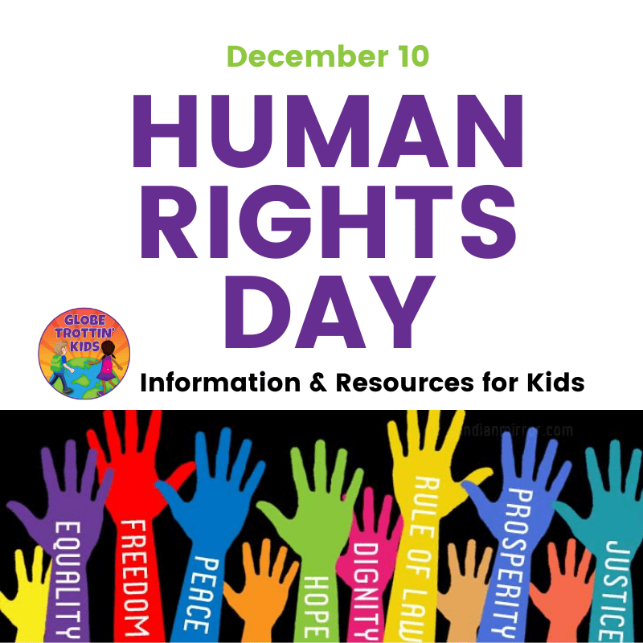
R.E.(Y3) –Creation and Covenant
Prior Knowledge
The Bible is in two parts called the Old and the New Testaments.
God gave people the responsibility to look after the world and each other-this is called stewardship.
To know of ways in which we can care for the earth.
God made a promise with Noah. Noah answered God’s call.
The rainbow is a sign of God’s promise.
Baptism is a sign of Jesus’ love.
Baptism welcomes us into the Christian family.
“Give thanks to the Lord, for he is good;
his love endures forever...” Psalm 107:1
Key Vocabulary
Creator | God made heaven and earth, He created all life within the world
Equality | everyone should be treated in the same way with respect and love
Genesis | the first book of the Bible which contains the Creation Story
Human Dignity | every single person has value, deserves to be respected, and should be treated fairly just because they are human
Image and Likeness | to be like God in what we do and say; to show God’s love and kindness to others
Laudato Si | a special letter written by Pope Francis asking us to look after the world
Key Knowledge
Humans are made in the image and likeness of God.
To recognise the poetic language used in the Creation Story to describe how the world was formed.
In the Creation Story humans are created equal.
To use the words of a psalm or prayer to illustrate how it describes the praise of creation.
Pope Francis asked everyone to have a loving relationship with God, everyone and the world.
Catholic Social Teaching helps us to think about human dignity.

