Slide 1
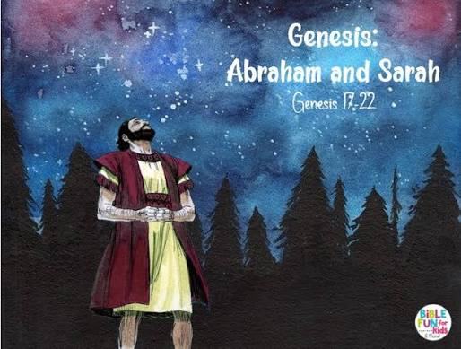

R.E.(Y4) –Creation and Covenant
Prior Knowledge
Humans are made in the image and likeness of God.
To recognise the poetic language used in the Creation Story to describe how the world was formed.
In the Creation Story humans are created equal.
To use the words of a psalm or prayer to illustrate how it describes the praise of creation.
Pope Francis asked everyone to have a loving relationship with God, everyone and the world.
Catholic Social Teaching helps us to think about human dignity.
Key Vocabulary
Covenant | a promise made between God and His people
Faith | belief or trust in someone or something
Forgiveness | choosing to let go of angry or hurt feelings when someone makes a mistake or treats you badly
Hope | wanting something good to happen and believing that it might come true
Love | strong feelings of emotions for someone else
Virtue | a way of acting that is right, kind, and helpful to others
Key Knowledge
Abraham’s covenant with God strengthened the Israelites.
To understand the family tree between Abraham and Joseph.
Abraham’s and Joseph’s decisions were based on their faith, hope and love in God.
Abraham’s covenant with God links Judaism and Christianity through the Old and New Testaments.
Faith, hope and love are virtues which guide our lives and show others God’s love.
Prayers are a way of showing our love and trust in God.
“ God said, ‘I am making you the ancestor of many nations. I will give you many descendants, and some of them will be kings. You will have so many descendants that they will become nations.’” Gen 17:5-6

