Slide 1
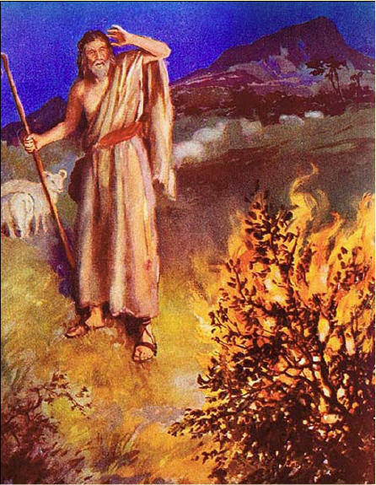

R.E.(Y5) –Creation and Covenant
Prior Knowledge
Abraham’s covenant with God strengthened the Israelites.
To understand the family tree between Abraham and Joseph.
Abraham’s and Joseph’s decisions were based on their faith, hope and love in God.
Abraham’s covenant with God links Judaism and Christianity through the Old and New Testaments.
Faith, hope and love are virtues which guide our lives and show others God’s love.
Prayers are a way of showing our love and trust in God.
Key Vocabulary
Covenant | a sacred promise between God and His people
Exodus | the second book in the Old Testament where the Israelites are enslaved and freed
Grace | God gives us His love, kindness, and forgiveness as a free gift
Mt Sinai | the mountain where Moses received the Ten Commandments
Summary | a short account of a longer text
The Ten Commandments | a set of rules which help people lead good lives
Virtue | a way of acting that is right, kind, and helpful to others
Key Knowledge
God made covenants with several leading Biblical characters-Noah, Abraham and Moses.
God appeared to Moses as a burning bush and made a covenant with him that He would lead them to freedom.
God made two covenants with Abraham.
The Ten Commandments given to Moses on Mt Sinai and are the basis for many laws-this is known as the Sinai Covenant.
The Ten Commandments and Jesus’ summary of the law guide people in leading good and happy lives.
Virtues are good habits which help people to lead good lives.
‘Moses replied, “Don't be afraid; God has only come to test you and make you keep on obeying him, so that you will not sin.”’ (Ex 20:20) .

