Slide 1
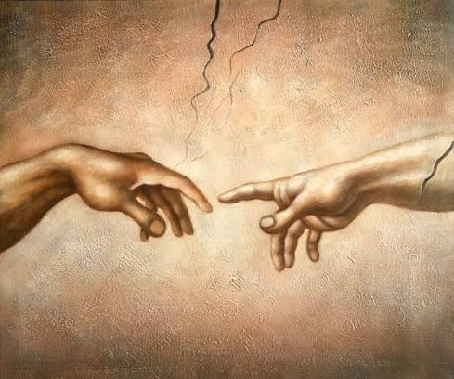

R.E.(Y6) –Creation and Covenant
Prior Knowledge
God made covenants with several leading Biblical characters-Noah, Abraham and Moses.
God appeared to Moses as a burning bush and made a covenant with him that He would lead them to freedom.
God made two covenants with Abraham.
The Ten Commandments given to Moses on Mt Sinai are the basis for many laws-this is the Sinai Covenant.
The Ten Commandments and Jesus’ summary of the law guide people in leading good and happy lives.
Virtues are good habits which help people to lead good lives.
Key Vocabulary
Adamah (Adam) | Hebrew word for earth,dirt, dust
Creation | the story of how heaven and earth were created
Eden | the garden where Adam and Eve lived with all creation
Evolution | how living things adapt and change over many generations.
Fall (the) | when Adam and Eve sinned and fell from God’s grace
Nicene Creed | a summary of Christian beliefs said in church
Original Sin | the first sin (wrong doing) committed by Adam and Eve
Salvation History | God's plan to save mankind from sin and lift the human family to the glory of Heaven
Stewardship | responsibility to look after the world
Key Knowledge
The work of Lemaitre/Mendel is key in understanding the beginnings of creation.
Many scientists do not see any conflict between their work and their faith.
The Biblical story of Creation is a figurative narrative using metaphor and symbolic language.
The second Creation story tells us that God breathed life into humans.
God created humans to look after the world and were called to be stewards.
Christian belief about original sin is linked to Adam and Eve in Genesis 2.
Christian belief acknowledges that sin damages the relationship with God, each other and the world.
Laudato Si is a call for all humans to respond to climate change.
Through Jesus a new covenant is made and the relationship with God is restored.
The Nicene Creed is a summary of Christian beliefs.
Baptism frees us from original sin and unites us in God’s family.
“Then the Lord God took some soil from the ground and formed a man out of it; he breathed life-giving breath into his nostrils and the man began to live.” Gen 2:7

Slide 2
o

