Slide 1
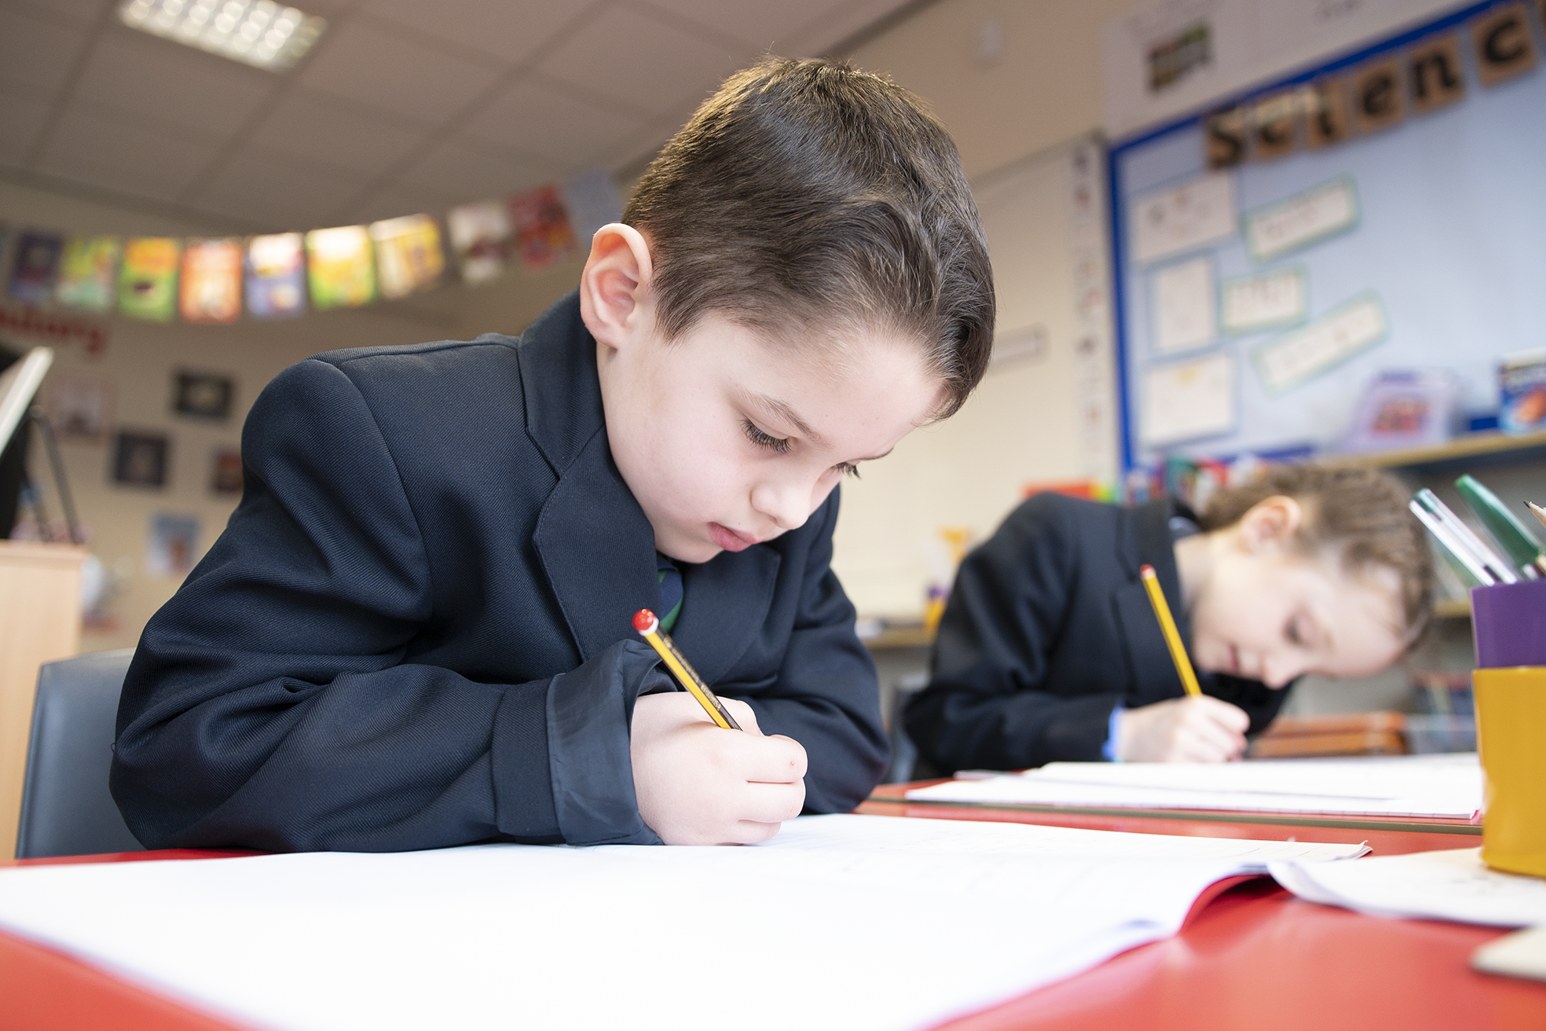
CURRICULUM: ART
Our Lady and St Thomas
Catholic Primary School
Christ at the Centre, Children at the Heart

Slide 2
CURRICULUM NARRATIVE
Posters
Human Form
Cityscapes
Cubism
Transient Sculptures
Portraits
Illuminated Letters and Patterns
Clay Tiles
Printing Patterns
Patterns in Nature
Flower Sculptures
Use of Line
2D to 3D Still Life
Masks
Pop Art
Shapes – Kandinsky/
Delaunay
Paper Sculptures
Observational Drawing
Expressive Arts and Design: In the EYFS children begin to use and explore a variety of
materials,tools and techniques such as paint, play doh, collage etc. They begin to
experiment with colour, design, texture, form and function linked to their interests,
and learn to mark make in different ways.
Drawing
Sculpture
Painting
Christ at the Centre, Children at the Heart

Slide 3
CURRICULUM NARRATIVE
Within our Art and Design curriculum, there are 4 key elements, which, when combined, ensure that our pupils can access a deep understanding of the subject. These Threshold Concepts are: Developing, Experimenting, Recording and Presenting.
Why do artists read?
For inspiration To find out specific information about products (materials, processes etc). To learn about the history of art. To help develop their own creative skills.
Write like an artist
Annotating - Children will be encouraged to annotate their work using stem sentences relating to likes, dislikes, techniques and materials they have used. They will evaluate their work, commenting upon how they could develop it further. Vocabulary – Children will use subject specific language to describe the processes they are using. They will become familiar with the names of prominent artists and their style of work. Asking questions – Answer key questions relating to Art History. For example: What attracts you to this work? What is it about the work that keeps you looking?
Threshold Concepts
 | Developing Children will develop ideas and inspiration through exploring other artists work and the natural world. Experimenting Children will experiment with different skills and techniques to further their learning and understanding. Recording Children will learn to record in a variety of ways. Presenting Children will use their sketchbooks to present their work, showing a clear understanding of concepts, skills and techniques.
In order to equip children with a breadth and depth of knowledge, the curriculum embeds these threshold concepts through the completion of three projects/units in each year group:
every year group will start with a drawing unit
each painting unit will start with a colour study
each class in a key stage will explore printing or collage as part of a drawing or painting unit.
Children will also be taught the formal elements in art and design which will develop and progress throughout each year. The formal elements are the parts used to make a piece of artwork. The formal elements are:
Line
Shape
Space
Form
Tone
Texture
Pattern
Colour
Composition.
They are often used together, and how they are organised in a piece of art determines what the finished piece will look like.
Christ at the Centre, Children at the Heart

Slide 4
CURRICULUM NARRATIVE
Progression through the Threshold Concepts
Developing
Children will develop ideas through investigations, demonstrating critical understanding of sources. They will be encouraged to explore materials and techniques and in doing so, develop ideas. Children will be encouraged to take chances and learn from them. They will learn to demonstrate a critical understanding of sources e.g. looking at nature, looking at trees, natural textures and rock formation. They will also look at different artists and explore their work by producing work that is inspired by them.
Experimenting
Children will be encouraged to develop their ideas further. Children will experiment with a range of different materials and techniques. Children will have evidence in their sketchbooks that they have explored a broad range of different techniques and materials and should begin to analyse how well each one works. Children will develop note taking skills called annotation in their sketchbooks.
Recording
Recording can be done in lots of different ways. Children will be encouraged to explore as many ways of recording as possible. Children are recording whenever they respond to an image or object through whatever material they happen to be using. Progression will be seen in sketchbooks as they develop their skills and techniques as an artist.
Presenting
Children will connect all of their experimentations together and show that they can make informed choices along the way in their sketchbooks. Their work will show that they have a clear understanding of what they have done and why. They will have had the opportunities to experiment with different techniques and materials in their sketchbook and will use these to inform their final piece to end each project. This means that they will ‘present’ their personal response meaning they’ve developed their own, original artwork by taking inspiration from artists. Children’s sketchbooks will show clear links between ideas and formal elements.
Formal Elements:
Line | Shape |  | Space |  | Form |  | Tone
Children will learn how to use lines in different ways to create multiple effects. | Children will develop their understanding of how to use shapes in different ways and that a shape is flat, and created by a closed line. |  | Children will begin to understand that space is the area around or between objects. Space includes the background, foreground, and middle ground. A space can be negative or positive. |  | Children will learn that form is a three dimensional shape. It may be a regular shape, such as a cube or pyramid, or an irregular, organic shape. |  | Children will know that the tone of something refers to how light or dark it is. Areas with lots of light are called highlights, and darker areas are called shadows. There are a range of tones in between. Shading can be used to create different tones in a drawing.
Texture |  | Pattern |  | Colour |  | Composition
Children will learn that texture refers to the surface quality of something, and the way it feels. Children will develop their understanding of actual texture through collage and sculpture, and visual texture through drawing painting and printmaking. |  | Children will begin to understand that a pattern uses a repeated design or a motif, created using line, shape, or tone. The design can be simple or complex. Some patterns are manmade and some are natural. |  | Children will learn about primary, secondary and tertiary colours through colour mixing and use of a colour wheel. Each painting unit starts with a colour study. |  | The children will begin to understand how the composition of a piece of art can draw the view to the work of art. They will experiment with different compositions.
Christ at the Centre, Children at the Heart

Slide 5
CURRICULUM NARRATIVE
Intent
Our Art and Design Curriculum has been designed through collaborative work with primary subject leaders and KS3 specialists. The curriculum narrative has been carefully planned to develop a child’s early creative experiences and build upon them each year, enabling them to express themselves in a practical and inspiring way. Through learning about a wide range of art and crafts, from various cultures, we hope to not only develop the children’s passion and love of the subject but also build a respect, natural inquisitiveness and an appreciation of art in all its forms which they may carry with them throughout their lives. Art and Design stimulates imagination and creativity; involving children in a range of visual, tactile and sensory experiences, which enable them to communicate what they see, think and feel in a range of ways, regardless of their ability; it promotes careful observation and an appreciation of the world around us. Through learning about the roles and functions of art, children can explore the impact it has had on contemporary life and on different periods and cultures.
Implementation
Our long term plan provides a rich and inspiring curriculum for all children from EYFS to year 6. Our creative curriculum allows for art to be placed into context along with key events, people and places and allows them to understand the effect artwork and artists have had on historical situations. Basic skills are introduced and then built upon, including drawing, printmaking, collage, painting and making. Skills are revisited and the use of ongoing sketchbook work underpins this process. We believe the role of the teacher is to introduce key skills, materials and ideas to the pupils in such a way that each pupil can then explore his or her own creativity. By creating a safe and nurturing environment, pupils are encouraged to take creative risks and to learn from the journey. The resources and experiences provided are suitable for pupils of all abilities, and enable every child to really delve into their creativity.
Our curriculum also takes into account the National Curriculum expectations for art and design. This ensures that all pupils:
• produce creative work, exploring their ideas and recording their experiences
• become proficient in drawing, painting, sculpture and other art, craft and design techniques
• evaluate and analyse creative works using the language of art, craft and design
• know about great artists, craft makers and designers, and understand the historical and cultural development of their art forms.
Our curriculum toolkits and resources promote a diverse range of creative teaching from EYFS to Key Stage 2, they are designed to be highly progressive and skills based. This ensures that the children are able to revisit and evolve skills consistently through school and therefore become masters of each of the main disciplines. They will also be introduced to a range of key artists, movements and styles and will refer back to these on a regular basis.
Impact
We measure the impact of our art curriculum with various formative methods of assessment including self and peer assessment. Children appraise and suggest constructive developments for their own work and that of their peers. Evidence of children’s work in art can be found in their ongoing sketch books as well as work displayed around school and photos in books.
As well as assessing the skills, knowledge and understanding that children have developed in the subject, we also consider their level of enjoyment and engagement. This enables us to identify the children for whom art is their gift. We endeavour to provide guidance and further opportunities to explore their talents and interest in this subject with extracurricular activities, visits from practising artists, community events and competitions or shows in our region. We also strive to provide opportunities for all children to witness well-known works of art by taking advantage of the plethora of wonderful art galleries that we have in our local area; including the Laing, Baltic and Shipley.
Christ at the Centre, Children at the Heart

Slide 6
CURRICULUM NARRATIVE
“Art has a role in education of helping children to become like themselves instead of more like everyone else.”
- Sydney Gurewitz Clemens
Curriculum Coverage
Upper KS2 | Y6 |  | Posters Pupils will use powerful messages and portraits of significant figures to develop propaganda posters. They will develop skills of drawing block letterings, vectorising portraits, and how to create a striking composition. |  | Human Form Pupils will revisit the art of making 3d sculptures. They will now explore how human form is represented through sculptural pieces. |  | Cityscapes Exploring the work of Charles Fazzino, children will create their own cityscape based on NYC using drawing and painting techniques.
 | Y5 |  | Portraits Pupils will develop their drawing skills through portraiture, also looking at famous portrait artists, such as Andy Warhol, and how colour theory can be used. |  | Transient Sculptures The children exploring ‘transient art’ and will be creating real life sculptures using foraged materials from outside, inspired by sculpture artist Andy Goldsworthy. |  | Cubism Pupils will learn about the Cubist movement and will explore the unique way cubist artist compose their work.
Lower KS2 | Y4 |  | Illuminated Letters and Patterns Pupils will explore the shapes, lines and coloured used in illuminated lettering which features in the Lindisfarne Gospels. |  | Clay Tiles Pupils will build up to creating a relief sculpture using clay. They will compare and contrast different artworks and use the natural world for inspiration. |  | Printing Patterns Children will be researching the artist, William Morris, They will experiment with printing blocks and print using a range of colours to create an accurate print design.
 | Y3 |  | Use of Line Children will explore how to manipulate lines to create different effects, such as a continuous line drawing. |  | Flower Sculptures Children will develop their 3D sculpture skills and use the natural world as inspiration. They will explore the work of Japanese artist Yoyoi Kusama. |  | Patterns in Nature Pupils will design and create patterns in nature. They will explore the works of artists, such as Charles Rennie Macintosh.
KS1 | Y2 |  | 2D to 3D Still Life Focusing on tonal shading, children will explore how to change a 2D drawing to 3D. |  | Masks Pupils will use a range of materials to design and make an African mask. They will use the medium of sculpture to develop and share ideas, experience and imagination. |  | Pop Art Pupils will explore pattern, texture, colour and line used in the Pop Art movement. The will learn about famous Pop Artists such as Andy Warhol and Roy Lichtenstien.
 | Y1 |  | Observational Drawing Exploring a range of mark making techniques. Children will explore local landscapes and artist such as Van Gogh and Lucy Pittaway. |  | Paper Sculptures The children will explore form, texture and composition to create sculptures using paper. |  | Shapes Children will explore a range of painting techniques. They will also explore the works of famous artists, Kandinsky and Delaunay, and discover the importance of colour in their work.
Christ at the Centre, Children at the Heart

Slide 7
CURRICULUM CONTINUITY – EYFS TO KS1
A team of Primary teachers and Secondary Heads of Department within BHCET have worked together to produce high quality units, following the threshold concepts. An effective history curriculum must cover all four of these concepts and within one lesson, at least three of these concepts should be covered. Writers of these units have worked to identify sufficient breadth of content and ensure that pupils learn in sufficient depth. The units are written for Year 1 pupils up to Year 6. This document captures the progression from EYFS into Key Stage One and gives suggested texts that could be explored with Early Years pupils to support the history threshold concepts.
Threshold Concepts
How does the Early Years Framework fit within the four threshold concepts?
Developing | Experimenting | Recording | Presenting
Nursery
Use a comfortable grip with good control when holding pens and pencils. Use drawing to represent ideas like movement or loud noises. | Explore colour and colour-mixing. Explore different textures. Join different materials. | Explore different materials freely, to develop their ideas about how to use them and what to make. Develop their own ideas and then decide which materials to use to express them. | Share their work with others.
Reception
Explore, use and refine a variety of artistic effects to express their ideas and feelings. Begin to use and develop skills linked to formal elements i.e. creating different types of lines, recognising patterns, beginning to colour in shapes etc. Explore famous artists and artworks, taking inspiration from them into their own work. Use a range of small tools, including scissors, paintbrushes and cutlery. | Safely use and explore a variety of materials, tools and techniques, experimenting with colour, design, texture, form and function. Explore ways to mark make using a range of techniques including painting, drawing, printmaking. | Create collaboratively, sharing ideas, resources and skills. Begin to show accuracy and care when drawing. | Return to and build on their previous learning, refining ideas and developing their ability to represent them. Share their creations, explaining the process they have used. Begin to use vocabulary linked to formal elements.
Christ at the Centre, Children at the Heart

Slide 8
CURRICULUM CONTINUITY – EYFS TO KS1
What are the Key Stage One End Points?
Developing | Experimenting | Recording | Presenting
Year 1
Recognise that ideas can be expressed in art work. Recognise and describe some simple characteristics of different kinds of art, craft and design (models, collage, Pop Art). | Experiment confidently with a range of materials and techniques. Use materials purposefully to achieve particular characteristics or qualities. Name the tools, materials, techniques and some formal elements (colours, shapes, tones etc.) that they use. | Use sketchbook to begin to record ideas and inspiration. Try out a range of materials and processes and recognise that they have different qualities. | Talk about their own, and other’s work, identifying similarities and differences and what they like.
Year 2
Identify that different forms of creative works are made by artists, craftspeople and designers, from all cultures and times. | Test ideas using other materials. Choose particular techniques for a given purpose. | Develop care and control over the materials and tools used. Use different techniques to begin to record ideas and develop designs. | Express, and give some reasons for preferences when looking at creative work. Talk about the materials, techniques and processes they have used, using an appropriate vocabulary: names of tools, materials and colours used.
Christ at the Centre, Children at the Heart

Slide 9
SEND
The BHCET Art curriculum has been designed to be delivered to the whole class. However, the tasks are adapted by class teachers to meet the needs of individual children. To ensure pupils with SEND achieve well, they should be exposed to the same learning as their peers; however, the way they evidence their learning through the tasks can be adapted. ​
​
Through scaffolding, tasks can be adapted to ensure all learners can access and evidence the same threshold concepts and learning objectives as their non-SEND counterparts. Scaffolding strategies can include providing sentence starters, a writing frame, vocabulary banks, sorting and matching cards or visual prompts. Reactive or proactive adaptations can make the BHCET curriculum accessible and achievable for all. ​
​
Other strategies of adaptation are outlined through the EEF’s Five-a-Day principles, which include explicit instruction, metacognitive strategies, flexible grouping and the use of technology:​
Scaffolding​
‘Scaffolding’ is a metaphor for temporary support that is removed when it is no longer required. Initially, a teacher would provide enough support so that pupils can successfully complete tasks that they could not do independently. This requires effective assessment to gain a precise understanding of the pupil’s current capabilities.​
Examples: Support could be visual, verbal, or written. Writing frames, partially completed examples, knowledge organisers, sentence starters can all be useful. Reminders of what equipment is needed for each lesson and classroom routines can be useful. Scaffolding discussion of texts: promoting prediction, questioning, clarification and summarising. ​
​
Explicit Instruction​
Explicit instruction refers to a range of teacher-led approaches, focused on teacher demonstration followed by guided practice and independent practice. Explicit instruction is not just “teaching by telling” or “transmission teaching” One popular approach to explicit instruction is Rosenshine’s ‘Principles of Instruction’.​
Examples: Worked examples with the teacher modelling self-regulation and thought processes is helpful. A teacher might teach a pupil a strategy for summarising a paragraph by initially ‘thinking aloud’ while identifying the topic of the paragraph to model this process to the pupil. They would then give the pupil the opportunity to practise this skill. Using visual aids and concrete examples promotes discussion and links in learning.​
​
Cognitive and Metacognitive Strategies​
Cognitive strategies are skills like memorisation techniques or subject specific strategies like methods to solve problems in maths. Metacognitive strategies help pupils plan, monitor and evaluate their learning​
Examples: Chunking the task will support pupils with SEND – this may be through provision of checklists, instructions on a whiteboard or providing one question at a time. This helps reduce distractions to avoid overloading working memory.​
Prompt sheets that help pupils to evaluate their progress, with ideas for further support.​
​
Flexible Grouping​
Flexible grouping describes when pupils are allocated to smaller groups based on the individual needs that they currently share with other pupils. Such groups can be formed for an explicit purpose and disbanded when that purpose is met​
Examples: Allocating temporary groups can allow teachers to set up opportunities for collaborative learning, for example to read and analyse source texts, complete graphic organisers, independently carry out a skill, remember a fact, or understand a concept. Pre-teaching key vocabulary, is a useful technique.​
​
Use of Technology​
Technology can assist teacher modelling. Technology, as a method to provide feedback to pupils and/ or parents can be effective, especially when the pupil can act on this feedback. ​
Examples: Use a visualizer to model worked examples. Technology applications, such as online quizzes can prove effective. Speech generating apps to enable note-taking and extended writing can be helpful.
Christ at the Centre, Children at the Heart

Slide 10
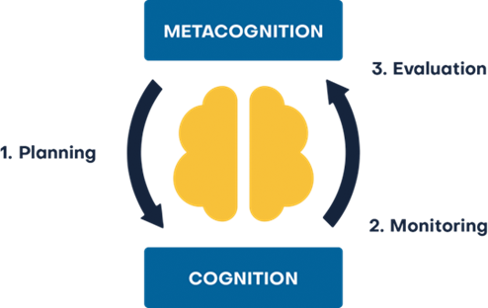
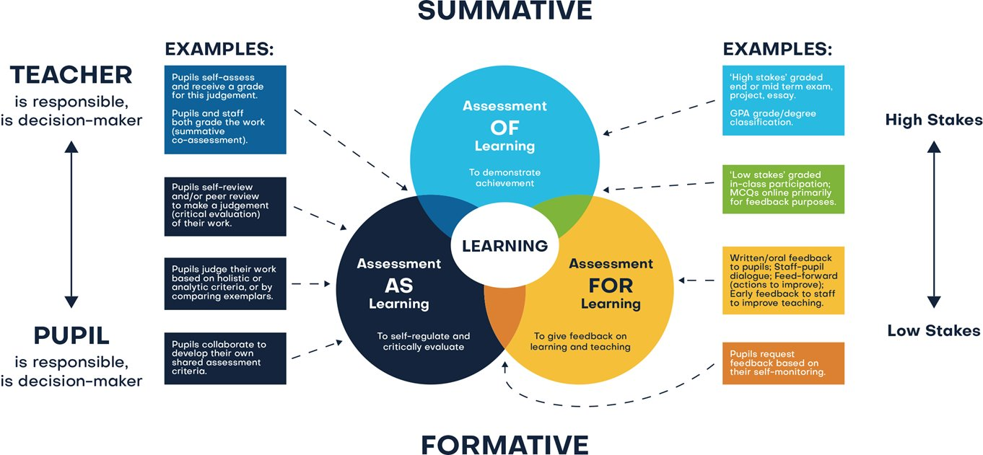
Assessment
Assessment comprises two linked processes:
Formative Assessment: provides Assessment for Learning. Is a continuous process and an integral part of teaching and learning; informal observations, dialogue/effective use of questioning, consolidation activities, low stakes quizzing, routine marking; and pupil/peer assessment all contribute to the developing profile of progress. When pupils make changes and consider actions to their work, based on the activity, they are ‘self-regulating’ their work. Self-regulating activities can be termed Assessment as Learning. Self-regulated learners are aware of their strengths and weaknesses, and can motivate themselves to engage in, and improve, their learning. Pupils start by planning how to undertake a task, working on it while monitoring the strategy to check progress, then evaluating the overall success.
Summative Assessment: provides Assessment of Learning and is a judgement of attainment at key points throughout the year- using past knowledge to measure attainment and progress. Examples of this are standardised tests, tasks and end of term/annual assessments which include a sample of pupil’s prior learning.
Assessment is a continuous process which is integral to teaching and learning and:
Enables an informed judgement to be made about a pupil’s understanding, skills, attitude to learning and successful acquisition of knowledge as they move through the curriculum.
Incorporates a wide range of assessment techniques to be used in different contexts/purposes.
Is accompanied by clear assessment criteria that enables effective marking and feedback, a reliable progress evaluation to be given and demonstrates clearly what a pupil must do to improve.
Provides feedback recognising achievement, increasing pupil confidence/motivation.
Supports learning by making clear to pupils: what they are trying to achieve; what they have achieved; what the learning gaps and misconceptions are and what the next steps in learning are.
Allows regular subject specific extended writing and access to high quality text/ reading.
Should be moderated and standardised to ensure purposeful, meaningful, and timely feedback.
Includes feedback to pupils to help them understand what they need to improve, challenging them to achieve their target rather than a grade.
Allows leaders and staff to make timely adaptations to the curriculum.
Christ at the Centre, Children at the Heart

