Slide 1
CURRICULUM: D&T
Our Lady and St Thomas
Catholic Primary School
Christ at the Centre, Children at the Heart

Slide 2
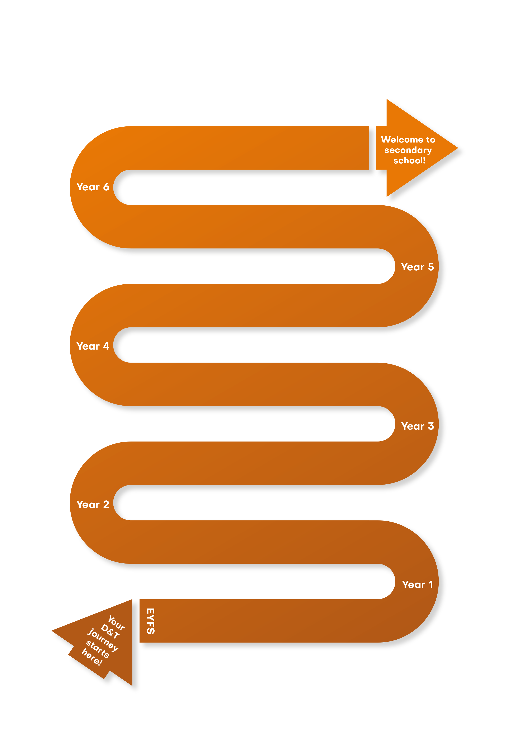
CURRICULUM NARRATIVE
Cooking and nutrition
Bolognese
Mechanical systems
A moving toy
Electrical systems
An alarm to protect
a valuable artefact
Textiles
A tablet case
Structures
A small -scale bird hide
Cooking and nutrition
A yeast-based snack
Cooking and nutrition:
A puff pastry tart/pizza
Electrical systems
A night light for a sibling or friend
Mechanical systems
A greeting card
Textiles:
A stuffed toy
Structures
CAD-based packaging to protect
and display a food product for sale
Cooking and nutrition
A bread-based product
Cooking and nutrition
A Rainbow Salad
Mechanisms
A small wheeled trolley
Textiles
A puppet to retell a story
Structures:
A strong chair for Baby Bear
Mechanisms
A moving storyboard
Cooking and nutrition
A smoothie
Textiles
Threading and weaving
Exploring materials
Structures
Junk
modelling
Construction
Cooking and nutrition
Exploring food, taste and texture
Hygiene
Play -Doh exploration
Mechanisms
Play and exploration with
with props and toys, e.g. vehicles
Christ at the Centre, Children at the Heart

Slide 3
CURRICULUM NARRATIVE
Why do Designers Read?
To find out specific information about products (materials, processes etc…) To gain inspiration. To learn about past and present influential people. To learn about the history of products. To help develop their own creative skills. To follow recipes and instructions.
Write like a Designer
Write for real purposes and audiences. Create design plans, explaining thought processes. Evaluate own products as well as pre-existing products, organising it under e.g. headings, subheadings. Produce questionnaires to acquire customer views. Collate research to present design ideas/products. Correctly use design vocabulary and technological key terms Use labels and annotations on diagrams. Instructions on how to make a product and how to prepare food. Write persuasively to promote their product.
Threshold Concepts
 | Design Make Evaluate Technical Knowledge Key Areas: Cooking and nutrition Mechanisms and Mechanical systems Structures Textiles Key Stage 2 only: Electrical systems Application of the Digital world
Intent
Design and Technology is an inspiring, rigorous and practical subject. It enables children and young people to actively contribute to the creativity, culture, wealth and well-being of themselves, their community and their nation. Using creativity and imagination, children design and make products that solve real and relevant problems within a variety of contexts, considering their own and others’ needs, wants and values.
We intend to build and apply a repertoire of skills, knowledge and vocabulary for children to design and make high-quality prototypes and products for a wide range of users. We draw on disciplines such as mathematics, science, engineering, computing and art. Children learn how to take risks, becoming resourceful, innovative, enterprising and capable citizens. Through the evaluation of past and present design and technology, they develop a critical understanding of its impact on daily life; the wider world; and an increasing technological world. High-quality design and technology education makes an essential contribution to the creativity, culture, wealth and well-being of the nation. We encourage children to use their creativity and imagination, to design and make products that solve real and relevant problems within a variety of contexts, considering their own and others’ needs, wants and values. At BHCET, we encourage children apply the Catholic virtues; to learn to think and intervene creatively to solve problems as individuals and as members of a team.
Christ at the Centre, Children at the Heart

Slide 4
CURRICULUM NARRATIVE
Implementation
Our Design Technology curriculum aims to excite and ignite our pupils’ interest in design and technology and prepare them to participate in the development of a rapidly changing world. The threshold concepts across the Design and Technology curriculum are taught sequentially over time to develop technical knowledge, skills and understanding from EYFS to Y6 and beyond. There are 6 key areas from Years 1 to 6: Cooking and nutrition, Mechanisms and Mechanical systems, Structures and Textiles, with Electrical systems and the application of the Digital world beginning in KS2. To equip children with a breadth and depth of knowledge, the curriculum embeds these threshold concepts and key areas through the completion of three projects in each year group. Each project has a planning resource document to help teachers implement the curriculum consistently and effectively; it is based on universal principles of effective teaching and learning in D&T. Each project ensures children carry out Investigative and Evaluative Activities, Focused Tasks and Design, Make and Evaluate Assignments.
The curriculum aims to ensure that all children:
Develop the creative, technical and practical expertise needed to perform everyday tasks confidently and to participate successfully in an increasingly technological world.
Build and apply a repertoire of knowledge, understanding and skills to design and make high-quality prototypes and products for a wide range of users.
Critique, evaluate and test their ideas and products and the work of others.
Impact
The Design and Technology curriculum at BHCET allows all children:
To develop their God given talents and gain the technical knowledge and skills needed to become confident individuals
Understand the functional and aesthetic properties of a range of materials and resources.
Understand how to use and combine tools to carry out different processes for shaping, decorating, and manufacturing products.
Build and apply a repertoire of skills, knowledge and understanding to produce high quality, innovative outcomes, including models, prototypes, CAD, and products to fulfil the needs of users, clients, and scenarios.
Understand and apply the principles of healthy eating and culture, including key processes, food groups and cooking equipment.
To understand and evaluate technical information.
To make informed decisions that impact on their own lives and the lives of those around them.
To develop an increasing awareness of the moral and ethical dilemmas technical discovery can bring.
To become active citizens of the world.
To receive regular oral and written feedback so children are aware of their position on the learning journey, their strengths and targets, which they consider when taking their next steps.
Self-evaluate and reflect on learning at different stages and identify areas to improve.
Christ at the Centre, Children at the Heart

Slide 5
CURRICULUM NARRATIVE
Threshold Concepts​
​
To equip children with a breadth and depth of knowledge, the curriculum embeds these threshold concepts and key areas through the completion of three projects in each year group:
Design:
Using research and exploration to identify and understand user needs.
Identifying and solving design problems.
Developing design specifications to inform the design of innovative, functional and appealing products in a variety of situations.
Using a variety of approaches to generate creative ideas.
Developing and communicating design ideas in a variety of formats.
Make:
Selecting and using specialist tools, techniques, processes, equipment and machinery.
Selecting and using a wide and complex range of materials, components and ingredients – considering their properties.
Preparing and cooking a variety of dishes using a range of cooking techniques.
Evaluate:
Analysing the work of past and present influencers.
Investigating new and emerging technologies.
Using a design specification and user feedback to test, evaluate and refine ideas.
Exploring the impact of design and technology on society and the environment.
Technical Knowledge:
Understanding and using materials based on their properties and structural performance.
Understanding how mechanical systems are used in products to change movement and force.
Understanding how electrical and electronic systems are used and can be powered within products.
Applying computing and programmable computers to embed intelligence into products.
Understanding the principles of a healthy and varied diet.
Understanding seasonality and food sources.
​
Key Areas:​
Cooking and nutrition | Mechanisms/Mechanical systems | Structures
Where food comes from, balanced diet, preparation and cooking skills. Kitchen hygiene and safety. Following recipes | Mimic natural movements using mechanisms such as cams, followers, levers and sliders. | Material functional and aesthetic properties, strength and stability, stiffen and reinforce structures.
Textiles | Electrical systems (Key Stage 2 only) | Digital world (Key Stage 2 only)
Fastening, sewing, decorative and functional fabric techniques including cross stitch, blanket stitch and applique. | Operational series circuits. Circuit components, circuit diagrams and symbols, combined to create various electrical products. | Program products to monitor and control, develop designs and virtual models using 2D and 3D CAD software.
Christ at the Centre, Children at the Heart

Slide 6
CURRICULUM NARRATIVE
“If you want to eat well, you have to cook yourself, there’s no magic to it.”
Jamie Oliver
Curriculum Coverage
Upper KS2 | Y6 |  | Cooking and nutrition: Bolognese Focus for learning: Celebrating culture and seasonality |  | Mechanical systems: A moving toy Focus for learning: Cams |  | Electrical systems: An alarm to protect a valuable artefact Focus for learning: More complex circuits and switches (including programming, monitoring and control)
 | Y5 |  | Cooking and nutrition: A yeast-based snack (pretzels) for parents and children participating in…(e.g. Mass, school sports day, Stay and Read) Focus for learning: Celebrating culture and seasonality |  | Structures: A small-scale bird hide for children to use in the school wildlife area/pavilion for the local park Focus for learning: Frame structures |  | Textiles: A tablet case Focus for learning: Fastenings (including computer-aided design)
Lower KS2 | Y4 |  | Cooking and nutrition: A puff pastry tart using seasonal vegetables and fruit/A pizza using seasonal vegetables and fruit Focus for learning: Healthy and varied diet and culture |  | Electrical systems: A night light for a sibling or friend Focus for learning: Simple circuits and switches (including programming and control) |  | Mechanical systems: A greeting card Focus for learning: Levers and linkages
 | Y3 |  | Cooking and nutrition: A bread-based product (wrap, sandwich, roll, blini, toastie) Focus for learning: Healthy and varied diet |  | Structures: CAD-based packaging to protect and display a food product for sale Focus for learning: Shell structures (including computer aided design) |  | Textiles: A stuffed toy for a younger child Focus for learning: 2-D shape to 3-D product
KS1 | Y2 |  | Cooking and nutrition: A Rainbow Salad Focus for learning: Preparing fruit and vegetables |  | Mechanisms: A small wheeled trolley that will carry tools to use in a school garden or for a character in a story Focus for learning: Wheels and axles |  | Textiles: A puppet to retell a story Focus for learning: Template and joining techniques
 | Y1 |  | Cooking and nutrition: A smoothie Focus for learning: Preparing fruit and vegetables |  | Structures: A strong chair for Baby Bear Focus for learning: Free standing structure |  | Mechanisms: A moving storyboard to retell a fairy tale to the class Focus for learning: Sliders and levers
Christ at the Centre, Children at the Heart

Slide 7
CURRICULUM NARRATIVE
Curriculum Coverage
In EYFS, pupils will be introduced to Cooking and nutrition by preparing and tasting a range of fruits and vegetables. They will explore and make food linked to their topic and learn about basic hygiene. They will develop their cooking skills and techniques by playing and experimenting with Play Doh. Structural design and make skills will be developed through junk modelling and construction, providing opportunities to use a range of motor skills. Children will explore a range of materials and apply a range of techniques, including cutting, joining, threading and weaving. Through free play, they will explore mechanisms through different vehicles and moving toys and books with simple sliders.
As they move into Year 1, pupils will further develop their design skills by making a ‘moving storyboard’ to retell a fairy tale to the class; simple sliders and levers will be introduced. Their structural knowledge will be enhanced by designing and making a free-standing structure, e.g. a strong chair for Baby Bear. A smoothie for themselves will be created, allowing them to prepare fruit and vegetables and investigate food sources and origins.
In Year 2, pupils will continue to investigate food sources and origins by making a Rainbow Salad; they will practise a greater range of food processing skills. A puppet to retell a story will be created, allowing them to develop textile skills, focusing on template and joining techniques. Their mechanical understanding will be developed further by using wheels and axels to make a wheeled trolley.
On entering Year 3, the pupils will further develop their design skills by designing and making their own packaging to protect and display a food product for sale. They will be introduced to computer aided design to make their structure. A bread-based product will be made, allowing pupils to gain skills in food preparation and understand a healthy and varied diet. Pupils will continue with textiles and make a stuffed toy for a younger child.
Moving into Year 4, pupils will continue to focus on a healthy balanced diet and seasonality by cooking their own tart or pizza using seasonal vegetables and/or fruit. A night light for a sibling or friend will be designed focusing on simple circuits and switches, including programming and control. For mechanical systems, a greeting card will be made using levers and linkages.
In Year 5, pupils will build upon their knowledge of structures to design and make a frame structure. This could be a bird hide for children to use in the school wildlife area, or a pavilion for their local park. Sewing skills will be honed during the textiles project to make a tablet case, focusing upon different types of fastenings, stitch and applique techniques, including computer-aided design. To celebrate culture and seasonality, a yeast-based snack, e.g. pretzels will be prepared and made.
As they enter Year 6 pupils will utilise the mechanical skills gained from prior learning by designing and making a moving toy with a cam mechanism. An alarm to protect a valuable artefact will allow them to gain further knowledge about electrical systems during their work with more complex circuits and switches, including programming, monitoring and control. While cooking a Bolognese, pupils will learn more about recipe adaptation and further develop their food hygiene and preparation skills.
Each project has been specially designed to provide children with the wide range of skills and technical knowledge needed to allow them to succeed and thrive in Design and Technology. Materials have been designed to ensure clarity and consistency of delivery to ensure an agreed standard. Core skills are sequenced to be revisited at least once within each key stage to ensure that knowledge is built upon and developed through retrieval and skill practice. Recall is a feature of theory sessions, developing student’s ability to transfer skills between projects and different media.
Christ at the Centre, Children at the Heart

Slide 8
CURRICULUM CONTINUITY – EYFS TO KS1
Threshold Concepts
How does the Early Years Framework fit within the four threshold concepts?
Planning, designing, making and developing skills and knowledge are all fundamental parts of our EYFS. Children will have plenty of opportunities through child-led learning to get to know each of these areas, as they explore different materials, processes and outcomes. Adults support and scaffold their learning, offering suggestions or listening to their ideas.
Design | Make | Evaluate | Technical Knowledge
Structures Making verbal plans and material choices Developing a junk model. Designing through construction materials, such as Lego, Duplo and various building blocks | Structures Improving fine motor/scissor skills with a variety of materials. Joining materials in a variety of ways (temporary and permanent). Joining different materials together. Describing their junk model, and how they intend to put it together. | Structures Giving a verbal evaluation of their own and others’ junk models with adult support. Checking to see if their model matches their plan. Considering what they would do differently if they were to do it again. Describing their favourite and least favourite part of their model. | Structures To know there are a range to different materials that can be used to make a model and that they are all slightly different. Making simple suggestions to fix their junk model.
Textiles Discussing what a good design needs. Designing a simple pattern with paper. Designing a specific product linked to the termly topic. Choosing from available materials. | Textiles Developing fine motor/cutting skills with scissors. Exploring fine motor/threading and weaving (under, over technique) with a variety of materials. Using a prepared needle and wool to practise threading. Exploring different materials, such as card, fabric, wool. | Textiles Reflecting on a finished product and comparing to their design. | Textiles To know that a design is a way of planning our idea before we start. To know that threading is putting one material through an object.
Cooking and Nutrition Designing a recipe as a class. Designing packaging. | Cooking and Nutrition Chopping plasticine and Play-Doh safely. Chopping fruit and vegetables with support. Develop cutting, slicing, spreading, rolling, scooping, kneading etc through preparing simple dishes and experimenting with Play-Doh. | Cooking and Nutrition Tasting different food and giving opinions. Describing some of the following when tasting food: look, feel, smell and taste. Choosing their favourite packaging design and explaining why. | Cooking and Nutrition To know that food can be made of different ingredients To know that vegetables are grown. To recognise and name some common fruits and vegetables. To know that different food, fruits and vegetables taste different. To know that eating fruits and vegetables is good for us. To discuss why different packages might be used for different foods.
Mechanisms Design a character prop for a play/story with a simple moving part. Design a model with moving parts using a range of construction materials. | Mechanisms Make use of props and materials when role playing characters in narratives and stories. Construct models with moving parts, such as Lego vehicles. | Mechanisms Reflecting on a finished model or product and assessing if it works and moves. | Mechanisms To know how to make objects move through wheels and simple sliders.
Christ at the Centre, Children at the Heart

Slide 9
CURRICULUM CONTINUITY – EYFS TO KS1
What are the Key Stage 1 end points?
Design | Make | Evaluate | Technical Knowledge
Key Stage 1
Cooking and Nutrition • Design appealing products for a particular user based on simple design criteria. • Generate initial ideas and design criteria through investigating a variety of fruit and vegetables. • Communicate these ideas through talk and drawings. | Cooking and Nutrition • Use simple utensils and equipment to e.g. peel, cut, slice, squeeze, grate and chop safely. • Select from a range of fruit and vegetables according to their characteristics e.g. colour, texture and taste to create a chosen product. | Cooking and Nutrition • Taste and evaluate a range of fruit and vegetables to determine the intended user’s preferences. • Evaluate ideas and finished products against design criteria, including intended user and purpose. | Cooking and Nutrition • Understand where a range of fruit and vegetables come from e.g. farmed or grown at home. • Understand and use basic principles of a healthy and varied diet to prepare dishes, including how fruit and vegetables are part of The Eatwell Guide. • Know and use technical and sensory vocabulary relevant to the project.
Structures • Generate ideas based on simple design criteria and their own experiences, explaining what they could make. • Develop, model and communicate their ideas through talking, mock-ups and drawings. | Structures • Plan by suggesting what to do next. • Select and use tools, skills and techniques, explaining their choices. • Select new and reclaimed materials and construction kits to build their structures. • Use simple finishing techniques suitable for the structure they are creating. | Structures • Explore a range of existing freestanding structures in the school and local environment e.g. everyday products and buildings. • Evaluate their product by discussing how well it works in relation to the purpose, the user and whether it meets the original design criteria. | Structures • Know how to make freestanding structures stronger, stiffer and more stable. • Know and use technical vocabulary relevant to the project.
Mechanisms • Generate ideas based on simple design criteria and their own experiences, explaining what they could make. • Develop, model and communicate their ideas through drawings and mock-ups with card and paper. • Generate initial ideas and simple design criteria through talking and using own experiences. • Develop and communicate ideas through drawings and mock-ups. | Mechanisms • Plan by suggesting what to do next. • Select and use tools, explaining their choices, to cut, shape and join paper and card. • Use simple finishing techniques suitable for the product they are creating. • Select from and use a range of tools and equipment to perform practical tasks such as cutting and joining to allow movement and finishing. • Select from and use a range of materials and components such as paper, card, plastic and wood according to their characteristics. | Mechanisms • Explore a range of existing books and everyday products that use simple sliders and levers. • Evaluate their product by discussing how well it works in relation to the purpose and the user and whether it meets design criteria. • Explore and evaluate a range of products with wheels and axles. • Evaluate their ideas throughout and their products against original criteria. | Mechanisms • Explore and use sliders and levers. • Understand that different mechanisms produce different types of movement. • Know and use technical vocabulary relevant to the project. • Explore and use wheels, axles and axle holders. • Distinguish between fixed and freely moving axles. • Know and use technical vocabulary relevant to the project.
Textiles • Design a functional and appealing product for a chosen user and purpose based on simple design criteria. • Generate, develop, model and communicate their ideas as appropriate through talking, drawing, templates, mock-ups and information and communication technology. | Textiles • Select from and use a range of tools and equipment to perform practical tasks such as marking out, cutting, joining and finishing. • Select from and use textiles according to their characteristics. | Textiles • Explore and evaluate a range of existing textile products relevant to the project being undertaken. • Evaluate their ideas throughout and their final products against original design criteria. | Textiles • Understand how simple 3-D textile products are made, using a template to create two identical shapes. • Understand how to join fabrics using different techniques e.g. running stitch, glue, over stitch, stapling. • Explore different finishing techniques e.g. using painting, fabric crayons, stitching, sequins, buttons and ribbons. • Know and use technical vocabulary relevant to the project.
Christ at the Centre, Children at the Heart

Slide 10
SEND
The BHCET DT curriculum has been designed to be delivered to the whole class. However, the tasks are adapted by class teachers to meet the needs of individual children. To ensure pupils with SEND achieve well, they should be exposed to the same learning as their peers; however, the way they evidence their learning through the tasks can be adapted. ​
​
Through scaffolding, tasks can be adapted to ensure all learners can access and evidence the same threshold concepts and learning objectives as their non-SEND counterparts. Scaffolding strategies can include providing sentence starters, a writing frame, vocabulary banks, sorting and matching cards or visual prompts. Reactive or proactive adaptations can make the BHCET curriculum accessible and achievable for all. ​
​
Other strategies of adaptation are outlined through the EEF’s Five-a-Day principles, which include explicit instruction, metacognitive strategies, flexible grouping and the use of technology:​
Scaffolding​
‘Scaffolding’ is a metaphor for temporary support that is removed when it is no longer required. Initially, a teacher would provide enough support so that pupils can successfully complete tasks that they could not do independently. This requires effective assessment to gain a precise understanding of the pupil’s current capabilities.​
Examples: Support could be visual, verbal, or written. Writing frames, partially completed examples, knowledge organisers, sentence starters can all be useful. Reminders of what equipment is needed for each lesson and classroom routines can be useful. Scaffolding discussion of texts: promoting prediction, questioning, clarification and summarising. ​
​
Explicit Instruction​
Explicit instruction refers to a range of teacher-led approaches, focused on teacher demonstration followed by guided practice and independent practice. Explicit instruction is not just “teaching by telling” or “transmission teaching” One popular approach to explicit instruction is Rosenshine’s ‘Principles of Instruction’.​
Examples: Worked examples with the teacher modelling self-regulation and thought processes is helpful. A teacher might teach a pupil a strategy for summarising a paragraph by initially ‘thinking aloud’ while identifying the topic of the paragraph to model this process to the pupil. They would then give the pupil the opportunity to practise this skill. Using visual aids and concrete examples promotes discussion and links in learning.​
​
Cognitive and Metacognitive Strategies​
Cognitive strategies are skills like memorisation techniques or subject specific strategies like methods to solve problems in maths. Metacognitive strategies help pupils plan, monitor and evaluate their learning​
Examples: Chunking the task will support pupils with SEND – this may be through provision of checklists, instructions on a whiteboard or providing one question at a time. This helps reduce distractions to avoid overloading working memory.​
Prompt sheets that help pupils to evaluate their progress, with ideas for further support.​
​
Flexible Grouping​
Flexible grouping describes when pupils are allocated to smaller groups based on the individual needs that they currently share with other pupils. Such groups can be formed for an explicit purpose and disbanded when that purpose is met​
Examples: Allocating temporary groups can allow teachers to set up opportunities for collaborative learning, for example to read and analyse source texts, complete graphic organisers, independently carry out a skill, remember a fact, or understand a concept. Pre-teaching key vocabulary, is a useful technique.​
​
Use of Technology​
Technology can assist teacher modelling. Technology, as a method to provide feedback to pupils and/ or parents can be effective, especially when the pupil can act on this feedback. ​
Examples: Use a visualizer to model worked examples. Technology applications, such as online quizzes can prove effective. Speech generating apps to enable note-taking and extended writing can be helpful.
Christ at the Centre, Children at the Heart

Slide 11
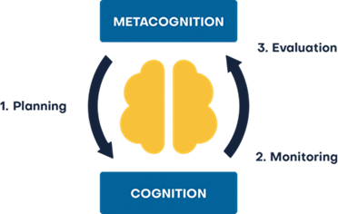
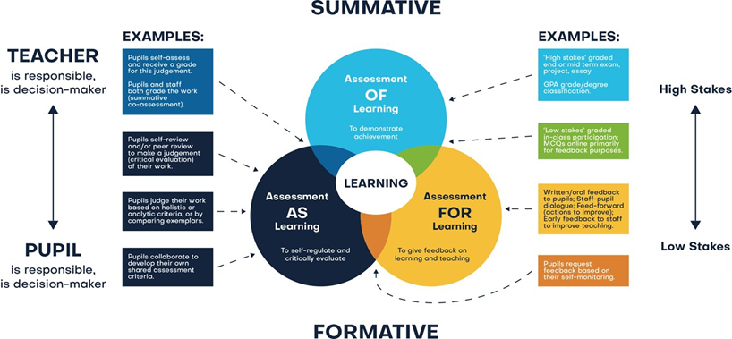
Assessment
Assessment comprises two linked processes:
Formative Assessment: provides Assessment for Learning. Is a continuous process and an integral part of teaching and learning; informal observations, dialogue/effective use of questioning, consolidation activities, low stakes quizzing, routine marking; and pupil/peer assessment all contribute to the developing profile of progress. When pupils make changes and consider actions to their work, based on the activity, they are ‘self-regulating’ their work. Self-regulating activities can be termed Assessment as Learning. Self-regulated learners are aware of their strengths and weaknesses, and can motivate themselves to engage in, and improve, their learning. Pupils start by planning how to undertake a task, working on it while monitoring the strategy to check progress, then evaluating the overall success.
Summative Assessment: provides Assessment of Learning and is a judgement of attainment at key points throughout the year- using past knowledge to measure attainment and progress. Examples of this are standardised tests, tasks and end of term/annual assessments which include a sample of pupil’s prior learning.
Assessment is a continuous process which is integral to teaching and learning and:
Enables an informed judgement to be made about a pupil’s understanding, skills, attitude to learning and successful acquisition of knowledge as they move through the curriculum.
Incorporates a wide range of assessment techniques to be used in different contexts/purposes.
Is accompanied by clear assessment criteria that enables effective marking and feedback, a reliable progress evaluation to be given and demonstrates clearly what a pupil must do to improve.
Provides feedback recognising achievement, increasing pupil confidence/motivation.
Supports learning by making clear to pupils: what they are trying to achieve; what they have achieved; what the learning gaps and misconceptions are and what the next steps in learning are.
Allows regular subject specific extended writing and access to high quality text/ reading.
Should be moderated and standardised to ensure purposeful, meaningful, and timely feedback.
Includes feedback to pupils to help them understand what they need to improve, challenging them to achieve their target rather than a grade.
Allows leaders and staff to make timely adaptations to the curriculum.
Christ at the Centre, Children at the Heart

