Slide 1
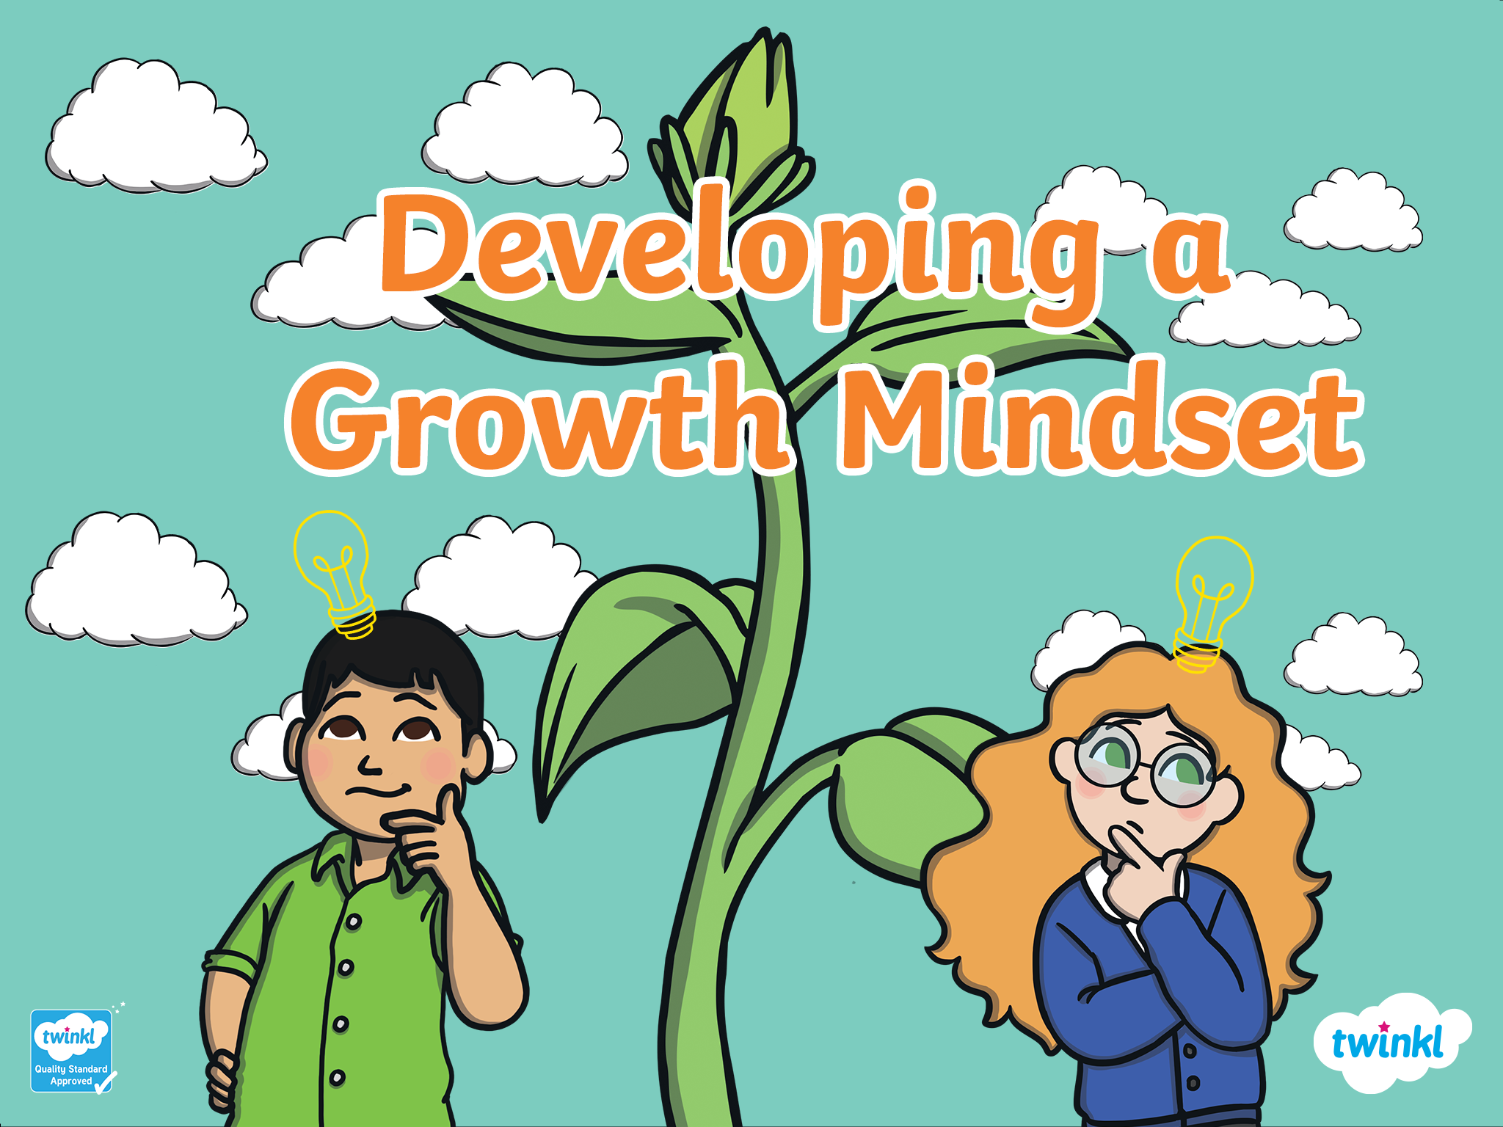

Slide 2



Mindset
A mental attitude that determines how you will interpret and respond to situations.
Today we are going to think about mindset.
Your mindset is all about your attitude.
It is about how you think and feel, rather than what you can or cannot do.

Slide 3
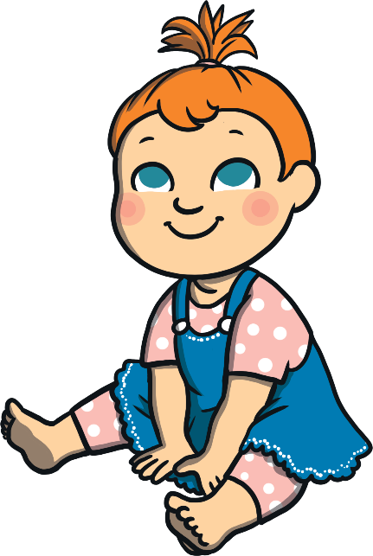
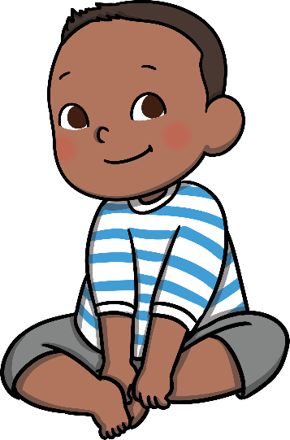
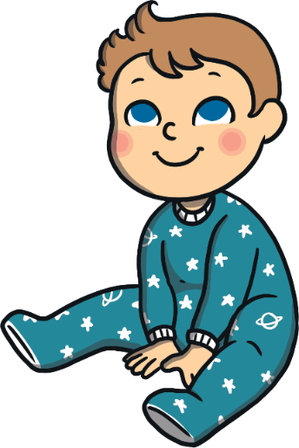


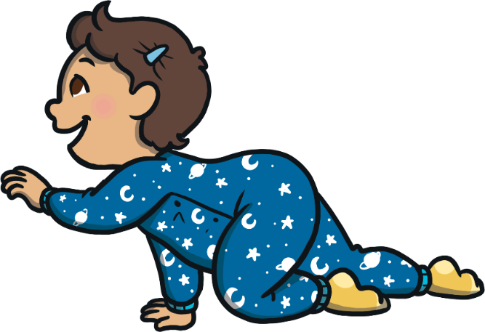
Babies are always trying new things.
They have to learn to do everything!

Slide 4


But as we get older, we find it hard to stay positive about trying new things.
It can make us sad if we make mistakes.

Slide 5
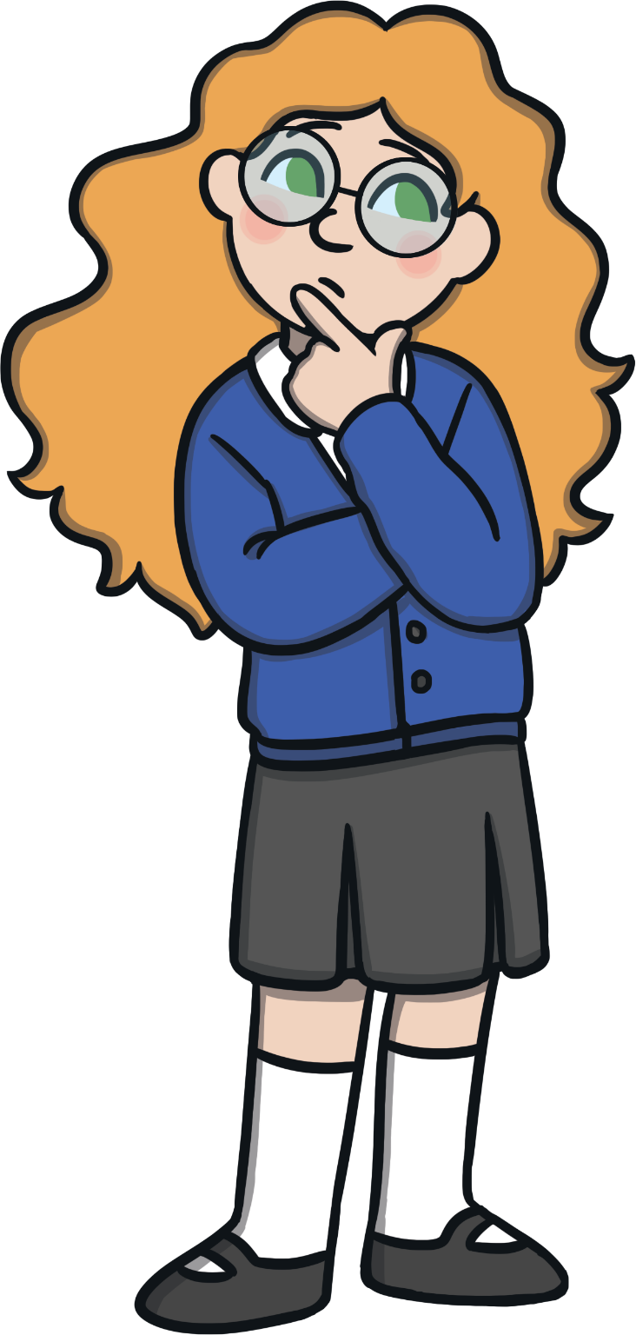
People used to believe that…
No matter how much you learn or how hard you work, your intelligence stays the same!
Scientists believed that you could not change how clever you are, or what you can achieve.
It was thought that you could not change this, no matter what your attitude was.

Slide 6


Now we believe that…
Mindset matters!
In 2008, scientists found that geniuses are more likely to have a positive attitude.
Geniuses are not born brilliant – They are really good at keeping trying when things are tricky, and trying new things to make their work better.

Slide 7





In other words…
It’s not what you are born with matters; it’s your mindset that matters!
You can be as brilliant as anybody else – you just need the right attitude. You can be a genius, if you believe you can!

Slide 8
We want to be…
Motivated
Persistent
Passionate
Dedicated
Enthusiastic
Keen
Flexible
Hard-working
Resilient
Can you explain any of these words?
Positive
Can you think of your own words to add?

Slide 9
We want to…
Keep trying
Take pride in our work
Tackle new challenges
Ask for help if we need it
Believe in ourselves
Remember that mistakes are OK
Bounce back if we find something tricky
Be positive about our friends’ achievements too
Can you think of anything else we could do to develop our growth mindset?
Are there any things here that you find tricky to do?

Slide 10


Change Your Mindset
‘This is tricky –
that means I must be learning!’
What could she say instead?
If I make a mistake,
I can try again.’
‘I can’t do it.’
‘I could ask Mr. Burton to explain it to me so that I can do it.’

Slide 11
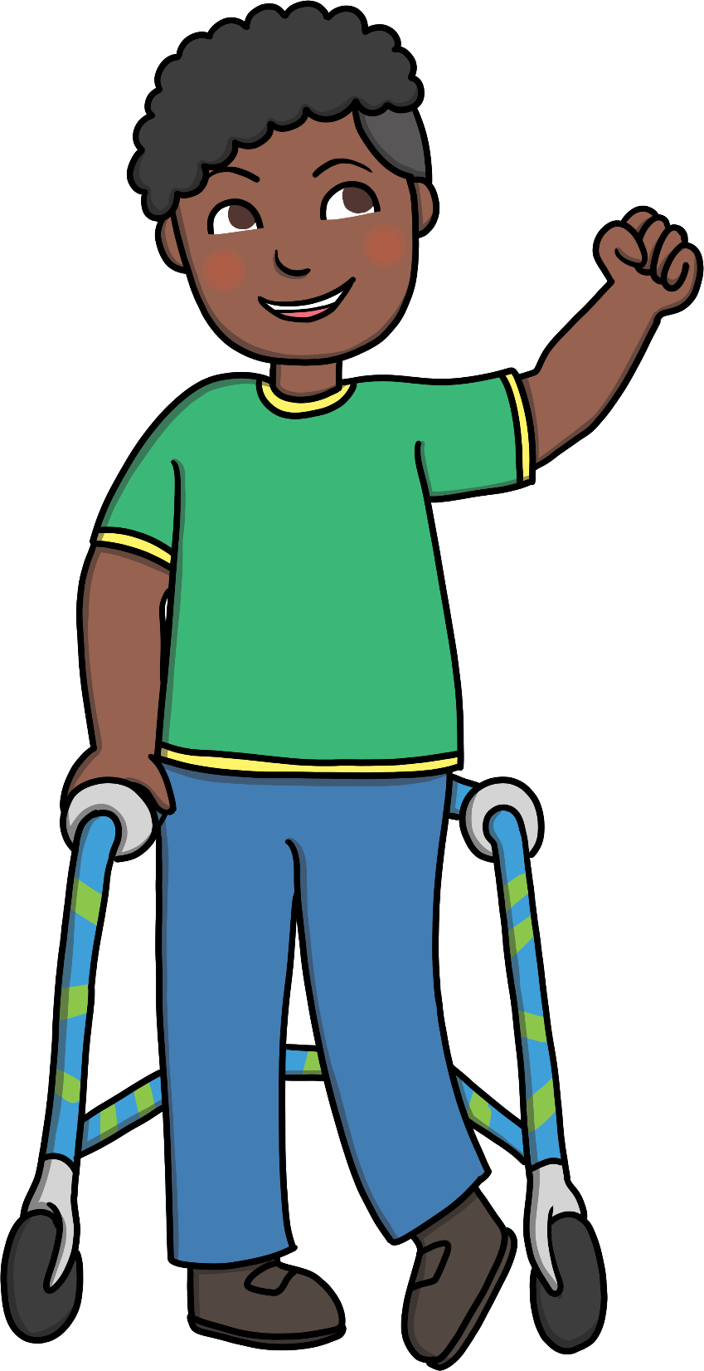

Change Your Mindset
What could he say instead?
‘I’ll never be able to do this.’
‘If I keep trying, I will get better at this.’
‘I will be happy when
I learn to do this.’
‘Even if I make a little improvement, that is a big achievement for me.’

Slide 12


Change Your Mindset
What could she say instead?
‘My friend is really good at this. I wonder if they could show me how to do it.’
‘My friend is a million times better at this than me.’
‘Everybody is good at different things.’

Slide 13



Change Your Mindset
‘I can do it!’
‘I can get better.’
‘I can keep trying.’
‘It is OK to make mistakes.’
‘I can try again.’
‘I am happy for my friends when they do well.’
‘Trying hard makes me feel proud.’
‘I can be a genius!’

Slide 14
Change Your Mindset
Try this today!

Slide 15
