Slide 2
There’s a magic word…

Slide 3
…it’s not very big…

Slide 4
…but it is very important…

Slide 5
…because it has special powers.

Slide 6
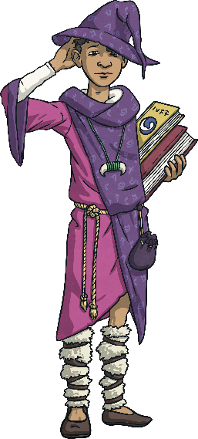
Look at these sentences.
I can’t run very far.
I don’t have good handwriting.
I can’t swim.
Think About It
Can you imagine the people who said these?
Can you think of a sentence like these that you might say about yourself?

Slide 7
Now for the magic word…

Slide 8
…what could it be?

Slide 9
Not long now…

Slide 10
…just a bit longer…

Slide 11
…no really, it’s coming soon…

Slide 12
…the word is…

Slide 13
Yet!
Admit it – are you a teensy bit disappointed?

Slide 14
Yet!
Is that better?

Slide 15
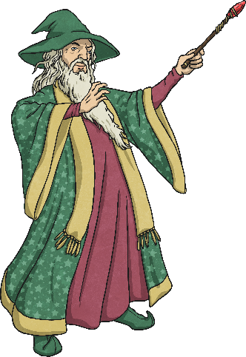
Seriously, this is what it does…
Click here
I can’t run very far yet.
I don’t have good handwriting yet.
I can’t swim yet.
Click here
Click here
How has that little, tiny word totally changed these sentences?

Slide 16
You Can Do It!
Adding the word “yet” to anything makes it possible.
It might not be easy, but it’s possible.
All we have to do now is think about
how we might achieve it.
What can we do?

Slide 17
What Can We Do?
I can’t run very far, but I can try to run a bit further every day.
I don’t have good handwriting, but I can practice for five minutes every day.
I can’t swim, but I can ask an adult to take me swimming once a week.

Slide 18
Your Turn
Discuss and finish these sentences:
I don’t know my eight times tables,
but I can…
I can’t draw,
but I can…
I can’t play an instrument,
but I can…

Slide 19
Now You…
Write three things you can't do or have trouble doing.
Write “yet” at the end of each sentence.
Now write what you can do to work towards achieving your goals by adding, “but I can…”
Share your ideas if you want to.

Slide 20


So there you have it, the magic of “yet.”

