Slide 2

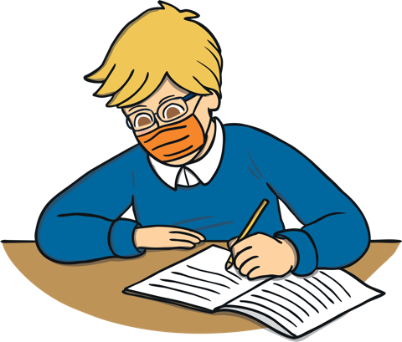
What is resilience?
Resilience means being able to deal with things when they go wrong.
It’s about trying your best and being strong on the inside.
Sometimes we can find doing something difficult. For example, throwing a ball into a net or not winning in a game.
It can make us feel sad or angry but we can show how we feel by using our words and talking to each other.

Slide 3
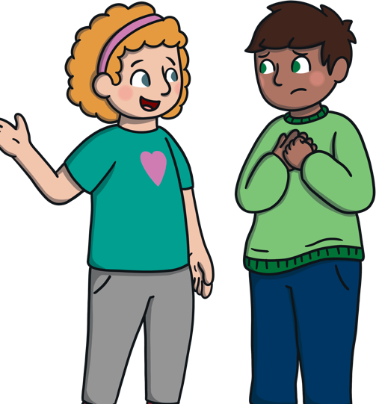
What does being resilient look like?
Controlling your emotions
For example, talking about how you are feeling instead of hitting or shouting.

Slide 4
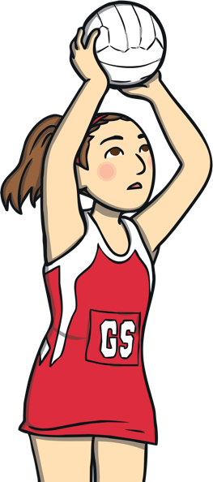
What does being resilient look like?
Trying your best no matter what
Always trying your best helps you become more resilient and you can get good at different activities. For example, skipping or zipping up your coat.

Slide 5
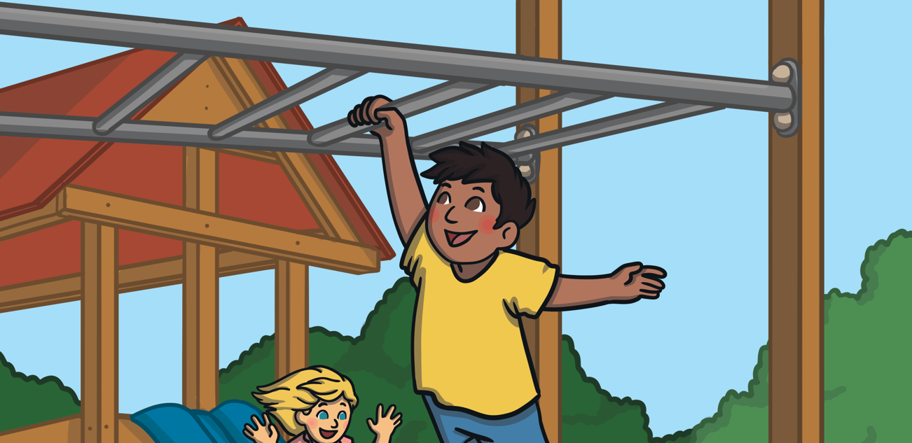
What does being resilient look like?
Trying something that you found hard before

Slide 6
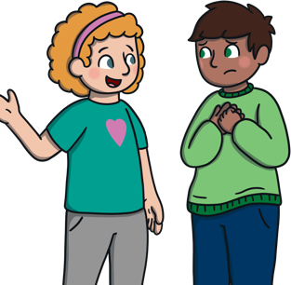
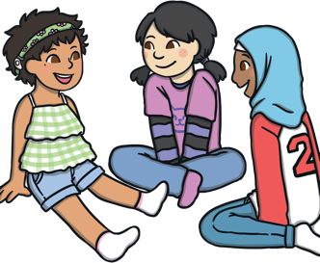

I am resilient
Understanding my feelings
Practise problem-solving
Positive thoughts

Slide 7
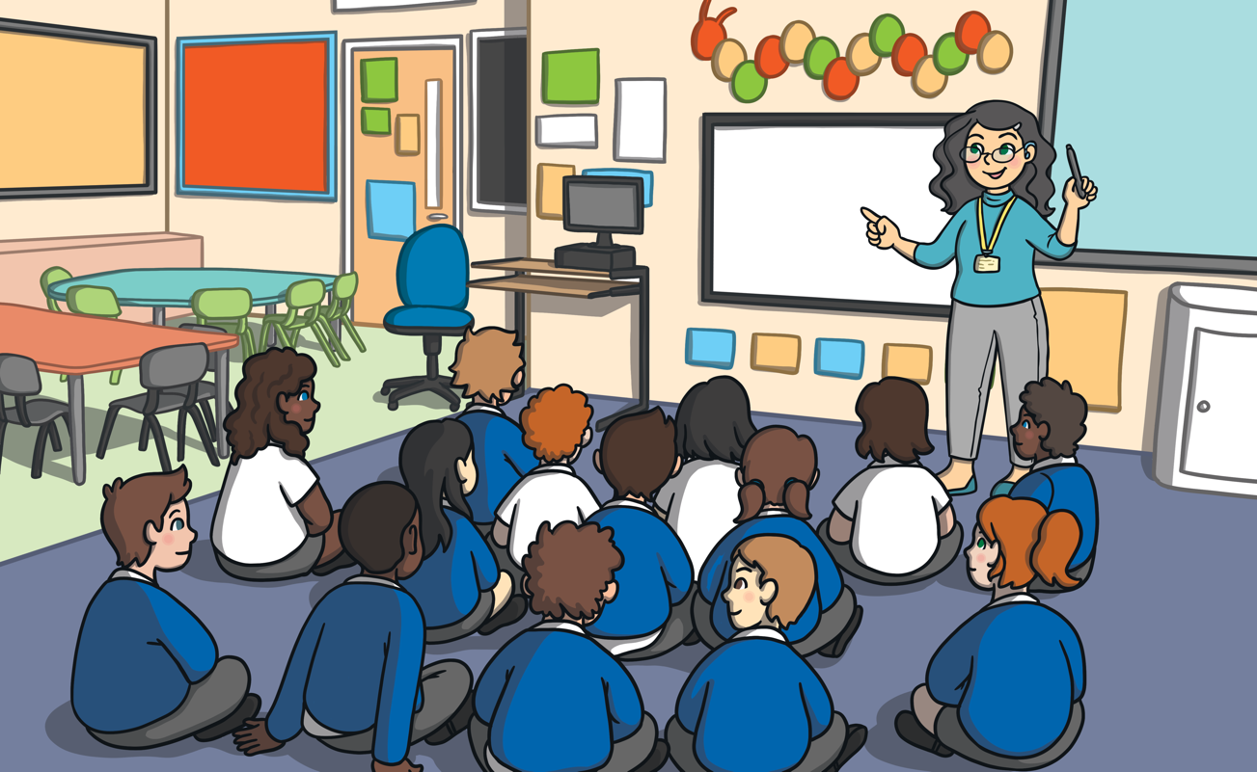
How can you be resilient in school?

Slide 8
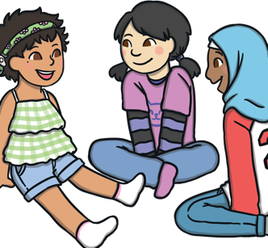
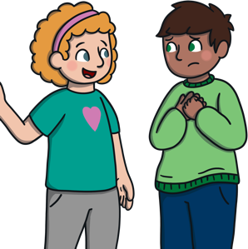


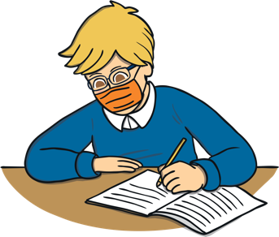
What does being resilient mean?

Slide 9

Here are some ways you can be resilient
Take a deep breath when you feel sad or cross
Find a quiet space to think about your feelings
Tell someone how you feel. Begin with ‘I feel________’
Eating healthy food can also help us to feel good too!

