Slide 1

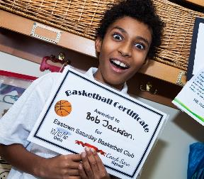
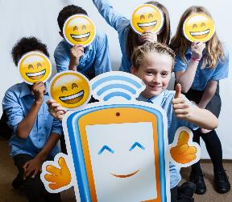
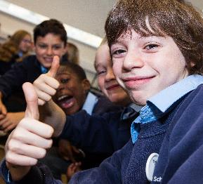
The Power of Image

Slide 2




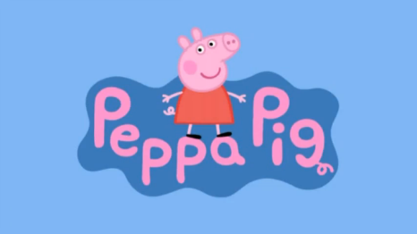









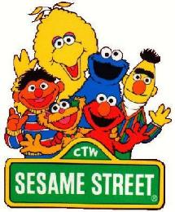


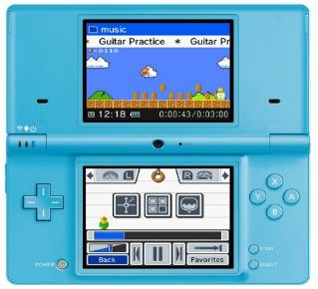



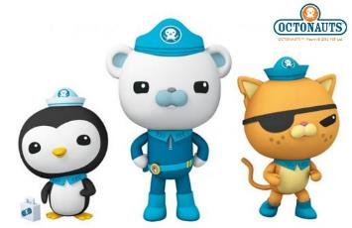
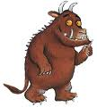

You might like …
2

Slide 3

Who has ever …
Searched for a picture on the internet?
Seen a selfie?
Taken a video of yourself?
Been in a photo with your family?
Pulled a funny face in a photo?
Watched a video online?

Slide 4






What pictures or videos do you like to look at online?

Slide 5
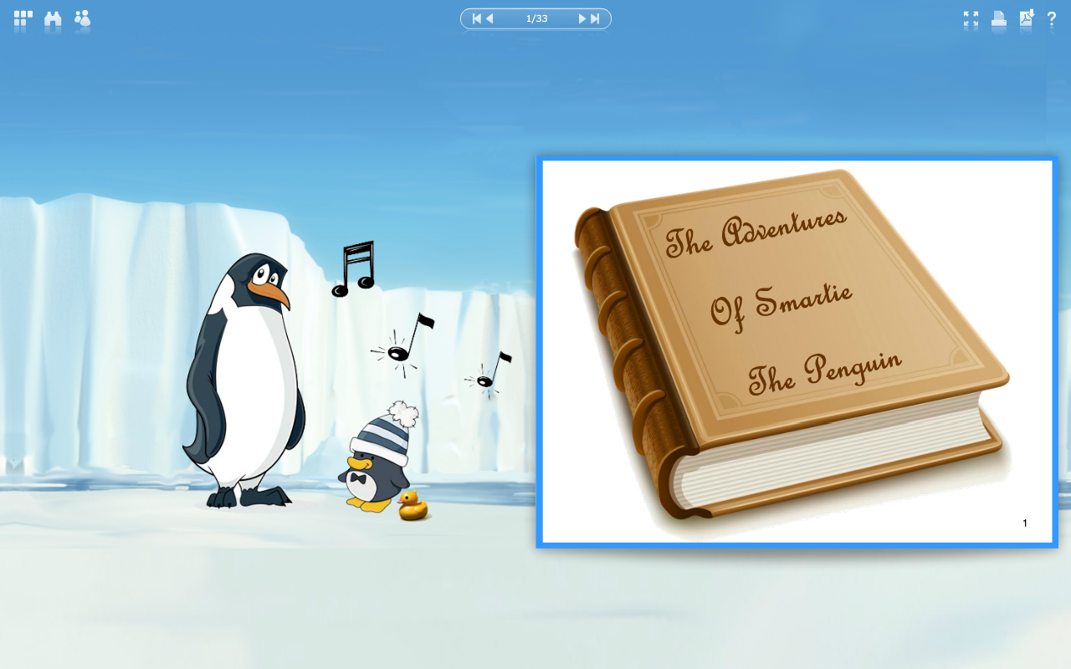

Slide 6



Smartie the Penguin had a school project to find out more about his favourite animal.
Smartie really liked lots of different animals, but his favourite were dolphins, so he went online to find a nice picture of one.
He typed ‘dolphin’ in the search box and was excited to see what pictures he would find.

Slide 7


Lots of pictures of dolphins appeared on the screen. Smartie saw one where the dolphin was caught in a net and looked really poorly.
The picture made Smartie feel really upset, he didn’t like seeing the dolphin look sad.
What should Smartie do? Should he ignore the picture and try to forget about it, or should he tell Mummy and Daddy Penguin?

Slide 8





Smartie went to find Mummy and Daddy Penguin. He told them about the picture of the poorly dolphin, and how it had made him feel sad.
“Well done Smartie” said Daddy Penguin.
“Yes, you made a good choice by coming to talk to us, and not trying to ignore that you felt sad” said Mummy Penguin.

Slide 9




Mummy Penguin was so pleased with what Smartie had done, she taught him a song to help him make sensible choices on the internet in the future …

Slide 10




Sing with me!
Before you tap and click…
You need to stop and think…
And TELL someone!

Slide 11

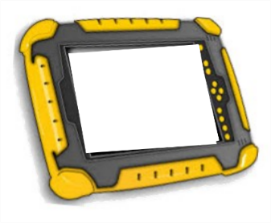


Mummy and Daddy talked to Smartie about what he had seen and why it made him feel sad. Together they found a website about people who look after poorly dolphins. This made Smartie much happier; now he knew there were kind people that helped dolphins too.

Slide 12






The next day, Smartie was playing his favourite game. Another player in the game sent Smartie a link to a video.
The other player said the video was of some monkeys swinging around and doing crazy tricks in the trees.
Smartie really liked monkeys, and he really wanted to see the cool video so he tapped the link and pressed play.
I’ve sent you a cool video
Hi!
www.zootube.com/
crazymonkeyvideo

Slide 13


“Eek!” said Smartie, “that’s not a monkey!”
The video hadn’t shown Smartie any monkeys. Instead, it had shown him a really loud and scary monster, that made him jump.
Smartie was worried Mummy and Daddy Penguin would be cross with him for looking at the video, but on the other hand, it was really frightening and he felt a little scared.
What should Smartie do? Should he ignore the video and hope he feels less scared soon, or should he tell Mummy and Daddy Penguin what happened?

Slide 14
Sing with me!
Before you tap and click…
You need to stop and think…
And TELL someone!

Slide 15
Smartie went to find Mummy and Daddy Penguin. He told them about being tricked into watching the scary monster video.
“Oh Smartie, you are a superstar!” said Mummy Penguin.
“Your did just the right thing by coming to talk to us, and not trying to feel better all by yourself” said Mummy Penguin.

Slide 16

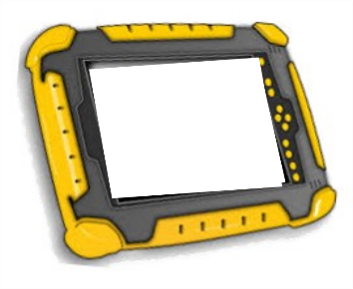

Mummy and Daddy explained to Smartie that lots of people like to share pictures and videos online, but we can’t always see what they are before we watch them.
They reminded Smartie not to press on links sent to him by people he doesn’t know, or if he isn’t sure where the link will take him.
Mummy Penguin found a fun website where Smartie could watch lots of monkey videos to help cheer him up.

Slide 17







From that day on, Smartie the Penguin always knew how to be safe when looking for pictures and playing on the internet!

Slide 18

What would you do if you saw something scary or upsetting on the internet?
Turn the tablet down/turn the screen off
Tell somebody
If someone sends you a photo or video, only look if you know and trust that person in the real world
Don’t ignore it
Don’t show a friend, they might get upset too
If you are still upset a few days later, go and talk to someone again

Slide 19



We are celebrating Safer Internet Day!
Today we will be doing some more fun
Safer Internet Day activities.
When you go home today, why don’t you teach your family or friends all about Smartie and the good advice you gave him?
You can find more Smartie stories on the Childnet website.

