Slide 1




The Power of Image

Slide 2
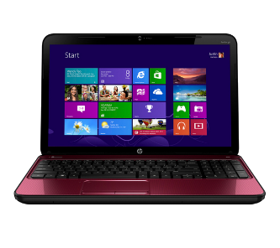







































What do you do online?

Slide 3

Who has ever …
Taken a photo?
Taken a selfie?
Shared a photo online?
Edited or changed a photo?

Slide 4



Picture time!
Show me your best poses!
I’d love to post this fantastic photo on the school website!
What question should I ask before I do that?

Slide 5
Who gets to see …?
If I show the Head Teacher the photo on this phone/tablet who gets to see it?
If I send this photo to the Head Teacher in a message, who gets to see it?
If I share this photo online, who gets to see it?
The Head Teacher
The Head Teacher and whoever else they share it with
It could be everyone who uses the internet!

Slide 6


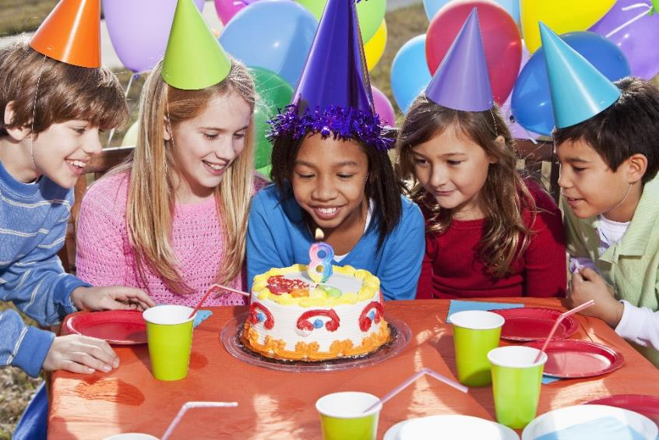
© IPGGutenbergUKLtd licensed under iStock standard license
© kali69 licensed under iStock standard license
What information can we find out from these pictures?
What do we call this type of information?
Personal information

Slide 7


Some photos you take might hold clues to your personal information.
Is it okay for everyone on the internet to see those clues?
Why or why not?

Slide 8

You in your school uniform
© Hongqi Zhang licensed under iStock standard license

Slide 9


A sunset
© beba licensed under CC0

Slide 10

Your lunch
© catiam licensed under CC0

Slide 11

Where you live
© George Clerk licensed under iStock standard license

Slide 12

Your group
of friends
© Heidi van der Westhui licensed under iStock standard license

Slide 13
How can we make sure we are sharing photos safely?
Before you take and share a photo, stop, think and ask yourself …
Who am I sharing this photo with?
Who else might get to see it?
What will people be able to find out about me?
What will people be able to find out about the other people in
the photo?
THINK BEFORE YOU POST!

Slide 14


We are celebrating Safer Internet Day!
Today we will be doing some more fun
Safer Internet Day activities.
Why don’t you talk to your family and friends about the
photos they share, and teach them what you have learnt about.
What’s OK and not OK to share online?

