Slide 1
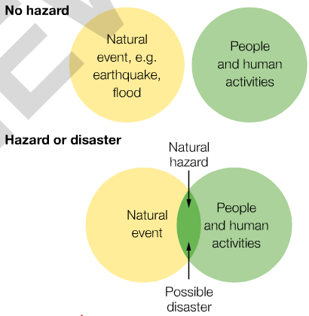
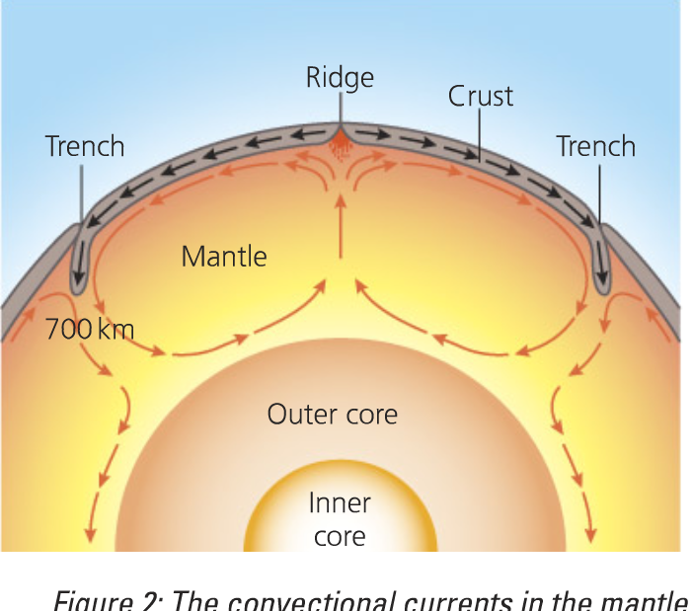
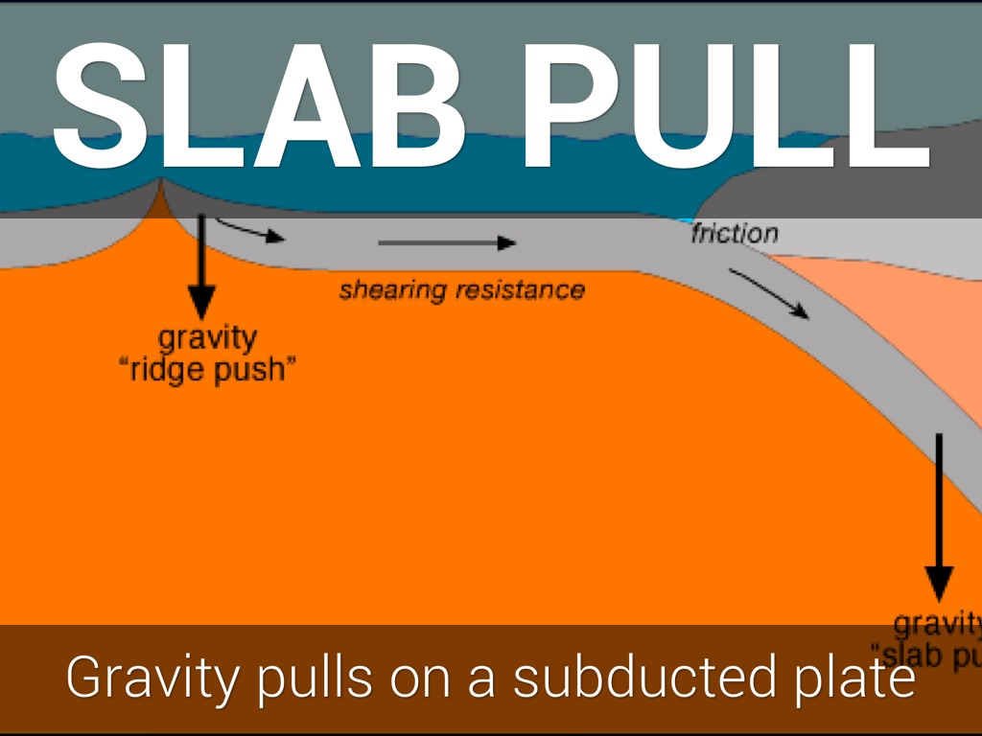
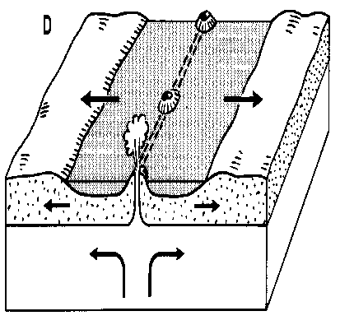
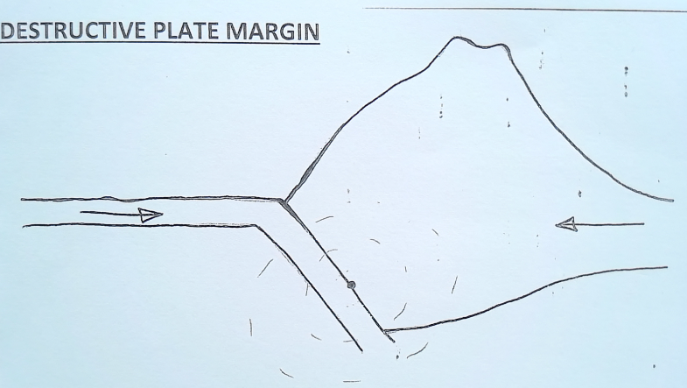
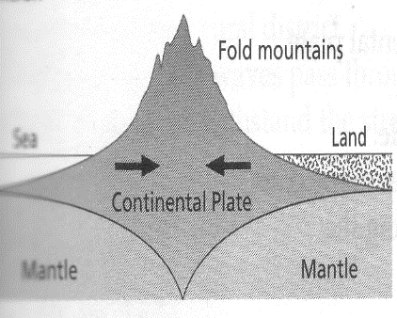
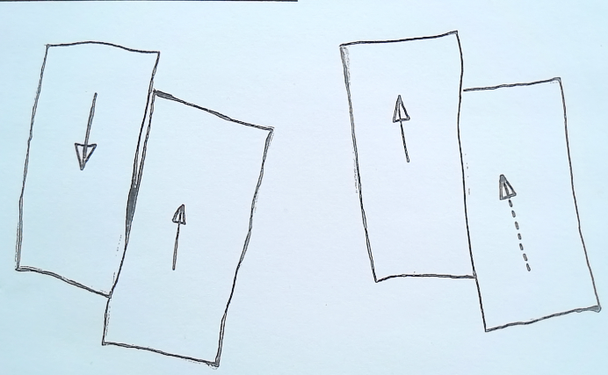
KS4 – The Geography Knowledge – TECTONIC HAZARDS (part 1)
Crust | Outer layer of the earth (solid, thin layer)
Mantle | Layer beneath the crust (semi-liquid, thick)
Outer Core | Layer beneath the mantle (liquid iron)
Inner Core | Very centre layer (solid iron)
Tectonic Plates | The crust is split into several pieces (like a cracked egg shell). These pieces of rock are called tectonic plates. They float on the mantle.
Oceanic Crust | Curst found under the oceans (thin, young, more dense)
Continental Crust | Crust found under land (thick, old, less dense)
Continental Drift | Theory that said the earth’s continents are very slowly moving and that once all the continents were joined together to form a super-continent called Pangea.
A natural hazard is natural process that poses a threat to people and property. A natural hazard only occurs when it impacts on people. If it poses no threat to humans it is called a natural event.
Atmospheric or meteorological hazard – hazard that occurs in the atmosphere (e.g. hurricane, thunder and lightening, tornado, drought)
Tectonic hazard – a hazard that occurs due to the movement of tectonic plates (e.g. volcanoes and earthquakes)
Hazard risk is the chance that a natural hazard may take place.
CONVECTION CURRENTS The mantle is made up of semi molten rock. Mantle rock is heated by the core. The warm material rises to earth’s surface. As it rises, the material starts to cool and sink. This motion of rising and sinking rock forms convection currents in the mantle. The semi molten rock flows in a circular motion. Convection currents cause the overlying tectonic plates to move.
SLAB PULL THEORY Large, dense, heavy plates sink into the mantle at destructive plate margins and pull the rest of the plate with it. Magma rises to the surface at constructive plate margins and creates new land. This pushes the rest of the plate away from the plate boundary.
CONSTRUCTIVE PLATE MARGIN
DESTRUCTIVE PLATE MARGIN
2 plates move away from each other due to convection currents/slab pull, leaving a gap between the two plates. Magma rises up from the mantle to fill the gap, constructing NEW CRUST (new land). This usually happens under the oceans. The new creation of land is called SEA-FLOOR SPREADING.
Volcanoes – there is no build-up of pressure = gentle eruptions
Earthquakes – there is no build-up of pressure = gentle earthquakes
2 different types of plate to move towards each other due to convection currents/slab pull. The denser oceanic plate is pushed beneath the lighter continental plate. This process is called SUBDUCTION and occurs at a subduction zone.
Volcanoes – as the oceanic plate sinks into the mantle, it melts = magma. This rises up through the continental crust until it reaches the surface.
Earthquakes – as the oceanic plate sinks beneath the continental plate, it causes friction and pressure to build up. This pressure is suddenly released = earthquakes.
CONSERVATIVE PLATE MARGIN
COLLISION PLATE MARGIN
Two plates slide past each other due to convection currents/slab pull. They can be moving in opposite directions or moving in the same direction but at different speeds. The line between the two plates is called the FAULT LINE.
No volcanoes (no subduction and so no melting)
Earthquakes – as the two plates slide past each other, pressure builds up. This is suddenly released, it causes VIOLENT EARTHQUAKES.
2 same types of plate to move towards each other due to convection currents/slab pull. As they are the same density neither subducts. Instead the plates collide and crumble up to form massive mountains (FOLD MOUNTAINS).
No volcanoes (no subduction and so no melting)
Earthquakes – the two colliding plates crash together creating a huge amount of pressure which when suddenly releases causes VIOLENT EARTHQUAKES.
Notes:
TEMPLATE

Slide 2
KS4 – The Geography Knowledge – TECTONIC HAZARDS (part 2)
CHILE EARTHQUAKE (HIC) Where: Chile, South America Plate Margin: destructive plate boundary. Nazca plate is being subducted beneath the South American plate. When: 03.34am local time, 27th February, 2010 Magnitude: 8.8 on the Richter Scale. | HAITI EARTHQUAKE (LIC) Where: Haiti, Caribbean Islands. Plate Margin: conservative plate boundary of the Caribbean and North American plates When: 12th January, 2010 Magnitude: 7.0 on the Richter Scale. Epicentre: 25km west of Port-au-Prince, at a depth of 13km
PRIMARY EFFECTS | SECONDARY EFFECTS
500 people died and 12,000 were injured 800,000 people affected Much of Chile lost power, water supplies and communication Port of Talcahuanao and Santiago airport badly damaged 220,000 homes, 4500 schools, 53 ports, 56 hospitals and other public buildings destroyed The total cost for repairing the damage was US$30 Billion Triggered a tsunami | 1500km of roads were damaged, mainly by landslides Communities were cut off for several days Several coastal towns devastated by tsunami A fire at a chemical plant near Santiago – the area had to be evacuated Several Pacific countries struck by tsunami – warnings prevented loss of life
IMMEDIATE RESPONSE | LONG TERM RESPONSE
Emergency services acted swiftly International help supplied field hospitals, satellite phones and floating bridges Temporary repairs made to the important Route 5 North-South highway within 24 hours; aid was then able to be transported from Santiago Power and water restored to 90% of homes within 10 days A national appeal raised US$60 Million, enough to rebuild 30,000 small emergency shelters | Chile’s strong economy, based on copper exports, could be rebuilt without much foreign aid A month after the earthquake Chile’s government launched a housing reconstruction plan to help 200,000 households effected The President announced it could four years for Chile to fully recover from the damage to buildings and portsBuild Back Better. Repaired infrastructure (water pipes/ sewers). $60 million donated by Chileans for shelters – 55,000 built within 4 months.
PRIMARY EFFECTS | SECONDARY EFFECTS
220,000 dead 300,000 injured 200,000 homes damaged and 100,000 destroyed 8 hospitals destroyed in Port-au-Prince 5000 schools destroyed or damaged Transportation routes (roads, rail, ports, airports) destroyed by fallen buildings Service lines (water, gas, electricity) destroyed | Trauma and diseases from dead bodies. 1.3 million Haitians in temporary camps Increase in unemployment and companies stop making money as cannot export goods High crime rates Aid supplies could not reach victims. 2 million Haitians with no food, electricity, water Cost :$11.5 billion
IMMEDIATE RESPONSE | LONG TERM RESPONSE
People were evacuated USA sent ships, helicopters and the army to search and rescue. USA sent people to clear rubble at the port so they work again (export goods to make money). UN sent police to distribute aid and keep order. The Red Cross set up temporary hospitals The UK raised £100 million for emergency aid USA gave $100 million for emergency aid (food, water, medical supplied, shelters) | Relocation – 1000s leave Port-au-Prince permanently Cash for work programs set up to clear rubble to give locals jobs in the long term. World Bank gave $100 million to support long term reconstruction in Haiti. ¾ of the buildings were repaired.
How can we protect ourselves from future earthquakes? We cannot prevent an earthquake from occurring, however we can PROTECT ourselves by: PLAN to prepare for when an earthquake occurs (emergency kit, practice drill, earthquake proof buildings, hazard mapping, evacuation routes). Monitor earthquake prone areas in order to PREDICT when it will occur (previous data, unusual animal behaviour, measure for small tremors)
MEASURE FOR SMALL TREMORS Just before a larger earthquake often there is an increase in the number of small tremors. Scientists use seismometers to record any ground movement. | PREVIOUS EARTHQUAKE DATA Historical records can be used to show patterns and trends. These can then be used to predict future earthquakes. | PRACTICE DRILLS Educate people about to do should an earthquake occur. e.g. in Japan on 1st September everyone practices what to do in an earthquake. It is called Disaster Prevention Day. | UNUSUAL ANIMAL BEHAVIOUR Animals often act strangely before an earthquake. In China, the city of Haicheng was evacuated following strange animal behaviour. Days later a 7.3 magnitude earthquake struck. It is estimated it saved 150,000 lives.
EMERGENCY KIT Residents are encouraged to have an emergency kit ready in case of an earthquake, including a torch, canned food, batteries, radio, medical kit, dust mask, water…etc. | EARTHQUAKE PROOF BUILDINGS Buildings are created to withstand the ground shaking during an earthquake. Examples shown in next box. | e.g. Using flexible steel frames which sway as the ground moves. e.g. Rubber foundations that absorb the shockwaves/shaking. e.g. A building with a larger base than top will be less likely to topple over (pyramid shape). | HAZARD MAPPING Prevent building on loose or weak ground and control the height of buildings in different parts of the city. This means that in high-risk areas, stronger and lower buildings can be used.
Notes:
Why are LICs worse affected than HICs?

Slide 3
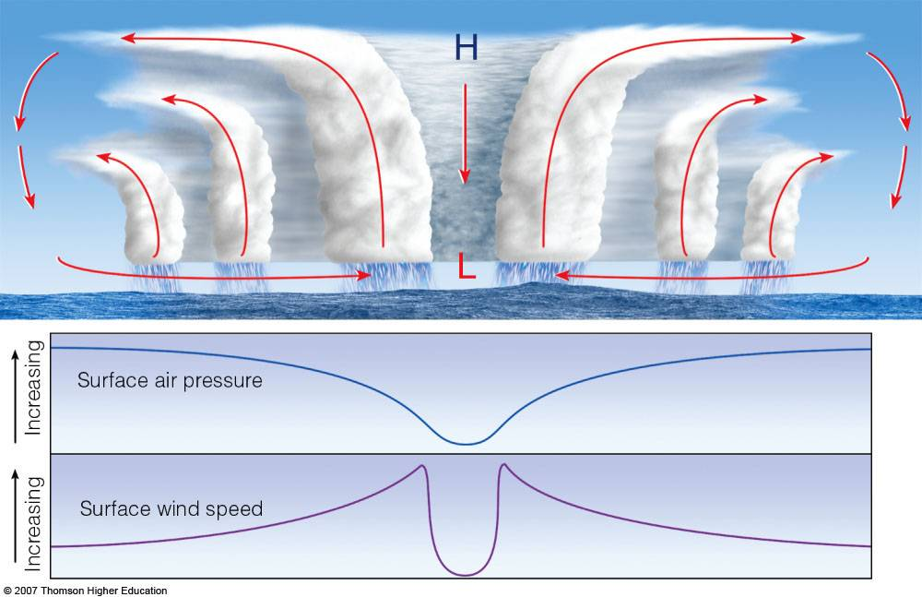
KS4 – The Geography Knowledge – METEROLOGICAL HAZARDS (part 3)
A tropical storm is a storm that is formed over warm water, near the tropics. It has wind speeds of over 74mph and torrential rain. Hurricanes (USA and Caribbean), Typhoons (Japan and the Philippines) Cyclones (SE Asia and Australia).
Tropical storms conditions: Warm water (>27°C). As a result they are often found in tropical areas and occur in the summer/autumn when seas are at their hottest. Latitudes between 5 -20° north and south of the equator. A tropical storm is a spinning mass of clouds. The earth’s spin between 5-20 is enough to spin the clouds = tropical storm. Tropical storms are measured using the Saffir-Simpson scale. There are 5 categories.
TROPICAL STORM FORMATION:
TYPHOON HAIYAN Where: Philippines, Asia When: November, 2013 Saffir-Simpson Scale: category 5 with wind speeds of 170mph and waves 15m high
PRIMARY EFFECTS | SECONDARY EFFECTS
6,300 dead 27,000 injured 1.1 million homes damaged 30,000 fishing boats destroyed Schools, hospitals and shops destroyed. 400m of rain flooded agricultural land. Transportation routes (roads, rail, ports, airports) blocked by trees and debris Specifically the Tacloban airport was damaged Service lines (water, gas, electricity) destroyed | Trauma and diseases from dead bodies. 1.1million people in temporary camps Increase in unemployment – ¾ farmers and fishermen lost their jobs Crops destroyed = loss of $53million to rice crop not being exported Surface and groundwater was contaminated by floodwater Looting and violence in Tacloban Aid supplies could not reach victims. Some areas had no power for 1 month Shortages of water, food and shelter led to disease.
IMMEDIATE RESPONSE | LONG TERM RESPONSE
People were evacuated to 1200 evacuation centres that were created USA sent aircraft/helicopters to search and rescue People cleared rubble Emergency food from Philippine Red Cross Emergency hospitals from France, Belgium and Israel Emergency shelter from UK | Reconstruction and relocation – 1000s of new homes built in flood safe areas Reconstruction of roads, bridges & airports NGOs (e.g. Oxfam) replaced fishing boats. Fishing industries were re-established. UN, UK, Australia, Japan and USA provided long-term medical supplies and financial aid US, Australia and EU provided financial support for people to start new lives Cash for work programmes were created to help people earn money in the long term
HEAVY | HEAT | The sun HEATS the sea/ocean.
ELEPHANTS | EVAPORATE | Warm, moist air EVAPORATES and rises.
REALLY | REPLACE/ REPEAT | More air rushes in to REPLACE the air that has just evaporated. It is also evaporated.
CAN | CONDENSATION/ CLOUDS | As the air rises it CONDENSES to form thick CLOUDS.
SQUASH | SPIN/SPIRAL | The clouds SPIN because of the rotation of the earth forming a SPIRAL.
SARAH | SINKING AIR = EYE | Cold air SINKS in the centre of the storm forming the EYE of the storm.
MARTIN | MOVE | It MOVES in the prevailing wind direction.
LOLS | LAND/LOSE ENERGY | It reaches LAND and LOSES energy as no warm water is being evaporated.
How can we protect ourselves from future tropical storms? We cannot prevent a tropical storm from occurring, however we can protect ourselves. PLAN to prepare for when a tropical storm occurs (emergency kit, practice drill, earthquake proof buildings, hazard mapping, evacuation routes). Monitor tropical storm prone areas in order to PREDICT when it will occur (previous data, unusual animal behaviour, measure for small tremors)
The eye – in the centre of the tropical storm cold air sinks. There are no clouds or wind. It is very calm.
On either side of the eye is the eye wall – a tall bank of cloud. Here are very strong winds, heavy rain, thunder and lightening.
WARNING SYSTEMS A warning alarm is used to alert people of an approaching tropical storm. | PREVIOUS TROPICAL STORM DATA We can use previous data and computer models to predict the course of a tropical storm. We can then instruct people living in hurricane prone areas how to protect themselves. | TRACK TROPICAL STORMS USING SATELLITE IMAGERY We can watch the hurricane progress using satellites and use this to get a better idea of where it will go next.
EMERGENCY KIT Residents are encouraged to have an emergency kit ready in case of a tropical storm (e.g. a torch, canned food, batteries, radio, medical kit, dust mask, water…etc) | PRACTICE DRILLS Educate people about what they need to do should a tropical storm occur. | PLANNED EVACUATION ROUTES Educate people where they need to go should a tropical storm occur. Use signs to clearly show where people should go and meet
Up to 300miles across.
Heavy rain & possible thunderstorms
Heavy rain and thunderstorms.

Slide 4
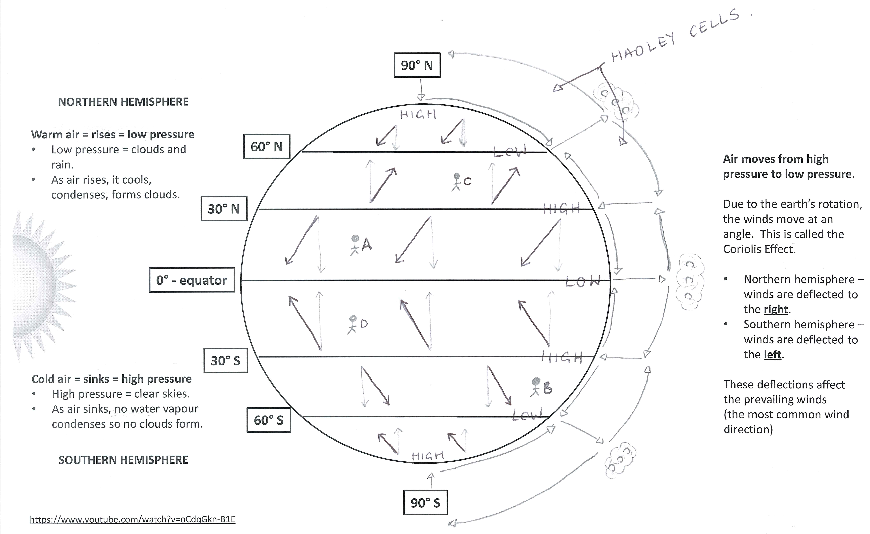
KS4 – The Geography Knowledge – METEROLOGICAL HAZARDS (part 4)
Weather is a description of the day-to-day conditions of the atmosphere. Extreme weather is a weather event that is significantly different from the normal. Evidence that weather is becoming more extreme: International Disaster Database – records show the number of floods have increased since 1960s. Climate models show an increase in the frequency and length of extreme events. e.g. USA – rainfall increased by 5-10% from 1997-2007 2003 Heatwave affected the whole of Europe. It lasted from June till August. Tourism increased in parts of the UK due to hot weather, however 2045 people died in the UK due to heat. 2007 Gloucestershire Floods. 2004 Boscastle Floods and 2014 Somerset Floods 2010 Big Freeze (heavy snow) – in January the UK experienced coldest weather since 1962. Temperatures dropped to -20C, gas suppliers were under pressure as people used so much heating, suppliers of rock salt for roads were also under pressure.
GLOBAL ATMOSPHERIC CIRCULATION Global atmospheric circulation is the world’s system of winds, which transport heat from equator to poles. It is the main factor determining global weather and climate patterns. Warm air rises = low pressure. Cold air sinks = high pressure Air moves from areas of high pressure to areas of low pressure. It is hot and rainy (humid) at the equator (0°). It is hot because there is direct sunlight. It is rainy because the hot air rises creating a low pressure system. As it rises, it cools, condenses and forms clouds. Once the clouds reach saturation, they precipitate. It is hot and dry (arid) at the 30°N and 30°S. It is It is hot because there is direct sunlight. It is dry because the air sinks creating a high pressure system. As the air sinks, no condensation occurs resulting in clear skies. It is cold and dry at the north pole (90°N) and south pole (90°S). It is cold because there is no direct sunlight. Also many of the sun’s rays are deflected off the earth’s surface. It is dry because the air sinks creating a high pressure system. As the air sinks, no condensation occurs resulting in clear skies.
SOMERSET FLOODS Where: Somerset, south-west England Physical landscape: Somerset is low lying farmland. There are several rivers, including the Tone and Parett, which flow into the Severn Estuary. When: January and February, 2014 Why: 350mm of rain in January and February (100mm above average), high tides, storm surges, rivers had not been dredged in 20 years and so were clogged with sediment.
SOCIAL EFFECTS | ECONOMIC EFFECTS | ENVIRONMENTAL EFFECTS
600 houses flooded. Many residents were evacuated to temporary accommodation for several months. 16 farms were evacuated Villages (e.g. Moorland) were cut off by the floodwater. This meant residents could not attend school, work or shop. Power supplies were cut off. Local roads and railway lines were flooded. | Somerset County Council estimated the cost at £10 million. 14,000 hectares of agricultural land was under water for weeks. During this time they did not export any products. Over 1000 livestock had to be evacuated. This cost the farmers and insurance companies money. Local roads and railway lines were flooded. These needed to be fixed. | Floodwater contained sewage and chemicals which contaminated farmland.
To prevent this from happening again, a £20 million Flood Action Plan was launched by Somerset County Council. In March 2014, 8km of the River Tone and the River Parratt were dredged. This is when material/soil/mud is removed from the river bed. As a result the river channel is larger and can hold more water. This prevents the river overflowing its banks. Roads have been elevated in places. As a result even if a flood occurs, people can still drive on the elevated roads. This also helps the economy by allowing import/export. Settlements in areas of flood risk have flood defences. As a result they are able to protect themselves. River banks have been raised. These are called embankments. This means the river channel can hold more water and therefore it is less likely to overflow. They plan to build a tidal barrage in 2024. This is a dam that is near the mouth of the river. It will prevent additional water being added to the channel by high tides or storm surges.

Slide 5
KS4 – The Geography Knowledge – CLIMATE CHANGE & EXTREME WEATHER IN UK (part 5)
CLIMATE CHANGE IS A CHANGE IN THE EARTH’S CLIMATE. There is a lot of evidence that shows climate change has been occurring during the Quaternary Period (covers from 2.6 million years ago to today).
Thermometer recordings show that average global temperatures have risen by 0.74°C during the last 100 years and by 0.5°C since 1980. | Photographs show over the past 20 years the Arctic ice has thinned to almost half of its thickness and permanent ice cover is reducing at a rate of 9% every 10 years. | Photographs show many of the world’s glaciers have retreated in the last 50-100 years. It is estimated up to 25% of global mountain glacier ice could disappear by 2050. | Paintings show that the River Thames was frozen over in 1677. People are shown ice skating over the frozen river | Ice cores are used to examine past global temperatures. When fresh snow falls, each layer contains sediments and molecules (e.g. oxygen) that can be used to calculate the temperature in the year that layer fell. Ice core data has allowed us to reconstruct temperature patterns for the last 400,000 years. It shows evidence of periods of time when the earth was warmer (The Medieval Warm Period and Roman Period) and colder (e.g. The Dark Ages and The Little Ice Age around 1700)
Natural causes of climate change Solar output (sunspots): A sunspot is dark patch on the sun that appears from time to time. Lots of sunspots = warmer Very few sunspots = cooler Every 11 years the number of sunspots changes from very few to lots to very few again. E.g. 1645 – 1715: very few sunspots. During this time, earth experienced a very cold period known as the ‘Little Ice Age’. Paintings show that the Thames completely froze over. Volcanic Activity: Violent volcanic eruptions blast lots of ash, gases (e.g. sulphur dioxide) and liquids into the atmosphere. Major volcanic eruptions lead to a brief period of global cooling. This is because the ash, gases and liquids can block out the sun’s rays, reducing the temperature. e.g. Krakatoa 1883 eruption = world temperatures fell by 1.2°C for a year. e.g. Pinatubo 1991 eruption = world temperatures fell by 0.5°C for a year. Orbital Change: changes in how the earth moves around the sun Orbital change affects how close the earth is to the sun. When the earth is very close to the sun, it is warmer. When the earth is further away from the sun, it is cooler. Eccentricity: how the earth orbits the sun. Every 100,000 years the orbit changes from circular to elliptical (egg-shaped). Axial tilt: the angle of the earth changes every 41,000 years between 22.5° to 24.5°. Precession: the natural wobble of the earth around its axis. Wobble cycles take 26,000 years . | Human causes of climate change The green house effect: Greenhouse gases create blanket around earth. Sunlight travels to earth as shortwave radiation. Sunlight bounces off the earth’s surface as long-wave radiation. The long-wave radiation bounce off the greenhouse gases and travel back to earth. They are trapped in the earth’s atmosphere = earth heats up. The enhanced greenhouse effect is when , due to human actions, there are extra greenhouse gases in the atmosphere which trap more heat = global warming. Methane is produced by cattle and sheep. Rising incomes and population = increased demand for meat = more animals farmed = more methane produced. 250% rise in methane since 1850. Carbon dioxide is produced by burning fossil fuels. Rising population = increased demand for electricity = more carbon dioxide produced. 30% rise in carbon dioxide production since 1850. Nitrous oxides is produced by car exhausts and airplanes. Rising incomes and population = increased cars and air travel = more nitrous oxide produced. 16% rise in nitrous oxide since 1850. Deforestation = less trees = less photosynthesis = less carbon dioxide removed from the atmosphere = more carbon dioxide in the air.
Mitigation: slow down climate change by reducing the production of greenhouse gases. Carbon capture: the process of capturing carbon dioxide and storing it so it does not go into the atmosphere. Carbon dioxide is captured from the power stations. It is transported in pipes. It is stored deep underground or in oceans so it doesn’t go into the atmosphere. Afforestation: planting trees = more trees = more photosynthesis = more carbon dioxide removed from the atmosphere = fewer greenhouse gases = less global warming. Trees remove 3 billion tons of carbon every year! e.g. China has had afforestation programs since 1970s. Forest cover has increased from 12% to 16%. Renewable energies: generating energy from natural renewable sources (e.g. solar panels, hydro-electric power, wind turbines, tidal energy). They do not produce greenhouse gases. International agreements: climate change is a global issue and requires global solutions. International agreements are when countries come together to implement large scale strategies. 2005 – The Kyoto Protocol – over 170 countries agreed to reduce carbon emissions by 5.2%. 2009 – Copenhagen meeting – world leaders agreed to reduce carbon emissions, with HICs providing LICs financial support to help them cope with impacts of climate change. 2015 – Paris Agreement – 195 countries legally promised to reduce greenhouse gas emissions, prevent global temperature rise above 2°C and to give $100billion per year to LICs to support initiatives to help them cope with the effects of climate change. | Adaptation: to adapt to the likely impacts of global warming. Changes in agriculture: Problems: a) climate change = more extreme weather; b) different pest/diseases due to different climate Adaptations: use drought-resistant crops, implement irrigation systems to water crops during droughts, plant trees to shade vulnerable crops from strong sunlight, change crops grown. Changes to water supply: Problems: a) climate change = more extreme weather and unreliable rainfall = droughts Adaptation – decrease the use of water: drip irrigation (uses much less water), recycle water (greywater – waste water from sinks, baths, shower is reused to water crops/plants). Adaptation – increase the supply of water: build reservoir for long-term solution. In the UK, London built a Thames Water desalination plant in Beckton. It removes the salt from the water, purifies it and pipes it to 400,000 homes. Reduce risk of sea level rise: Problems: melting glaciers = sea level rise (rise of 20cm since 1900 and estimated future rise: 3mm per year = coastal flooding and huge damage costs (estimated at £120 billion in UK alone) Adaptations: coastal management (sea walls, rock armour, gabions), improve drainage, build houses on stilts in flood prone areas, invest in monitoring and prediction strategies, invest in planning strategies (e.g. hazard mapping, warning alarm, emergency kits).

Slide 6
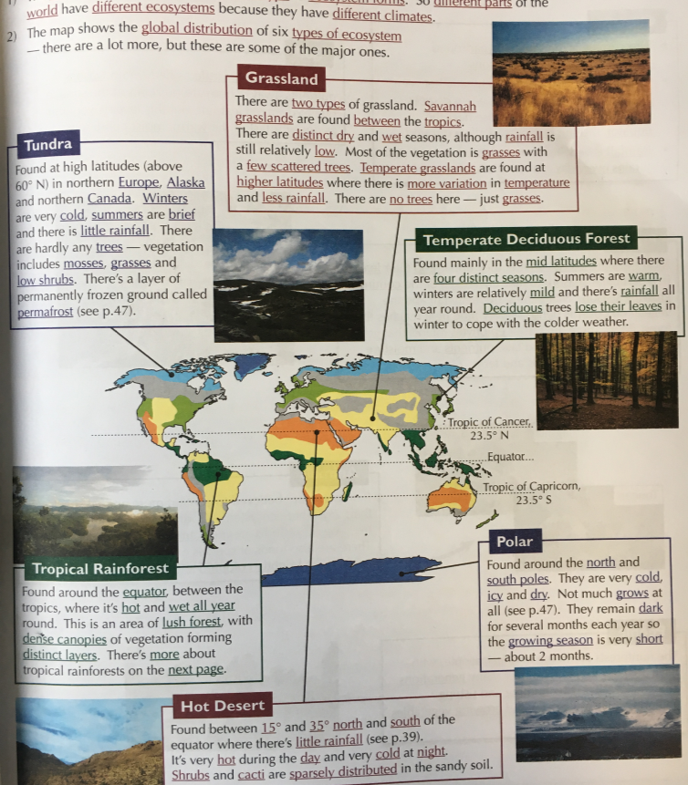
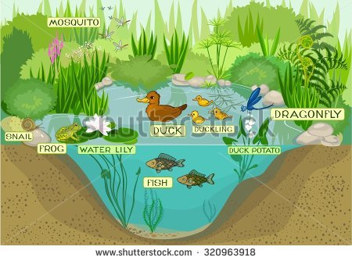
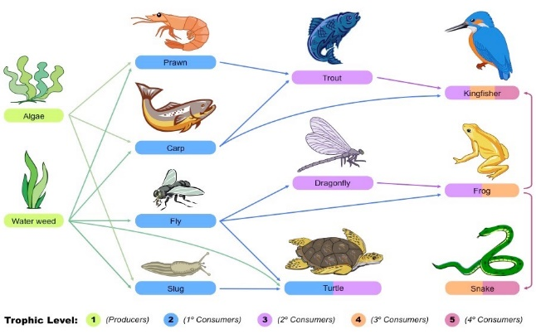
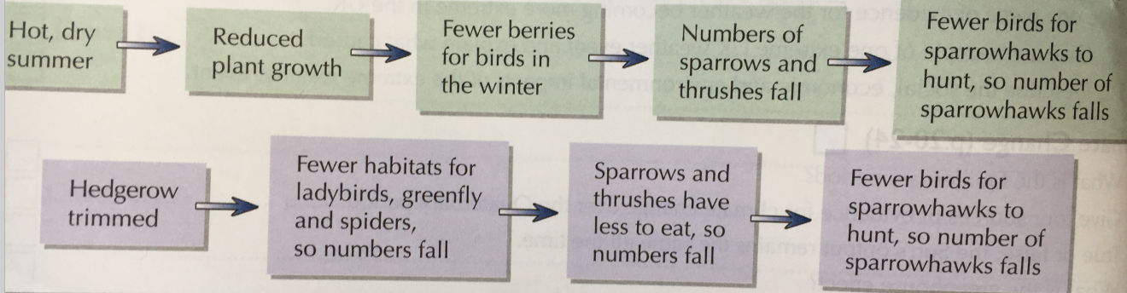
KS4 – The Geography Knowledge – ECOSYSTEMS (part 1)
An ECOSYSTEM is a natural system made up of plants, animals and the environment. There are many complex interrelationships (links) between the living (plants & animal) and non-living (atmosphere) components. Ecosystems can be as small as a hedgerow or pond. Larger ecosystems, on a global scale, are known as biomes, such as tropical rainforest or the desert.
Producer | Organisms that get their food from the natural environment (e.g. by photosynthesis)
Consumer | Organisms that feed on the producers or each other. They are made up of: herbivores (only eats plants), carnivores (eat only animals) omnivores (eats animals and plants)
Decomposer | Fungi and bacteria feed on dead and waste material. They break down dead material and recycle the nutrients back to the soil.
Food Chain | A food chain and web shows what eats what. A food chain is a single line of linkages between producers and consumers.
Food Web | A food chain and web shows what eats what. A food web shows all the linkages between the producers and consumers in an ecosystem.
Nutrient Cycle | The movement of nutrients around an ecosystem. e.g. when dead material is decomposed, nutrients are released into the soil. The nutrients are then taken up from the soil by plants. The nutrients are then passed to consumers when they eat the plants. When the consumers die, decomposers return the nutrients to the soil. This is the nutrient cycle.
A freshwater pond ecosystem is an example of a small scale ecosystem in the UK. It provides a variety of habitats for plants and animals, due to changes in oxygen, water and light. It is made up of the plants, fish, birds and other organisms that live within it, as well as the water, sunlight, temperature in the area. Producers: algae, marsh marigold, waterlily Consumers: frog, heron, fish (e.g. perch), duck, waterworms, rat tailed maggot
A change in one part of an ecosystem has an impact on other parts of the ecosystem. Some parts of an ecosystem depend on the others (e.g. consumers depend on producers for a source of food) and some depend on them for a habitat. So if one part changes it affects all the other parts that depend on it. Two examples can be seen to the right.
Notes:
TEMPLATE

Slide 7
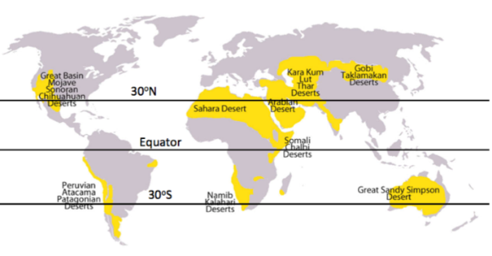
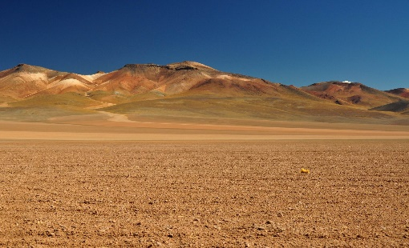
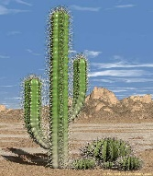
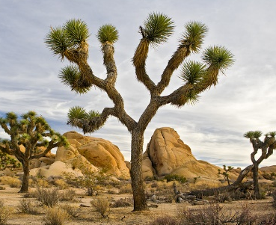
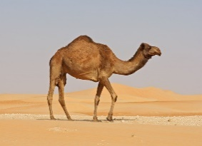
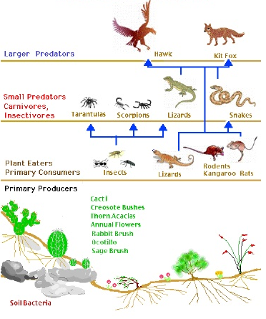
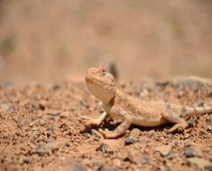
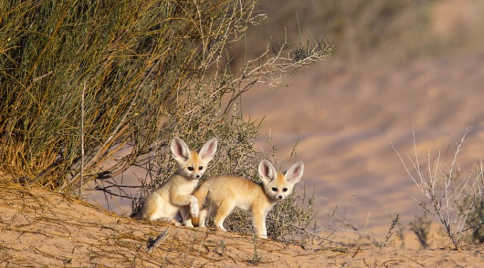
KS4 – The Geography Knowledge – THE DESERT (part 2)
Location | Deserts are located along the Tropic of Cancer & Tropic Capricorn (23.5° – 30° north and south of the equator latitude), Examples: Sahara Desert: Africa (Algeria, Egypt), Mojave desert: USA
Climate | Hot and dry: arid. 2 seasons (summer and winter). Temperature range: over 40°C in the day – less than 0°C at night Precipitation range: less than 250mm per year
Vegetation | Very sparse & sporadic (giant saguaro cactus, Joshua tree, desert daisy)
Animals | Very few (lizards, scorpion, camel, wolf spider, kangaroo)
Soil | Not very fertile as there is hardly any decaying plants to add nutrients to the soil. It is shallow, dry and has a coarse, gravelly texture.
People | Indigenous people in the desert are usually nomadic farmers who travel with their herd (goats and sheep) in search of food, water. New groups have started to live in the desert to use their natural resources (e.g. oil, farming, tourism, renewable energy)
VEGETATION ADAPTATIONS
Cactus:
Some have deep roots to reach water deep under the ground
Some have a very shallow horizontal root system, just below the surface, so that it can soak up water before it evaporates.
Succulent: store water in the stems.
Thick, waxy skin to reduce water loss from transpiration
Spines reduce water loss and protect the cacti from predators.
Joshua Tree:
Deep roots to reach water deep under the ground
Small needle like leaves to reduce water loss.
Leaves are covered in a waxy resin to avoid water loss.
DESERTS HAVE LOW BIODIVERSITY. Biodiversity is the variety of organisms living in a particular area (plants and animals) Small areas of the desert that are near water (rivers, ponds) have the highest diversity of plants, animals and humans. Treats to the desert and surrounding area: Humans are causing desertification in the desert and surrounding savannah. This is causing the desert to get larger and the soils to become drier = erosion. Climate change = more extreme weather (e.g. droughts) = plants and animals are unable to survive the even hotter and drier weather = loss of biodiversity.
ANIMAL ADAPTATIONS
All parts of the desert ecosystem are linked together (climate, soil, water, animals, plants and people). If one of them changes, everything else is affected.
Camel:
Large, flat feet to spread their weight on the sand.
Two rows of eye lashes to keep sand out.
Their colour helps them camouflage (blend in)
Store fats in their hump, which can be used for energy. They can also break this down into water when needed.
Lizard:
Burrow during the hot days and emerge at night to feed.
Their colour helps them camouflage (blend in)
Nocturnal – only come out at night when cooler.
Other adaptations:
Some animals sit very still in the shade during the hottest part of the day (e.g. fennec foxes).
Plants get their nutrients from the soils. Animals get their nutrients from the plants.
Animals spread seeds in their dung (poo), helping new plants to grow.
Hot and dry climate = water is very quickly evaporated = leave salts behind = salinity/salty soils.
Very few nutrients are recycled as there is so little vegetation = very litter decay.
Sparse vegetation = lack of food = low density of animals
Water supplies in the desert are caused due to low rainfall and quick evaporation. As a result humans use irrigation to water their crops using deep wells = less water available for plants and animals.
Notes:
TEMPLATE

Slide 8
KS4 – The Geography Knowledge – THE DESERT (part 3)
People use the Sahara Desert in a number of ways. These are known as economic opportunities.
Development in the Sahara Desert is challenging due to:
Mining for Oil and Gas | What: digging under the desert for oil and gas. Where: Hassi Messaoud oilfield in Algeria, Sahara Desert, Northern Africa Good: ½ the money Algeria earns comes from oil and gas, Hassi Messaoud employs 40,000 people Bad: must fly 40,000 workers to the remote oilfield, fly out water and food reserves, difficult to drill hundreds of metres beneath desert and hard to construct pipelines 100s of kilometres across the desert to the coastline.
Solar Panels | What: solar panels are built to make use of the 12+ hours of bright sunshine in the desert Where: Algeria and Tunisia, Northern Africa Good: money for development from sold energy, it is clean renewable energy. Bad: sandstorms destroy solar panels & dusty conditions mean they need cleaning. This requires 10,300 gallons of water per day.
Agriculture | What: using the River Nile to irrigate land and grow crops (dates, figs and fruit) to feed increasing population (20 to 79 million in last 25 years). Where: Next to the River Nile, Egypt, Northern Africa. Good: accounts for 13% of Egypt’s income, employs 32% of labour force. Bad: rapid evaporation of irrigation water, leaves salt crystals = salinity.
Tourism | What: visit world’s largest desert, Egyptian culture, pyramids, camel treks. Where: Egypt, Northern Africa Good: income for development, employment, development of transport and infrastructure. Bad: pollution from development, overuse of water, cultures are used as entertainment rather than tourists learning about their tradition,
Extreme Temperatures Daily temperatures can reach over 40⁰C Evening temperatures can go below freezing The hot temperatures can cause illness, death and can be too hot for tourists = less come. Inaccessibility The Sahara is HUGE = people often have to travel long distances, usually by plane which is expensive. It is difficult to provide services across such a large area It is difficult to transport products from oil or energy fields, as extensive pipelines have to be built. Water Supply There is very low rainfall in the Sahara Desert (less than 70mm in some places). As a result providing water to workers, tourists, industries or for irrigation is very hard.
DESERTIFICATION is the process where land gradually turns into a desert. It becomes drier, less fertile and is vulnerable to erosion.
Causes of desertification
Responding to desertification: how can we reduce the risk of desertification?
OVER-GRAZING Too many cattle and sheep eat the vegetation = the soil is no longer held together by the plants = vulnerable to soil erosion. Cattle and sheep also trample on the soil. | OVER-CULTIVATION Population growth = more demand for food. As a result land is being over-cultivated. This uses up all the nutrients in the soil, leaving it dry and exposed to erosion.
DEFORESTATION Population growth = increased demand for fuel wood = increased deforestation. The roots therefore no longer bind the soil together and the nutrient cycle is stopped = soil becomes dry and exposed to erosion. | CLIMATE CHANGE Climate change results in extreme weather, such as droughts. Lack of rainfall = not enough rain for the soils to have moisture and stay healthy. High temperatures = any water is immediately evaporated leaving behind salts = salty, dry soil that is vulnerable to erosion.
Afforestation (planting trees) | The roots also help to hold the soil together and prevent erosion. When the plants/leaves die, their nutrients are giving back to their soil. They act as windbreakers and therefore reduce wind erosion.
Crop Rotation Grazing Rotation | When farmers allow a field to rest between farming. This allows the soil time to repair and get their nutrients back. This prevents over-cultivation. Move the animals from place to place to reduce the amount of vegetation eaten or reduce the number of farm animals. This prevents over-grazing.
Water Management | Grow crops that don’t need a lot of water (e.g. millet or olives) Use irrigation techniques that use very little water (e.g. drip irrigation)
Appropriate Technologies | Use cheap, sustainable and easily available materials Earth Dams: collect and store water in the wet season. The stored water is then used to irrigate crops in the dry season. Using Manure: animal manure is used to fertilise the soil by adding nutrients.
Notes:
TEMPLATE

Slide 9
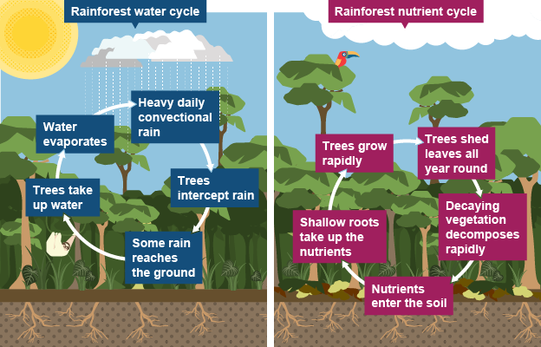
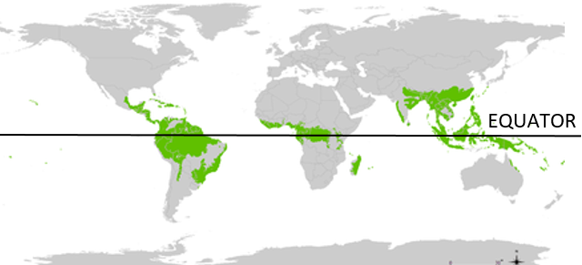
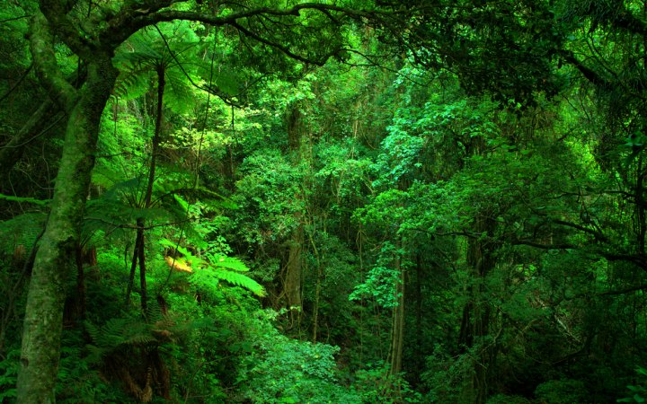
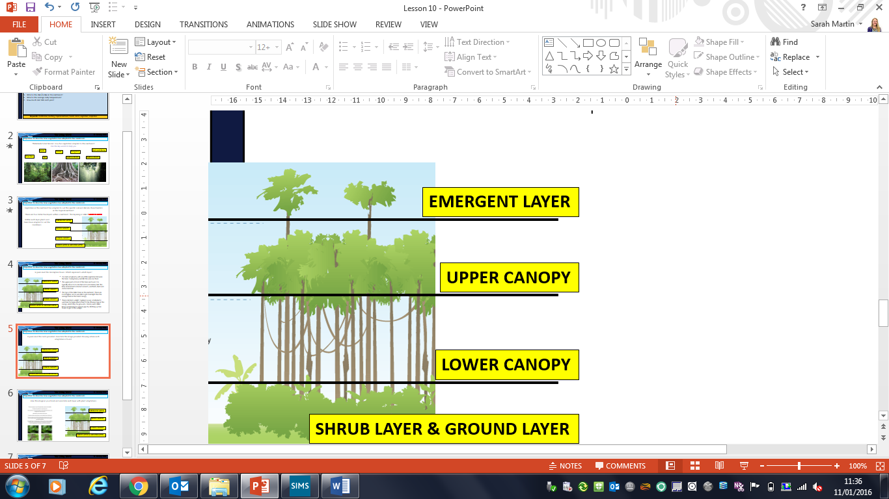
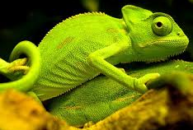
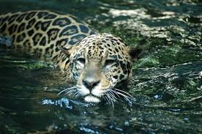
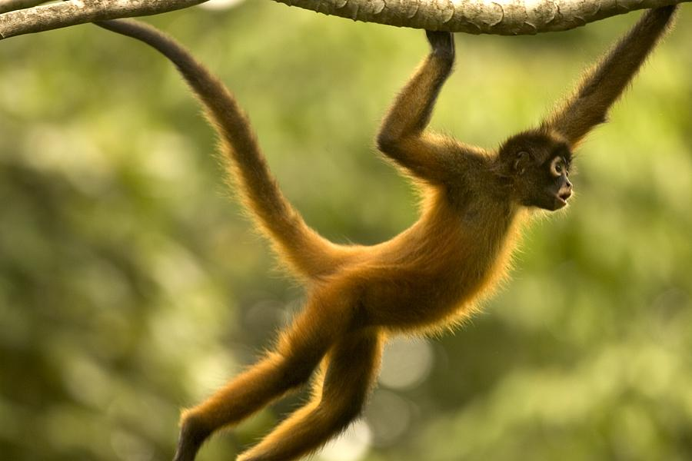
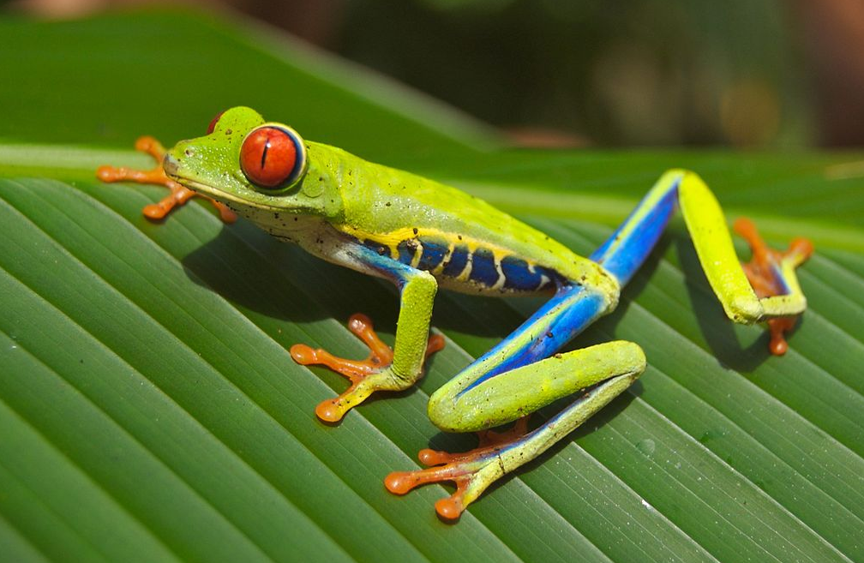
KS4 – The Geography Knowledge – THE TROPICAL RAINFOREST (part 4)
Location | Rainforests are located along the equator (0° latitude). Examples: South America (Brazil), Asia (Indonesia), Africa (Congo).
Climate | Hot and wet (humid). No seasons Temperature range: 20-30°C (due to direct sunlight from the sun) Precipitation range: 160 – 330mm/month or 2000mm per year
Vegetation | Very dense and varied (e.g. banana and rubber trees).
Animals | Very dense and varied (e.g. apes, parrots, jaguars, insects)
Soil | Not very fertile, as heavy rainfall washes nutrients away. This is known as leaching. Most nutrients are in the top layer of the soil due to nutrient cycling from the decayed leaves.
People | Tribes have lived in rainforests for a long time (sustainable). New groups of people and companies have arrived more recently, trying to make money from the rainforests through logging, energy, mining…etc (unsustainable)
VEGETATION ADAPTATIONS
The trees can grow to over 40 meters high in order to find sunlight.
Lianas are woody vines that start at ground level and use trees to climb up to the upper canopy where they spread from tree to tree to get as much light as possible.
The leaves have drip tips to shed heavy rain.
Large buttress roots support the tall trees.
Some plants have very large leaves so they can catch as much sunlight as possible. Plants, such as the fan palm, have large fan-shaped leaves which are segmented so that excess water drains away easily.
The forest floor is very dark and damp. There is little growth here as the sunlight cannot reach this layer.
Trees have shallow roots as there is only a shallow layer of fertile soil.
Most trees are evergreen, meaning they don’t drop their leaves (green all year round).
Rainforests have very high BIODIVERSITY. Biodiversity is the variety of organisms living in a particular area (plants and animals) Rainforests contain around 50% of the world’s plants, animals and insect species. Rainforests are stable and productive as animals and plants do not need to deal with changing climates (one season all year round). Deforestation is causing a loss of biodiversity in the rainforest, as many animals and plants become endangered or extinct.
All parts of the rainforest ecosystem are linked together (climate, soil, water, animals, plants and people). If one of them changes, everything else is affected.
ANIMAL ADAPTATIONS
The humid climate = dead plants and animals decompose quickly by decomposers (fungi and bacteria) on the forest floor = the nutrients from the decaying plants/animals makes the top layer of the soil very nutrient rich = lots of plants can grow.
Plants pass on their nutrients when they are eaten by animals. There is a lot of vegetation = lots of animals.
People remove trees (deforestation) = less carbon dioxide is removed from the atmosphere = more greenhouse gases = more climate change.
Trees absorb water = this water travels through the tree to the leaves = transpiration evaporates water from the trees’ leaves to the atmosphere = condensation in the atmosphere creates clouds = precipitation. The trees are one of the main reasons there is so much rainfall in the rainforest.
Camouflage: animals (e.g. chameleon and leaf-tailed gecko) can blend into their surroundings to hide from predators.
Many animals in the rainforest can swim due to high rainfalls and many rivers (e.g. jaguar and anaconda).
Some animals have suction cups on their feet and hands to help them climb up trees and leaves (e.g. red-eyed tree frog)
Spider monkeys have long, strong arms and tails so they can swing between the trees in the upper canopy. Some animals spend their entire lives in the upper canopy.
Some animals have adapted to the low light levels in the shrub and ground layer. Anteaters have a sharp sense of smell and hearing so they an detect predators without seeing them.
Notes:
TEMPLATE

Slide 10

KS4 – The Geography Knowledge – THE TROPICAL RAINFOREST (part 5)
People use the Amazon Rainforest in a number of ways.
Deforestation in the Amazon The Amazon Rainforest is the largest rainforest on earth, covering 8 million km₂ of land. Since 1978, 750 000km₂ of land has been deforested. This is three times the size of the UK! Why is the land being deforested? 70% due to cattle farming 20% due to subsistence farming 5% due to other farms (soy, rice and corn) 3% due to logging companies 2% due to mining, roads, settlement and energy extraction (hydro-electric power stations)
Cattle farming | Clear land for massive, commercial cattle farms. These are sold.
Logging | Cutting down hardwood trees to sell.
Hydro-electric energy | Build dam and reservoir to create and sell hydro-electric energy. (e.g. Belo Monte dam in Brazil)
Mining | Digging to extract iron ore, aluminum, copper, tin and gold to sell. (e.g. The Carajas Mine in Brazil)
Building roads | Logging companies, cattle ranches, farms, mines need roads to reach them and transport products to the coast to export = roads built.
Urban growth | Increasing population = increasing urban areas. (e.g. Manaus’ pop. Grew 22% between 2000 – 2010 reaching 1.7million)
Subsistence farming | Local famers clear the land using slash and burn and grow only enough food for their family to eat.
These uses of the rainforest have a number of positive and negative impacts.
POSITIVE ECONOMIC AND ENVIRONMENTAL IMPACTS | NEGATIVE ECONOMIC AND ENVIRONMENTAL IMPACTS
Economic: Jobs – mines, farms, power stations, construction. In Peru the Buenaventura mining company employs 3100 people. Economic development. Money from these companies helps country to develop. In 2008 Brazil made $6.9 billion from selling cattle. Improved transportation make trading faster and easier = more is exported. There are no positive environmental impacts of deforestation. | There are no negative economic impacts of deforestation. Environmental: Habitat loss – many animals live in the tree canopy. If the trees are cut down their habitats are lost. Loss of animal biodiversity – plant species are lost as they are deforested. Additionally animals are endangered as their homes are lost. Climate change – trees remove CO₂ from the atmosphere during photosynthesis. If there are less trees, less CO₂ is removed = more greenhouse gases in atmosphere. The Amazon Rainforest stores 100 billion tons of carbon. The more trees cut down, the less it can store = more in atmosphere. Climate change – large cattle ranches contain lots of cattle. These release a lot of methane when they fart and poo). Soil erosion – when trees are cut down they cannot hold the soil together. As a result heavy rains wash away the soil (erosion).
SUSTAINABILITY IN THE RAINFOREST - meeting the needs of today, without harming the environment in the future.
INTERNATIONAL AGREEMENT – DEBT RELIEF Areas of the rainforest are given monetary value and used to repay outstanding debt. e.g. In 2008 the USA reduced the debt that Peru owed them by $25 million. In exchange Peru had to conserve/look after part of their rainforest. | SELECTIVE LOGGING Only selected trees are cut down, rather than cutting down all the trees in an area. They usually cut down the older trees. As a result the rainforest canopy is preserved where many of the animals live. | PROMOTING RESPONSIBLE MANAGEMENT Forest Stewardship Council (FSC) and Rainforest Alliance are charities that give their logo to products that are produced sustainably. Consumers can then choose to buy products from sustainable sources. This increases the demand for sustainable products.
INTERNATIONAL AGREEMENT – CARBON SINK Trees remove carbon dioxide during photosynthesis and are therefore known as carbon sinks. Rainforests are protected due to their role in reducing global warming. e.g. The Gola Forest in Sierra Leone (Africa) is protected for its role in reducing global warming, using money from the European Commission, French Government and NGOs. | NATIONAL PARKS and AFFORESTATION Areas are protected from development and deforestation. e.g. The Tumucumaque National park in Brazil is the largest in the world. It protects over 38,000 square kilometres of rainforest. Afforestation is when new trees are planted as others are cut down. In some countries it is law to replant trees. | ECOTOURISM – SUSTAINABLE TOURISM Tourist resorts that use sustainable practices to reduce their impact. e.g. reduce negative environmental impacts: renewable energies, water tanks, grey water, e.g. improve social impacts: local employees, use local produce and materials. Money goes into local economy.
Notes:
TEMPLATE

Slide 11
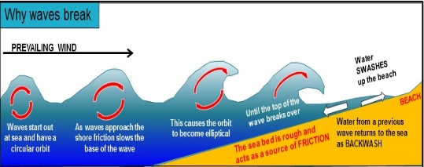
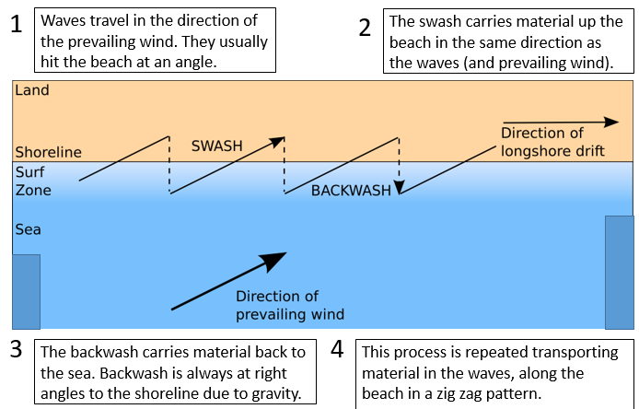
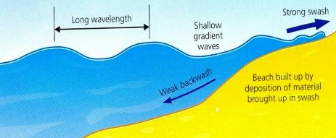
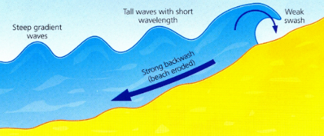
KS4 – The Geography Knowledge – PHYSICAL LANDSCAPES: COASTS (part 1)
Coastline | The outline of the land. Where the land meets the sea
Waves
Wave length | The horizontal distance between two wave crests
Wave height | The vertical distance from the trough to the crest.
Wave crest | The top of a wave
Wave trough | The base of a wave
Wave fetch | The distance of water over which the wind blows (the size of the sea/ocean)
Swash | Breaking waves rush water and sediment up the beach.
Backwash | The water that rushes flows back to the sea.
Erosion | The removal of rock by the sea
Weathering | The breakdown of rocks caused by the day-to-day changes in the atmosphere
Transportation | The movement of sediment along the beach
Deposition | The dropping of sediment
Longshore Drift | The transportation of material along a beach. The material is moved in the direction of the waves and prevailing wind.
Infiltration | Water enters the ground
Saturation | Rock that is full of liquid
Impermeable rock (non-porous rock) | Rocks that do not allow liquid to pass through
Permeable rock (porous rock) | Rocks that allow liquid to pass through
Slip plane | A line of weakness along which movement occurs
How are waves formed and how do they break? Winds cause friction at the surface of the sea, causing the surface of the water to be pushed in the direction of the wind. The water moves in a circular motion = waves. The waves move into shallow water. The rough sea bed = friction = water travels slower at the base of the circular wave The top of the wave moves faster than the base. Eventually the top of the wave breaks Constructive Waves: Long wavelength and low wave height Strong swash and gentle backwash = add material and create big beaches Very gentle, created in calm conditions and a short fetch. Destructive Waves Short wavelength and high wave height Weak swash and strong backwash = remove material and erode beaches Very powerful, created in storms and with a long fetch.
Erosion is the wearing away or removal of rocks. Erosion attacks the base of the cliff.
Hydraulic Action: The force of the waves hitting the cliffs removes material. Air bubbles in the water are pushed into cracks in the cliff and remove material due to an increase in pressure.
Abrasion: Material in the sea hits against the cliffs and removes rocks and soil. It acts like sandpaper.
Corrosion: Chemicals in the water dissolve the cliff.
Attrition: Material in the sea crash into each other and break into smaller pieces. Continued attrition = smaller, smoother pebbles and sand particles.
Weathering is the breakdown of rocks caused by the day-to-day changes in the atmosphere. Weathering attacks the face and top of the cliff. There are three types of weathering: chemical (carbonation), mechanical (freeze-thaw, salt weathering, wetting and drying) and biological (roots & burrowing animals)
Freeze-thaw: Water collects in cracks. At night this water freezes and expands. The cracks get larger. In the day the temperature rises and the ice melts (thaws). The repeated freezing and thawing weakens the rock = breaks apart.
Salt Weathering: Sea water is naturally salty. Sea water gets into cracks in the rocks. When it evaporates it leaves behind salt crystals. These salt crystals expand putting pressure on the rocks. Eventually the rocks break apart
Wetting and Drying: Soft rocks (e.g. clay) expand if they get wet and contract when they dry. Repeated expanding and contracting = cracks appear.
Roots & Burrowing Animals: Plant roots grow in cracks in the rocks and break them apart. Animals burrow into weak rocks and break it apart.
Carbonation: Carbon dioxide and sulphur dioxide mix with rainwater to produce acid rain. This reacts with rocks. e.g. rainwater + CO2 = carbonic acid. Carbonic acid + calcium carbonate (in rocks such as limestone) = calcium bicarbonate which is soluble = rock dissolves.
Material is transported along the beach by the process of Longshore Drift. It is transported in the direction of the waves and prevailing wind.
Deposition is the dropping of material carried by the water.
It takes place in areas where the flow of water slows down. Waves lose energy and can no longer carry sediment and is therefore dropped.
Material is deposited in sheltered bays when the wave’s energy decreases.
Material is deposited in areas where there are constructive waves (strong swash/weak backwash)
Material is deposited where there are groynes. These are wooden walls that are built out to sea, along the beach. They trap sediment being transported by longshore drift.
Notes:
TEMPLATE

Slide 12
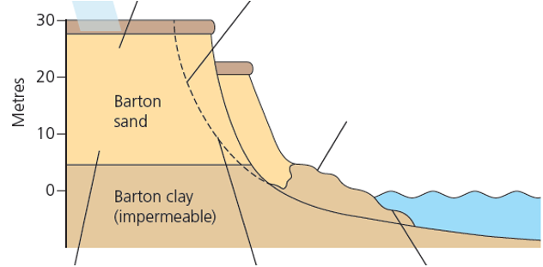
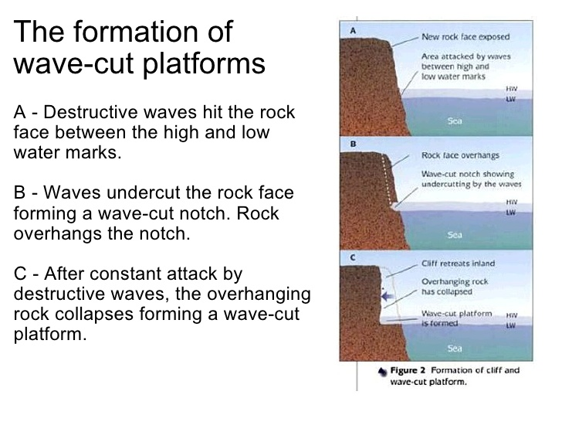
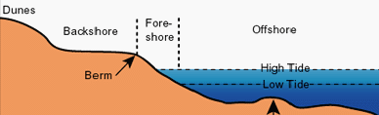
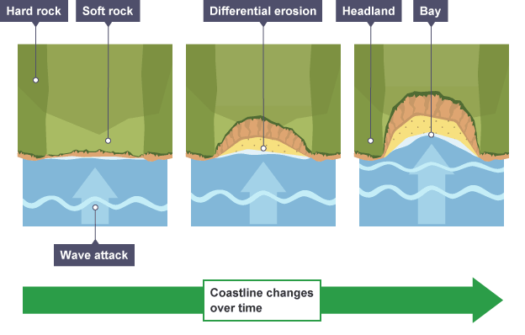
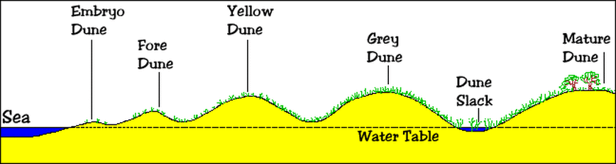
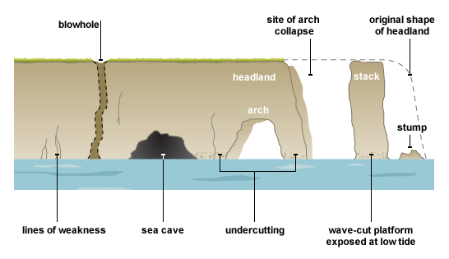
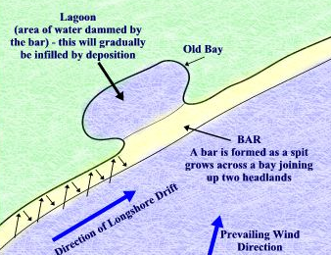
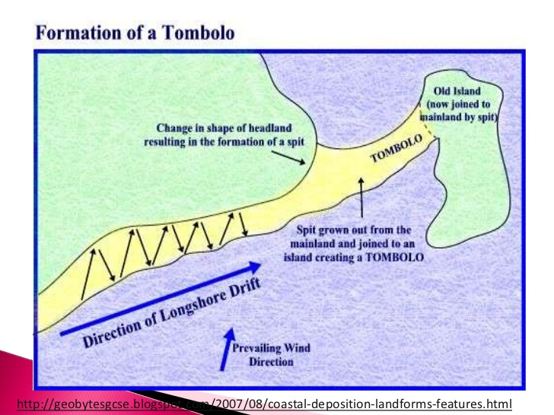
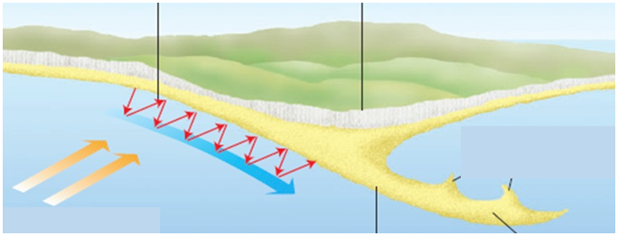
KS4 – The Geography Knowledge – PHYSICAL LANDSCAPES: COASTS (part 2)
Mass movement is the downhill movement of material caused by gravity. Weathering and erosion weaken the cliff making it unstable = mass movement.
Rotational Slump – where saturated material moves down a slope, along a curved line of weakness. | Rock Fall – where rocks fall vertically down a cliff face due to gravity. | Landslide – rock, soil and mud move down a slope due to heavy rainfall and gravity. Heavy rain infiltrates soil and rock = saturated and heavier. The rock becomes unstable. A line of weakness (slip plane) forms. The heavy rain soaked material falls down the slope, along a line of weakness.
Heavy rain infiltrates the permeable rock = saturated and heavier. The rocks become unstable and a CURVED line of weakness (slip plane) forms.
Further rain = increase in weight of rock and increase of pressure on the CURVED line of weakness = land slumps down the CURVED line of weakness due to gravity.
Freeze-thaw weakens the rocks at the top of the cliff.
These weakened rocks fall due to gravity to the base of the cliff.
The material that collects at the bottom of the cliff is called a scree slope.
Erosional Landforms
Depositional Landforms
WAVE CUT PLATFORM | BEACHES – deposits of sand and shingle (pebbles) at the coast. Sandy beaches – constructive waves in sheltered bays. Stronger swash than backwash = material added = big wide beaches. Pebble beaches – destructive waves in exposed coastlines. Stronger backwash than swash = material removed = narrow, steep beaches.
HEADLAND AND BAY | SAND DUNES – mounds of sand at the back of the beach, where material has been blown inland and deposited near obstacles (driftwood/fences) and collected. As you travel inland from the sea, the sand dunes get: taller, larger, darker, more vegetated.
CAVE, ARCH, STACK | BARS AND TOMBOLAS Bar: continued longshore drift = spit grows across the bay = bar and freshwater lake behind. Tombola: continued longshore drift joins a spit to an island.
 | SPITS Waves hit the beach at an angle. Longshore drift transports material along the beach. Where there is a sudden bend in the coastline, the waves lose energy = deposition. Longshore drift continues to transport sediment in the direction it had been travelling, out to sea. More and more sediment builds up = a beach the extends far out to sea (a spit). Strong winds and waves curve the end of the spit = recurved end. The area behind the spit is sheltered from waves = low energy = deposition. Saltmarshes and mud flats are common here. They attract lots of wildlife.
Waves erode (hydraulic action and abrasion) the base of the cliff between the high and low tide levels.
Continued erosion = wave cut notch and overhanging cliff. The notch gets larger = overhanging cliff becomes unstable.
Eventually it collapses leaving a flat area of rock (wave cut platform) and the cliff retreats.
Beaches are made up of the offshore (out to sea), foreshore (between high and low tide lines) and backshore (high up the beach, near the sand dunes).
A headland is a cliff that sticks out into the sea.
A bay is an indentation in the coastline between headlands
Discordant coastlines with different rock types will erode at different rates.
The tougher hard rock (granite) will erode more slowly = headlands.
The weaker soft rock (clay) will erode more quickly = bays.
Bays are sheltered = deposition = beaches are formed.
INLAND
Erosion (hydraulic action, abrasion) attacks a line of weakness n the cliff = cave.
Continued erosion, erodes the back of the cave = arch.
Weathering (freeze-thaw, animals, salt) weakens the top of the arch = unstable. It eventually collapses = stack.
The stack is eroded from the base by the sea and weakened at the top by weathering = stump.
2
5
1
3
4
Notes:
TEMPLATE

Slide 13
KS4 – The Geography Knowledge – PHYSICAL LANDSCAPES: COASTS (part 3)
Our coastline is at risk of erosion due to destructive waves, soft rock and longshore drift. We must protect our coastline, however we cannot protect all of it. For a section of coastline to be protected, the cost of the scheme must be less than the value of the land, property and infrastructure (e.g. roads) saved, and the scheme must have no negative ‘knock-on’ environmental effects, for example making erosion worse somewhere else. The British Government creates shoreline management plans (SMPs) that outline how our coastline will be protected. There are four strategies. Advance the line: build new coastal defence structures in front of existing defence structures. It is expensive and used to protect very high value land. Hold the line: maintain or improve existing coastal defences to continue protecting the coastline from erosion. It is expensive and used to protect high value land. Management realignment: move the line of coastal defences inland and allow the sea to naturally move inland until it comes to a natural barrier of higher land. Leads to loss of land and infrastructure and so used in areas where there is low land value. Do nothing: no change, no investment, no existing or new defences. Natural processes are allowed to shape the coastline. Used in areas where there is very low land value.
Hard engineering – using manmade, artificial structures to prevent erosion and flooding..
More effective, long lasting and need less maintaining than soft engineering, however more expensive and less natural/environmentally friendly.
Soft engineering – using natural, environmentally friendly methods to prevent erosion and flooding. Often cheaper than hard engineering however need more maintaining and have a shorter lifespan.
Sea Wall | A strong concrete wall built in front of the cliff/settlement that absorbs the wave’s energy. Effective, long lifespan, tourists like to walk along it. Expensive to build and maintain, looks unnatural.
Rock Amour | Large rocks placed in front of the cliff or settlement, that absorb the wave’s energy. Effective, long lifespan, more natural than sea wall and easier to build/maintain. Expensive, access to the beach can be difficult, can become slippery and dangerous.
Gabions | A wire cage filled with rocks that are placed in front of the cliff or seaside settlement, that absorb the wave’s energy. Effective, long lifespan, cheaper than rock armour/sea walls, if covered in vegetation can look natural. Wire cages have short lifespan (5-10 years). Sea water corrodes metal cages = broken gabions which can be dangerous to tourists. More expensive than soft engineering.
Groynes | Wood or rock fences built out into the sea. They trap sediment transported by longshore drift and make the beach larger. Groynes - Beach becomes wider = waves lose energy as they rush up the beach = less erosion. Big beaches boosts tourism. They prevent sediment reaching beaches further along the coastline = problem is shifted and not solved. More expensive than soft engineering.
Off-shore Break-water | Stone walls built up in the ocean parallel to the coastline. They reduce the energy of the waves and help deposition to occur = beach gets larger (e.g. Sea Palling), however they can also be very expensive and can interfere with boats.
Beach Nourishment | Adds sediment to the beach to make it wider = acts as a barrier from the waves = reduces erosion and flooding. Cheap and easy to maintain, natural looking, bigger beaches = more tourism Short lifespan, constant maintenance, beach is closed due it is being done.
Beach Reprofiling | Material removed by longshore drift or destructive waves is returned to the beach = prevents the beach getting smaller. Cheap and easy to maintain, natural appearance, bigger beach = more tourists Short lifespan, constant maintenance, beach is closed due it is being done.
Dune Regeneration | Sand dunes are repaired and made larger using fences or marram grass = barrier from the waves. Cheap, very natural, popular with wildlife (creates habitats). While being repaired, dunes are closed = less tourists, constant maintenance as dunes are constantly changing.
Dune Fencing | Fences are built on sandy beaches to collect sand and create new sand dunes = act as a barrier from the waves Cheap, natural, help make dunes larger, minimal impact on wildlife. Can be dangerous if the fences break, need regular maintenance after storms
Managed retreat – a deliberate decision to allow the sea to flood an area of low-value land. People are evacuated, buildings demolished and any existing sea defences removed. The sea floods the land and salt marshes develop which absorb the energy of future waves. New flood defences can be built in high-value land behind the salt marshes. Medmerry Managed Retreat, Chichester, South England: largest managed retreat project in Europe The flat, low-lying land had a low value (used for farming and caravan parks). The sea wall that protected the area needed repairing, but the decision was to not repair it and allow the land to flood as it was cheaper than repairing the sea wall. The managed retreat took place in November 2013.
Example: North Norfolk is located on the east coast of England. Historic records show that between 1600 and 1850, >250m of land was eroded by the sea. This is due to soft rock (clay), large wave fetch (4000 miles from Arctic) and strong weather. Along the coastline they have a number of Shoreline Management Plans (SMPs). Happisburgh – very low land value. SMP: do nothing. Old sea defences are not repaired the cliff is left to erode. Owners were given 40% of their homes full value (non-risk value) Sea Palling – mid land value (homes, few shops, pub). SMP: hold the line. They have a concrete sea wall and offshore breakwaters. Sheringham – high land value (lots of homes and businesses). SMP: hold the line. They have a sea wall, wooden groynes, rock armour and beach nourishment.
ADVANTAGES | DISADVANTAGES
Created large saltmarsh that protected the most expensive inland areas from flooding. Created wildlife habitats Cheaper than repairing sea wall | People and businesses were flooded and relocated. It cost the government £28 million. Large areas of agricultural land was lost.
Notes:
TEMPLATE

Slide 14
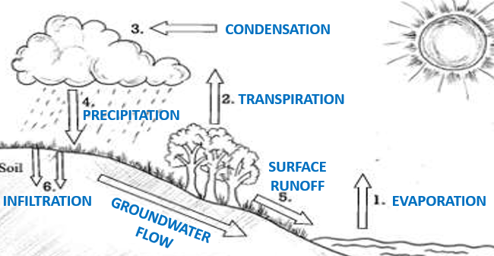
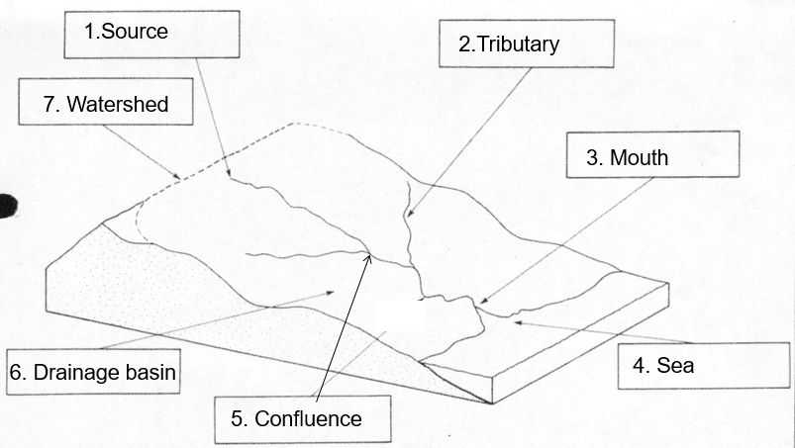
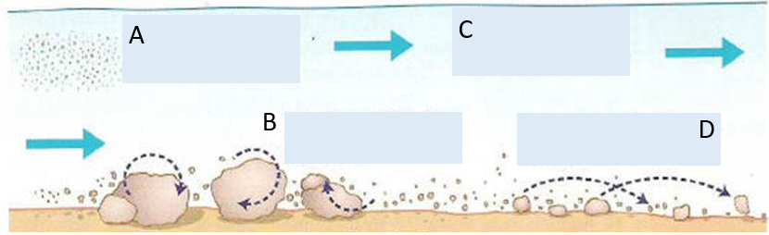
KS4 – The Geography Knowledge – PHYSICAL LANDSCAPES: RIVERS (part 1)
Evaporation | The sun heats up water. The water turns into a gas which rises up into the atmosphere (air).
Transpiration | The sun heats up water on the leaves of trees. The water turns into a gas which rises up into the atmosphere (air).
Condensation | As the water in the atmosphere rises, it cools and condenses to form clouds.
Precipitation | Water in the cloud falls to the earth’s surface as rain, hail, sleet and snow.
Surface run-off | When the water runs off the surface of the ground as a river or stream.
Groundwater flow | When water flows through the rocks and soil underground.
Infiltration | When water enters a rock.
Drainage Basin | The area of land in which water drains into a specific river.
Watershed | The boundary of a drainage basin. It separates one drainage basin from another. It is usually high land.
Source | The point where the river begins.
Tributary | A stream or small river that joins a larger stream or big river.
Confluence | A point where two streams or rivers meet.
Mouth | The point where the river meets the sea or ocean.
Long Profile | Shows the gradient of a river from its source to mouth.
Cross Profile | Shows the shape of the river channel and valley. It is an imaginary ‘slice’ across a river channel/valley at a specific point.
Erosion | The removal of rock by the river
Weathering | The breakdown of rocks caused by the day-to-day changes in the atmosphere
Transportation | The movement of sediment along the river
Deposition | The dropping of sediment
Embankments | Raised river banks on either side of a river
Contour Line | Brown lines on an OS map that join up points of equal height. They allow us to determine slope gradient.
Flood | A flood occurs when there is too much water in the river channel. As a result water spills out onto the floodplain.
Flash Flood | Rapidly rising river levels leading to greater
Storm Hydrograph | Shows how a river changes after a storm and is used to predict floods
Lag time | The time (in hours) between the peak rainfall and peak discharge
Discharge | The volume of water in a river channel (measured in cumecs)
The long profile shows the gradient of a river from its source to its mouth.
The cross profile shows the shape of the river channel and valley. It is an imaginary slice across a river at a specific point.
Rivers are split into three courses:
Upper course: steep gradient; vertical erosion = steep V shaped valleys, waterfalls and gorges; narrow and steep river channel, turbulent water with rapids,
Middle course: gentle gradient, lateral erosion = wider and deeper river valley and channel, less turbulent flow, faster flow, tributaries join = more water added to river. Landforms = meanders
Lower course: very gentle gradient, lateral erosion = very wide open valley floor, widest and deepest river channel, lots of deposition caused by flooding. Landforms = estuaries, floodplain, levees, meanders, ox bow lakes
Erosion is the wearing away or removal of rocks. Erosion attacks the base of the cliff.
Hydraulic Action: The force of the waves hitting the river bed and banks removes material. It is most effective when there is lots of very fast moving water.
Abrasion: Sediment carried by the river repeatedly hits the river bed and banks. It acts like sandpaper removing material.
Corrosion: Chemicals in the water dissolve rocks (e.g. limestone)
Attrition: Stones carried by the river hit into each other, gradually making the rocks smaller and smoother.
Weathering is the breakdown of rocks caused by the day-to-day changes in the atmosphere.
Freeze-thaw: Water collects in cracks. At night this water freezes and expands. The cracks get larger. In the day the temperature rises and the ice melts (thaws). The repeated freezing and thawing weakens the rock = breaks apart.
Transportation: eroded material is carried by the river downstream.
Deposition takes place where a river does not have enough energy to carry sediment (its load). As a result it is dropped.
Larger rocks are deposited first in the upper course as they require more energy to transport them.
Finer sediment requires less energy to move it. As a result it is deposited further downstream in the middle and lower course.
Suspension: small particles are carried in the water.
Solution: chemicals dissolved in the water
Traction: rocks and large pebbles roll along the river bed.
Saltation: Smaller pebbles bounce along the river bed.
Notes:
TEMPLATE

Slide 15
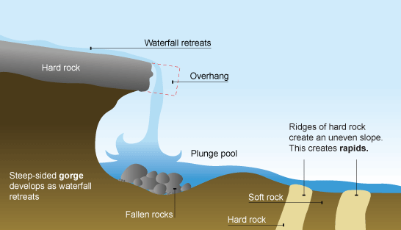
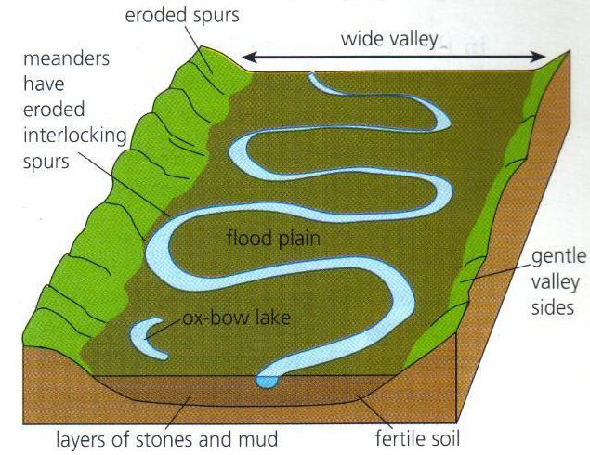
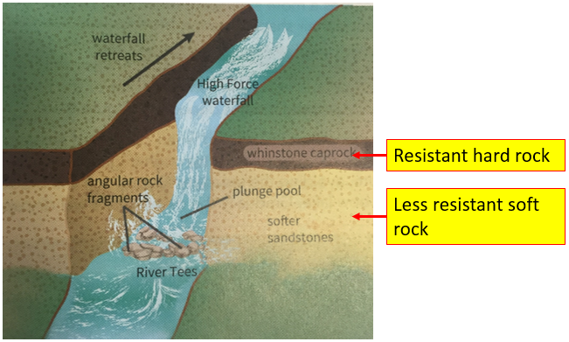
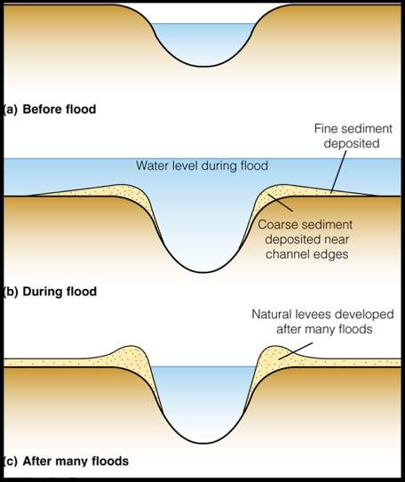
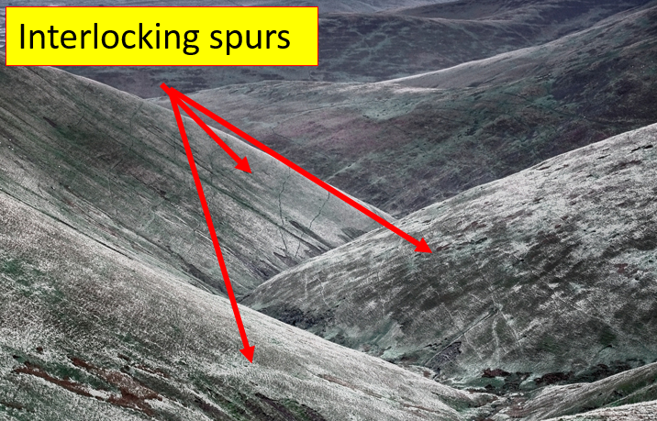





KS4 – The Geography Knowledge – PHYSICAL LANDSCAPES: RIVERS (part 2)
WATERFALL – steep fall of water in the upper course of a river. | A FLOODPLAIN is a wide, flat area of marshy land on either side of a river in the lower course of a river.
 | A LEVEE is a raised river bed found alongside a river in the lower course, caused by repeated flooding
INTERLOCKING SPURS | An ESTUARY is the wide part of a river near the mouth.
MEANDERS are bends in a river on the valley floor. They are caused by lateral erosion. | OX-BOW LAKES are U-shaped lakes formed when a meander is no longer connected to a river.
Waterfalls are formed when hard rock overlays softer rock.
The softer rock is eroded more quickly than the harder rock = plunge pool and overhanging rock.
Continued erosion makes the plunge pool deeper and overhanging rock unstable.
The overhanging rock collapses and the waterfall retreats upstream.
When a river floods in the lower course, it deposits very fine sediment (silt). Layer after layer builds up to form a thick deposit of silt across a very flat wide valley.
The floodplain is made wider due to large meanders that wind across the floodplain.
GORGES – a narrow steep sided valley that is usually found immediately downstream from a waterfall.
It is formed by the gradual retreat of a waterfall over hundreds or thousands of years.
When a river floods, the speed of the river decreases = less energy = deposition.
Heavier, coarser sand and small stones are deposited first next to the river bank.
Lighter silt/mud is deposited further across the floodplain.
Over time the height of the banks are raised by a build up of coarser sand deposits = levees.
In the upper course, the river erodes vertically (downwards) = steep valley sides. Weathering of the valley sides = deep V shape valleys.
The river near the source is not powerful enough to erode horizontally through the hard rock and so flows around it.
The resistant hard rock creates ridges with jut out = spurs. They overlap = interlocking spurs.
Estuaries are the transitional zone between the river & sea.
The water flowing down the river meets water flowing up the river from the sea (during high tides) = river stops flowing = energy reduces = lots of deposition.
Due to deposition, salt marshes form = habitats for wildlife.
In some estuaries humans have made ports for industry.
It starts with a slight bend. Water moves faster on the outside of the bend and slower on the inside.
The fast water erodes the outside of the bend. The slower water deposits material on the inside of the bend. Continued erosion and deposition makes the bend bigger.
Erosion = meander bigger = neck narrows.
3. Eventually the neck breaks through and the water takes the most direct route, avoiding the meander.
4. As less water is flowing through the meander, the energy is reduced = deposition. The meander is blocked off and an oxbow lake is created.
A STORM HYDROGRAPH is a graph that shows how a river’s discharge changes after a periods of rainfall and can be used to predict floods.
NO FLOOD | Trees in drainage basin – intercept rainfall = longer lag time. Gentle rain = more water infiltrated = takes longer to reach river channel Permeable rock = more water infiltrated = takes longer to reach river. Dry soils = more water infiltrated = takes longer to reach river channel Large drainage basins = water has to travel further to reach river = slower
FLOOD | Deforestation – no trees to intercept rainfall = shorter lag time Intense rain = too fast to infiltrate = more surface runoff = quicker to river Impermeable rock = rain not infiltrated = more surface runoff = quicker to river. Impermeable surfaces created when areas are urbanised (concrete). Steep slopes = quick transfer of water to river channel = short lag time
Notes:
TEMPLATE

Slide 16

KS4 – The Geography Knowledge – PHYSICAL LANDSCAPES: RIVERS (part 3)
Hard engineering – using manmade, artificial structures to prevent erosion.
More effective, long lasting and need less maintaining than soft engineering, however more expensive and less natural/environmentally friendly.
c Where: Somerset, south-west England Physical landscape: Somerset is low lying farmland. There are several rivers, including the Tone and Parett, which flow into the Severn Estuary. When: January and February, 2014 Why: 350mm of rain in January and February (100mm above average), high tides, storm surges, rivers had not been dredged in 20 years and so were clogged with sediment.
Dam & Reservoir | Used to regulate river flow and reduce the risk of flooding. The flow of water can be ‘turned off’ during periods of heavy rainfall. The water is stored in a reservoir so that the river does not flood downstream. Effective, long lifespan, used for irrigation, water supply, recreation and HEP. Expensive, damage habitats, people have to relocate due to flooding.
Channel Straightening | Rivers are straightened by cutting through meanders to create a straight river channel. This speeds up the flow of water along the river. Effective as water does not have time to build up, long lifespan. Expensive, unnatural, damage habitats, result in flooding downstream.
Embankment | A raised riverbank (levee) which allows the river to channel to hold more water. Effective, long lifespan, can look natural if covered in vegetation Expensive, if concrete is used it is unnatural and unattractive.
Flood Relief Channel | A man-made river channel constructed to divert water in a river channel away from urban areas. Effective as regulate river discharge (in heavy rain, relief channels are opened) Expensive
SOCIAL EFFECTS | ECONOMIC EFFECTS | ENVIRONMENTAL EFFECTS
600 houses flooded. Many residents were evacuated to temporary accommodation for several months. 16 farms were evacuated Villages (e.g. Moorland) were cut off by the floodwater. This meant residents could not attend school, work or shop. Power supplies were cut off. Local roads and railway lines were flooded. | Somerset County Council estimated the cost at £10 million. 14,000 hectares of agricultural land was under water for weeks. During this time they did not export any products. Over 1000 livestock had to be evacuated. This cost the farmers and insurance companies money. Local roads and railway lines were flooded. These needed to be fixed. | Floodwater contained sewage and chemicals which contaminated farmland.
Soft engineering – using natural, environmentally friendly methods to prevent erosion. It aims to reduce and slow down the transfer of water to the river channel to help prevent flooding.
Often cheaper than hard engineering however need more maintaining and have a shorter lifespan.
To prevent this from happening again, a £20 million Flood Action Plan was launched by Somerset County Council. In March 2014, 8km of the River Tone and the River Parratt were dredged. This is when material/soil/mud is removed from the river bed. As a result the river channel is larger and can hold more water. This prevents the river overflowing its banks. Roads have been elevated in places. As a result even if a flood occurs, people can still drive on the elevated roads. This also helps the economy by allowing import/export. Settlements in areas of flood risk have flood defences. As a result they are able to protect themselves. River banks have been raised. These are called embankments. This means the river channel can hold more water and therefore it is less likely to overflow. They plan to build a tidal barrage in 2024. This is a dam that is near the mouth of the river. It will prevent additional water being added to the channel by high tides or storm surges.
Afforestation | Planting trees to create a woodland/forest Trees slow down the movement of water into channels (longer lag time) = less likely to flood. Water is stored in trees and so less in river channel. Cheap. Less effective than hard engineering.
Wetlands | Where land next to wetlands is left to flood. Cheap, easy to maintain, create habitats, stores water so less in river channel. Short lifespan, constant maintenance, beach is closed due it is being done.
Floodplain Zoning | Land is allocated for different uses according to its flood risk. Land closest to the river is used as parkland and land further from rivers is used for housing and industries. Doesn’t’ stop the flood but reduces overall cost as infrastructure is not destroyed. Flood is not stopped, is difficult to if the land has already been built on.
River Restoration | Returns a river to its natural state (e.g. remove channel straightening or a dam). Cheap, easy to maintain, creates habitats, natural. Flooding still occurs, less effective.
Planning & Preparation | Rivers are monitored to measure flood risk using satellites, instruments and computer models. The Environmental Agency issue alarms if a flood will happen. People can prepare – sandbags around home, move valuable upstairs, evacuate Flood still occurs, house prices can drop if deemed ‘at risk’
Contour lines tell us about the relief of the land (slope gradient). Contour lines are brown lines on an OS map. They join up points of equal height, shown on the lines.
They often show changes in height of 5 or 10 metres.
Contours very close together = steep gradient (upper course – gorge)
Contours far apart = flat land (lower course – floodplain)
http://www.bbc.co.uk/education/clips/zpxwq6f
Notes:
TEMPLATE

Slide 17


KS4 – The Geography Knowledge – URBANISATION (part 1)
URBANISATION is the increase in people living in towns and cities. This causes URBAN GROWTH which is the increase in land area covered by cities. 1950: >33% of the world’s population lived in urban areas. 2015: 55% of the world’s population lived in urban areas. 2050: it is predicted 70% of the world’s population will live in urban areas. WHY? Natural increase. If a country has a higher birth rate than death rate, the population will naturally increase. This type of population is often found in stages 2 and 3 of the DTM where there is a high number of young adults (18-35 years) who are having lots of children and few older people who are dying due to improved healthcare. Therefore urban growth is common in NEEs. Rural to urban migration. The movement of people from the countryside to cities. It is caused by push factors (pushing people out of rural areas) and pull factors (pulling people to cities). High rates of urbanisation are leading to the growth of megacities. A megacity is an urban area with over 10 million people living there (e.g. Mumbai in India). There are now 34 megacities in the world, with more than 65% in LICs and NEEs. More megacities are expected to emerge in Asia and Africa by 2030.
PUSH FACTORS | PULL FACTORS
Farming is hard and poorly paid Natural disasters (e.g. floods and earthquakes) Use of machinery in farming = less people needed to word = unemployment Dry land in rural areas caused by desertification = land cannot be farmed Fewer doctors, hospitals, schools and transportation routes | More highly skilled, better paid jobs Range of entertainment opportunities More and better doctors and hospitals More schools and better education Better transportation routes/public transport
Urban growth is currently occurring faster in LICs and NEEs and slower in HICs because… As a country develops their economy changes from agriculture (primary) to manufacturing (secondary) and services (tertiary). This occurs during the industrial revolution. Most of the secondary and tertiary jobs are in towns and cities. When this occurs, lots of people move from rural to urban areas = rapid urbanisation. HICs went through their industrial revolution a long time ago, whereas LICs and NEEs are going through their industrial revolution now. As a result more people in LICs and NEEs are currently moving to urban areas. LICs and NEEs are in stages 2 and 3 of the demographic transition model. In these stages there is a high birth rate and lower death rate. As a result more people are being born than are dying = the population naturally increases. In HICs there is a low death rate and even lower birth rate = the population is declining. In NEEs, a lot of economic development is happening (e.g. Brazil, Mexico, China, India). This means lots of jobs are available in cities = people move to urban areas = urbanisation. Counter-urbanisation in HICs is more common. People decide to leave cities and live in the surrounding countryside to get a better quality of life (less pollution, quieter, more space). They can commute to work due to improved transportation. URBAN GROWTH IN AN LIC or NEE : RIO DE JANEIRO URBAN GROWTH IN THE UK : BRISTOL
………………………………………………………………………………………………………………………………………………………………………………………………………………………………………………………………………………………………………………………………………………………………………………………………………………………………………………………………………………………………………………………………………………………………………………………………………………………………………………………………………………………………………………………………………………………………………………………………………………………………………………………………………………………………………………………………………………………………………………………………………………………………………………………………………………………………………………………………………………………………………………………………………………………………………………………………………………………………………………………………………………………………………………………………………………………………………………………………………………………………………………………………………………………………………………………………………………………………………………………………………………………………………………………………………………………………………………………………………………………………………………………………………………………………………………………………………………………………………………………………………………………………………………………………………………………………………………………………………………………………………………………………………………………………………………………………………………………………………………………………………………………………………………………………………………………………………………………………………………………………………………………………………………………………………… ………………………………………………………………………………………………………………………………………………………… …………………………………………………………………………………………………………………………………………………………
Notes:
TEMPLATE

Slide 18




KS4 – The Geography Knowledge – URBANISATION – RIO (part 2)
RIO DE JANEIRO is located in Guanabara Bay, on the south-east coast of Brazil. It lies next to the Atlantic Ocean. It is the cultural capital of Brazil and 2nd largest city, with a population of 12.5 million. It has a growing global importance as an industrial and finance centre. It hosted the 2014 World Cup, 2016 Olympics and annually the Rio Carnival. Many people have moved to Rio from rural Brazil and wider countries, including South Korea, China, UK, USA, Portugal (due to shared language), Argentina and Bolivia.
Urban growth in Rio has also created many social, economic & environmental challenges
Challenge | Evidence in Rio
Lack of healthcare | In 2013 only 55% of the city had a local family health clinic.
Lack of education | Not enough schools, teachers or funding for education.
Lack of water supply | Around 12% of Rio does not have access to running water.
Lack of energy | Due to illegal tapping onto electricity lines = blackouts.
Unemployment and informal sector jobs | Many people are unemployed or work in the informal sector (e.g. street vendor), which are poorly paid, no contract, no taxes paid.
Air pollution | caused by too many cars and growth of factories = 5000 deaths per year.
Water pollution | caused by sewage running into rivers (200 tonnes/day) and industrial waste from factories and oil spills.
Waste pollution | a lack of waste disposal = rubbish on streets.
Creation of squatter settlements (favelas) | These are illegal settlements on the outskirts of cities where people have built homes on land they do not own. Characteristics: Poorly built homes using basic materials Houses built on steep slopes = landslides (e.g. 2010: 224 killed and 13,000 lost their homes) and limited road access 30% no electricity, 50% no sewage system and 12% no running water. 20% are unemployed. Those who are, are employed in informal sector Drug gangs are common & police is rare (murder rate is 20 per 1000ppl) Infant mortality rate: 50 per 1000 people due to high population densities (37,000 per km²), lack of waste disposal, spread of disease and lack of health care.
Urban growth in Rio de Janeiro has created many social and economic opportunities:
Opportunity | Evidence in Rio
Jobs Jobs with higher wages (tertiary) | Rio provides >6% of all jobs in Brazil. Rio is home to many manufacturing industries, (pharmaceuticals, clothing, furniture and processed foods) and service industries (banking, insurance). As Rio grows there are many jobs in construction
Economic growth | The growth of urban industrial areas can increase economic development. It will attract businesses to the area.
Better access to education | Rio provide grants to poor families to encourage children to attend school. Rio have many volunteers who help in schools. There are adult classes to help adults gain skills = better jobs
Better access to services | Rio has a new nuclear generator and hydro-electric power station = more energy produced. 60km of new electricity lines = better access to energy By 2014, 95% of Rio had access to a mains water supply. This was due to 7 new water treatment plants and 300km of new water pipes being laid. 12 new sewage works have been built and 5km of sewage pipes installed in badly polluted areas.
Better access to healthcare | Some areas in Brazil (Barra de Tijuna) have a life expectancy of 80 years old. Brazil (as a country) has an average life expectancy of 63 years. Medical staff go into favelas and offer emergency medication to people’s homes.
More entertainment | One of the world’s top tourist destinations - The Statue of Christ the Redeemer, stunning natural surroundings and entertainment.
More transport options | It has two major airports and five shipping ports Public transport, toll roads and one way systems to control traffic
URBAN PLANNING: improving quality of life in favelas. Favela Bairro Project is a site and service scheme that improves quality of life in Complexo de Alemao (favela in north Rio). Roads have been improved and paved Improved access to water pipes and sanitation Hillsides strengthened to prevent landslides New healthcare, leisure and education facilities Cable car has been installed that connects favela to centre of Ipanema (central Rio). Favela residents given free return daily ticket. 100% mortgages provided for locals to buy homes A Pacifying Police Unit (UPP) was set up = less crime Successful because: access/mobility is better = access to jobs in city centre, improved healthcare, education, access to services, 100% mortgages = more people can buy homes, less crime, fewer landslides. Unsuccessful because: new infrastructure not maintained and residents did not have skills to fix it, area improved = increase in demand to live there = increase in rent = poorest had to move, budget of US$1 billion could not help all favelas.
Notes:
TEMPLATE

Slide 19
KS4 – The Geography Knowledge – URBANISATION – BRISTOL (part 3)
Population Distribution | The way something is spread out over an area.
Industrialisation | Growth of secondary manufacturing
De-industrialisation | Decline of secondary manufacturing
Post industrial economy | Economy is mainly tertiary and quaternary industries
Brownfield site | Land that has previously been built on
Greenfield site | Land that has never previously been built on
International Migration | The movement of people across countries.
Urban Growth | The increase in the proportion of people living in urban areas.
Urban Sprawl | Unplanned growth of urban areas into the surrounding rural area
Urban Greening | Increasing the amount of green space in a city.
Social Inequalities | Some areas have more opportunities than others.
Rural-urban Fringe | The area on the edge of a city, where it meets the countryside.
Green Belt | Protected land at the rural-urban fringe where building is restricted.
Dereliction | Areas that are abandoned and become run down
Urban Regeneration | The reversal of urban decline through redevelopment, aiming to improve the local economy
Social Deprivation | When a person or area is deprived of services and amenities.
The UK’s population is unevenly distributed. 82% of people live in urban areas 32% live in London and the South East Sparse populations – Scotland and Wales Why do more people live in urban areas? Higher paid jobs and better working conditions in tertiary and quaternary sector, more entertainment options, better transport, more housing, better healthcare and education. Why do more people live in the south-east? Warmer, less rainfall, flatter land in the SE. In central Scotland and Wales its is colder, more rainfall and mountainous. Bristol is located in the south-west of England. It’s population is 440,500 people, which is expected to grow to 500,000 by 2029. International migration has accounted for 50% of Bristol’s population growth. There are 50 countries represented in its population. High levels of international migration have had many positive and negative impacts: Hard working workforce that bring new skills = contribute to local/national economy Enrich the culture of the city (food, music) Young migrants balance aging population Pressure on housing, healthcare and education Language barrier and different religions= challenge to integrate into wider community Why do people migrate to Bristol? Culture/entertainment– sport venues, theatres, music venues, cathedrals Two cathedrals – religious importance Two universities – higher education Transport (M4, M5, rail) link Bristol to UK Transport (ports/airports) link Bristol to Europe and USA. Economic growth – in tertiary and quaternary industries = jobs (finance, technology, aerospace, media, defence) Economic growth due to inward investment from companies such as airbus (France) and BMW (Germany).
OPPORTUNITIES IN BRISTOL Bristol is constantly changing as it grows (population, economy, industrialisation, de-industrialisation, regeneration) . These changes create a number of social, economic & environmental opportunities. SOCIAL OPPORTUNITIES Increase in migration = diverse population = range of food, festivals and cultural experiences. Entertainment: new theatres and music venues (the Old Vic, Bristol Arena and Tobacco Factory) Recreation: lots of sport teams (rugby, cricket, football) are developing their opportunities for people in Bristol. Bristol Rovers are building new football stadium on the outskirts of the city. New shopping centres: Cabot’s Circus in the city centre and Cribbs Causeway on the outskirts of the city offer residents shops, cinemas, restaurants, accommodation, jobs…etc. Improved transportation links (e.g. an integrated transport system, metrobus, electrification of the trains to London and improved public transport) = people can get around Bristol faster and the air is cleaner (due to less cars = less pollution). ECONOMIC OPPORTUNITIES Growth in tertiary and quaternary industries = employment opportunities (85% of jobs are in tertiary, 6% in quaternary, 8% in secondary and 1% in primary). Redevelopment of brownfield sites (e.g. the Temple Quarter) has attracted new tertiary and quaternary companies = jobs = higher disposable income = money spent in local area and therefore reinvested into the area = further economic development. Growth of high-tech industries due to access to highly skilled university graduates, research facilities, clean non-polluted environment, cheaper land, superfast broadband speeds (the government gave £100million to create a super connected city). Companies include: Hewlett-Packard, Toshiba, Aardman Animations (clay films), Defence Procurement Agency (DPA) (employs 10,000 people to make army and navy products) and aerospace (14 of the 15 main aircraft companies are in Bristol (e.g. Rolls Royce and Airbus) who produce aircraft parts and navigation/communication systems. ENVIRONMENTAL OPPORTUNITIES As the city has grown, Bristol has created transport systems to reduce traffic congestion. Bristol’s Integrated Transport System links different forms of public transport. (e.g. part of the ITS is the Rapid Transit Network which connects three bus routes, the Temple Meads railway station and park and ride network). They have also improved the rail links through electrification of the line to London = greener energy and faster connection to London. As the city has grown and redeveloped, Bristol has focused on urban greening, to increase and preserve open green spaces. Urban Greening: Bristol has worked and its continuing to work very hard. Currently in Bristol: 90% of people live within 350m of parkland with 300 parks in the city 27% of the city is part of a wildlife network and 30% of the city is covered in trees Brownfield sites are turned into green spaces (Queen Square was a dual-carriageway) EXAMPLE: In 2015 Bristol became the 1st UK city to be awarded the status of: European Green Capital. Their current goals and achievements include: To reduce energy use by 30% and CO₂ emissions by 40% by 2020; In 2015 100 electric car charging points were installed. Increase the use of brownfield sites for businesses and housing. In 2015 every primary pupil in Bristol planted a tree to increase Bristol’s green coverage. Increase the use of renewable energies from 2%.
Notes:
TEMPLATE

Slide 20
KS4 – The Geography Knowledge – URBANISATION – BRISTOL (part 4)
CHALLENGES IN BRISTOL Bristol is constantly growing. These changes have created a number of challenges in Bristol, such as urban sprawl, derelict buildings, waste disposal, air pollution, social inequalities and housing pressure on the rural-urban fringe.
CHALLENGE: RISE IN DERELICT AREAS: Industrial decline in the 20th century was caused due to an increase in manufacturing abroad, closure of many inner city ports and rise in tertiary and quaternary industries. As a result many inner city areas, such as Stokes Croft, became abandoned, run-down and deprived. Plans to fix the challenge of derelict areas. Lottery grants have helped improve the area of Stokes Croft. The money has been used to redevelop buildings, attract new businesses and create green spaces. Artists are used public to make the area more appealing New music venues, independent shops and nightclubs have opened in the area = improving the area’s environment. | CHALLENGE: URBAN SPRAWL Urban sprawl is caused by a rise in population and lack of housing (4000 homes were damaged/destroyed in WW2). The demand for new housing has resulted in many people moving to the suburbs (outskirts of the city). This puts pressure on the rural-urban fringe for new housing = development of greenfield sites. e.g. Bradley Stokes and Harry Stokes are examples of new developments on greenfield sites. 1200 new homes have been built at Harry Stokes, with 2000 more planned. Building on greenfield sites is cheaper and buyers like it due to the clean environment, however it results in congestion, air pollution, loss of farmland and habitats, loss of green space and increases the risk of flooding. | Plans to reduce urban sprawl Focus on building new homes on brownfield sites. Between 2006 – 2013 only 6% of new housing developments were on greenfield sites. By 2026, over 30,000 new homes are planned on brownfield sites. Redeveloping brownfield sites is more expensive as land must be cleared and decontaminated from previous industrial use. However, it is the best option. Bristol’s Harbourside was a derelict area in Bristol city centre. They have spent 40 years redeveloping the area, building flats and culture and leisure facilities. Finzels Reach is a 2 hectare brownfield site near the CBD. The abandoned factories and warehouses were redeveloped to create new offices, shops and 400 apartments.
CHALLENGE: WASTE DISPOSAL Bristol produces 500,000 tonnes of waste/year and is currently produces the most food waste in the UK. Plans to reduce issues with waste disposal: Reduce the waste sent to landfill sites. In 2004/05 88% of waste was sent to landfills. In 2012/13 it was only 27%. Increase recycling by making it easier to recycle by using roadside collections. In 2004/o5 12% of waste was recycled. In 2012/13 it was 51%. Increase the amount of waste that is sent to waste treatment plants where the waste is used to generate energy. (e.g. Avonmouth treatment plant makes electricity for 25,000 homes). | CHALLENGE: AIR POLLUTION Bristol is the most congested city in England = air pollution = 200 deaths per year. The prevailing winds from the south-west blow pollution from the industrial area at Avonmouth over the city. Plans to reduce air pollution: Integrated Transport Network Frome Gateway: a walking/cycling route to the city centre. Electrical vehicle charging points in 40 car parks Poo bus: buses between Bath and Bristol Airport will fun on bio-methane gas produced from human waste. | CHALLENGE: SOCIAL INEQUALITY Some areas in Bristol are more deprived than others. This is know as social inequalities. It is due to a lack of investment from the government.
FILWOOD | STOKE BISHOP
1/3 of people live in low-income homes Over 1300 crimes per year 36% of students get top GCSEs Life expectancy is 78 years old 1/3 of people aged 16-24 are unemployed Poor access to fresh fruit & veg. 62% of people feel unsafe at night | Fewer than 4% live in poverty Less than 30 crimes per year 94% of students get top GCSEs and 50% have a degree Life expectancy is 83 years old 3% of people are unemployed Highest level of car ownership in the city
EXAMPLE OF REGENERATION: THE TEMPLE QUARTER, BRISTOL.
Social improvements:
New transport links (e.g. new bridge across the River Avon to the Bristol Arena)
Improved transport links (e.g. electrification of the rail link to London = faster)
Improved public transport – ITS and rapid transit network
New entertainment: Bristol Arena: theatre that seats 4000 people for conventions, exhibitions and concerts. It also can host sporting events for 12,000 people.
Economic improvements:
Jobs: Enterprise Zones offer incentives (e.g. low rent) to businesses to move to the area
Jobs: Engine Shed – high tech hub attracts quaternary industries
Jobs: New office developments such as Glass Wharf and Temple Studios
Environmental improvements:
Improved public transport (ITS, RTN, improved Temple Meads station) = encourages people to use it and not drive = less air, noise and visual pollution.
Electrification of the line between London and Bristol = greener (less pollution)
The Temple Quarter is located in central Bristol. It is the first part of the city that visitors see when driving from the south/south-east or arriving by train.
It was developed in the 18th century as a industrial area (glassworks, gasworks, ironworks, lighting). In 1841 a railway line was added. Extra lines were added until they covered 40% of the area.
The closing of the city port and growth of tertiary and quaternary industries = many factories closed and people moved away. The area became rundown, abandoned and derelict.
The government decided to do something and began a massive Urban Regeneration project. Successful urban regeneration must improve an area socially economically and environmentally.
Redeveloping brownfield sites is often more expensive as the land must be cleared first and it might be contaminated from previous industrial use. However, it is always the preferred option.
Notes:
TEMPLATE

Slide 21
KS4 – The Geography Knowledge – URBANISATION – BRISTOL (part 5)
SUSTAINABLE URBAN PLANNING Sustainable cities are cities that meet the needs of the people who live in them today, without meaning that future generations do not have their needs met. Basically it means behaving in a way that does not irreversibly damage the environment or use up resources faster than they can be replaced. There are many things that cities can do to be more sustainable.
FREIBERG: A SUSTAINABLE CITY | TRAFFIC MANAGEMENT STRATEGIES
Freiburg is located in the south-west of Germany. In 1970 is set a goal to become a sustainable urban area. Preventing the overuse of water: water conservation – collecting and recycling water to prevent overuse. Collecting and recycling water: Green roof gardens with water harvesting systems, which collect rainwater to reuse. Inhabitants are given incentives to use less water. Waste water systems allows rainwater to be retained, reused or to seep back into the ground (e.g. permeable pavements). Water in the River Dreisam, which flows through Freiburg, is managed using flood retention basins. These reduce the danger of flooding by storing excess water, which is used in the city. Prevent overuse of water: Toilets installed that use less water to flush = people use less water. Water meters that remind residents how much water they are using = people use less water Preventing the overuse of energy and increasing the production of energy from renewable sources. Freiburg plans to be 100% powered by renewable energy by 2050. This will require many residents to half their current use of energy. Renewable energies It is one of the sunniest cities in Germany so solar power is used. There are approximately 400 solar panels installations in the city, including at the railway station and football stadium. These produce 10 million kilowatts of electricity per year. Freiburg’s solar valley employs 1000 people in solar technology, in the production of solar panels, developing solar technology, such as solar cooling technology. Other renewable energies that Freiburg uses include biomass and biogas. Prevent overuse of energy: The government provide incentives to encourage people to become more energy efficient, by allowing homeowners to sell any excess energy to the national grid. Increasing the amount of green spaces. Green spaces are environmentally sustainable as they provide clean air, habitats and prevent flooding during intense rainfall. They are also socially sustainable as they create a calm, relaxing space for people to spend time and encourage exercise. Afforestation – 75% of the deforested trees are re-grown every year. River Dreisam does not have any flood management strategies and provides natural habitats for animals and vegetation. 44,000 trees have been planted in the city = 40% of the city is forested. Of these areas, 56% are nature conservation areas. In the Riselfield District, 78 hectares are built on and 240 hectares are open space. | Traffic congestion can lead to a number of problems: Air pollution, health problems (e.g. asthma), higher fuel consumption, accidents, increased journey times, noise and visual pollution, loss of habitats, cost of maintaining roads…etc. There are many traffic management strategies to reduce the issue of traffic congestion.
CYCLE ROUTES are often provided alongside existing main roads, with some new cycle paths that exclude cars. There are many benefits of cycling. Increase exercise, improve health, reduce air pollution, reduce stress, reduce congestion. The number of people cycling in Bristol has doubled in the last 10 years. To encourage even more people Bristol has: made 20mph speed limits, increased cycle routes, installed cycle maps and signs and increased bike parking zones.
METROBUS is a new express bus service in Bristol. It is made up of three routes that link key areas in Bristol. It will encourage more people to use public transport by improving the service it provides. Faster and more reliable than current buses, next stop announcements, bus stops with real time information and full accessibility. In Bristol the MetroBus is made up of 3 routes that link key areas of Bristol. They have priority over other transport = quicker journey times. e.g. Long Ashton Park and Ride to Hengrove currently takes 50 minutes. The MetroBus will take 12 minutes.
PARK AND RIDE: Free car parks are available on the outskirts of the city. People then take the bus into the city centre. One bus with 40 passengers causes less congestion than 20 cars with 2 people in each They have social, economic and environmental impacts: Less cars in the city = less congestions = less pollution (air, visual, noise), less time wasted in traffic, less accidents, less space needed in the city centre for car parks. Bristol has three Park and Ride Schemes around the city.
AN INTEGRATED TRANSPORT NETWORK is a system that links different forms of public transport within the city and the surrounding area to make journeys smoother and easier. It is a sustainable transport system that reduces congestion as more people are travelling by public transport by making it easier and more convenient. e.g. The MetroBus is a Rapid Transit Network and part of the ITS. It connects 3 bus routes, the Temple Meads railway station and Park and Long Ashton Park and Ride.
Congestion Charge – motorists pay £11.50 to drive the centre of London. This means more people are likely going to use public transport as it is cheaper. It dramatically reduced the number of cars in London (by 21% in just 3 years). It has also reduced accidents, pollution and shortened journey times.
Oyster Cards – integrated payment cards that can be used on a variety of different types of public transport. This encourages people to use public transport as it is easier and more convenient.
Car Pool – people are encouraged to share car journeys together. Benefits include cheaper fuel, less congestion, less pollution and reduced overall car service costs (as you will be using your car less).
Notes:
TEMPLATE

Slide 22


KS4 – The Geography Knowledge – THE CHANGING ECONOMIC WORLD (part 1)
HIC | High Income Country
NEE | Newly Emerging Economy
LIC | Low Income Country
Development | The process of change for the better
Development Indicators | A measure of development
Birth Rate | Number of births per 1000 people
Death Rate | Number of deaths per 1000 people
Infant Mortality Rate | The number of deaths of infants under the age of 1 per 1000 people
Life expectancy | The number of years an average person is expected to live
Access to Clean Water | Percentage of people with access to safe drinking water
Literacy Rate | Percentage of people with basic reading and writing skills
Gross National Income | Total income of a country (including money earned overseas).
Gross Domestic Product | Total income of a country (excluding money earned overseas).
Number of Years in School | The number of years an average person spends at school
People per doctor | The number of doctors per 1000 people
Human Development Index | Used by the UN to determine development. It uses literacy rate, GDP, life expectancy and number of years in school.
Causes of the Development Gap Social: education is worse in LICs = people do not develop skills = stay poor. Less water and it is dirtier in LICs = more disease and death = high death rates. Economic: LICs sell cheap primary goods and buy expensive secondary goods = stay poor. HICs sell expensive secondary goods and buy cheap primary goods = get richer. HICs have better trade links. LICs are in debt. Physical: more natural disasters occur in HICs = money spent fixing instead of developing country. Extreme climates in LICs = cannot grow crops easily = fewer goods to export. Central African countries are landlocked = not easy to trade. Historical: Colonialism in 1400s = LICs were exploited by HICs and became reliant on HICs. After LICs gained independence, corruption and civil wars occurred. Other countries and companies do not want to do business with countries experiencing corruption or civil war. Also the governments do not spend money on the things that matter (e.g. food, water, education). | Effects of the Development Gap Difference in wealth: HICs are richer. The USA’s share of global wealth is 35%. Africa’s share of global wealth is just 1%. Difference in health: there is a higher death rate and lower life expectancy in LICs, where 4/10 children die before 15 years and only 2/10 life past 70 years. Migration: the movement of people from one place to another. People leave voluntarily (e.g. for a job or family) or are forced (due to war). An economic migrant is someone who chooses to leave. A refugee is someone who is forced to leave.
AID A country receives help from another country of NGO, in the form of money, emergency supplies, food, technology, skills. WaterAid (water pumps) or Oxfam’s Goat Aid. | TOURISM LICs and NEEs can use tourism to generate income and improve their healthcare, food, water and education. Tourism brings Jamaica $2 billion per year (45% of its GNI). They use this to develop. | MICROFINANCE LOANS Very small loans given to locals in LICs to start small businesses. They help the economy to grown and employment rates to rise. Grameen Bank in Bangladesh offer low interest loans of $100 to develop small businesses.
DEBT RELIEF HICs reduce the amount of money LICs and NEEs have to pay back (reduce interest or invested money). In 2006, the International Monetary Fund cancelled the debts owed by 19 LICs. | FAIR TRADE Ensures the farmers in LICs and NEEs get a fair price for their crops and invest money in local communities. Uganda coffee farmers get additional income from Fairtrade premium. | INVESTMENT Countries & TNCs invest money and expertise in LICs to increase their profits. It helps LICs with employment, income and accessing resources. Shell and KFC in Nigeria. Also more than 2000 Chinese companies invest billions in Afria.
Population Pyramids and the Demographic Transition Model The population is divided up into 5 year gaps. It tells you the number of men/women alive in each 5 year gap. It shows a snapshot of the population at the time it was created.
Notes:
TEMPLATE

Slide 23
KS4 – The Geography Knowledge – THE CHANGING ECONOMIC WORLD – NIGERIA (part 2)
Nigeria is a newly emerging economy. It is located just north of the equator in west Africa. It borders four countries including, Chad, Cameroon, Niger and Benin. The Atlantic Ocean is found along its southern coastline. Its two largest cities are Abuja (the capital) and Lagos. Since 1990 Nigeria’s population has increased to over 182 million people. Since 1990 the number of people living in cities has increased to over 87 million people.
Political Context Prior to 1960 Nigeria was a British colony. In 1960 it gained independence. Until 1970 there were power struggles and civil wars as groups tried to gain power. Since 1999 it has had a stable government = lots of foreign investment. (China invests in construction in Abuja) (American companies invest in power) | Social Context Multi-ethnic – there are many groups of people who identify with different cultures and traditions (e.g. Yoruba, Hausa and Fulani, Igbo) Multi-faith – there are many religious groups (e.g. Christianity, Islam and traditional African religions). This social diversity has often resulted in conflicts between different groups.
Environmental Context North – savannah and semi-desert. In the savannah lots of farming occurs (cattle, cotton, millet). Drier in the north. South – rainforest. High rainfall and temperatures. Crops – rubber, cocoa, oil palm. It suffers from the tsetse fly so not many cattle. | Cultural Context Music (e.g. Fela Kuti) Cinema – Nollywood: 2nd largest film industry worldwide. Literature – Wole Soyinka Sport – winner of African Cup of Nations
Local importance Nigeria: fastest growing economy in Africa. In 2014 it had the highest GDP in Africa and the 3rd largest manufacturing industry. Highest agricultural ouput in Africa, employing 70% of the population. They grow yams, millet and keep livestock. Nigeria can act as a role model for other African countries who are hoping to develop. | Global importance Nigeria: fast growing economy. In 2014 it became the world’s 21st largest economy. It is predicted to have the world’s highest GDP growth for 2010-15. It supplies 2.7% of the world’s oil, making it the 12th largest producer. It accounts for 14% of Nigeria’s GDP and 98% of its exported earnings. It has a diverse economy with growth in telecommunications and the media. Politically global – it is the 5th largest contributor to UN peacekeeping missions.
Nigeria's political links Nigeria's Trade links
Nigeria’s Changing Economy Primary – extraction of raw materials (agriculture, mining, fishing) Secondary – manufacturing industry of raw materials (food processing, clothes) Tertiary – selling of services and skills (education, health service, transportation) In 1999 people mainly employed in the primary sector. By 2012 there is a balanced economy with similar number of people employed in the primary, secondary and tertiary sectors. This is due to: Decline in primary sector: increased used of farm machinery and better pay/better working conditions in manufacturing industries. Increase in secondary sector – stable government and rise of construction, food production and motor manufacturing. Increase in tertiary sector – improved trade links = increase in telecommunications and finance Increase in tertiary sector – increase in number of people who speak English. Knock on benefits of rise in manufacturing sector (the multiplier effect) Higher income = increase in money to buy goods from Nigerian companies (cars, clothes, etc) Higher sales of one product (eg cars) = increase demand for car parts, made by another company. Increase in employment and wages = increase in taxes. Thriving industrial sector = increase in foreign investments = further economic growth. Oil processing chemical by-products (waste products) can be used to make soaps and plastics
Commonwealth | It has equal status with all countries in the commonwealth, including the UK
African Union | Economic planning and peacekeeping group with Niger, Chad, Benin and Cameroon. It provides troops.
United Nations (the UN) | In 2013 Nigeria was the 5th largest contributor of troops for peacekeeping.
ECOWAS | Economic Community of West African States is a trading group
CEN-SAD | Community of Sahel-Saharan States is a trading group.
Import | Telephones. Cars, rice and wheat | China, EU, USA, India, Japan
Export | Crude oil (sweet oil) Agriculture – rubber, cocoa, cotton | EU, USA, China, India, Indonesia, Brazil
Transnational Corporations in Nigeria Globalisation: the increase in links between countries and people across the world, which has been made easier by improved communications (internet, smart phones) and improved transport (airplanes, cargo ships). Globalisation has led to the creation of TRANSNATIONAL COPORATIONS, which are companies that operate in several countries. There are around 40 TNCs in Nigeria. Many have their headquarters in the UK, USA or Europe, such as KFC, Unilever and Shell Oil. Shell Oil in the Niger Delta It is an Anglo-Dutch company with its headquarters in the Netherlands. Since oil was discovered in the Niger Delta in 1958, Shell has been present in Nigeria. The swampy river delta is very difficult to extract oil. Luckily the very rich TNC, Shell, was able to invest huge sums of money and expertise to extract the oil.
Advantages | Disadvantages
Increase in jobs. Shell has provided 65,000 jobs and a further 250,000 jobs in related industries (e.g. companies who make parts for the oil rigs) People have more money to spend in local shops = boosts local economy. Country earns money from increased exported goods and increased taxes. TNCs often invest in the local infrastructure and education. Increased demand of products that design parts. Shell give 91% of contracts to local Nigerian companies | Working conditions/wages in sweat shops are bad. Oil spills cause water pollution & soil degradation, reducing crop production and fishing yields. Oil flares from oil rigs send toxic fumes into the air. Local workers are poorly paid. Much of the profits generated goes abroad to the country where the TNC has their headquarters. Oil Theft and sabotage are big problems in the Niger delta. It can cause reduced production levels and costings TNCs and the government billions of dollars.
Notes:
TEMPLATE

Slide 24

KS4 – The Geography Knowledge – THE CHANGING ECONOMIC WORLD – NIGERIA (part 3)
AID in Nigeria Types of aid: Emergency aid: aid given immediately after a disaster or war (e.g. food, shelter, medical supplies) Developmental long-term aid: aims at improving quality of life over a longer time (e.g. WaterAid, schools, roads, electrical supplies) Aid can be given by: Individuals Charities and non-governmental organisations (NGOs) (e.g. Oxfam, WaterAid) Governmental aid from countries (e.g. UK, USA) International organisations (e.g. World Bank, International Development Agency (IDA)) Why does Nigeria need aid? 60% of Nigerians (almost 100 million people) live on less than $1/day (£0.63p/day). Many Nigerians live with limited access to services such as clean water, sanitation and electricity. Birth rates and infant mortality rates are high and life expectancy is low. What aid does Nigeria receive? Nigeria receives 4% of all aid given to Africa. In 2013 = $5000 million = 0.5% of their GNI Aid came from: UK, USA, World Bank, charities, NGOs The Aduwan Centre In northern Nigeria, the Aduwan community did not have a health centre. In 2010 wit the support of ActionAid and the World Bank, they built a new health clinic. This supported people by: Trains local women to educate mothers about the importance of immunising their children against polio and other diseases. Develops skills and knowledge, long term, helps important problem, involves local community. Tests for HIV and immunises children against polio. Helps important problem. Unfortunately still 100 million Nigerians live on less than $1/day and have limited access to clean water and sanitation. This is partly due to: Corruption by individuals or the government. Money is diverted by the government to other projects (e.g. the military or navy) Donors (whose who give money) give the aid but insist on where it is spent. This is not always in the best interest of the people (e.g. Akosombo Dam)
Negative environmental impacts of rapid economic development
Industrial Growth – increase in factories and industrial plants. Water pollution caused by harmful pollutants running into drains (e.g. Kano, Kaduna and Lagos). Water pollution caused by chemical waste being disposed on nearby land. Air pollution caused by factories releasing harmful gases into the atmosphere. | Urban Growth – increased urbanisaiton = too many people in towns and cities. Not enough houses = squatter settlements Not enough services Not enough waste disposal = rubbish on ground Not enough roads = traffic congestion and pollution.
Mining and Oil Extraction Tin mining = soil erosion and water pollution Oil spills in Niger Delta = fires, air pollution, acid rain, water pollution…etc Bodo Oil Spill (2008-9) Leaks in a pipeline = 11 million gallons of crude oil to spill over the land. Farmers and fishermen lost their livelihoods. In 2015 Shell agreed to pay £55 million in compensation to be spent on health clinics and schools. | Commercial farming and Deforestation 70-80% of Nigeria’s forests have been deforested = many species have disappeared (cheetahs and giraffes and nearly 500 types of plants) Farming has caused land degradation. Groundwater pollution caused by harmful chemicals leaking into soil and river channels The building of roads and settlements have destroyed habitats and increased carbon dioxide emissions.
How has economic development affected quality of life in Nigeria? Better paid jobs in manufacturing and service industries Higher wages = more disposable income = more money spent on schooling, homes, food, clothes…etc. Better access to clean water and sanitation Improvement to infrastructure (e.g. roads) Better quality health care, with more doctors and better equipped hospitals. Reliable electrical supplies providing lighting and heating/ The benefits can also be shown using the Human Development Index. Nigeria’s HDI has been increasing steadily since 2005 and it is expected to continue. 2000 Nigeria was among the least developed nations in terms of wealth and education. 2011, Nigeria had one of the highest HDI improvements in the world over the last decade. Having said this, 60% of Nigerians still live in poverty, with limited access to clean water, sanitation or reliable electricity This is in part due to continued political corruption and the ineffective use of money generated by oil. Moving forwards, Nigeria must make the following changes:
Political | Nigeria must have a consistently STABLE government to increase foreign investment.
Social | Peace among the religious groups, such as the Christians in the south and Muslims in the north. Peace among the ethnic groups, such as the Yoruba and Igbo tribes.
Environmental | Sanctions to prevent further oil spills in the Niger Delta. Rules to prevent desertification (e.g. to prevent over-grazing, over-cultivation, deforestation…etc)
Notes:
TEMPLATE

Slide 25

KS4 – The Geography Knowledge – THE CHANGING ECONOMIC WORLD – THE UK (part 4)
Economic Sectors
19% of the UK’s population lives in rural areas. Recently the % of people living in rural areas is changing. South Cambridgeshire – population is rising to an expected 182,000 by 2031. Due to counter-urbanization (urban to rural migration), made possible by improved transport links = people are able to commute. Social impacts: congestion due to more cars, demand for housing increases, house prices increase, modern developments can cause breakdown of rural culture. Economic impacts: local businesses succeed due to increase in customers, farm land is sold for housing developments changing the local economy and petrol prices rise due to high demand. Outer Hebrides – population is declining. Their population is 27,400 and has declined by 50% since 1901. Due to outward migration – people leave to look for better paid jobs and entertainment. Social impacts: schools close – enough children, younger people move away leaving elderly population. Economic impacts: lack of customers = shops close down, fishing industries decline due to lack of work force, there is not enough infrastructure to support tourism industry.
Primary | Extraction of raw materials (agriculture, mining, fishing)
Secondary | Manufacturing of raw materials (food processing, clothes, oil refinery)
Tertiary | Selling of services and skills (education, health service, transportation)
Quaternary | Information and research services (ICT, computing, research, consultancy)
Industrialisation in the late 18th century, resulted in a rise in factory manufacturing. People moved from agriculture to factories to work. De-industrialisation in the late 1900s = decline in the manufacturing industries. This led to the creation of a Post Industrial Economy where most people work in the tertiary and quaternary sectors.
IMPROVEMENTS TO RAIL IN THE UK Crossrail: railway from east to west London. It will cost £14.8 billion, however will reduce congestion on trains (fewer people) and make it easier for people to commute to London from further away. 200 million passengers are expected to use it. High Speed 2 from London to the midlands and north. It will reduce journey time, improve the UK economy, help businesses in the midlands and north and reduce congestion on the roads. Arguments against: it costs £42 billion, airlines might have less customers and it cause visual and noise pollution. | IMPROVEMENTS TO ROADS IN THE UK The ‘Road Investment Strategy’ states the UK will create 100 new roads and add 100 miles of new lanes to motorways to reduce congestion. Smart motorways (M4): Varying speed limits and extra lanes To reduce congestion on the A303 in SE England, they have added a lane to create a dual carriageway
IMPROVEMENTS TO AIRPORTS IN THE UK Expansion to Heathrow – plans to build a 3rd runway. Boost economy by over £200 billion, improve UK’s global links, provide jobs. It is very expensive (£18.6 billion), villages would be relocated and it causes noise, visual and air pollution. | IMPROVEMENTS TO PORTS IN THE UK London Gateway Port opened in 2013. It can accommodate the largest ships (up to 400m long and carrying 18,000 containers!) It will employ 2000 people and a further 6000 will be employed in the logistics park next door where companies will store/distribute products.
Causes of the de-industrialisation of the UK Globalisation – more goods are manufactured abroad due to cheaper materials and wages, improved communications and transportation and less strict environmental laws. Development of trade links (World Trade Organisation, EU) make it easier to trade between countries. Development of IT and technology – the internet means people can store information online that can be accessed anywhere in the world. It also attracts business from abroad. This has encouraged goods to be manufactured and businesses links with the wider world.
TERTIARY SECTOR (services & finance) The UK service sector has grown rapidly since 1970s. 1948: 46% of the UK’s GDP Today: 79% of the UK’s GDP The UK is the world’s leading centre for financial services (finance, insurance). The financial sector accounts for 10% of the UK’s GDP and employs 2 million people.
QUANTERNARY SECTOR (research & IT) The UK’s research sector employs 60,000 highly qualified people and accounts for £3 billion of the UK’s GDP. IT employs over 60,000 people in companies such as IBM and Microsoft. The research sector employs highly qualified graduates. As a result Science Parks (a site on which high-tech industries carry out scientific research) are located near universities, such as Cambridge Science Park (CSP), which opened in 1970. Below are the advantages and disadvantages of Cambridge as a location for the CSP.
The North-South divide is the cultural and economic differences between the north and south of England. North: lower standard of living, shorter life expectancy, less jobs, lower wages, lower house prices South: higher standard of living, longer life expectancy, more jobs, higher wages, higher house prices Reasons for the divide: De-industrialisation = many factories and coal fields closed down in the north = unemployment. A post industrial economy = more jobs in the tertiary industry are found in the south (e.g. London) Fewer jobs and lower wages in the north = lower demand for housing = house prices fell. More jobs and better pay in the south = higher demand for housing = house prices rise. How are they reducing the divide? Better transportation to connect north with south and wider world (HS2, new ports, smart motorways) Investment from government and EU to improve businesses (e.g. Nissan opened car manufacturing plant near Newcastle in 1984 and Mitsubishi open car manufacturing plant near Edinburgh in 1975). Local Enterprise Partnerships (LEPs) are created to help local businesses succedd = boost local economy. This will create new jobs, improve infrastructure and develop area)
Advantages of CSP’s location | Disadvantages of CSP’s location
Good transport (M11 to London & Stansted Airport) Highly skilled graduates from Cambridge University. Close to the city – shops, entertainment options Close to rural open spaces – green areas/woodland Edge of the city so more space and cheaper rent. | City can be overcrowded/congested House prices are expensive in cities Rail routes need improvement to become faster.
Notes:
TEMPLATE

Slide 26
KS4 – The Geography Knowledge – THE CHANGING ECONOMIC WORLD – THE UK (part 5)
THE UK IS LINKED WITH THE WIDER WORLD IN A NUMBER OF WAYS: The Commonwealth The British Empire once covered 1/3rd of the world. During the late 20th century, most countries within the Empire gained independence, such as Nigeria. This led to the creation of the COMMONWEALTH. There are 53 countries within the Commonwealth including India, Canada and Australia. The heads of each country meet every two years to discuss items of common interest. The UK maintains its links with the Commonwealth through trade, culture and migration. Many people of British descent now live in Australia and Canada. There are also sporting connections within the Commonwealth Games held every 4 years. All of the countries within the commonwealth share common values, such as democracy, human rights and trade. The European Union (EU) and Trade In 1973 the UK joined the European Union. The EU allows the free movement of people, goods and services between the member countries. It is an important trading group with a total of 28 countries, such as France, Italy, Spain, Germany and Belgium. How does the EU affect the UK? Financial support for farmers. In 2015, £18 million was used to support dairy farmers in the UK. Since the early 20th century, 10 Eastern European countries have joined the EU. Since, many people from these countries have migrated to the UK looking for better paid work. The UK support poorer members by paying more money into the EU. Most of the UK’s trading partners are within the EU. This is not surprising because: The UK is part of the EU, which encourages trade between EU countries. European countries are geographically closer to the UK and therefore it is easy to transport goods European countries are wealthy, which means they can afford more expensive goods. The top 5 countries the UK exports to are: USA, Germany, Netherlands, France and Switzerland. The top 5 countries the UK imports from are: USA, Germany, Netherlands, France and China. Transport and Communication Transport: The flight routes from airports (e.g. Heathrow) reflect the parts of the world the UK is linked to. Examples of countries that UK airport fly to are: Canada, USA, South Africa, Singapore and India. The Channel Tunnel is a railway line that connects the UK and mainland Europe. Communication: The biggest growth in global links has been caused by the internet. It has had a huge impact on businesses and our economy. By 2014, almost 3 billion people had access to the internet (40% of the global population) In 2013, on average 183 billion e-mails were sent and received each day. This is 2.1 million every second. The UK is one of the world’s most connected countries. In 2014 90% of people in the UK used the internet, compared to just 27% in 2000.
……………………………………………………………………………………………………………………………………………………………… ………………………………………………………………………………………………………………………………………………………………………………………………………………………………………………………………………………………………………………………………………………………………………………………………………………………………………………………………………………………………………………………………………………………………………………………………………………………………………………………………………………………………………………………………………………………………………………………………………………………………………………………………………………………………………………………………………………………………………………………………………………………………………………………………………………………………………………………………………………………………………………………………………………………………………………………………………………………………………………………………………………………………………………………………………………………………………………………………………………………………………………………………………………………………………………………………………………………………………………………………………………………………………………………………………………………………………………………………………………………………………………………………………………………………………………………………………………………………………………………………………………………………………………………………………………………………………………………………………………………………………………………………………………………………………………………………………………………………………………………………………………………………………………………………………………………………………………………………………………………………………………………………………………………………………………………………………………………………………………………………………………………………………………………………………………………………………………………………………………………………………………………………………………………………………………………………………………………………………………………………………………………………………………………………………………………………………………………………………………………………………………………………………………………………………………………………………………………………………………………………………………………………………………………………………………………………………………………………………………………………………………………………………………………………………………………………………………………………………………………………………………………………………………………………………………………………………………………………………………………………………………………………………………………………………………………………………………………………………………………………………………………………………………………………………………………………………………………………………………………………………………………………………………………………………………………………………………………………………………………………………………………………………………………………………………………………………………………………………………………………………………………………………………………………………………………………………………………………………………………………………………………………………………………………………………………………………………………………………………………………………………………………………………………………………………………………………………………………………………………… …………………………………………………………………………………………………………………………………………………………
THE COMMONWEALTH | TRADE
THE EUROPEAN UNION (EU) | TRANSPORT AND COMMUNICATION
Notes:
TEMPLATE

Slide 27
KS4 – The Geography Knowledge – THE CHALLENGE OF RESOURCE MANAGEMENT (part 1)
WORLD’S ESSENTIAL RESOURCES
Food Food is important because it affects your health. The World Health Organisation says we need 2000-2400 calories per day to be healthy. If you do not have sufficient food you become malnourished or suffer from undernutrition. Food surplus: North America, Europe, Australia, Russia, UK, USA Food deficit: Africa (e.g. Chad, Congo, Ethiopia) | Water Water is important as we need it for our health and for economic development (agriculture, manufacturing, cleaning, drinking). Water surplus: areas where there is high rainfall and water storage (aquifers/reservoirs). E.g. USA, Canada, Europe, Russia Water deficit: areas where there is low rainfall and a lack of water storage. E.g. Africa, Brazil, Argentina, Australia, China. | Energy Energy is important because it is used to build homes, heat homes, power machinery, make food…etc. It is also traded between countries and so helps a country develop. HICs consume (use) far more energy than LICs and NEEs. LICs – use very little energy (few machines, lack of processed foods, few families use power in their homes). NEEs – use more energy (increase in factories = increased use of machines = more energy used). HICs – use the most energy (lots of energy used in industries and homes, people eat a lot of processed foods.
THE UK
FOOD | WATER | ENERGY
40% of all food consumed in the UK is imported. This is due to: Food is cheaper to make food in LICs. Demand for exotic foods (mangoes, bananas) Demand for seasonal foods all year round. People want strawberries all year round. Not just the summer. Some foods cannot be grown in the UK due to our climate. The increase in imported food = increase in food miles (distance travelled by food to our plate) and increase in carbon footprint (the amount of CO2 a country produces. How has the UK responded? Organic Farming: farming that does not use chemicals. It is usually small scale farms, that produce seasonal, local food. (e.g. Riverford Farm – vegetables and milk produced in Devon) Uses natural predators instead of pesticides Crop rotation is used instead of fertilisers Grows seasonal food locally. It is usually more expensive because yields are low (less food is produced) and more people are employed, due to lack of machinery used. This means they need to charge a lot to make a profit. Agribusiness: large scale intensive farms that use lots of machinery and chemicals to increase food production. (e.g. Lynford Farm – 570 hectare farm producing a lot of potatoes, sugar beet and wheat, using chemicals, machinery and irrigation) Hedges are cut down = large fields Lots of machinery – combine harvester and tractors Lots of fertilizers to add nutrients to the soil Technology – GM crops, hydroponics, high yielding varieties More food can be produced = less needs to be imported. Use of machinery = fewer people employed = cheap food. It can, however, harm the ecosystem due to use of chemicals = water pollution. | The demand for water in the UK has increased in recent years. (e.g. households use 70% more water). This is because: More wealth = more household appliances that use water Population increase & people wash more often Increase in water used for industrial factories. Distribution of water in the UK: Water surplus: areas where there is high rainfall and low population (e.g. central Wales and Scotland) Water deficit: areas where there is a low rainfall and high population (e.g. south east England and parts of central England). Water transfer schemes move water from areas of surplus to areas of deficit. The government proposed a UK wide water grid in 2006, however it was not built due to high costs, pollution and impact on ecosystems. Some water transfer schemes do exist. Causes of water pollution: Only 27% of water in the UK is classified as clean. This is because: Pesticides and fertilizers in farming = eutrophication Waste (chemicals/metals) from factories goes into rivers Sewage from sewage works is pumped into the sea Oil from cars and boats goes into rivers/the sea Impacts of water pollution: Waste from factories = toxic water = harm wildlife & humans Fertilizers get into water = growth of algae = lack of oxygen and light in the pond = wildlife die (eutrophication) Micro-bacteria from sewage plants = diseases in water Water management schemes: UK has strict laws to control waste production and disposal Chlorine is added to water, which removes most bacteria. Water treatment plants remove bacteria, algae and chemicals Sewage systems are improved (e.g. the Tideway project in London prevents sewage overflow into the Thames) | The UK’s energy mix: 52.6% fossil fuels (coal, gas and oil) 21% nuclear energy. 24.7 renewable energies (solar, wind, hydro-electric, tidal) Fossil fuels are used less in the UK because: a) 75% of oil and gas reserves are gone, b) 100% of coalfields are closed down & c) the EU fines companies who release too many greenhouse gases. Renewable energies are used more because the government has been investing in these sources. Fossil fuels will still be used in the future because: a) coal is cheap to import, b) new nuclear stations and renewable energy infrastructure is expensive and c) we have enough fossil fuels to provide the UK with energy for several decades. Economic and Environmental impact of each energy type Fossil Fuels: Ec. Coal must now be imported from South Africa. Ec. Fossil fuels release greenhouse gases = global warming. The impacts of global warming are expensive to fix Ec. Cost of drilling for oil in North Sea is expensive. En. Greenhouse gases = global warming. En. Coal mines need land to be cleared = loss of habitats En. Waste from mines = visual and noise pollution Renewable Energies: Ec. New infrastructure is expensive to build Ec. They are unreliable En. Wind turbines and solar panels = visual pollution and affect ecosystems. Noisy = wildlife do not like this. Nuclear Power: Ec. Nuclear power stations are expensive to build (£18 billion) Ec. Radioactive waste must be carefully stored = expensive. Ec. Closing down a nuclear power station is very expensive. En. Warm water waste can harm local ecosystems En. Radioactive leaks harm people and wildlife (e.g. cancer)
Notes:
TEMPLATE

Slide 28

KS4 – The Geography Knowledge – RESOURCE MANAGEMENT – UK (part 2)
CAUSES OF FOOD SURPLUS/FOOD DEFICIT
Food supply | Where food is grown. High food supply: countries with high populations (China, India) High food supply: countries with investment and use of machinery (HICs)
Food consumption | Where food is eaten. High food consumption in HICs (USA, Canada, UK, France) and low food consumption: LICs (many African countries) Future development and population growth will affect food consumption patterns. Countries with increasing populations need more food for the extra people. As a country develops, people start to eat more meat and processed foods.
Food security | When a population has access to enough safe, affordable, nutritious food to maintain a healthy and active life.
Food insecurity | When a population does not have access to enough safe, affordable and nutritious food.
Undernourishment | a poor diet with a lack of nutrients and vitamin
Climate (physical) Reliable rainfall and mild climate = food surplus. Lack of rain (droughts), too much rain (floods) = food deficit. | Conflict (human) War = food deficit because: Farmers are fighting/not farming. Political corruption = aid does not reach the most vulnerable. Food is used as a weapon and kept from the most vulnerable.
Water Supply (physical) Food deficit occurs in countries where there is not enough water for crops to grow (e.g. lack of rainfall or lack of irrigation). | Technology (human) LICs cannot afford technology (e.g. GM crops, biotechnology, hydroponics, aeroponics…etc.), whereas HICs can. As a result more food is produced in HICs than LICs.
Pests and Diseases (physical) LICs suffer from more pests and diseases due to their warm climates and lack of pesticides, GM crops = food deficit. HICs use GM crops and pesticides = less crops die = food surplus. | Poverty (human) LICs cannot afford seeds, technology, irrigation, fertilizer = food deficit. HICs are able to afford seeds, technology, irrigation, fertilizers, GM crops = food surplus
The Green Revolution started in the 1960s. It aim was to increase food supply through using high yielding varieties (HYVs) of crops that produced high yields = food supply increased. They also introduced chemicals (pesticides, fertilizers) to increase yields = more food was produced. Unfortunately global population grew faster = not enough food produced.
THE NEW GREEN REVOLUTION began to respond to the shortage of food. They achieve it by:
Use GM crops that are resistance to pests, drought, disease…etc. = less food lost.
Recycle nutrients using crop rotation. Fields are given time to recover and gain back nutrients.
Increase crop production in more fertile areas to avoid having to farm on marginal land (land that is not fertile).
Create irrigation schemes that ensure there is enough water.
Use APPROPRIATE TECHNOLOGIES. These are strategies that are appropriate to where they are being used. e.g. hydroponics is more appropriate in HICs due to the skills and money needed, whereas irrigation is appropriate everywhere. Machinery is more appropriate in HICs due to skills and money needed, whereas in LICs they use different methods (see image)
IMPACTS OF FOOD SURPLUS/FOOD DEFICIT
Famine & Undernutrition Famine: the widespread shortage of food. Undernutrition: the lack of a balanced diet (not enough minerals/vitamins). This is common in Southern Asia and Sub-Saharan African. The UN estimates that 258,000 people died in Somalia due to food insecurity during 2010-12 famine. At the worst point, 30,000 people died each month. | Food Riots and Social Unrest Shortage of food = conflict as people fight over food. This is common in North Africa and the Middle East. In 2011, a food riot in Algeria lasted 5 days and killed 4 people. It was because the cost of cooking oil and flour doubled.
Rising Food Prices Shortage of food = increase in demand of food = increase in price of food. In LICs the shortage of food can cause the price of basic foods (e.g. rice/maize) to become too expensive for the average family. | Soil Erosion Soil erosion is when the top layer of fertile soil is removed by wind or water. It is caused by the same things that cause desertification: Overgrazing Over cultivation Deforestation Farming on marginal land
THANET EARTH: A LARGE SCALE AGRICULTURAL DEVELOPMENT
Thanet Earth is located in east Kent, in the south east of England.
What?
5 greenhouses grow seasonal food all year using a hydroponics system.
Large lights give artificial sunlight = longer growing seasons. Crops can be grown all year round.
Rainwater is collected into 7 onsite reservoirs for irrigation
Each greenhouse has its own power station providing its heat & lighting. The energy produced is sold and the waste produced (carbon dioxide and heat) is recycled. It is pumped back into the greenhouses to help the plants grow.
ADVANTAGES | DISADVANTAGES
500 jobs. More food grown in UK, therefore less food imported = better food security. Less imported food = less food miles = less carbon emissions. Natural predators are used = less chemicals (pesticides) used. Hydroponics system reduces waste. The exact amount of water, nutrients, fertilisers are used. | A large area of green farmland was built on = habitats lost/ecosystem disrupted. Money goes to large companies rather than local communities. Greenhouses use artificial lights = very bright = visual pollution. Energy is used to power the greenhouses, package the food and transport it to the supermarkets = release of greenhouse gases.
Notes:
TEMPLATE

Slide 29



KS4 – The Geography Knowledge – RESOURCE MANAGEMENT – UK (part 3)
STRATEGIES TO INCREASE FOOD SUPPLY
THE MAKUENI FOOD & WATER SECURITY PROGRAMME:
A LOCAL SCHEME IN AN LIC/NIC TO INCREASE FOOD SUPPLY SUSTAINABLY
Where?
Makueni is located in south Kenya (east Africa), 200km south east from Nairobi. I has a population size of 885,000 and receives 500mm of rain per year. They grow crops to feed their population (maize, sweat potatoes, millet), however due to a lack of rainfall, poverty, pests and lack of technology they cannot have food insecurity.
In April, 2004, the charity ‘Just a Drop’ joined forces with the African Sand Dam Foundation to increase their food supply.
Built a water harvesting tank on the roof of the school
Planted trees to prevent erosion.
Built a sand dam.
What is a sand dam?
A concrete wall is built across a river channel. During Kenya’s rainy season, rain rushes down the slopes and picks up lots of sand/sediment. The concrete wall stops the water as it flows down the river. The energy of the river reduces = deposition of sand. Over the rainy season, more and more sediment is deposited, until eventually the river behind the dam is filled with sand. The sand is porous/permeable and so allows water to pass through. Eventually the sand river is full of water and acts as a aquifer. It benefits the community as they have access to water for drinking, irrigation, cleaning. Also none of the water is lost due to evaporation in the hot climate. It is sustainable because it is cheap, easy and does not require skills.
How did it help?
Crop yields increased as there was a reliable water supply.
Waterborne diseases decreased as the sand filtered the water.
Less time was wasted collecting water from far away streams = more time to study/work.
Children at the schools in Makueni (e.g. Kanyenyoni Primary School (463 students) have access to a clean and safe water supply.
HYROPONICS and AEROPONICS
Hydroponics: plants are grown in a nutrient rich water. Aeroponics: plants are suspended in the air and their roots are sprayed with a fine mist of water and nutrients.
The plants receive the precise amount of light, water, nutrients, fertilizers and pesticides to ensure all crops are healthy and grow quickly.
They are grown in tanks, which can be stacked on top of each other = more crops grown in same space.
Crops stay fresh for longer as they continue to grow as they are being shipped.
It uses less water than traditional farming in soil.
It requires expert knowledge/skills and can be expensive, therefore less suitable in LICs
Some consumers say the food doesn’t taste as good as traditional farming.
BIOTECHNOLOGY Plants are genetically modified (GM) to make them more resistant. Resistant to pests, diseases, salty soils, droughts…etc. Increase the vitamins in the crops or increase the food’s shelf life. Concerns of using GM crops: Environmental: super weeds could develop, resistant to new crops Social: increase in number of allergies in humans since using GM crops Economic: they are expensive and require specialist knowledge. Why are they still used/good? The use of GM maize in the Philippines has increase yields by 24%. Increased yields Instead they increase yields = more products are sold = higher income = people can buy more food. Most GM crops are used to create animal fed, cotton and oil. As a result there are fewer risks with human. | IRRIGATION) Irrigation is the artificial watering of land. It means that crops always have enough water to grow = increase in crop yields (more crops produced). Large scale schemes – reservoir and dams. Water from the reservoir is used to irrigate the crops. Flood irrigation – the whole field is flooded. Some people do not like it because it can cause waterlogging and uses a lot of water. Sprinkler – a sprinkler sprays water over fields. Drip irrigation – crops are watered just where the plants’ roots are. Water flows through a pipe that had holes in it, every point there is a root. It means water is not overused. Irrigation can cause sanlisation/salinty, which is when irrigated water evaporates, leaving behind salts and minerals on the soils and crops.
STRATEGIES TO INCREASE FOOD SUPPLY SUSTAINABLY (increase food supply without harming the environment)
Organic Farming / Permaculture No chemicals are used. Rainwater is collected and recycled using water harvesting tanks. Natural predators are used instead of pesticides. Soil is kept fertile using manure/compost instead of fertilizers. | Urban Farming Gardens are created on unused land in urban areas (allotments). These gardens are used to grow food. Economic – people can sell their produce. Environmental – food does not travel far & brownfield sites are used.
Seasonal Food and Reduce Food Waste Food is only grown in the season it naturally grows in (e.g. strawberries in the summer and apples in the autumn. Food miles are reduced as food does not travel as far = fewer carbon emissions (reduced carbon footprint). Boosts local economy as local food is brought. Less energy is used to grow the food (no additional heat or light is needed). | Buy from Sustainable Sources Buy meat from small scale (free range and organic) that use less energy Do not buy meat from large scale intensive farms that use chemicals, lots of energy (in heating large indoor spaces) and produce lots of greenhouse gases. Buy fish from fish farms that do not use chemicals, that use a pole and line, that use divers to catch shellfish, that only take the fish/shellfish they need, that meet EU requirements to only fish a certain amount. Do not buy fish from large scale intensive fish farms that use chemicals, large nets (that catch all species rather than what they want) or that use seabed dredging to collect shellfish. This process lifts up the entire of the seafloor = ecosystems destroyed.
Notes:
TEMPLATE

Slide 30
Technique | What is it used to measure | Method | Is this reliable?
FIELD SKETCH | Field sketches are a simple drawing or sketch of a site, showing its key features. e.g. they can show the different sea defences and coastal management plans at each site. | Decide the angle of view to draw – it should include as many key features as possible. Decide a frame for your sketch – where are you going to start and stop? Draw and annotate what you see. Include all the key features. Annotate the direction that you are drawing. Use a compass point Annotate the sketch with the date, time, weather conditions | We did a field sketch and took pictures Our field sketches were accurate representations of the areas Poor weather = cannot draw the field Changing conditions = 30 minutes later and the site might look very different. Depending on the direction you are facing you will miss certain features, however you should try and include as many as possible
BIPOLAR EVALUATIONS | Bipolar evaluations measure our own opinion about a fieldwork site. What do we think about the site. | Create a recording sheet containing the features of a perfect coastal defence Decide on a place to stand, where you can see most of the coastal sea defence For each feature, decide a score using a scale of -5 to +5 for the coastal sea defence you are looking at. Once you have allocated a score for each feature, add all the numbers up . You will then repeat for the other sites. | We are able to do the same analysis at each site Subject to your personal opinion. Categories can be difficult to determine. e.g. How do we know how much disturbance there was during construction? On different days the site might look different, we are only looking on one day at one specific time.
LONGSHORE DRIFT | Measures the speed and direction of the transportation of sediment along the coastline. | Place two ranging poles 20m apart along the beach with the third ranging pole at the centre. Throw a float from the central ranging pole into the breaking waves in the sea. Start the timer at the point the float meets the water. Follow the float and note down the direction of its travel and how long the float takes to move 10 metres as it crosses the other ranging pole. The time taken can be divided by 10 to give you a speed metres/second | The data can be repeated multiple times to collect an average It can be completed at all different sites The strength of the waves can be influenced by the wind. If there is a strong wind, the waves might seen to be stronger or the wind might blow the float faster. The float might get lost in the waves. If the wave is thrown too far, depending on who throws it. It needs to be thrown many times and can take a long time.
WAVE COUNT | Wave counts measure the number of waves that break in a minute. They are used to measure if the waves are constructive or destructive. | Pick a point where the wave breaks (turns white). Start the stop watch and count every time a wave breaks at the chosen point. Count the number of waves that break during 60 seconds. Decide if the waves are constructive or destructive. You must then repeat this three times at each site. | The data can be repeated multiple times to collect an average It can be completed at all different sites Winds and storms can make the sea more destructive than it normally is. Each person will pick a different point, it can never be completely accurate.
COST BENEFIT ANALYSIS | The cost of the scheme is compared to the value of the land, infrastructure and property. It is used to determine where the more expensive management plans should be located. | Create recording sheet. Start at the cliff line and walk 200m inland. Identify each different building and decide if they are small houses or large houses. Create a tally of the number of small and large houses, as well as the different businesses that you pass. Calculate the cost of the sea defences in each location. Compare the cost of the sea defences and value of the land. | It can be repeated by anyone The data has a numeric score rather than a comment- this makes people be more specific. The analysis is subject to personal opinion- each person might have a different value. There could be two different land uses in the same piece of land. It can therefore be difficult to categorise as a whole. There is not a wide range of categories to choose from (e.g. residential, recreation, shops..etc).
FLOOD RISK MAPPING | Flood risk mapping is a map that shows each locations’ risk of flood and how severe the flood would be at each location. | Take a map of the area that has already been split up into different sections (blocks). For each section/block decide how likely it is that it will flood and write down a score (1 = most likely : 3 = least likely) Decide the land use for each section/block and write down its corresponding severity score (this has been done for you). (1 = worst likely : 3 = least severe) | Can be repeated at different sites Is repeatable Subject to personal opinion There could be two different land uses in the same block of land. It can therefore be difficult to categorise as a whole. There is not a wide range of categories to choose from (e.g. residential, recreation, shops..etc).
SECONDARY DATA | OS map | Ordnance Survey maps show a detailed picture of the land. We used both 1:25,000 and 1:50,000 scale maps | Read the map Use the scale Look at different human and physical features
 | Historical maps | Historical maps show the area 50-100 years ago. They can be compared with todays maps for the changes. | Read the map Use the scale Compare with OS maps from today
 | Sea defence information | Information about sea defences, from local authorities and DEFRA. | Compare data with other sites
 | Average house price | The average house price is released by the HM land registry. It combines the house prices of all recently sold houses and divides by the number of houses, making an average. | Prepare data for use in cost benefit analysis.
KS4 – The Geography Knowledge – Fieldwork techniques
Notes:
PRINT as A3 stapled

Slide 31



Technique | What is it used to measure | Method | Is this reliable?
Questionnaires/ surveys | Peoples opinions of the location or area. | Create a questionnaire template- have agree/ disagree answers(include introduction about topic) Select a location to ask your questionnaires Ask as many people as possible to complete your questionnaire (aim for 10 at each site) | Can ask very specific questions Get real opinions or comments from people People might have very strong opinions There might not be enough people to complete the questionnaire or surveys Questions might not be relevant to the topic Questionnaire might be too long and not completed if people are busy
Environmental quality survey | An environmental quality survey uses an observer’s judgements to assess environmental quality against a range of indicators. | Create a template to complete at each site Template includes different attributes marked on scale of 1 to 5 Often they work on a sliding scale of quality (like 1 to 5) to represent less good to good. Select a site to complete your survey Repeat at following sites. | We are able to do the same checklist at each site Simple to complete, quick can be repeated looking in different locations. Subject to your personal opinion. Categories can be difficult to determine. e.g. How do we know how much disturbance there was during construction? On different days the site might look different, we are only looking on one day at one specific time.
Pedestrian counts | A pedestrian count is used to measure footfall (number of people passing by). | Select a location to complete your survey decide two points on the ground (pavement slabs) where you will count from Mark a tally on your score sheet every time someone walks between the pints selected. In each location for a 2-minute period tally the pedestrian type and note down any identifying characteristics | Data can be collected at different sites The data can be repeated multiple times There can be discrepancies in people walking past the selected ‘points’ On different days the amount of people might look different (weekdays will differ from weekends)
Width of river Depth of river |  | Width Using a tape measure, hold one end at the point where the water meets the bank one side of the channel. Ensure the tape is not twisted Pull the tape measure across the river and measure to the point where the water meets the bank directly opposite. Depth At 10 cm intervals, use a meter stick to measure from the top of the water to the bottom. | Taking several readings can increase validity of results Allows us to see the difference at different sites along the river Human error- tape measure twisted, meter rule at an angle Rocks can be at the bottom of the river changing the depth Each person will pick a different point, it can never be completely accurate.
Quadrat sampling (done in biology) | Shows the number of different species in the location (biodiversity) It would be impossible to count all the plants in a habitat, so a sample is taken. A tool called a quadrat is often used in sampling plants. | Random sampling- throw the quadrat onto the ground Count the number of different species in each quadrat Refer to species guide to identify species Write down percentage of plant cover Repeat in different locations | More reliable when you look at the results from many quadrats Quadrats placed randomly Not all species can be identified Some plant species can cover the whole of the quadrat(will be 100%) the total of the quadrat will then be above 100%
Wind speed and direction | Wind speed and direction | Wind Direction A compass should be used to determine North Place a weather vane in the exact location- always 2metres of the ground. Use a compass to calculate wind direction. Wind Speed Use a anemometer to measure the speed of the wind (Select the kilometres per hour (km/h) scale. Hold above head height (this will ensure the flow of the wind is not interrupted by your body) Note down the speed of the wind Do three times and take average | Taking several readings and finding the average can increase validity of results Using an electronic anemometer can improve accuracy Very high or low wind speeds can be difficult to measure Wind strength is hard to measure at ground level The Beaufort scale is subjective.
Dune profiles, same as beach profiling | Succession Transects The aim of dune profiling is to investigate the structure of the dune system from the fore dunes (most recently formed). | Decide on a transect to follow across the dune system from the pioneer dunes towards the climax community. Lay a tape measure out to mark your transect route Place ranging poles at obvious changes in slope angle, and record profile data as for beach profiles Use a quadrat to sample the percentage vegetation cover and the frequency / coverage of different plant species at each sample point (a species identification chart or key will be required to identify the species). | Take a number of profiles across the width of the dunes for comparative purposes Accuracy can be increased by taking measurements closer to each other The presence of some plant species may be dependent upon the season, and as a result the outcomes of the investigation may vary depending on the time of year Use of percentage cover estimates is a judgement rather than exact science, so may be subjective
Depth
Width
Notes:
Other types of data techniques methods
http://www.rgs.org/OurWork/Schools/Fieldwork+and+local+learning/Fieldwork+techniques/Fieldwork+techniques.htm

Slide 32







GRAPH | EXAMPLE | DESCRIPTION OF GRAPH | WHAT DATA IS IT APPROPRIATE FOR?
LINE CHART |  | A line chart or line graph shows continuous changes in data over time. A straight line joins data points on a graph. | Traffic flows Population Change Height of sediment (groyne profile)
BAR CHART |  | A bar chart or bar graph is a graph where data is shown by rectangles that are drawn to a certain length (height). | Number of people/ animals in certain locations. Bipolar analysis
A DIVIDED BAR CHART OR STACKED BAR CHART |  | Similar to a bar chart/graph as the data is shown using rectangles that are drawn to a certain length. However in a divided or stacked bar chart the rectangle is subdivided into different categories. e.g. the graph shows different countries and their use of fossil fuels. The total length shows the total use of all fossil fuels, however the colours show the use of oil, gas, coal. | Data with a number of different subdivisions.
PIE CHARTS |  | A circle is divided into sectors that represent a proportion of a whole. To draw a pie chart, we need to represent each part of the data as a proportion of 360°, because there are 360° degrees in a circle. | Questionnaire data with specific answers.
PICTOGRAMS |  | A pictogram uses pictures to represent numerical data. e.g. the number of trees in a city is represented by the number of trees shown. | Number of cars, pedestrians, animals in a certain area.
HISTOGRAM |  | A histogram is similar to a bar chart, but a histogram groups numbers into range along the X axis. This uses continuous data. Eg. If the tree is 225cm tall it will be added to the 200-250 range. | Waiting times Amount of people or animals in a certain area. A pedestrian count.
SCATTER GRAPHS |  | A scatter graph (also called a scatter plot/chart/graph/diagram) show a number of data points plotted onto a graph. They usually show the relationship between two variables. e.g. how does life expectancy change as GDP increases? Positive correlation: the data points start low and then begin to rise up the Y axis Negative correlation: the data points start high and then sink down the Y axis | Continuous data that could potentially link with other data.
Notes:
These two slides both have a range of different data and how it can be presented.

Slide 33







MAP | EXAMPLE | DESCRIPTION OF GRAPH | WHAT DATA IS IT APPROPRIATE FOR?
POPULATION PYRAMID |  | A population pyramid shows a population’s structure. It can be done to show the population of a continent, country, town, city, village…etc. A population pyramid breaks the population up into 5 year groups (0-4, 5-9). It shows the number of males and females alive in each 5 year group. (e.g. the number of men aged 0-4 or 10-14 or 25-29). | Populations (humans or animals) in an area.
CHLOROPLETH MAP |  | Different colours, shades or symbols are used to represent data. Allows you to see similarities and differences. e.g. the darker shades indicate higher population density. e.g. the lighter shades indicate high altitude (height above sea level) e.g. different colours are used to indicate 100% of the population with access to clean water. | Population density Altitude Access to clean water
PROPORTIONAL CIRCLE MAPPING |  | The circles are used to show data. The size of the circle indicates the value/amount of data it is representing. e.g. the bigger the circle, the larger the population size e.g. the bigger the circle, the higher their release of greenhouse gases. | Wave counts Total bipolar scores
ISOLINE MAP |  | Isolines are lines drawn to link different places that share a common value. They help patterns or links to be seen within data sets. e.g. contour lines on a map join points of equal height. They allow you to easily see the gradient. Lines close together = steep. | Contour lines Isobars lines that show air pressure.
DOT MAPS |  | Each dot represents a certain piece of data/information (e.g. population). Map Dot maps show spatial patterns. e.g. in a population distribution map, each dot represents a certain number of people (e.g. 1 dot = 100,000 people). You can easily see where most people live. | Population distribution Where people died in London following the Black Death.
DESIRE LINES |  | A desire line diagram shows the movement of a product from one place to another. Each line joins the place of origin and destination of a particular movement. e.g. where a country imports and exports its goods. e.g. where an airline flies to and from. | Imports and exports
FLOW LINES |  | Flow line maps show a movement/flow of a product or group. The line is drawn from the place of origin to the point of destination. The thickness of the line represents how many of a product or group moves. e.g. flow of migrants between or within countries. e.g. flow of traffic along roads. | Imports and exports Immigration/ Emigration Transport links
Notes:
TEMPLATE

