Slide 1
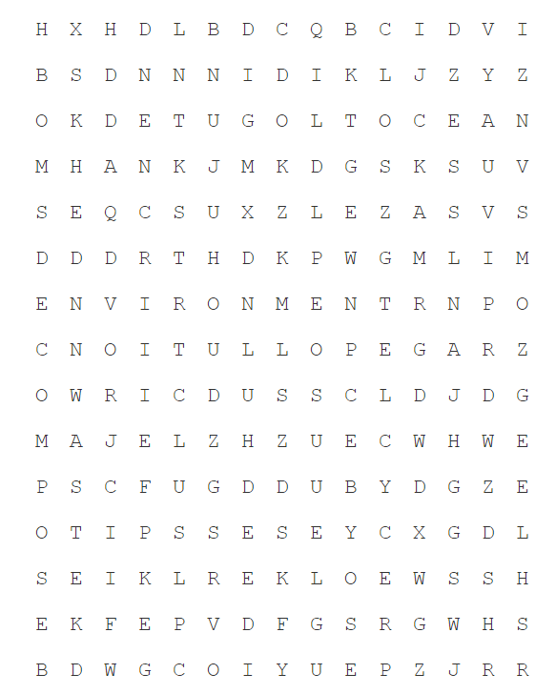
Lesson One: What is Plastic?
Objective: To identify different types of plastic and their uses.
DO NOW Complete the wordsearch, it contains some of the keywords for this topic
Challenge: Can you define the keywords?
Biodegrade
Decompose
Environment
Ocean
Plastic
Pollution
Recycle
Reduce
Reuse
Single Use
Waste

Slide 2
Biodegrade
Decompose
Environment
Ocean
Plastic
Pollution
Recycle
Reduce
Reuse
Single Use
Waste

Slide 3
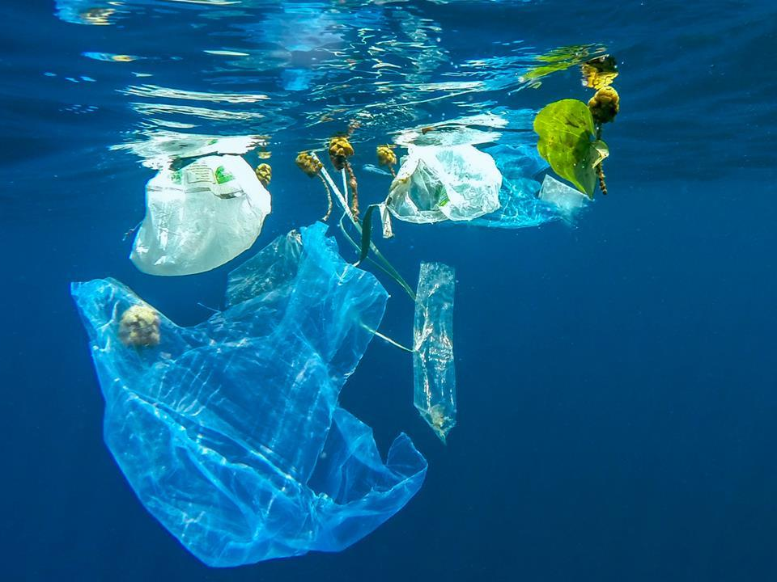
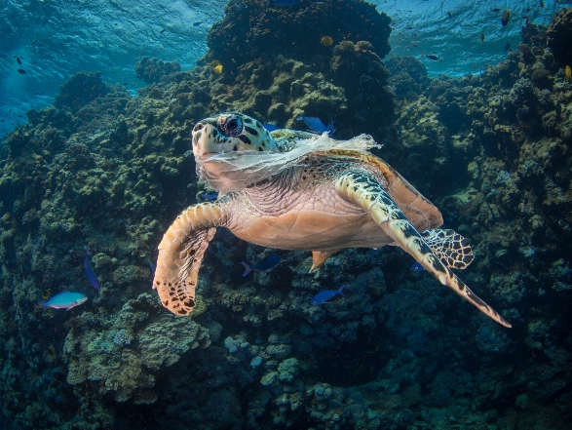
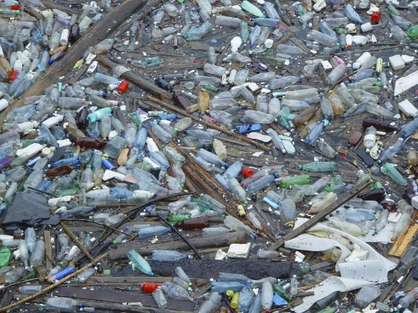
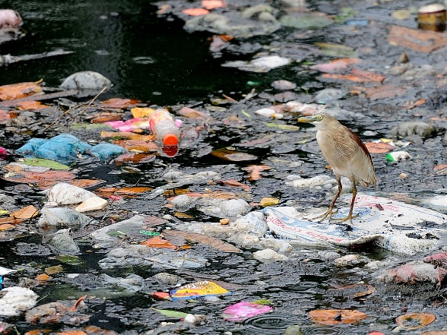
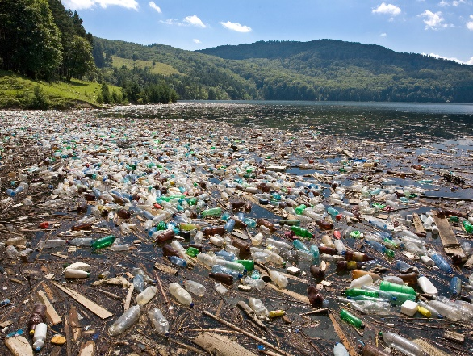
Objective: To identify different types of plastic and their uses.
TASK:
Look at the following pictures and write down:
What you can see in the picture
How it makes you
What the pictures have in common

Slide 5
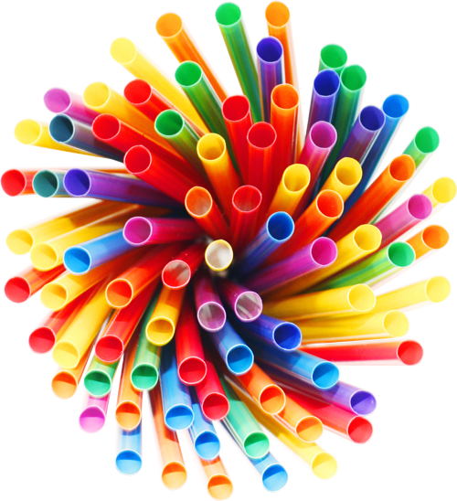
Objective: To identify different types of plastic and their uses.
Using Plastic
Using Plastic
In what ways have you used plastic items this week?
Draw a spider diagram with all the plastic items you have used- make your spider diagram colourful and include some pictures.
Challenge: Which are examples of single use plastic items (something you use once and then throw away)?

Slide 6
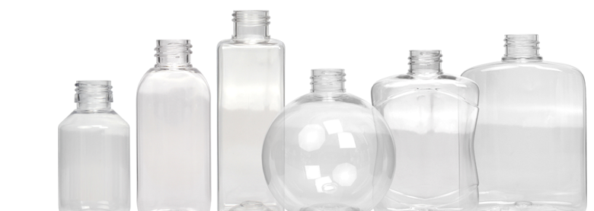
Objective: To identify different types of plastic and their uses.
Collect up a range of plastic from around your house, using the Plastics Information Chart complete the complete the identifying plastics table, looking at:
If there is symbol
How see through it is
How bendy it is
How it cuts
If it floats

Slide 7
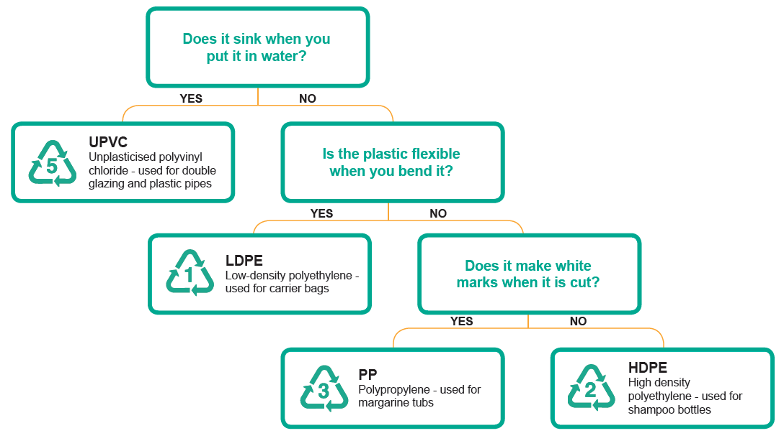
Notes:
7

Slide 8
Item Name | Can you see through it? | Does it float or sink? | Is it bendy? | Does it go white when cut? | Type of plastic (UPVC etc) | Draw the symbol
Notes:
8

