Slide 1
Objective: Describe some ways in which plastic causes problems.
DO NOW:
What do you think the problems are associated with waste plastic?
Problem with Plastic

Slide 2
Objective: Describe some ways in which plastic causes problems.
Plastic in the Ocean
https://www.youtube.com/watch?v=YFZS3Vh4lfI

Slide 3
Objective: Describe some ways in which plastic causes problems.
TASK:
Using the information you have learned so far and on the following slides, create an infographic (poster with a majority of words- 80%) on the ‘plastic problem’.
There are some examples on the slides for you to use as inspiration.

Slide 4
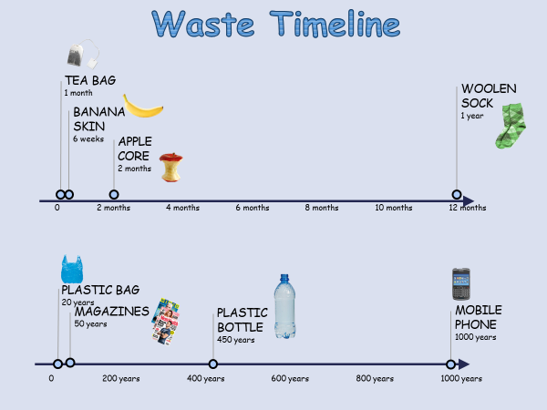
Objective: Describe some ways in which plastic causes problems.

Slide 5
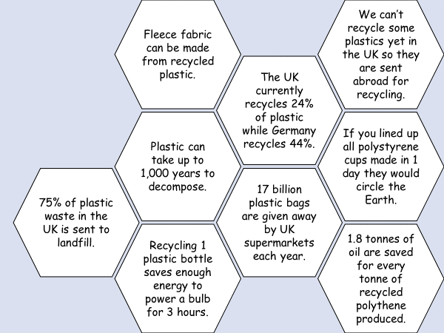
Objective: Describe some ways in which plastic causes problems.
Facts

Slide 6
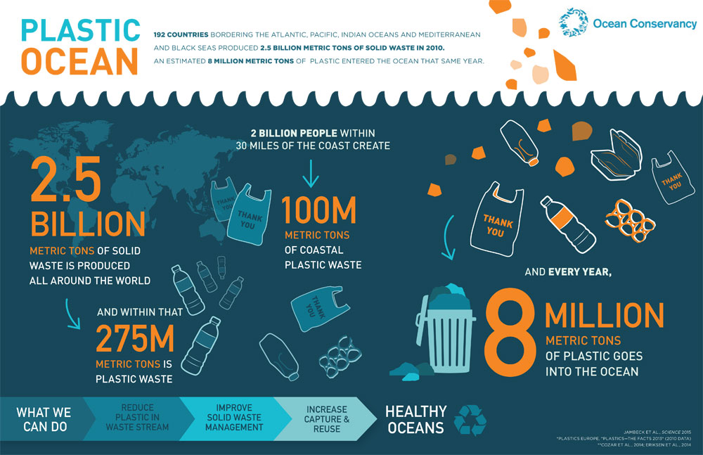

Slide 7
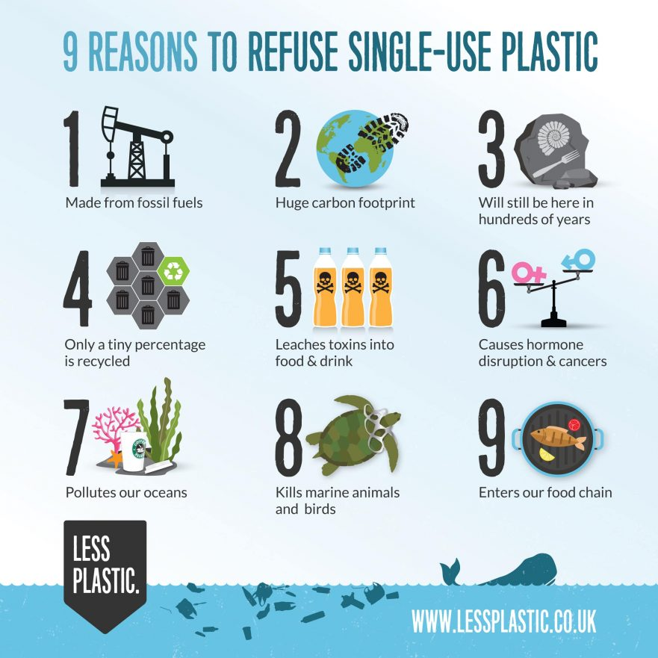

Slide 8
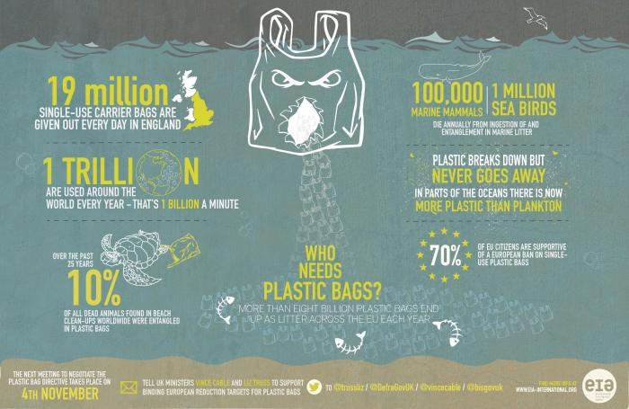

Slide 9
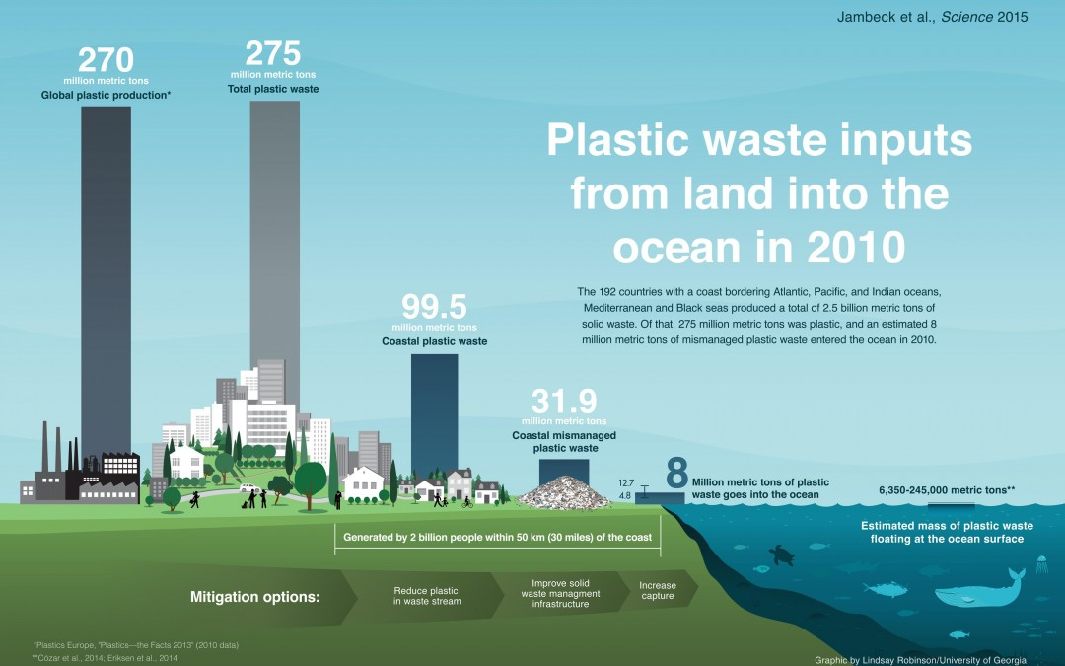

Slide 10
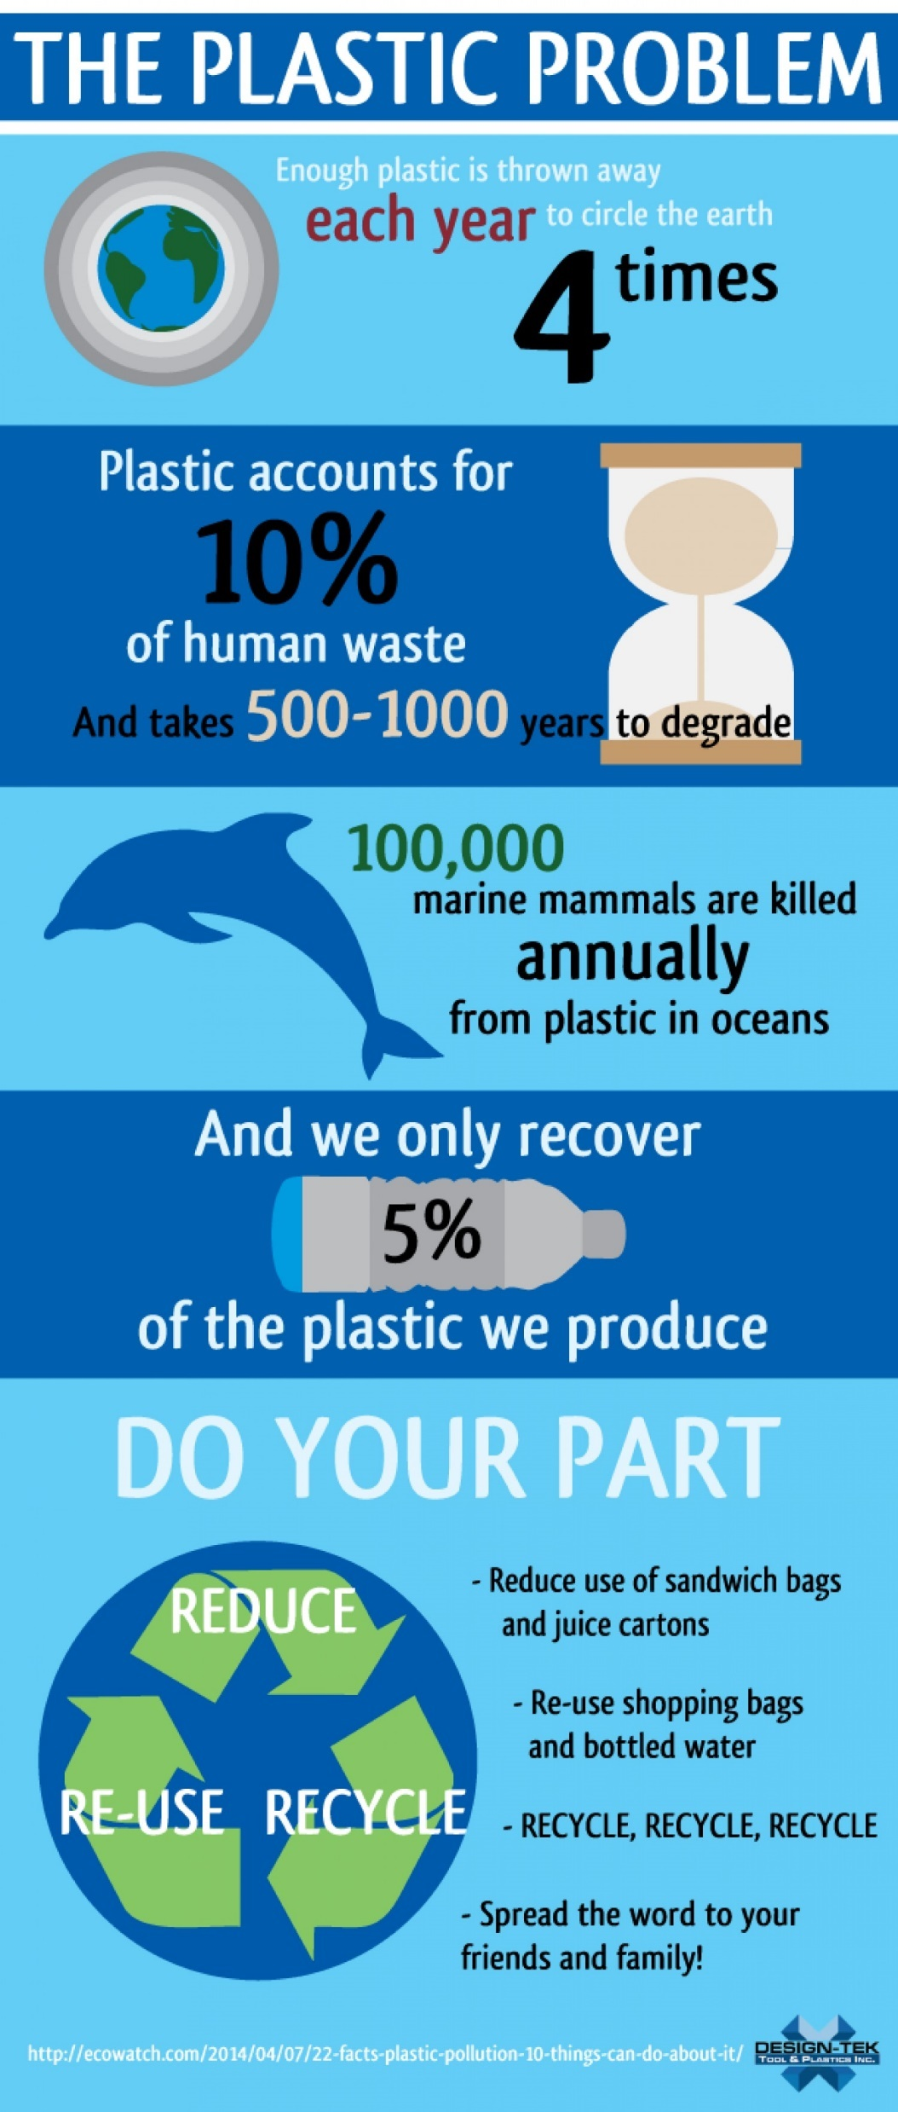

Slide 11
