Slide 1
Objective: Describe some solutions to the plastic problem.
DO NOW
What ways can you cut down on the plastic that you use?
Cut down on plastic use

Slide 2
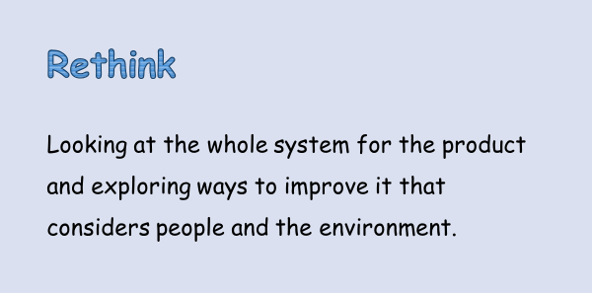
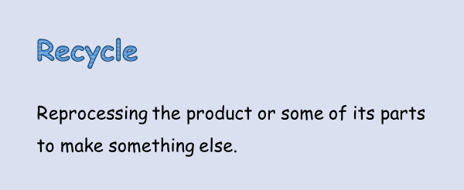
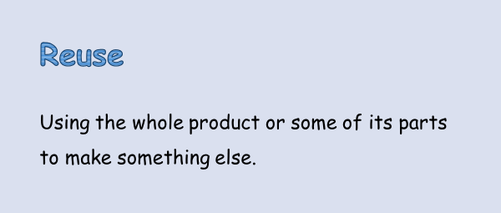
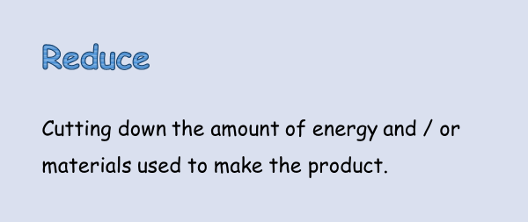
Objective: Describe some solutions to the plastic problem.
4R’s
Which of the 4R’s are you doing?
Go back to your spider diagram and colour-code the things you put down, which R do you have most?

Slide 3

Objective: Describe some solutions to the plastic problem.
Ways to Reduce Plastic Use

Slide 4
Objective: Describe some solutions to the plastic problem.
TASK:
Create a poster trying to get people to combat the plastic problem.
 | State ways in which we can all cut down on plastic.
 | Describe how we can cut down on the plastic we use.
 | Explain how cutting down on the plastic we use can solve the plastic problem.
 | Suggest large scale solutions for the plastic problem- thinking about what big companies / governments can do.

