Slide 1
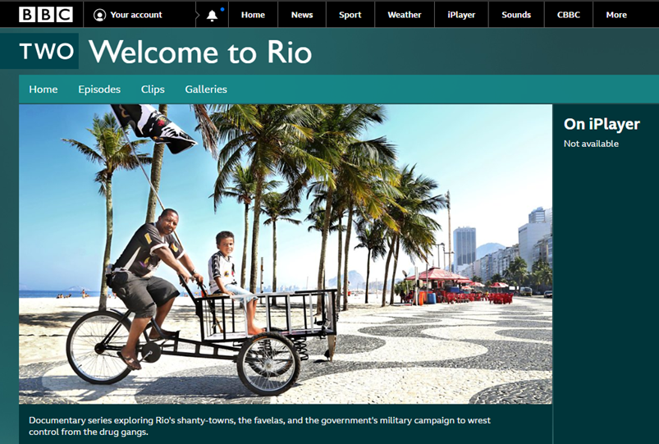
Unit: Urban Challenges, case study: Rio
https://www.youtube.com/watch?v=LAtygXMHHGw&list=PL5A4nPQbUF8DLVbRHmigqfkF16hK24Bgj&index=3
https://www.bbc.co.uk/programmes/b045h9nn
https://www.youtube.com/watch?v=3X_evEIh2hw&list=PL5A4nPQbUF8DLVbRHmigqfkF16hK24Bgj&index=3&t=0s
Deadline
Monday
1st June
To prepare for our next unit you will need to be familiar with Rio, the environment, challenges and opportunities.
Preparation:
Watch documentaries on Rio – I have added some links to help
Complete the Teams Quiz
Submit a piece of writing discussing the challenges and opportunities of both question 3 and question 12 from the quiz

