Slide 1
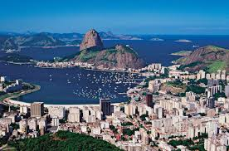
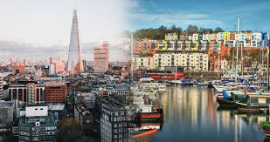
Yr10 (into Yr11)
Geography Summer reading
URBANISATION

Slide 2
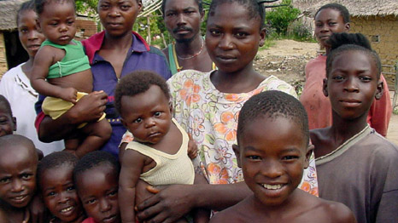
KS4 – The Geography Knowledge – URBANISATION (part 1)
URBANISATION is the increase in people living in towns and cities. This causes URBAN GROWTH which is the increase in land area covered by cities. 1950: >33% of the world’s population lived in urban areas. 2015: 55% of the world’s population lived in urban areas. 2050: it is predicted 70% of the world’s population will live in urban areas. WHY? Natural increase. If a country has a higher birth rate than death rate, the population will naturally increase. This type of population is often found in stages 2 and 3 of the DTM where there is a high number of young adults (18-35 years) who are having lots of children and few older people who are dying due to improved healthcare. Therefore urban growth is common in NEEs. Rural to urban migration. The movement of people from the countryside to cities. It is caused by push factors (pushing people out of rural areas) and pull factors (pulling people to cities). High rates of urbanisation are leading to the growth of megacities. A megacity is an urban area with over 10 million people living there (e.g. Mumbai in India). There are now 34 megacities in the world, with more than 65% in LICs and NEEs. More megacities are expected to emerge in Asia and Africa by 2030.
PUSH FACTORS | PULL FACTORS
Farming is hard and poorly paid Natural disasters (e.g. floods and earthquakes) Use of machinery in farming = less people needed to word = unemployment Dry land in rural areas caused by desertification = land cannot be farmed Fewer doctors, hospitals, schools and transportation routes | More highly skilled, better paid jobs Range of entertainment opportunities More and better doctors and hospitals More schools and better education Better transportation routes/public transport
Urban growth is currently occurring faster in LICs and NEEs and slower in HICs because… As a country develops their economy changes from agriculture (primary) to manufacturing (secondary) and services (tertiary). This occurs during the industrial revolution. Most of the secondary and tertiary jobs are in towns and cities. When this occurs, lots of people move from rural to urban areas = rapid urbanisation. HICs went through their industrial revolution a long time ago, whereas LICs and NEEs are going through their industrial revolution now. As a result more people in LICs and NEEs are currently moving to urban areas. LICs and NEEs are in stages 2 and 3 of the demographic transition model. In these stages there is a high birth rate and lower death rate. As a result more people are being born than are dying = the population naturally increases. In HICs there is a low death rate and even lower birth rate = the population is declining. In NEEs, a lot of economic development is happening (e.g. Brazil, Mexico, China, India). This means lots of jobs are available in cities = people move to urban areas = urbanisation. Counter-urbanisation in HICs is more common. People decide to leave cities and live in the surrounding countryside to get a better quality of life (less pollution, quieter, more space). They can commute to work due to improved transportation. URBAN GROWTH IN AN LIC or NEE : RIO DE JANEIRO URBAN GROWTH IN THE UK : BRISTOL
………………………………………………………………………………………………………………………………………………………………………………………………………………………………………………………………………………………………………………………………………………………………………………………………………………………………………………………………………………………………………………………………………………………………………………………………………………………………………………………………………………………………………………………………………………………………………………………………………………………………………………………………………………………………………………………………………………………………………………………………………………………………………………………………………………………………………………………………………………………………………………………………………………………………………………………………………………………………………………………………………………………………………………………………………………………………………………………………………………………………………………………………………………………………………………………………………………………………………………………………………………………………………………………………………………………………………………………………………………………………………………………………………………………………………………………………………………………………………………………………………………………………………………………………………………………………………………………………………………………………………………………………………………………………………………………………………………………………………………………………………………………………………………………………………………………………………………………………………………………………………………………………………………………………………… ………………………………………………………………………………………………………………………………………………………… …………………………………………………………………………………………………………………………………………………………
2
Notes:
TEMPLATE
2

Slide 3
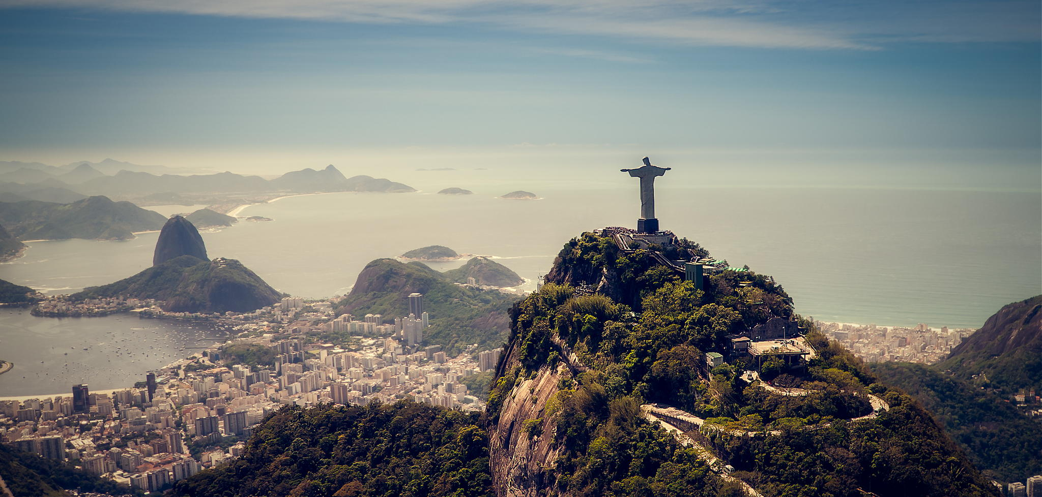
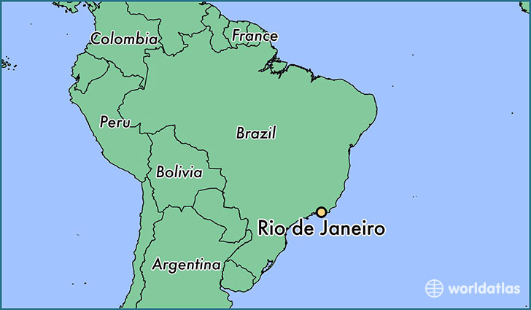
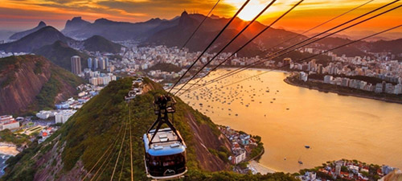
KS4 – The Geography Knowledge – URBANISATION – RIO (part 2)
RIO DE JANEIRO is located in Guanabara Bay, on the south-east coast of Brazil. It lies next to the Atlantic Ocean. It is the cultural capital of Brazil and 2nd largest city, with a population of 12.5 million. It has a growing global importance as an industrial and finance centre. It hosted the 2014 World Cup, 2016 Olympics and annually the Rio Carnival. Many people have moved to Rio from rural Brazil and wider countries, including South Korea, China, UK, USA, Portugal (due to shared language), Argentina and Bolivia.
Urban growth in Rio has also created many social, economic & environmental challenges
Challenge | Evidence in Rio
Lack of healthcare | In 2013 only 55% of the city had a local family health clinic.
Lack of education | Not enough schools, teachers or funding for education.
Lack of water supply | Around 12% of Rio does not have access to running water.
Lack of energy | Due to illegal tapping onto electricity lines = blackouts.
Unemployment and informal sector jobs | Many people are unemployed or work in the informal sector (e.g. street vendor), which are poorly paid, no contract, no taxes paid.
Air pollution | caused by too many cars and growth of factories = 5000 deaths per year.
Water pollution | caused by sewage running into rivers (200 tonnes/day) and industrial waste from factories and oil spills.
Waste pollution | a lack of waste disposal = rubbish on streets.
Creation of squatter settlements (favelas) | These are illegal settlements on the outskirts of cities where people have built homes on land they do not own. Characteristics: Poorly built homes using basic materials Houses built on steep slopes = landslides (e.g. 2010: 224 killed and 13,000 lost their homes) and limited road access 30% no electricity, 50% no sewage system and 12% no running water. 20% are unemployed. Those who are, are employed in informal sector Drug gangs are common & police is rare (murder rate is 20 per 1000ppl) Infant mortality rate: 50 per 1000 people due to high population densities (37,000 per km²), lack of waste disposal, spread of disease and lack of health care.
Urban growth in Rio de Janeiro has created many social and economic opportunities:
Opportunity | Evidence in Rio
Jobs Jobs with higher wages (tertiary) | Rio provides >6% of all jobs in Brazil. Rio is home to many manufacturing industries, (pharmaceuticals, clothing, furniture and processed foods) and service industries (banking, insurance). As Rio grows there are many jobs in construction
Economic growth | The growth of urban industrial areas can increase economic development. It will attract businesses to the area.
Better access to education | Rio provide grants to poor families to encourage children to attend school. Rio have many volunteers who help in schools. There are adult classes to help adults gain skills = better jobs
Better access to services | Rio has a new nuclear generator and hydro-electric power station = more energy produced. 60km of new electricity lines = better access to energy By 2014, 95% of Rio had access to a mains water supply. This was due to 7 new water treatment plants and 300km of new water pipes being laid. 12 new sewage works have been built and 5km of sewage pipes installed in badly polluted areas.
Better access to healthcare | Some areas in Brazil (Barra de Tijuna) have a life expectancy of 80 years old. Brazil (as a country) has an average life expectancy of 63 years. Medical staff go into favelas and offer emergency medication to people’s homes.
More entertainment | One of the world’s top tourist destinations - The Statue of Christ the Redeemer, stunning natural surroundings and entertainment.
More transport options | It has two major airports and five shipping ports Public transport, toll roads and one way systems to control traffic
URBAN PLANNING: improving quality of life in favelas. Favela Bairro Project is a site and service scheme that improves quality of life in Complexo de Alemao (favela in north Rio). Roads have been improved and paved Improved access to water pipes and sanitation Hillsides strengthened to prevent landslides New healthcare, leisure and education facilities Cable car has been installed that connects favela to centre of Ipanema (central Rio). Favela residents given free return daily ticket. 100% mortgages provided for locals to buy homes A Pacifying Police Unit (UPP) was set up = less crime Successful because: access/mobility is better = access to jobs in city centre, improved healthcare, education, access to services, 100% mortgages = more people can buy homes, less crime, fewer landslides. Unsuccessful because: new infrastructure not maintained and residents did not have skills to fix it, area improved = increase in demand to live there = increase in rent = poorest had to move, budget of US$1 billion could not help all favelas.
3
Notes:
TEMPLATE
3

Slide 4
KS4 – The Geography Knowledge – URBANISATION – BRISTOL (part 3)
Population Distribution | The way something is spread out over an area.
Industrialisation | Growth of secondary manufacturing
De-industrialisation | Decline of secondary manufacturing
Post industrial economy | Economy is mainly tertiary and quaternary industries
Brownfield site | Land that has previously been built on
Greenfield site | Land that has never previously been built on
International Migration | The movement of people across countries.
Urban Growth | The increase in the proportion of people living in urban areas.
Urban Sprawl | Unplanned growth of urban areas into the surrounding rural area
Urban Greening | Increasing the amount of green space in a city.
Social Inequalities | Some areas have more opportunities than others.
Rural-urban Fringe | The area on the edge of a city, where it meets the countryside.
Green Belt | Protected land at the rural-urban fringe where building is restricted.
Dereliction | Areas that are abandoned and become run down
Urban Regeneration | The reversal of urban decline through redevelopment, aiming to improve the local economy
Social Deprivation | When a person or area is deprived of services and amenities.
The UK’s population is unevenly distributed. 82% of people live in urban areas 32% live in London and the South East Sparse populations – Scotland and Wales Why do more people live in urban areas? Higher paid jobs and better working conditions in tertiary and quaternary sector, more entertainment options, better transport, more housing, better healthcare and education. Why do more people live in the south-east? Warmer, less rainfall, flatter land in the SE. In central Scotland and Wales its is colder, more rainfall and mountainous. Bristol is located in the south-west of England. It’s population is 440,500 people, which is expected to grow to 500,000 by 2029. International migration has accounted for 50% of Bristol’s population growth. There are 50 countries represented in its population. High levels of international migration have had many positive and negative impacts: Hard working workforce that bring new skills = contribute to local/national economy Enrich the culture of the city (food, music) Young migrants balance aging population Pressure on housing, healthcare and education Language barrier and different religions= challenge to integrate into wider community Why do people migrate to Bristol? Culture/entertainment– sport venues, theatres, music venues, cathedrals Two cathedrals – religious importance Two universities – higher education Transport (M4, M5, rail) link Bristol to UK Transport (ports/airports) link Bristol to Europe and USA. Economic growth – in tertiary and quaternary industries = jobs (finance, technology, aerospace, media, defence) Economic growth due to inward investment from companies such as airbus (France) and BMW (Germany).
OPPORTUNITIES IN BRISTOL Bristol is constantly changing as it grows (population, economy, industrialisation, de-industrialisation, regeneration) . These changes create a number of social, economic & environmental opportunities. SOCIAL OPPORTUNITIES Increase in migration = diverse population = range of food, festivals and cultural experiences. Entertainment: new theatres and music venues (the Old Vic, Bristol Arena and Tobacco Factory) Recreation: lots of sport teams (rugby, cricket, football) are developing their opportunities for people in Bristol. Bristol Rovers are building new football stadium on the outskirts of the city. New shopping centres: Cabot’s Circus in the city centre and Cribbs Causeway on the outskirts of the city offer residents shops, cinemas, restaurants, accommodation, jobs…etc. Improved transportation links (e.g. an integrated transport system, metrobus, electrification of the trains to London and improved public transport) = people can get around Bristol faster and the air is cleaner (due to less cars = less pollution). ECONOMIC OPPORTUNITIES Growth in tertiary and quaternary industries = employment opportunities (85% of jobs are in tertiary, 6% in quaternary, 8% in secondary and 1% in primary). Redevelopment of brownfield sites (e.g. the Temple Quarter) has attracted new tertiary and quaternary companies = jobs = higher disposable income = money spent in local area and therefore reinvested into the area = further economic development. Growth of high-tech industries due to access to highly skilled university graduates, research facilities, clean non-polluted environment, cheaper land, superfast broadband speeds (the government gave £100million to create a super connected city). Companies include: Hewlett-Packard, Toshiba, Aardman Animations (clay films), Defence Procurement Agency (DPA) (employs 10,000 people to make army and navy products) and aerospace (14 of the 15 main aircraft companies are in Bristol (e.g. Rolls Royce and Airbus) who produce aircraft parts and navigation/communication systems. ENVIRONMENTAL OPPORTUNITIES As the city has grown, Bristol has created transport systems to reduce traffic congestion. Bristol’s Integrated Transport System links different forms of public transport. (e.g. part of the ITS is the Rapid Transit Network which connects three bus routes, the Temple Meads railway station and park and ride network). They have also improved the rail links through electrification of the line to London = greener energy and faster connection to London. As the city has grown and redeveloped, Bristol has focused on urban greening, to increase and preserve open green spaces. Urban Greening: Bristol has worked and its continuing to work very hard. Currently in Bristol: 90% of people live within 350m of parkland with 300 parks in the city 27% of the city is part of a wildlife network and 30% of the city is covered in trees Brownfield sites are turned into green spaces (Queen Square was a dual-carriageway) EXAMPLE: In 2015 Bristol became the 1st UK city to be awarded the status of: European Green Capital. Their current goals and achievements include: To reduce energy use by 30% and CO₂ emissions by 40% by 2020; In 2015 100 electric car charging points were installed. Increase the use of brownfield sites for businesses and housing. In 2015 every primary pupil in Bristol planted a tree to increase Bristol’s green coverage. Increase the use of renewable energies from 2%.
4
Notes:
TEMPLATE
4

Slide 5
KS4 – The Geography Knowledge – URBANISATION – BRISTOL (part 4)
CHALLENGES IN BRISTOL Bristol is constantly growing. These changes have created a number of challenges in Bristol, such as urban sprawl, derelict buildings, waste disposal, air pollution, social inequalities and housing pressure on the rural-urban fringe.
CHALLENGE: RISE IN DERELICT AREAS: Industrial decline in the 20th century was caused due to an increase in manufacturing abroad, closure of many inner city ports and rise in tertiary and quaternary industries. As a result many inner city areas, such as Stokes Croft, became abandoned, run-down and deprived. Plans to fix the challenge of derelict areas. Lottery grants have helped improve the area of Stokes Croft. The money has been used to redevelop buildings, attract new businesses and create green spaces. Artists are used public to make the area more appealing New music venues, independent shops and nightclubs have opened in the area = improving the area’s environment. | CHALLENGE: URBAN SPRAWL Urban sprawl is caused by a rise in population and lack of housing (4000 homes were damaged/destroyed in WW2). The demand for new housing has resulted in many people moving to the suburbs (outskirts of the city). This puts pressure on the rural-urban fringe for new housing = development of greenfield sites. e.g. Bradley Stokes and Harry Stokes are examples of new developments on greenfield sites. 1200 new homes have been built at Harry Stokes, with 2000 more planned. Building on greenfield sites is cheaper and buyers like it due to the clean environment, however it results in congestion, air pollution, loss of farmland and habitats, loss of green space and increases the risk of flooding. | Plans to reduce urban sprawl Focus on building new homes on brownfield sites. Between 2006 – 2013 only 6% of new housing developments were on greenfield sites. By 2026, over 30,000 new homes are planned on brownfield sites. Redeveloping brownfield sites is more expensive as land must be cleared and decontaminated from previous industrial use. However, it is the best option. Bristol’s Harbourside was a derelict area in Bristol city centre. They have spent 40 years redeveloping the area, building flats and culture and leisure facilities. Finzels Reach is a 2 hectare brownfield site near the CBD. The abandoned factories and warehouses were redeveloped to create new offices, shops and 400 apartments.
CHALLENGE: WASTE DISPOSAL Bristol produces 500,000 tonnes of waste/year and is currently produces the most food waste in the UK. Plans to reduce issues with waste disposal: Reduce the waste sent to landfill sites. In 2004/05 88% of waste was sent to landfills. In 2012/13 it was only 27%. Increase recycling by making it easier to recycle by using roadside collections. In 2004/o5 12% of waste was recycled. In 2012/13 it was 51%. Increase the amount of waste that is sent to waste treatment plants where the waste is used to generate energy. (e.g. Avonmouth treatment plant makes electricity for 25,000 homes). | CHALLENGE: AIR POLLUTION Bristol is the most congested city in England = air pollution = 200 deaths per year. The prevailing winds from the south-west blow pollution from the industrial area at Avonmouth over the city. Plans to reduce air pollution: Integrated Transport Network Frome Gateway: a walking/cycling route to the city centre. Electrical vehicle charging points in 40 car parks Poo bus: buses between Bath and Bristol Airport will fun on bio-methane gas produced from human waste. | CHALLENGE: SOCIAL INEQUALITY Some areas in Bristol are more deprived than others. This is know as social inequalities. It is due to a lack of investment from the government.
FILWOOD | STOKE BISHOP
1/3 of people live in low-income homes Over 1300 crimes per year 36% of students get top GCSEs Life expectancy is 78 years old 1/3 of people aged 16-24 are unemployed Poor access to fresh fruit & veg. 62% of people feel unsafe at night | Fewer than 4% live in poverty Less than 30 crimes per year 94% of students get top GCSEs and 50% have a degree Life expectancy is 83 years old 3% of people are unemployed Highest level of car ownership in the city
EXAMPLE OF REGENERATION: THE TEMPLE QUARTER, BRISTOL.
Social improvements:
New transport links (e.g. new bridge across the River Avon to the Bristol Arena)
Improved transport links (e.g. electrification of the rail link to London = faster)
Improved public transport – ITS and rapid transit network
New entertainment: Bristol Arena: theatre that seats 4000 people for conventions, exhibitions and concerts. It also can host sporting events for 12,000 people.
Economic improvements:
Jobs: Enterprise Zones offer incentives (e.g. low rent) to businesses to move to the area
Jobs: Engine Shed – high tech hub attracts quaternary industries
Jobs: New office developments such as Glass Wharf and Temple Studios
Environmental improvements:
Improved public transport (ITS, RTN, improved Temple Meads station) = encourages people to use it and not drive = less air, noise and visual pollution.
Electrification of the line between London and Bristol = greener (less pollution)
The Temple Quarter is located in central Bristol. It is the first part of the city that visitors see when driving from the south/south-east or arriving by train.
It was developed in the 18th century as a industrial area (glassworks, gasworks, ironworks, lighting). In 1841 a railway line was added. Extra lines were added until they covered 40% of the area.
The closing of the city port and growth of tertiary and quaternary industries = many factories closed and people moved away. The area became rundown, abandoned and derelict.
The government decided to do something and began a massive Urban Regeneration project. Successful urban regeneration must improve an area socially economically and environmentally.
Redeveloping brownfield sites is often more expensive as the land must be cleared first and it might be contaminated from previous industrial use. However, it is always the preferred option.
5
Notes:
TEMPLATE
5

Slide 6
KS4 – The Geography Knowledge – URBANISATION – BRISTOL (part 5)
SUSTAINABLE URBAN PLANNING Sustainable cities are cities that meet the needs of the people who live in them today, without meaning that future generations do not have their needs met. Basically it means behaving in a way that does not irreversibly damage the environment or use up resources faster than they can be replaced. There are many things that cities can do to be more sustainable.
FREIBERG: A SUSTAINABLE CITY | TRAFFIC MANAGEMENT STRATEGIES
Freiburg is located in the south-west of Germany. In 1970 is set a goal to become a sustainable urban area. Preventing the overuse of water: water conservation – collecting and recycling water to prevent overuse. Collecting and recycling water: Green roof gardens with water harvesting systems, which collect rainwater to reuse. Inhabitants are given incentives to use less water. Waste water systems allows rainwater to be retained, reused or to seep back into the ground (e.g. permeable pavements). Water in the River Dreisam, which flows through Freiburg, is managed using flood retention basins. These reduce the danger of flooding by storing excess water, which is used in the city. Prevent overuse of water: Toilets installed that use less water to flush = people use less water. Water meters that remind residents how much water they are using = people use less water Preventing the overuse of energy and increasing the production of energy from renewable sources. Freiburg plans to be 100% powered by renewable energy by 2050. This will require many residents to half their current use of energy. Renewable energies It is one of the sunniest cities in Germany so solar power is used. There are approximately 400 solar panels installations in the city, including at the railway station and football stadium. These produce 10 million kilowatts of electricity per year. Freiburg’s solar valley employs 1000 people in solar technology, in the production of solar panels, developing solar technology, such as solar cooling technology. Other renewable energies that Freiburg uses include biomass and biogas. Prevent overuse of energy: The government provide incentives to encourage people to become more energy efficient, by allowing homeowners to sell any excess energy to the national grid. Increasing the amount of green spaces. Green spaces are environmentally sustainable as they provide clean air, habitats and prevent flooding during intense rainfall. They are also socially sustainable as they create a calm, relaxing space for people to spend time and encourage exercise. Afforestation – 75% of the deforested trees are re-grown every year. River Dreisam does not have any flood management strategies and provides natural habitats for animals and vegetation. 44,000 trees have been planted in the city = 40% of the city is forested. Of these areas, 56% are nature conservation areas. In the Riselfield District, 78 hectares are built on and 240 hectares are open space. | Traffic congestion can lead to a number of problems: Air pollution, health problems (e.g. asthma), higher fuel consumption, accidents, increased journey times, noise and visual pollution, loss of habitats, cost of maintaining roads…etc. There are many traffic management strategies to reduce the issue of traffic congestion.
CYCLE ROUTES are often provided alongside existing main roads, with some new cycle paths that exclude cars. There are many benefits of cycling. Increase exercise, improve health, reduce air pollution, reduce stress, reduce congestion. The number of people cycling in Bristol has doubled in the last 10 years. To encourage even more people Bristol has: made 20mph speed limits, increased cycle routes, installed cycle maps and signs and increased bike parking zones.
METROBUS is a new express bus service in Bristol. It is made up of three routes that link key areas in Bristol. It will encourage more people to use public transport by improving the service it provides. Faster and more reliable than current buses, next stop announcements, bus stops with real time information and full accessibility. In Bristol the MetroBus is made up of 3 routes that link key areas of Bristol. They have priority over other transport = quicker journey times. e.g. Long Ashton Park and Ride to Hengrove currently takes 50 minutes. The MetroBus will take 12 minutes.
PARK AND RIDE: Free car parks are available on the outskirts of the city. People then take the bus into the city centre. One bus with 40 passengers causes less congestion than 20 cars with 2 people in each They have social, economic and environmental impacts: Less cars in the city = less congestions = less pollution (air, visual, noise), less time wasted in traffic, less accidents, less space needed in the city centre for car parks. Bristol has three Park and Ride Schemes around the city.
AN INTEGRATED TRANSPORT NETWORK is a system that links different forms of public transport within the city and the surrounding area to make journeys smoother and easier. It is a sustainable transport system that reduces congestion as more people are travelling by public transport by making it easier and more convenient. e.g. The MetroBus is a Rapid Transit Network and part of the ITS. It connects 3 bus routes, the Temple Meads railway station and Park and Long Ashton Park and Ride.
Congestion Charge – motorists pay £11.50 to drive the centre of London. This means more people are likely going to use public transport as it is cheaper. It dramatically reduced the number of cars in London (by 21% in just 3 years). It has also reduced accidents, pollution and shortened journey times.
Oyster Cards – integrated payment cards that can be used on a variety of different types of public transport. This encourages people to use public transport as it is easier and more convenient.
Car Pool – people are encouraged to share car journeys together. Benefits include cheaper fuel, less congestion, less pollution and reduced overall car service costs (as you will be using your car less).
6
Notes:
TEMPLATE
6

