Slide 1
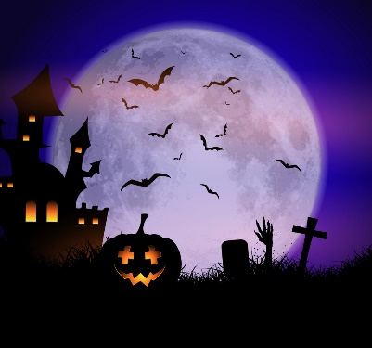
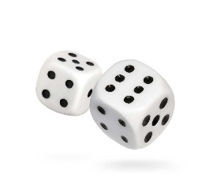
PSHCE – This half term we are learning about relationships. Choose someone who is special to you and tell me at least 5 things that make them special. You can present this however you like: a poster, a letter, a video – get creative!
Mathematics – Practise your column subtraction by answering the questions on the sheet stuck in your book. Remember, you might need to exchange sometimes!
English – We are writing spooky stories in English this half term. Draw a picture of a spooky scene and write a description of the scene using at least 5 adjectives and 2 similes. Don’t forget to try and include some fronted adverbials!
Mathematics – Roll a dice to create a 2-digit number (or make your own numbers) and double this number by partitioning (double the tens and ones separately before adding together).
Do this 10 times.
Reading – Look at the picture that is stuck in your homework book and answer the inference questions about this picture. Remember to write your answers in complete sentences.
Silver Class Homework Grid
Autumn Term 2
Science – This half term we are learning about Sound in Science. Make or draw a picture of an instrument and write a simple explanation of how the sound is made. E.g what part of the instrument is vibrating to make the sound?
Geography – Our learning this half term is all about the water cycle. Create your own model/draw a picture to explain how the water cycle works.
Key words to use: precipitation, evaporation, condensation, water vapour
One piece of homework must be completed each week (there is no expectation that all pieces will be completed this half term as long as one piece is completed per week). Homework books are to be handed in by Friday each week.
Please feel free to email me any questions. dellison@poolhouse.lancs.sch.uk

