Slide 1
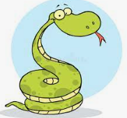
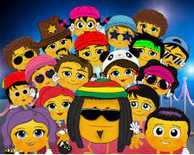
English
Recently in class, we have been looking at reading vipers. I would like you to create me an information poster that we can display in our class room. This needs to explain to others in detail what reading vipers are and how and why we use them. Can you think of a fun and creative way of displaying these?
English
In English, we have been looking at explorers. I would like you to research an explorer of your choice and create a fact-file about what they have done and why they are famous. Think about the places they have visited, what obstacles they have had to overcome and any dangers they may have faced. You can choose one from our English lessons or someone new.
Spellings
New spellings will not be given this half term. We will still have a weekly test, but these will be randomly generated from all the words we have sent home so far this year. These can all be found on the school website.
Diamond Class
Summer Term 1 Homework Grid
Please complete one of these tasks each week in your book or email it to me ☺
gyeulett@poolhouse.lancs.sch.uk
SPAG
Complete the boxes on the Summer 1 sheet given to you. Read each one carefully and try to think back to previous lessons.
Mathematics
We have been looking at long multiplication in Mathematics. Please complete the sheet provided using the method we use in class.
Times Tables
Using Laugh Along and Learn on YouTube, sing the times table songs you are unsure of and then test your knowledge using the mixed games over on Top Marks. Play Hit the Button to challenge your skills.
www.topmarks.co.uk/maths-games/hit-the-button

