Slide 1
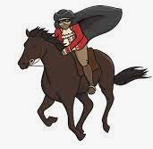
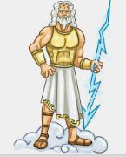
Reading
We have been reading David Walliams Ice Monster this half term in class. I would like you to get into character role and pretend to be Elsie. I would like you to write me a letter explaining what it is you and Dotty are trying to achieve with the Professor and the Ice Monster. This can be different from the book – your own version!
English
In English this half term, we have been looking at Greek Mythology. I would like you to think about one of the stories we have looked at in class and create a front cover and blurb for the story.
Spellings
New spellings will not be given this half term. We will still have a weekly test, but these will be randomly generated from all the words we have sent home so far this year. These can all be found on the school website.
Diamond Class
Summer Term 2 Homework Grid
Please complete one of these tasks each week in your book or email it to me ☺
gyeulett@poolhouse.lancs.sch.uk
English
We have also looked at The Highwayman poem. Can you create a fact-file about one of the characters from the poem. You can use words and pictures to do this.
Mathematics
We have been looking at decimal numbers in Mathematics this half term. Please complete the sheet – arranging numbers to make decimals.
Times Tables
Using Laugh Along and Learn on YouTube, sing the times table songs you are unsure of and then test your knowledge using the mixed games over on Top Marks. Play Hit the Button to challenge your skills.
www.topmarks.co.uk/maths-games/hit-the-button

