Slide 1
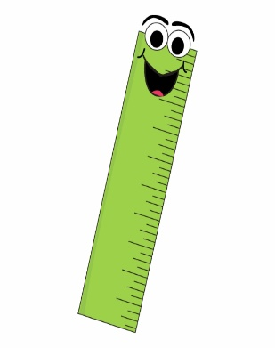
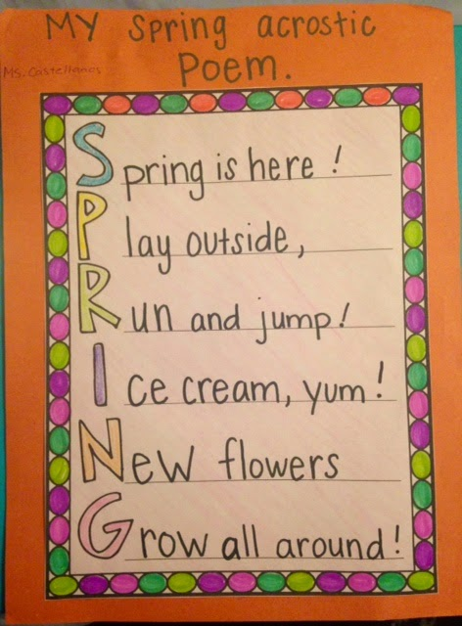
Mathematics
Lengths - Can you use a centimetre ruler to measure 5 or 10 items in your home. List the items and their sizes. Which item is the longest? Which item is the shortest? Are any of the items the same size?
Challenge: What else can you use to measures lengths?
English
Poetry – Can you write your own rhyming poem. Or maybe you have got a favourite poem that you can write about? What is it about? How does it make you feel?
Really try and describe your poem in as much detail as you can. Support: You can research ‘poems for kids’ online.
Science
Plants - Go for a walk in the park or somewhere where there are plants and flowers. Can you draw five flowers or plants and research their names.
Challenge: Can you label the different parts of one of the flowers.
Geography
The Weather - Create a weather poster or booklet. Can you record the weather everyday for 5 days. Include lots of detail and colourful pictures. Hint: Maybe you could watch the Weather on TV for ideas.
Moonbeam Class
Homework grid Spring Term 2
Design Technology
Structures – Can you make a model structure. This could be a building or structure you have seen, or a structure from your own imagination. You can use any materials, maybe cardboard boxes or dry food like pasta. Be as creative as you can.
Remember: Be careful with sharp tools/materials and ask permission before using household materials.
English
Poetry – Write your own ‘Acrostic Poem’. Remember: This starts with a title that is written down the left side of the page and then each sentence of your poem starts with the first letter. Hint: you could link this poem to flowers/plants (Science) or the Weather (Geography).
Please choose one piece of homework to complete each week and hand in by FRIDAY.
Please read at home every night and sign your child’s reading record. Please encourage your child to discuss the phonics sounds they have learnt each week, as well as working on their segmenting and blending when reading.

