Slide 1


Name _________________________ Technology group ___________ Teacher ____________________
Year 8 Food and Nutrition 2025/26
Recipe Book

Slide 2
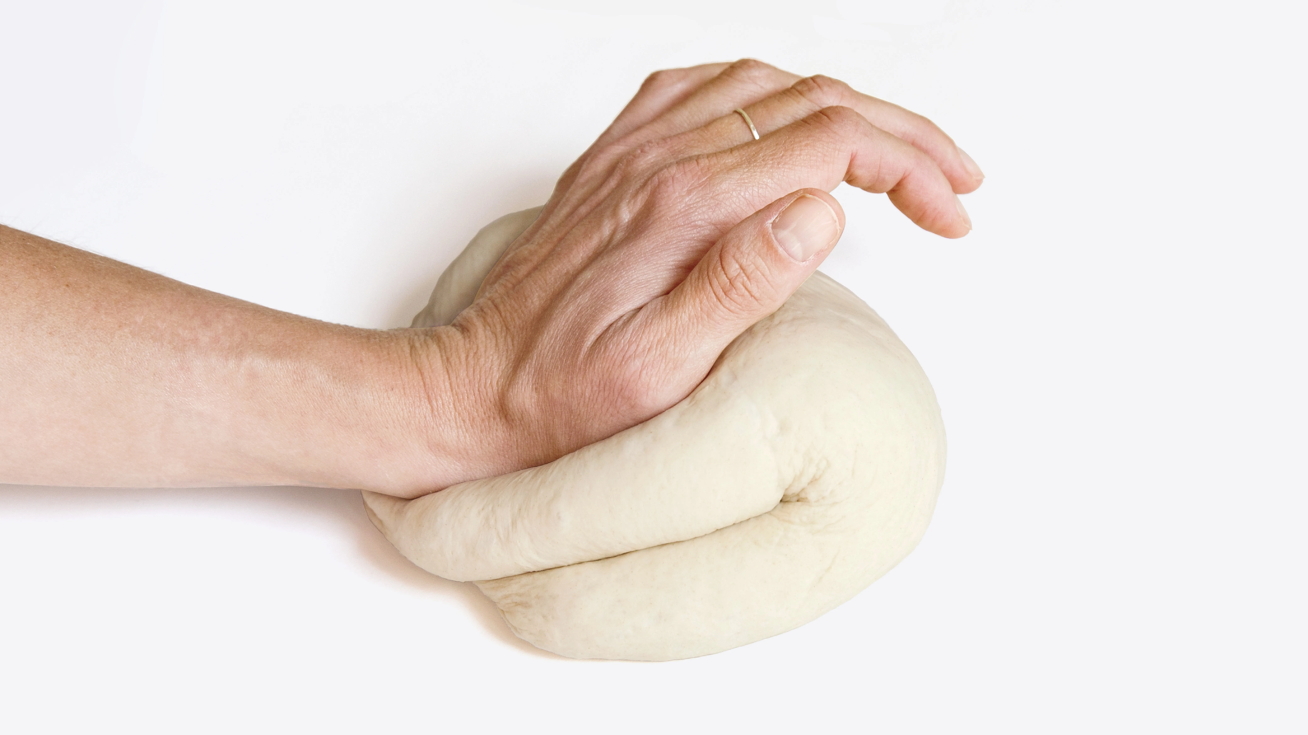
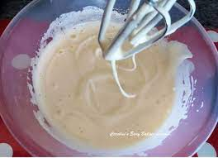
Helpsheet
Skill | Picture
Kneading - Lay your room-temperature dough on the surface. Stretch it away from you with the heel or knuckles of one hand and fold it back over the top towards you. Repeat the stretch and fold process again and again for 10 minutes. The dough is kneaded enough when your hands are fairly clean of flour, springy to touch and smooth.
Whisking method – Using an electric whisk, whisk together eggs and sugar until it has doubled in size and leaves a trail of mixture on the surface.

Slide 3

Note to parents/carer’s…
This recipe book contains all the recipes needed for the GCSE Foundation Food and Nutrition. In Year 8, students will have a 1 hour lesson a fortnight, with one lesson being theory and the following lesson making a practical product. Students will need to bring this recipe book to every lesson along with ingredients and a container to take their products home in. Students will be given at least a weeks notice for ingredients, if there are any problems in getting ingredients please make a note in your child’s planner, in advance of the lesson please, so we can ensure ingredients are available and your child does not miss out on vital practical lessons. Please note some practical's may go across two lessons where appropriate storage will take place normally in the freezer.
Recipes can be added to or changed with ingredients at home you may have closer to the date. Ingredients must be weighed out at home before the lesson and stored in their Food Technology room before registration. Please only place highlighted ingredients in the fridge, named,
Pg No | Dish | Skills demonstrated
4 | Kebabs | Bridge and claw, using the grill, marinating.
5 | 2. Chicken kiev | Bridge and claw, using the oven, handling meat safely, breadcrumbing.
6 | 3. Scotch eggs | Using the oven, shaping a wet mixture, breadcrumbing,
7 | 4. Lasagne | Bridge and claw, meat handling, reduction sauce, gelatinisation.
8 | 5. Bread rolls | Using yeast, using the oven, kneading,
9 | 6. Pizza, | Bridge and claw, using yeast, using the oven, kneading, shaping,
10 | 7. Decorated shortbread, | Using the oven, rubbing in method, using a bain mariee, presentation techniques.
11 | 8. Pasties, | Rubbing in method, using the oven, shaping and crimping.
12 | 9. Swiss roll, | Using the oven, whisking method, rolling.
Michelin Star rating – all recipes have been given a Michelin star rating for difficulty to challenge.
High level skilled, most challenging.
Medium level skilled.
Basic skill level.

Slide 4
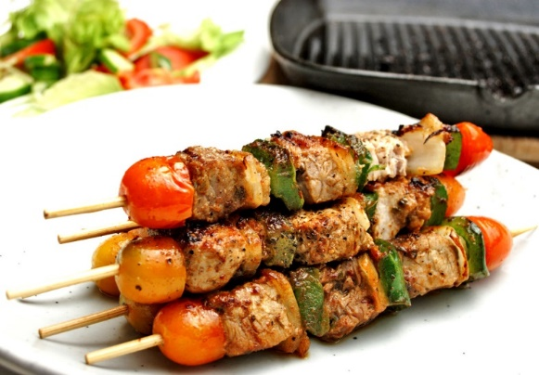
Kebabs Ingredients:
Method:
Don’t forget…skewers and container.
Make marinade by combining all ingredients in a bowl and stir together,
Slice and dice vegetables into similar size pieces,
Assemble the vegetables onto the skewers alternating between the different ingredients,
Using a pastry brush, brush the marinade onto the skewers.
Place on a baking tray and grill until the chicken is white all the way through.
1 block of halloumi (optional)
3 types of vegetables
  8 cherry tomatoes,
  8 button mushrooms,
  ½ pepper,
  8 pineapple chunks,
  1 courgette,
  2 onions.
  5 rings pineapple,
  1 small aubergine
Marinade:
Shop bought marinade,
OR
Honey and lemon – 2 tbsp lemon juice, 1 tbs oil, 2 tsp honey or brown sugar, ½ tsp herbs, 1 clove garlic,
Tikka – small carton yoghurt, 2 tsp curry powder, 2 tsp lemon juice,
Chinese – 1 tbsp soy sauce, 1 tbsp brown sugar, 1 tbsp oil, 1 clove garlic
Sizes for kebab
No smaller

Slide 5
Chicken Kievs Ingredients:
Method:
Preheat oven to gas mark 6, 180C.
Crush the garlic and place into a small bowl. Mix with the finely chopped parsley, tarragon and soft cheese until well combined.
Roll into 2 sausage shapes and wrap in baking paper and freeze/refrigerate for as long as possible.
Meanwhile butterfly 2 chicken breast. Slice the breasts part way through with a sharp knife and open them out like a book. Be careful not to slice too far and make a hole as you need to secure a pocket for the soft cheese.
Place each chicken breast between 2 sheets of baking paper or clingfilm and bash with a rolling pin until 5 mm thick. Bashing the chicken to an even thickness means you can easily roll the soft cheese into the centre and ensure that it cooks evenly. Be careful not to tear the chicken or the filling will leak out.
Lay a piece of chicken on a sheet of clingfilm, place a roll of cheese at a long edge, then fold over the short edges slightly. Use the clingfilm to lightly roll it up into fat sausage shape. If the kievs don’t stay sealed, then mix a little beaten egg and flour together to make a paste and use it glue.
Remove Kievs from the fridge. Place flour into a bowl, in a separate bowl beat 1 egg and in another bowl place your breadcrumbs. Dust each kiev with flour then dip in the beaten egg and gently roll in the breadcrumbs to coat completely.
Heat oil in a non stick pan and fry over a medium heat until they are browned all over. Place on a lined baking tray and bake for 20 mins.
Don’t forget…a container.
Ingredients:
2 garlic cloves,
Handful of fresh flat leaf parsley, finely chopped (optional),
Handful of fresh tarragon, finely chopped (optional),
50g soft cheese,
2 chicken breasts,
1 egg,
20g plain flour,
80g breadcrumbs
Options:
Use halloumi instead of chicken and only breadcrumb,

Slide 6
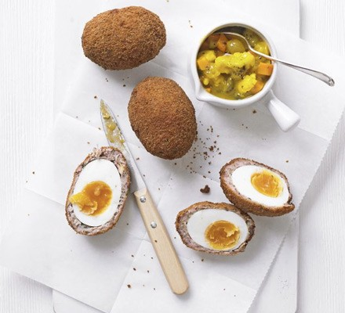
Scotch eggs Ingredients:
Method:
Bring a pan of salted water to a rapid boil, then lower four of the eggs into the pan and simmer for 7 mins 30 secs exactly. Scoop out and place in a bowl of iced water, cracking the shells a little (this makes them easier to peel later). Leave them to cool completely, then peel and set aside. Can be boiled the day before.
Preheat oven to 180C,
Put the sausagemeat, stuffing and herbs in a small bowl, mix to combine, then divide into four equal balls. Squash one of the balls between a piece of cling film until it’s as flat as possible. One at a time, lightly flour each cooked egg, then use the cling film to help roll the sausagemeat around the egg to completely encase. Repeat with the remaining sausage balls and eggs.
Beat the remaining egg and put on a plate. Put the flour and breadcrumbs on two separate plates. Roll the encased eggs in the flour, then the beaten egg and finally the breadcrumbs.
Spray the scotch eggs all over with cooking oil. Bake on a baking tray lined with non-stick baking paper for 20 minutes until lightly golden.
Don’t forget…a container.
Ingredients:
4 hard boiled eggs (boil at home),
300g good-quality pork sausage, skinned (please no Richmond sausages)
100g plain flour,
100g dried breadcrumbs or 2 slices of white bread.
1 egg (beaten to breadcrumb
Optional seasoning:
25g sage, apple & onion stuffing mix
1 tsp chopped sage
1 tsp chopped thyme
1 tsp chopped parsley

Slide 7
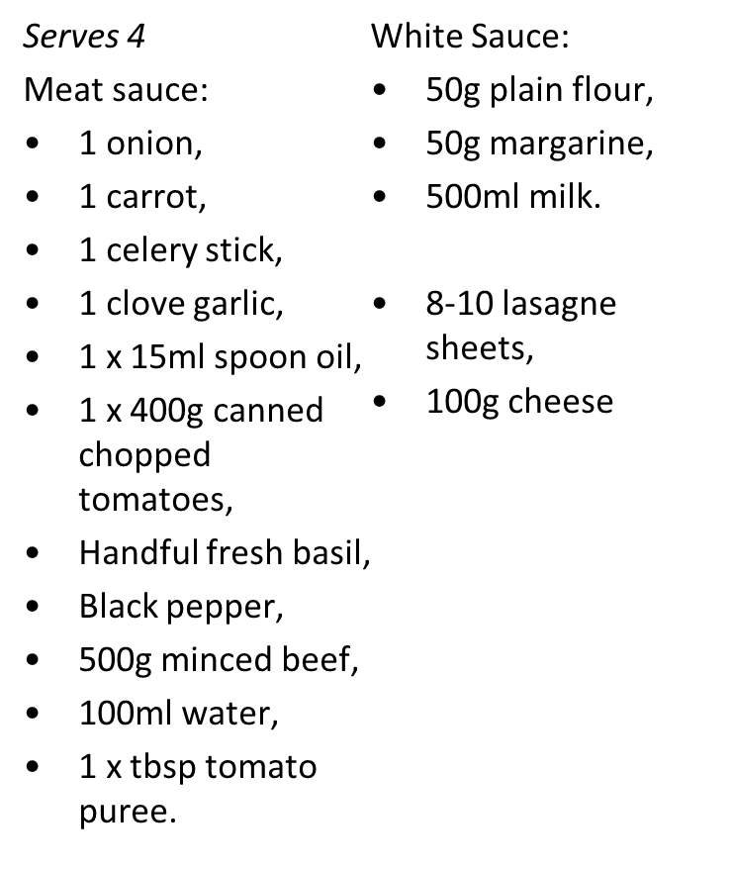
Lasagne
Ingredients:
Don’t forget an oven proof dish
Method:
Prepare and chop all vegetables.
Sauté mince, onions and carrot until brown.
Stir in tomatoes, tomato puree, other vegetables.
Bring to the boil, and simmer on a medium heat for 10 minutes.
Put into a bowl and wash saucepan.
Melt butter, then add flour off the heat to form a dough consistency.
Gradually add the milk, stirring continuously making sure it is smooth, place back on the heat.
Remove from the heat, add most of the cheese, saving a little for the top.
Put half the meat sauce into a shallow oven proof dish cover with lasagne add the rest of the meat and cover with lasagne.
Finish with a layer of white sauce.
Sprinkle with cheese on the top.
Options:
Swap 250g minced beef to 250g Quorn,
Add extra vegetables,
Add more cheese.

Slide 8
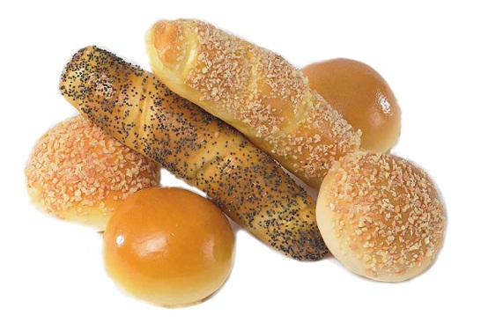
Bread roll
Ingredients:
Home Learning – Weigh ingredients accurately at home.
Method:
Grease or line the baking tray.
Sift the flour and salt into the mixing bowl.
Rub in the margarine, add the sugar.
Stir in the yeast.
Make a well in the centre of the flour and add warm water.
Work into a soft dough with your hand.
Turn onto a lightly floured surface and knead for 5 - 10 minutes until smooth.
Divide the dough into 8 equal pieces.
Pat and roll each piece into an oval shape and place on the baking tray.
Once shaped, brush bread rolls with a little milk and sprinkle with poppy or sesame seeds, if desired.
Place in the oven and turn the oven to 220C/ Gas Mark 8 and bake for 20 minutes, until the rolls sound hollow when tapped on the base.
Place on the cooling rack.
Focus: To look at use of shapes for presentation.
300g strong white flour
½ x 5ml spoon salt
½ 5ml spoon sugar
15g margarine
1 sachet quick acting yeast (7g)
200ml warm water (at school)
Milk for glazing
A few spoon poppy / sesame seeds, optional

Slide 9
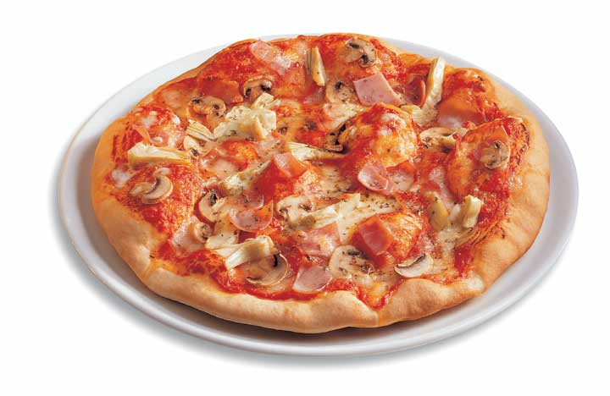
Bread based Pizza
Ingredients:
Home Learning – Weigh ingredients accurately at home. Slice and dice vegetables. Bring in a container.
Method:
Set oven to Gas mark 8 or electric 220C
Place flour, salt, sugar and margarine in a bowl.
Use hands to rub in the margarine,
Add sachet of yeast,
Stir in warm water gradually to form a dough,
Knead on a floured work surface for 10 minutes,
Grease baking tray, roll out dough to 1cm thick and place on a tray,
Spread base with tomato layer,
Prepare other toppings and add on top,
Leave to rise for 10 minutes in a warm place,
Cook in main oven for 15-20 minutes.
Base:
300g strong white flour,
½ tsp salt,
½ tsp sugar,
15g margarine,
1 sachet quick acting yeast,
200ml warm water (at school),
Topping:
3 tablespoons tomato puree/ketchup/passata,
100g grated cheese,
1 tsp mixed herbs,
75g chopped ham,
1 red or yellow pepper.

Slide 10
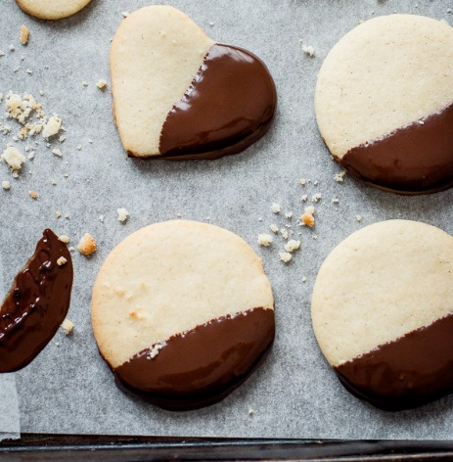
Decorated shortbread
Home Learning – Weigh ingredients accurately at home
Method:
Line a tray with baking parchment. Meanwhile heat your oven to 170C.
Mix together the butter and sugar, using an electric hand whisk, until pale and smooth.
Gently mix in the flour until completely incorporated,
Using your hands, squeeze the mixture together into a ball of dough.
Gently roll the dough out to about 5mm/¼in thick on a floured work surface,
Cut into shapes using a biscuit cutter .
Transfer the biscuits onto the baking tray and chill in the fridge for 15 minutes to rest.
Sprinkle each biscuit with a pinch of sugar.
Bake for 15–20 minutes, or until pale golden brown.
Transfer the biscuits to a wire rack to cool and serve.
Ingredients
200g butter, softened,
100g caster sugar,
300g plain flour,
Decoration:
50g milk chocolate,
50g white chocolate.

Slide 11
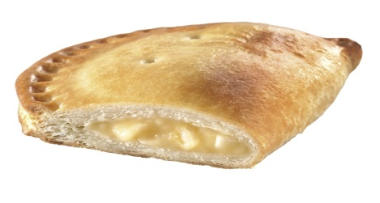
Pasties
Home Learning – Weigh ingredients accurately at home.
Method
Heat oven Gas 5/180°C
Rub fat into flour to give breadcrumbs, add water to give a soft dough,
Mix together filling ingredients in a bowl.
Roll out pastry onto a floured surface and use a small plate to cut out rounds
Place a spoonful of mixture in the centre of each round, brush edges with water.
Draw edges up so they meet over the top in a pasty style and press well together.
Brush well with milk and place onto baking tray.
Bake for 15-20 minutes until pastry is golden and crisp.
Ingredients
Shortcrust Pastry:
200g plain flour,
50g white fat e.g. Trex or lard,
50g block marg.
8 tbsp cold water (at school),
Cheese and Onion filling:
100g grated cheese
½ chopped onion
50g tinned sweetcorn
½ tsp dried mixed herbs

Slide 12
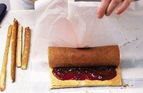
Swiss Roll Ingredients:
Home Learning – Weigh ingredients accurately at home.
Method:
Preheat oven to 200C/Gas Mark 6. Grease and line a Swiss roll tin.
Whisk the eggs and sugar in a bowl until pale and fluffy,
Fold the flour and spoon the mixture into the tin. Bake in the oven for 7-10 minutes, or until light and springy to touch,
Remove from the oven and turn the sponge out onto another piece of greaseproof paper,
For the filling, spread the jam onto the sponge. Roll the sponge to cover the filling.
3 eggs,
75g caster sugar,
75g self raising flour,
Filling:
75g jam/chocolate spread(must not contain nuts)/lemon curd.

Slide 13
Tried and tested recipes for you to try at home…

Slide 14
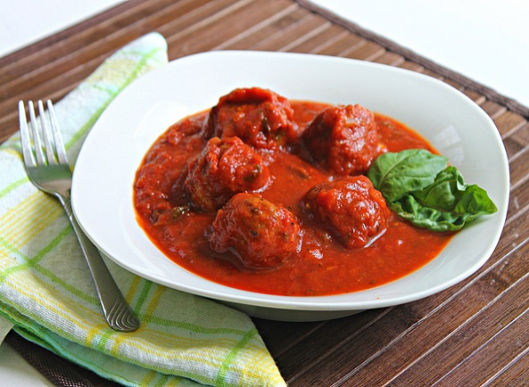
Meatballs and Tomato Sauce Ingredients:
Method:
Put the beef, egg, breadcrumbs and herbs into a large bowl. Peel and finely grate the garlic then add to the bowl.
Work the mixture together with your hands until thoroughly mixed. Season with salt and pepper. Roll the mixture into 12 equal-sized balls.
Heat the oil in a large frying pan over a medium-high heat. Fry the meatballs for 8 minutes until golden-brown all over.
Add the chopped tomatoes, mixed herbs. Peel and grate the garlic, add to then pan then cook over a medium heat for 20 minutes.
Don’t forget…a container with a lid.
Focus: To create a nutritionally balanced family meal.
For the meatballs
250g/9oz minced beef
1 egg
2 tbsp fresh or dried breadcrumbs
1 tsp dried mixed herbs
1 garlic clove
1 tbsp vegetable oil
salt and pepper
For the sauce (Ragu)
400g tin chopped tomatoes
1 tsp dried mixed herbs
1 garlic clove

Slide 15
Veggie Meatballs and Tomato Sauce Ingredients:
Method:
Tip the quinoa, onion mixture, beans, egg and breadcrumbs into a food processor with a little seasoning and whizz until smooth-ish. Use clean, wet hands to form into 20 balls, each about the size of a walnut, put onto a tray and chill for 15 minutes.
Work the mixture together with your hands until thoroughly mixed. Season with salt and pepper. Roll the mixture into 12 equal-sized balls.
Heat the oil in a large frying pan over a medium-high heat. Fry the meatballs for 8 minutes until golden-brown all over.
Add the chopped tomatoes, mixed herbs. Peel and grate the garlic, add to then pan then cook over a medium heat for 20 minutes.
Don’t forget…a container with a lid.
Focus: To create a nutritionally balanced family meal.
For the meatballs
75g quinoa
½ onion, finely chopped
3 garlic cloves, finely chopped
2 tsp sweet smoked paprika
400g tin black beans , drained and rinsed
1 egg
30g dried breadcrumbs
For the sauce (Ragu)
400g tin chopped tomatoes
1 tsp dried mixed herbs
1 garlic clove

Slide 16
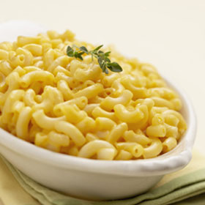
Macaroni Cheese
Ingredients:
Home Learning – Weigh ingredients accurately at home. Grate cheese.
Method:
Bring a saucepan of water to the boil, and then add the macaroni. Cook for about 10-12 minutes, until al dente.
Grate the cheese and slice the tomato.
While the pasta is cooking, make the sauce.
  Place the butter or margarine, flour and milk into a small saucepan.
  Bring the sauce to a simmer, whisking it all the time until it has thickened.
  Reduce the heat and allow to simmer for 2 minutes.
  Stir in 75g of the grated cheese.
Preheat the grill.
Drain the boiling hot water away from the macaroni into a colander in the sink.
Stir the drained macaroni into the cheese sauce and add a few twists of black pepper.
Pour the macaroni into an oven-proof dish or foil tray.
Arrange the tomato slices over the macaroni.
Sprinkle over the remaining cheese.
Place under a hot grill until the cheese is bubbling and golden brown.
Don’t forget…an ovenproof dish.
Serves 4
200g macaroni
150g Cheddar cheese
1 tomato
50g soft margarine
50g plain flour
500ml semi-skimmed milk
Black pepper

Slide 17
Pasta Bake
Ingredients:
Home Learning – Weigh ingredients accurately at home. Grate cheese.
Method:
Fill your saucepan ¾ full with water, put on the hob to boil,
When your pan of water is boiling, place your pasta in the pan, and turn down to a simmering heat,
Grate cheese, cut broccoli, prepare any other ingredients.
When your pasta is cooked, take off the hob and strain using a colander,
While your pasta is cooking, place the butter or margarine, flour and milk into a small saucepan,
Bring the sauce to a simmer, whisking it all the time,
Reduce the heat, stir in oregano and allow to simmer for 2 mins,
During the last 2 minutes of the pasta boiling, add the sweetcorn and broccoli,
Preheat the grill,
Drain the boiling hot water away from the pasta and vegetables with a colander in the sink,
Pour the drained pasta and vegetables into the sauce,
Stir in canned tuna,
Pour the mixture into an ovenproof dish or foil tray,
Sprinkle cheese over the top and place under the grill until golden brown.
Don’t forget…an ovenproof dish.
Serves 4
200g pasta e.g. rigatoni
100g cheese
50g soft margarine
50g plain flour
500ml semi-skimmed milk
1 x 5ml spoon dried oregano
Black pepper
Optional:
100g broccoli
50g sweetcorn (canned or frozen)
100g canned tuna (in water) drained

Slide 18
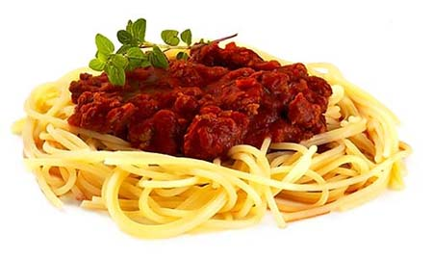
Bolognese Ingredients:
Method:
1. Peel and chop the onion, carrot and celery and peel and crush the garlic.
2. Fry the onion, carrot, celery and garlic in the oil for 5 minutes, until soft. Add the meat until the mince is lightly browned.
3. Add the tomatoes, tomato puree, mixed herbs and water and mix all ingredients together. Tear in the basil leaves.
4. Add a few twists of black pepper, then allow to simmer gently for 30 minutes (longer if possible).
Don’t forget…a container with a lid.
Focus: To create a nutritionally balanced family meal.
1 onion
1 carrot
1 celery stick
1 clove garlic
1x15ml spoon oil
1 x 400g canned chopped tomatoes
handful of fresh basil
black pepper
250g minced beef
100ml water (at school)
1 x tbsp tomato puree.
Options:
Swap 250g minced beef to 250g Quorn,
Add extra vegetables.

Slide 19

Chilli Con Carne
Ingredients:
Don’t forget…a container with a lid.
Method:
1 onion
1 clove garlic
1 green pepper
1 x 10ml spoon oil
250g minced beef
1 x 10ml spoon flour
250ml stock
1 x 400g can red kidney beans
1 x tbsp tomato puree
1 x tsp chilli powder
Prepare the vegetables:
  Peel and chop the onion.
  Deseed and chop the pepper.
  crush the garlic.
Fry the onion and garlic in the oil for 3-4 minutes.
Add the minced beef and cook until it has browned.
Stir in the flour.
Pour in the stock.
Drain the red kidney beans and add to the meat.
Stir in the tomato puree and chilli powder.
Bring to the boil, then allow to simmer for 20 minutes.
Add the green pepper and allow to cook for a further 15 minutes.
Options:
Swap 250g minced beef to 250g Quorn,
Add extra vegetables.

Slide 20
Chicken Tikka Masala
Ingredients:
Method:
Don’t forget…a container with a lid.
2tbs oil
1 medium onion
2tbs Tikka Masala Paste
200ml water
1tsp garlic & ginger chopped (optional)
250g diced chicken breast
200g canned chopped tomatoes,
100ml double cream.
Heat oil in a medium saucepan.
Add onion; cook until soft.
Add Tikka Masala Paste, 100ml of water, ginger and garlic. Stir occasionally, until reduced and thickened.
Add chicken, fry until sealed.
Add 100ml water, tomatoes, bring to the boil, simmer un-covered for 10 minutes.
Add double cream.
Simmer un-covered for 5 minutes.
Optional at home:
You can marinade the chicken first
with half yoghurt, half the spice paste, and then either grill it separately or add it uncooked into the sauce and allow to cook through.

Slide 21
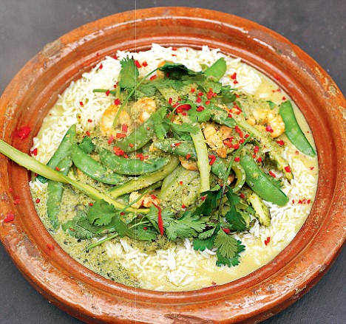
Thai Green Chicken Curry
Ingredients:
Method:
Prepare the vegetables:
  slice the spring onions;
  cut the sugar snap peas in half;
  crush the garlic.
On a separate clean chopping board using a separate clean knife, cut the chicken into small chunks.
Fry the spring onions, garlic and chicken in the oil for 3-4 minutes.
When the chicken has turned ‘white’, stir in the green curry paste, followed by the sugar snap peas.
Pour in the coconut milk and simmer for 15 minutes.
Squeeze the lime and pour over the curry.
Tear the coriander and add to the curry.
Serve.
Don’t forget…a container with a lid.
1 x 10ml spoon oil
3 spring onions
1 clove of garlic
80g sugar snap peas
1 small chicken breast
2 x 15ml Thai green curry paste
200ml coconut milk (reduced fat)
1/2 lime
Small bunch of coriander

Slide 22
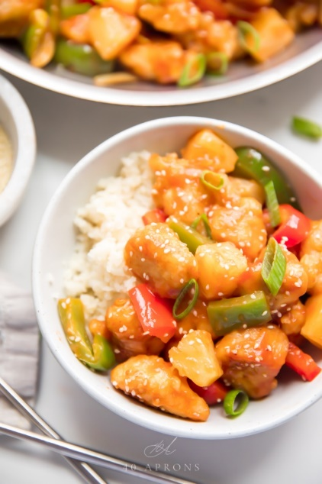
Sweet and Sour Chicken
Ingredients:
Method:
Make sweet and sauce by whisking together the pineapple juice, tomato ketchup, malt vinegar and cornflour. There should be 300ml – add water or stock if you are short.
Heat the oil in a frying pan or wok over a high heat. Add the onion, chilli, peppers, carrots and chicken and stir fry for 3-5 mins until the vegetables are starting to soften and the chicken is almost cooked.
Add the pineapple and sauce. Bubble for 2 mins, add tinned tomatoes and cook for 2 mins until the sauce thickens, the chicken is cooked and the vegetables are tender.
Don’t forget…a container with a lid.
425g can pineapple chunks,
2 tbsp. tomato ketchup
2 tbsp. corn flour,
2 tbsp. malt vinegar,
1 onion,
1 red chili,
1 pepper,
2 carrots,
150g diced chicken,
1 tin tomatoes.

Slide 23
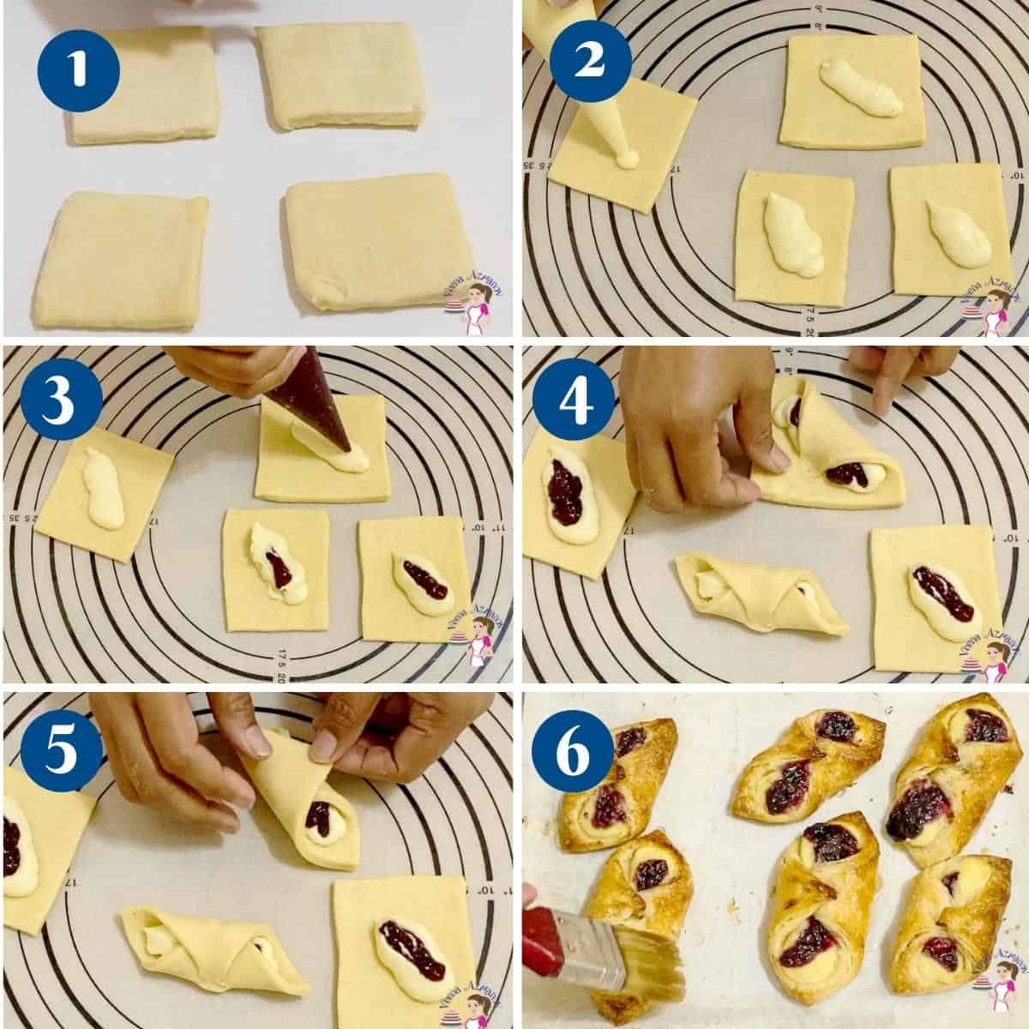
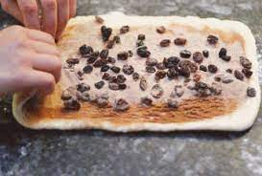
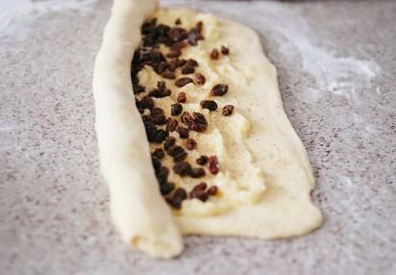
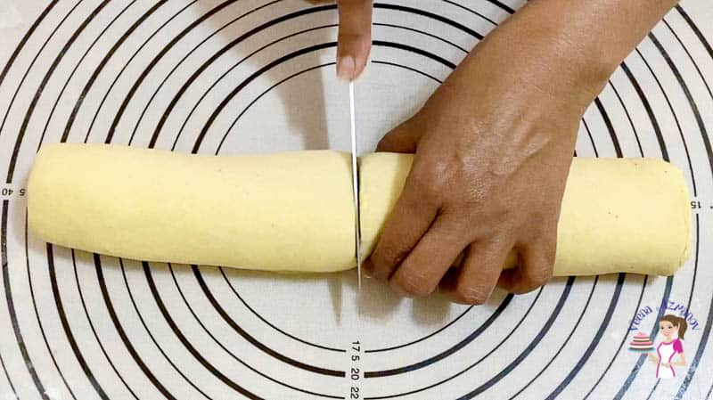
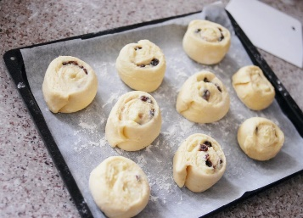
Danish Pastries
Basic pastry base:
Unroll the sheet of pastry and cut squares no smaller than a post it note.
To cook:
Heat oven to 220C/200C fan/gas 7. Dust with the remaining demerara and cook for 20 mins until the pastry is golden.
Ingredients
Puff Pastry:
I packet ready rolled puff pastry.
Filling:
For the apricot custard turnovers
150g tub custard
1 x 320g cans apricots
few tsps apricot jam
OR
For the raisin swirls
100g raisin
50g caster sugar
1 tsp mixed spice
75g soft butter
50g icing sugar
Apricot turnovers:
Put 2 tsp custard in the middle of a square of pastry, sit two apricot halves on top, dot with jam, then pull 2 corners over and pinch to seal.
Raisin Swirls:
Mix 100g raisins, 50g caster sugar, 1 tsp mixed spice and 75g soft butter. Instead of cutting the dough into 9, leave it whole and spread the filling over.
Roll up, slice into 9 rounds, then squash each one. Blend 50g icing sugar and a few drops of water to drizzle over once baked.

Slide 24

Breaded chicken goujons
Home Learning – Weigh ingredients accurately at home.
Method
Preheat the oven to 220C/200C Fan/Gas 7.
Put the flour in a wide, shallow bowl.
Break the egg into a second shallow bowl and beat with a fork until smooth and pale. Tip half of the breadcrumbs into a third shallow bowl.
Coat each chicken strip first in flour, then egg, then breadcrumbs, pressing firmly and turning to coat on both sides. Set aside on baking paper.
If oven-cooking the chicken, brush a baking tray with 1 tablespoon of oil. Place the chicken pieces on the tray and brush generously but lightly with 3 tablespoons more oil.
Bake for 15 minutes, turning halfway through.
Ingredients
2 chicken breasts cut into strips,
3 tbsp plain flour
1 large free-range egg
80g dried breadcrumbs, ideally panko or coarse dried breadcrumbs or 2 slices of bread,
4–6 tbsp oil
Optional – could you stretch yourself by making a sauce (see next page for more ideas)?
Curry sauce:
120g mayonnaise,
3 tsp curry powder,

Slide 25
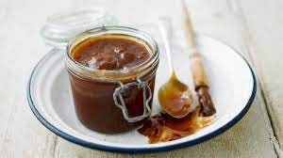

Sauces
Tomato Ketchup
Ingredients
1 tbsp oil
1 onion
2 tblsp tomato puree
6 tomatoes – medium sized (not cherry tomatoes)
½ tsp ground coriander
½ tsp ground cumin
½ tsp fennel seeds
1tsp sugar
Pinch ground ginger
1 tbsp white wine vinegar
BBQ Sauce
Ingredients
1 tbsp olive oil
1 onion, finely chopped
400g can chopped tomatoes
3 garlic cloves, finely chopped
85g brown sugar
3 tbsp malt vinegar
2 tbsp Worcestershire sauce
1 tbsp tomato purée
Method
Heat oil in a saucepan and add the onion. Cook over a gentle heat 4-5 mins, until softened.
Add the remaining ingredients, season and mix. Bring to the boil, then reduce heat and simmer for 20-30 mins, until thickened.
For a smooth sauce, simply whizz the mixture in
a food processor or with a hand blender for a few seconds
Method
Peel and finely chop / grate the onion.
Skin the tomatoes by placing in boiling water to soften and release the skin and then remove skin carefully. Chop the skinned tomatoes.
Heat the oil in a small saucepan over a medium heat. Add the onions and fry for 2-3 minutes, until softened.
Add the spices and sugar, white wine vinegar and chopped tomatoes and tomato puree to the onions.
Simmer gently over a medium heat for 10 minutes, or until the tomato has softened and become a sauce. WASH UP!
Take off the heat and allow to cool slightly.
Using the hand blender – blend your sauce carefully for 30 seconds.
Pass the sauce through a sieve over a large
glass bowl. Push the sauce gently through the sieve with a wooden spoon.
Transfer your sauce to a measuring jug and CAREFULLY pour into a clean glass jar or plastic container.

Slide 26
Risotto
Ingredients:
Home Learning – Weigh ingredients accurately at home. Slice and dice vegetables. Bring in a container.
Method:
1tsp Vegetable oil
1 Bunch spring onions, trimmed and chopped
300g Risotto rice
1 Garlic clove, crushed
200g Mushrooms, sliced
900ml Hot vegetable stock (one stock cube mixed with 900ml of hot water from school from the kettle in a measuring jug)
75g Frozen peas, thawed
Ground black pepper
Heat the vegetable oil in a large frying pan or saucepan and cook the spring onions over a medium-high heat for a few seconds.
Add the rice and cook over a low heat for about 1 min, stirring all the time until the rice looks glossy but not brown.
Add the garlic and mushrooms and any other flavouring ingredients, then pour in about half the hot stock and stir well. Cook over a medium heat for 20-25 mins, stirring often and gradually and adding the remaining stock a little at a time until the rice has absorbed all the liquid.
Check that the rice is tender. It should have a nice creamy texture. If it needs cooking for a bit longer, add a little more hot water. Add the peas, stirring gently to mix them in. Check the seasoning, adding some pepper if needed.
Options:
Add extra vegetables,
Swap mushrooms for other ingredients such as ham, sweetcorn, other vegetables.

Slide 27
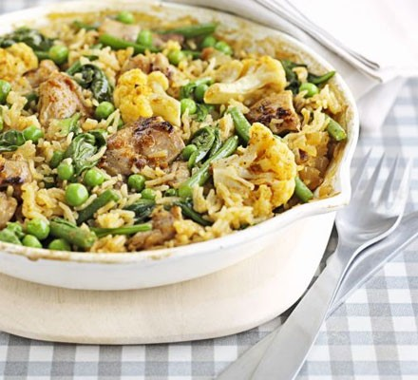
Chicken Pilaf
Ingredients:
Home Learning – Weigh ingredients accurately at home. Slice and dice vegetables. Bring in a container.
Method:
1 tsp sunflower oil
1 small onion, chopped
1 large or 2 small boneless, skinless chicken fillets,
2 tsp curry paste (choose your favourite)
100g basmati rice
225 ml chicken stock (one stock cube mixed with 225ml of hot water from the kettle in a measuring jug)
100g frozen mixed vegetables
50g frozen leaf spinach
Heat the oil in a frying pan, then fry the onion for 5-6 mins until softened. Add the chicken pieces, fry for a further couple of mins just to colour the outside, then stir in curry paste and rice. Cook for another min.
Pour in the chicken stock and throw in any larger bits of frozen veg.
Bring to the boil, lower the heat, then cover the pan with a lid.
Cook for 10 mins, then stir in the remaining veg.
Scatter over the spinach, cover, then cook for 10 mins more until all the stock is absorbed and the rice is tender.
Options:
Add extra vegetables,
Change the chicken to turkey, Quorn.

Slide 28
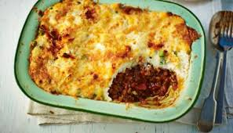
Shepherd’s Pie
Ingredients:
Method:
Home Learning:
Mash Potato, grate cheese, chop slice and dice vegetables at home.
Preheat oven to 180'C/Gas mark 4
Place the meat in a large frying pan and heat gently, stirring frequently, until the meat begins to brown
Add the onions carrots and garlic and continue to cook for 10 minutes - stir in the stock and tomatoes and bring to the boil
Add the Worcestershire sauce and herbs cover the pan and simmer gently for 25 mins giving it the occasional stir
Meanwhile cook the potatoes in boiling water until tender, then drain and mash, mixing in the butter (don't use too much butter, you want the mash to be quite firm)
Turn the meat into an ovenproof dish - add on the mashed potato and smooth over
Cook for approximately 30 minutes until the potatoes are golden brown
500g lamb mince
4 carrots, chopped
2 garlic (cloves), crushed
500ml stock
200g chopped tomatoes
1 tbsp Worcestershire sauce
1 tsp mixed herbs
Options:
Swap 250g minced beef to 250g Quorn,
Add extra vegetables,
Add more cheese.

Slide 29
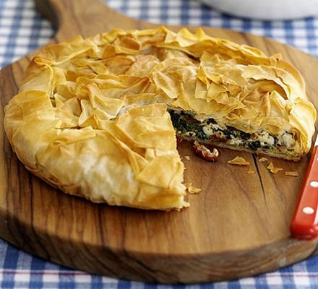
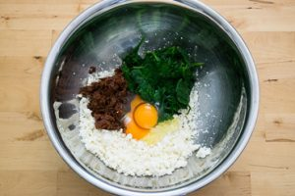
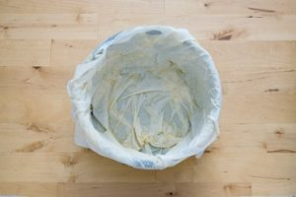
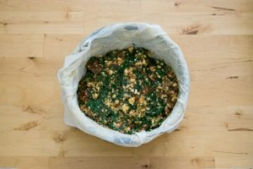
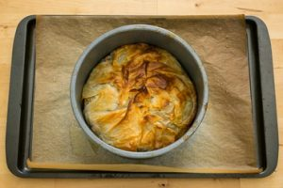
Crispy Greek Style Pie
Method:
Home Learning –Bring in an ovenproof dish/ round sandwich cake tin to cook it in.
Heat oven to 180C/fan 160C/gas 4,
Put the spinach into a large pan. Pour over a couple tbsp water, then cook until just wilted. Tip into a sieve, leave to cool a little, then squeeze out any excess water and roughly chop.
Roughly chop the tomatoes and put into a bowl along with the spinach, feta and eggs. Mix well.
Carefully unroll the filo pastry. Take a sheet of pastry and brush liberally with some of the sundried tomato oil. Drape oil-side down in a 22cm loose bottomed cake tin so that some of the pastry hangs over the side. Brush oil on another piece of pastry and place in the tin, just a little further round. Keep placing the pastry pieces in the tin until you have roughly three layers, then spoon over the filling. Pull the sides into the middle, scrunch up and make sure the filling is covered. Brush with a little more oil.
Cook the pie for 30 mins until the pastry is crisp and golden brown.
Ingredients
200g bag spinach leaves
175g jar sundried tomato in oil
100g feta cheese, crumbled
2 eggs
125g filo pastry
Alternatives:
1 cooked shredded chicken breast,

Slide 30
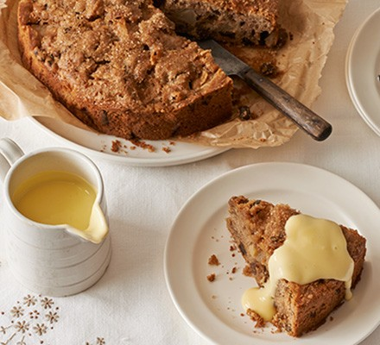
Dorset Apple Cake
Home Learning – Weigh ingredients accurately at home.
Ingredients
60g unsalted butter, diced and chilled, plus extra for the tin
115g self-raising flour
1 tsp ground cinnamon
60g light brown sugar
1 large egg, beaten
4 tbsp milk
110g Bramley or Granny Smith apples, peeled, cored and diced
50g sultanas
1 tbsp demerara sugar (optional)
Method
Heat the oven to 180C/160C fan/gas 4. Butter and line a 20cm cake tin with baking parchment.
Mix the flour and cinnamon together in a large bowl. Add the butter and rub into the flour using your fingers, until it resembles fine breadcrumbs.
Stir in the light brown sugar.
Beat in the egg followed by 4 tbsp of milk – add it gradually until you have a smooth, thick batter.
Add the apples and sultanas and mix to combine. Scrape the batter into the prepared tin and gently level out.
Sprinkle over the demerara sugar, if using, and bake for 30-40 mins or until golden and a skewer inserted into the middle comes out clean.
Allow to cool in the tin for 15 mins and then carefully turn out onto a wire rack to cool further.

Slide 31
Chocolate Fudge Cupcakes Ingredients:
Home Learning – Weigh ingredients accurately at home. Decorate at home.
Method:
Heat oven to 160C/140C fan/gas 3 and line a 12-hole muffin tin with cases.
Gently melt the butter, chocolate, sugar and 100ml hot water together in a large saucepan, stirring occasionally, then set aside to cool.
Stir the eggs and vanilla into the chocolate mixture.
Put the flour into the chocolate mixture and mix until smooth.
Spoon into cases until just over three-quarters full,
Bake for 20-22 mins.
200g butter
200g plain chocolate , under 70% cocoa solids is fine
200g light, soft brown sugar
2 eggs , beaten
1 tsp vanilla extract
250g self-raising flour
Don’t forget…12 muffin cases

Slide 32
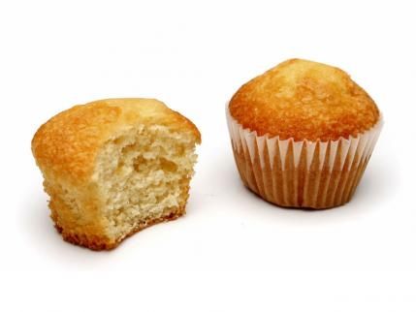
Fairy Cake
Ingredients:
Home Learning – Weigh ingredients accurately at home. Decorate at home. Bring in 12 cake cases.
Method:
Preheat oven to 180C/Gas Mark 4
Place paper cases in a bun tin.
Make cakes using the all in one method, Put all ingredients into a large mixing bowl and using an electric hand whisk, beat together for 2 minutes, until mixture is smooth.
Divide mixture evenly between 12 cake cases using a metal spoon.
Place in oven for 15minutes until well risen and springy to touch.
Remove from tins and place on a cooling wire.
115g caster sugar
115g margarine
115g self raising flour
2 eggs
Options:
Buttercream (150g icing sugar, 75g butter),
Glace icing (100g icing sugar 3 tsp cold water),
Sprinkles,
Chocolate.

Slide 33
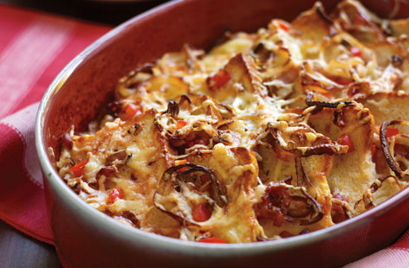
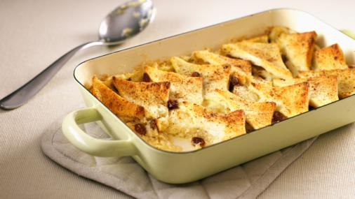
Home Learning – Weigh ingredients accurately at home.
Savoury Bread and Butter Pudding
Sweet Bread and Butter Pudding
Ingredients:
1tbsp vegetable oil
1/2 onion, finely chopped
2 rashers bacon, diced and cooked
1 red pepper, deseeded and diced
50g butter
6 slices bread
3 eggs
400ml milk
25g grated cheese.
Ingredients:
6-8 slices of bread/6-8 croissants/pain au chocolat/6-8 hot cross buns.
25g butter or spread (plus a little extra for greasing)
50g dried fruit/chocolate chips,
25g sugar
350 ml milk
2 eggs
Method:
Lightly grease an ovenproof dish.
Spread the bread with butter and cut each slice into 4 triangles.
Place a layer of the bread in the dish, sprinkle with fruit and sugar, repeat this and end with a layer of bread.
Beat the eggs and the milk together.
Pour over the bread through a sieve. Leave for 10 minutes to stand, if time.
Bake at 180/gas mark 4 for 30-40 minutes until set and golden brown.
Method:
Preheat oven to gas 5, 190ºC, fan 170°C.
Heat oil in a pan and fry the onion until soft. Add bacon and pepper and fry over a high heat until the bacon is browned.
Butter an ovenproof dish. Thickly butter one side of the bread slices, cut into triangles and arrange in the dish.
Spoon over the onion and bacon.
Beat the eggs and milk together, pour over the top.
Top with cheese and bake for 20 minutes until golden.
Don’t forget…an oven proof dish.

Slide 34
Ice Cream
Ingredients:
Home Learning – Weigh ingredients accurately at home.
Method:
Whisk the egg whites in a large bowl until stiff peaks form when the whisk is removed.
Slowly whisk in the caster sugar, then continue to whisk until the egg whites are stiff and glossy.
Whisk the cream in a separate bowl until soft peaks form when the whisk is removed.
Fold the cream, egg yolks and your chosen flavouring (see ingredients list) into the meringue mixture until well combined.
Pour into a plastic container and freeze for at least two hours.
4 free-range eggs, separated
100g/3½oz caster sugar
300ml/½pint double cream
Options:
Vanilla flavour - 1 tsp vanilla extract
Ginger flavour - 100g/3½oz stem ginger, chopped, plus 4 tbsp syrup from the jar
Coffee flavour - 2-3 tbsp coffee essence
Raspberry flavour - 150ml/5fl oz sieved raspberry purée (you could also use strawberry)

Slide 35
No Churn Ice Cream
Ingredients:
Home Learning – Weigh ingredients accurately at home.
Method:
Put the condensed milk, cream and vanilla into a large bowl. Beat with an electric whisk until thick and quite stiff, a bit like clotted cream.
Scrape into a freezer container or a large loaf tin, cover with cling film and freeze until solid.
½ a 397g can sweetened condensed milk
600ml pot double cream
1 tsp vanilla extract
Options:
Vanilla flavour - 1 tsp vanilla extract
Ginger flavour - 100g/3½oz stem ginger, chopped, plus 4 tbsp syrup from the jar
Coffee flavour - 2-3 tbsp coffee essence
Raspberry flavour - 150ml/5fl oz sieved raspberry purée (you could also use strawberry)

Slide 36
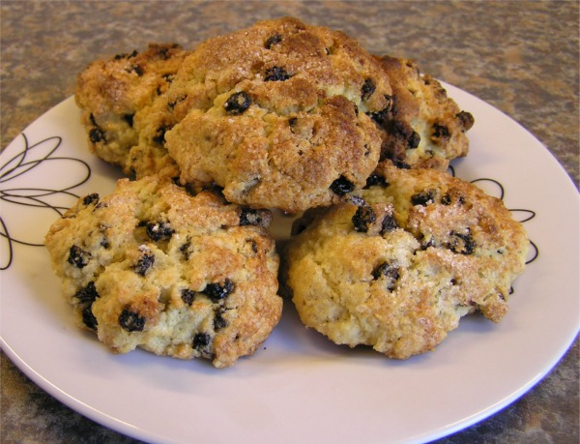
Rock cake
Ingredients:
Home Learning – Weigh ingredients accurately at home. Bring in a container.
Method:
Preheat oven to 220c/gas mark 7,
Sieve flour into the bowl.
Rub in butter into the flour until it looks like breadcrumbs.
Stir in sugar and dried fruit.
Whisk the egg lightly in a bowl.
Make a well in the middle of the flour and carefully add the egg.
Mix to form a soft dough.
Using 2 spoons, divide the dough into 8 rock shapes and place on a baking tray.
Bake for 12-15 minutes until golden brown.
Allow to cool on a cooling rack.
75g caster sugar,
75g margarine,
200g self raising flour,
1 egg
75g mixed fruit

Slide 37
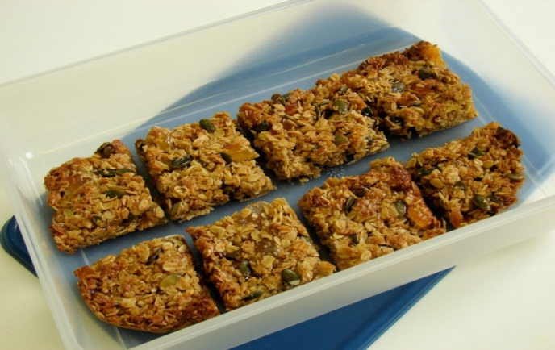
Tropical Granola Bars
Home Learning – Weigh ingredients accurately at home.
Ingredients
50g butter or margarine
2 x 15ml spoon honey
100g sugar
150g jumbo oats
1 x 5ml spoon cinnamon
40g pumpkin seeds
40g dessicated coconut
75g tropical dried fruit
Method
1.Preheat the oven to 180ºC or gas mark 4.
2.Place the butter or margarine, sugar and honey into a saucepan and gently heat until the butter or margarine has melted.
3.Stir in all the other ingredients.
4.Pour the mixture into a non-stick (or lined) baking tin.
5.Pat down the mixture in the baking tin.
6.Bake for 20 minutes, until lightly browned.
7.Remove from the oven and cut into ‘bars’ in the baking tin while hot.
Don’t forget…a round foil dish or Victoria Sandwich tin.

Slide 38
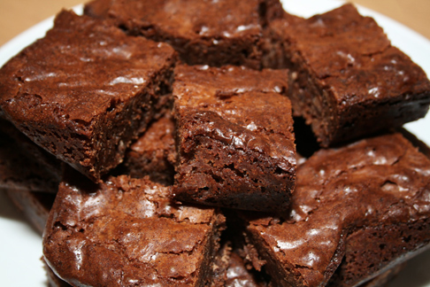
Chocolate Brownies
Ingredients:
Method:
Preheat oven to 180C/ Gas mark 4
Grease and line a shallow tin with greaseproof paper.
Break up chocolate and put in a bowl with the butter over a pan of simmering water.
Stir the caster sugar and muscovado sugar into the melted butter and chocolate.
Gradually beat in the eggs and extra egg yolk.
Fold in the flour and cocoa powder until evenly blended.
Pour the mixture into the prepared tin and bake for 30 minutes – the cake will be slightly soft in the middle and surface will look cracked.
85g dark chocolate
100g butter
125g caster sugar
100g light muscovado sugar
2 whole eggs + 1 egg yolk
100g plain flour
3 tbsp cocoa powder

Slide 39
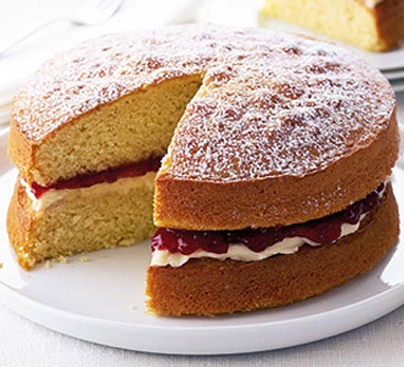
Victoria Sandwich Cake Ingredients:
Method:
Preheat oven to 180C/Gas Mark 4.
Cream together margarine and sugar using an electric whisk until light and fluffy.
Crack eggs into jug and beat with a fork, add to the mixture gradually and whisk together until its combined.
Sift flour into the mixture and fold in gently with a metal spoon, ensuring all flour is stirred in.
Spoon mixture into 2 round tins lined with baking parchment and spread evenly.
Place in oven for 20-25minutes until well risen and springy to touch.
Remove from tins and place on a cooling wire.
225g caster sugar,
225g margarine,
225g self raising flour,
4 eggs
1 jar of jam.
Optional:
Buttercream -100g icing sugar,
50g Butter.
Don’t forget…a container to take home in.

Slide 40
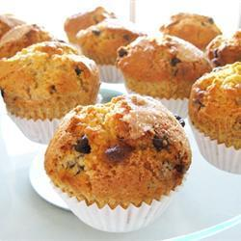
Chocolate chip muffins
Home Learning – Weigh ingredients accurately at home.
1.Preheat oven to 200 C / Gas 6. Grease bottoms only of 12-hole muffin tin or line with paper cases.
2.In a medium bowl, combine flour, 100g sugar, baking powder, chocolate chips and salt; mix well. In a small bowl, combine milk, oil and egg; blend well. Add dry ingredients all at once; stir just until dry ingredients are moistened (batter will be lumpy).
3.Fill holes 2/3 full. Sprinkle tops of muffins before baking with a combination of 3 tablespoons sugar and 2 tablespoon dark brown soft sugar.
4.Bake for 20 to 25 minutes or until skewer inserted in centre comes out clean. Cool 1 minute before removing from tin. Serve warm.
Ingredients
Makes: 12 muffins
250g plain flour
100g caster sugar
3 teaspoons baking
powder
1/2 teaspoon salt
175ml milk
75ml vegetable oil
1 egg
125g dark chocolate chips
1 tablespoons caster sugar
1 tablespoons dark brown soft sugar
12 muffin cases

Slide 41
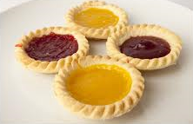
Jam Tarts
Home Learning – Weigh ingredients accurately at home.
Method:
Preheat the oven to 180C or gas mark 4,
Place flour and butter into the food processor and blend for 10 seconds, until it ressembles fine breadcrumbs,
Add the water and blend for a further 5 seconds until the dough comes together to make a firm dough,
Roll out on a floured surface using a rolling pin,
Cut out 12 rounds using a cutter that will fit a bun tin,
Press in gently, put teaspoon jam in each one,
Bake in the oven for 10 mins.
Ingredients
200g plain flour,
100g butter/margarine
½ jar jam
4 tbsp cold water

Slide 42
Chelsea Buns
Ingredients:
Method:
Preheat the oven to 220°C or gas mark 8.
Grease or line the baking tray.
Sift the flour and salt into the mixing bowl.
Rub in the margarine.
Stir in the yeast.
Make a well in the centre of the flour and add warm water.
Work into a soft dough with your hand.
Turn onto a lightly floured surface and knead for 5 - 10 minutes until smooth.
Place the dough in the bowl. Cover with cling film and prove in a warm place until doubled in size.
Turn dough onto a lightly floured surface and knead. Roll dough out to a rectangle and brush with melted butter.
Sprinkle with the soft brown sugar, cinnamon and mixed fruit.
Roll up and the cut into 8 slices,
Place slightly touching on baking tray or round cake tin,
Brush buns with milk,
Bake for 10 minutes, until the rolls sound hollow when tapped on the base.
Place on the cooling rack.
300g strong white flour
½ x 5ml spoon salt
½ 5ml spoon sugar
15g margarine
1 sachet quick acting yeast (7g)
200ml warm water
Filling:
25g/1oz unsalted butter, softened
75g/3oz soft brown sugar,
2 tsp ground cinnamon,
150g/5oz dried mixed fruit

