Slide 1

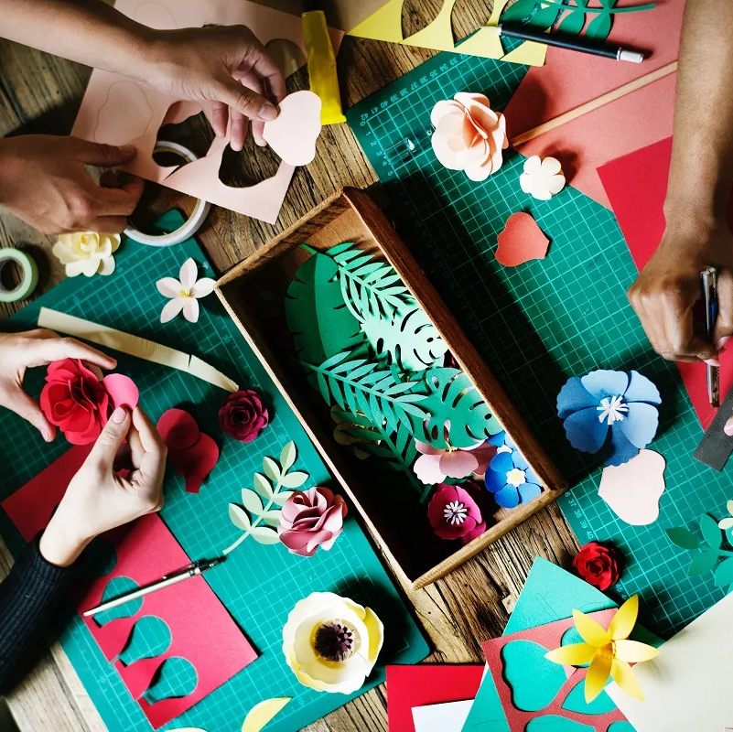
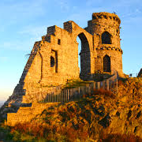

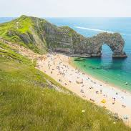
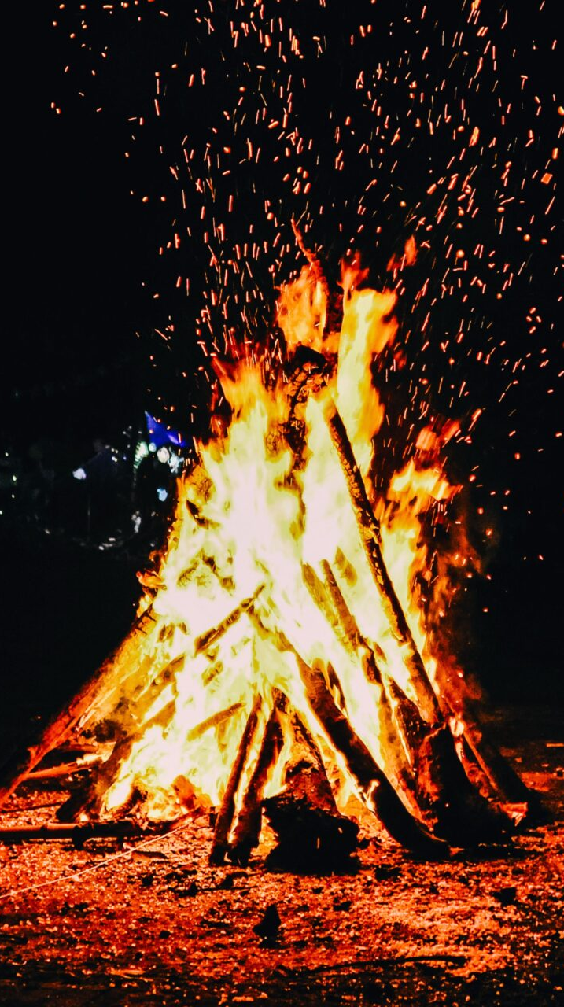



Cultural Entitlement

Slide 2
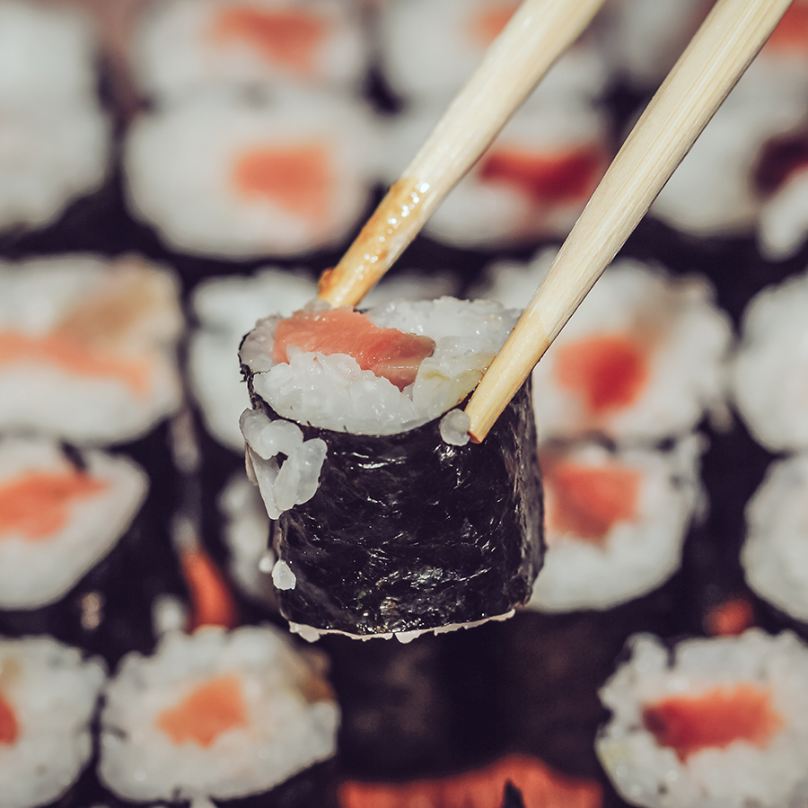
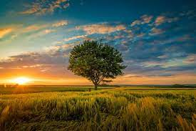

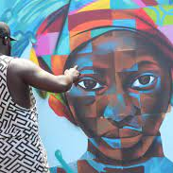
MY experiences
CULTURE & COMMUNITY
NATURE & ADVENTURE
MUSIC & PERFORMANCE
ARTS & CRAFTS
Investigating
Investigating different cultures, environments and around me.
Exploring
Exploring our local and national environments
Performing
Exploring performing arts
Arts
Looking at and creating my own art

Slide 3


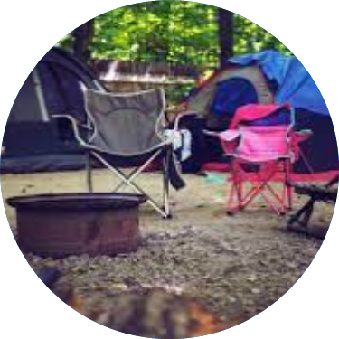
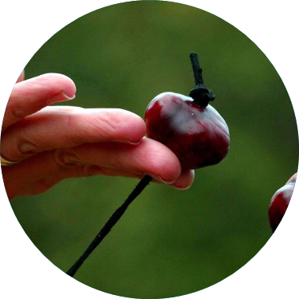
MY experiences
HISTORY & HERITAGE
WORD & VERSE
AROUND ME
HAVING FUN
Interest
Finding out more about personal, natural and social history.
Literature
Reading and listening to different literatures and meeting the people who create them.
Environment
Being out and about in the natural environment.
Learning
Finding out about different ways to have fun and enjoy myself

Slide 4
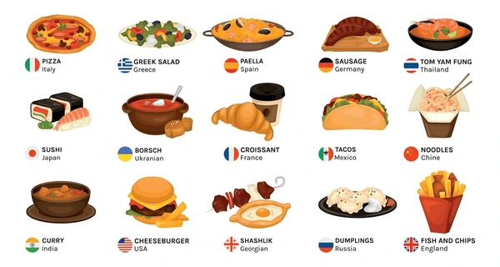
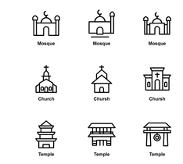

Culture and Community
BRONZE
GOLD
Community visit i.e. library
Food culture tasting day
Volunteer or raise money for charity.
Visit a university
Visit a place of worship
Prepare and celebrate a festival from another culture.
Food culture tasting day and dance festival
SILVER
Visit a workplace
Visit a college
Cultural clothing workshop
Research and design a cultural display

Slide 5
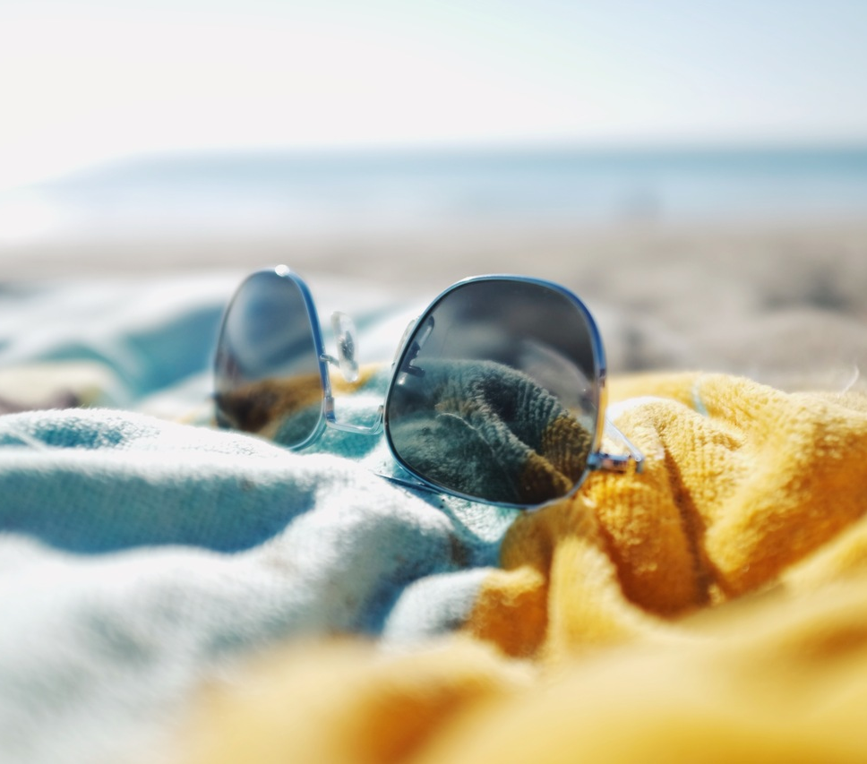
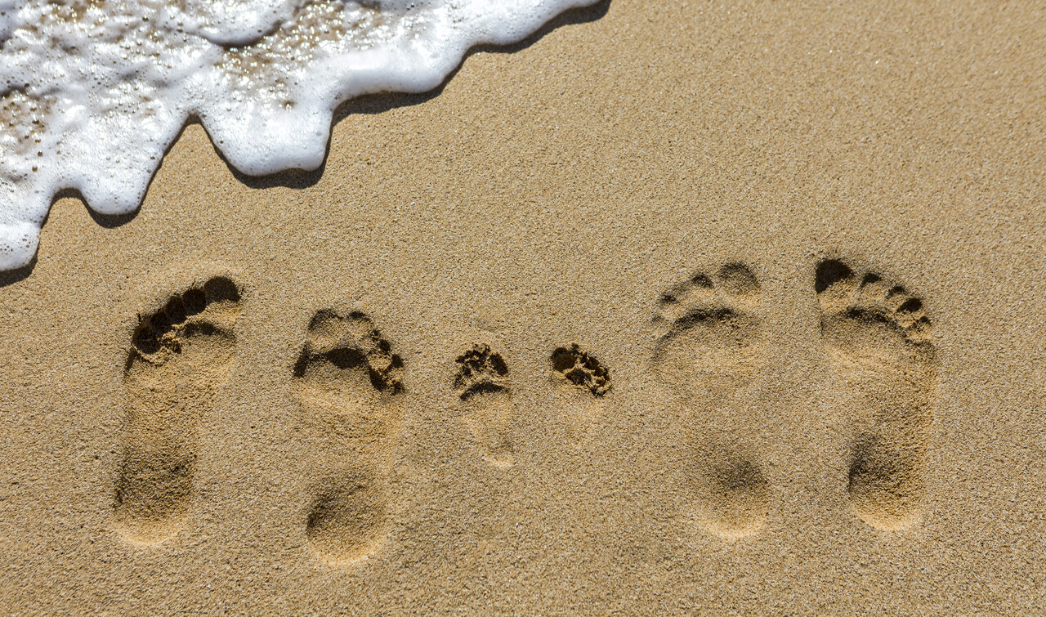
NATURE & ADVENTURE
BRONZE
Nature treasure hunt
Visit a new walk/trail
Visit a forest
Cooking outdoors - Bannock bread or marshmallow toasting
GOLD
Visit the Beach
First Aid training
Forging & camping scenarios
Campout/Summit route
SILVER
Mountain/woodland trek
Build mini rafts + float test experiment
Cook using camp stoves + ration planning
Duke of Edinburgh

Slide 6
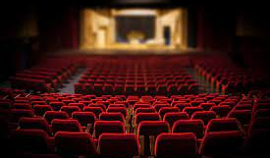


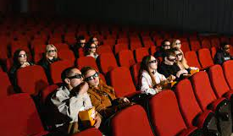
MUSIC & PERFORMANCE
GOLD
BRONZE
Watch a theatre performance
Use technology to create music
Performance for parents/public
Visit a music festival
Watch a movie at the cinema
Learn a basic instrument
Learn a folk dance
SILVER
Experience a concert
See a dance performance
Make a short film
African drumming workshop

Slide 7
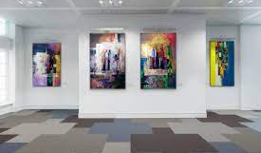
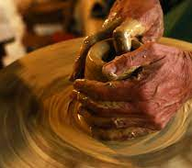

ARTS & CRAFTS
GOLD
BRONZE
Visit an Art exhibition
Create a ceramic sculpture
3D art portraits
Use digital app to create art
Visit an Art gallery
Create simple printing patterns
Sculpture from recyclables
Design and make clay pinch pots
SILVER
Meet an artist
Mosaic tile art
Create a collage or clay modelling

Slide 8
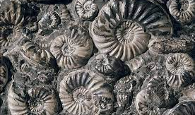
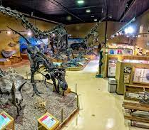

HISTORY & HERITAGE
BRONZE
Bring in an old toy/photo
Investigate family history
Create a family tree
SILVER
Watch a historical movie
Visit a museum
Find a fossil
GOLD
Find a fossil at the ‘wren’s nest’
Visit a castle
Visit a history exhibition

Slide 9



WORDS & VERSE
BRONZE
Favourite story rhyme
Meet an author
Shakespear play recital
Read a book of more than 50 pages
GOLD
Share your writing publicly
Watch a play at the theatres
Read a book of more than 250 pages
Re-inact Shakespeare play
SILVER
Listen to poetry
Read a book of more than 100 pages
Read a book to younger person
Visit a book festival

Slide 10
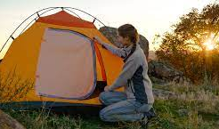
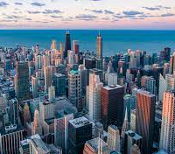

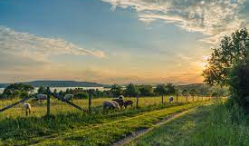
AROUND ME
GOLD
BRONZE
Visit a place of historical significance
Volunteer for a community group
Have a picnic
Visited somewhere haunted
Visit the countryside
Visit a new walk/trail
Road safety, sign hunt
Me & My community scrapbook
SILVER
Visit a city or town ( not in the West Midlands)
Visit a Farm
Community action i.e. litter picking, soup kitchen

Slide 11
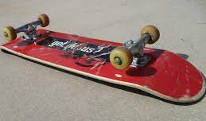
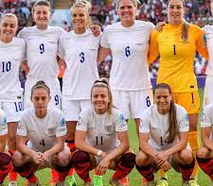
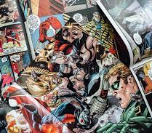

HAVING FUN
BRONZE
GOLD
Dress-up, Role play
Play conkers
Play a card game
Charity fundraiser event
Go to a sports event
Wellbeing fun day i.e. cosmic yoga, circuit training
See England Play
Duke of Edinburgh
SILVER
Outdoor STEM games
Go to a theme park
Ride a skateboard
Take part/ Organise community event, i.e. fun run, coffee morning.

