Slide 1






Preparation for Adulthood

Slide 2



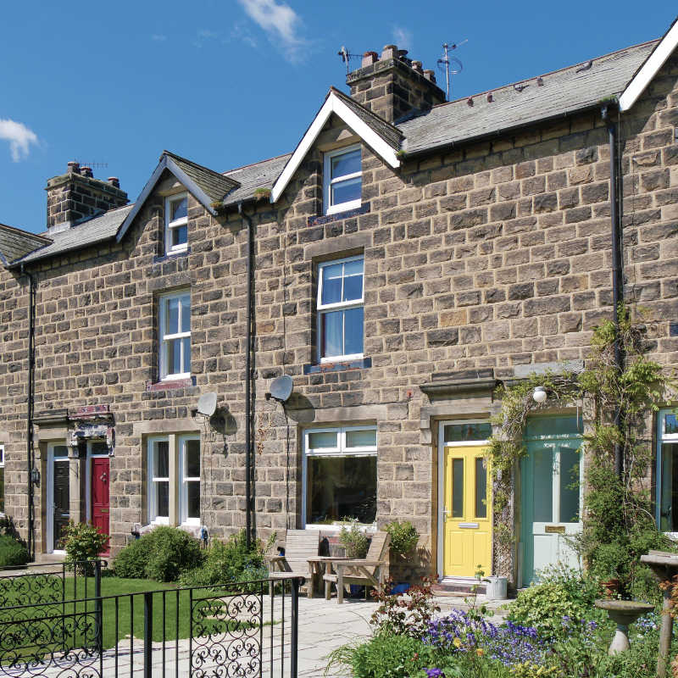
MY EXPERIENCES
GETTING READY
TRANSPORT
ROAD & STREET SAFETY
LIVING ON MY OWN
Employment
Finding out how to get ready to go to work
Out & About
Exploring different ways how to get around.
Safe Surroundings
Learning what signs and safety means.
Independent living
Exploring different living opportunities, and what responsibilities I have.

Slide 3
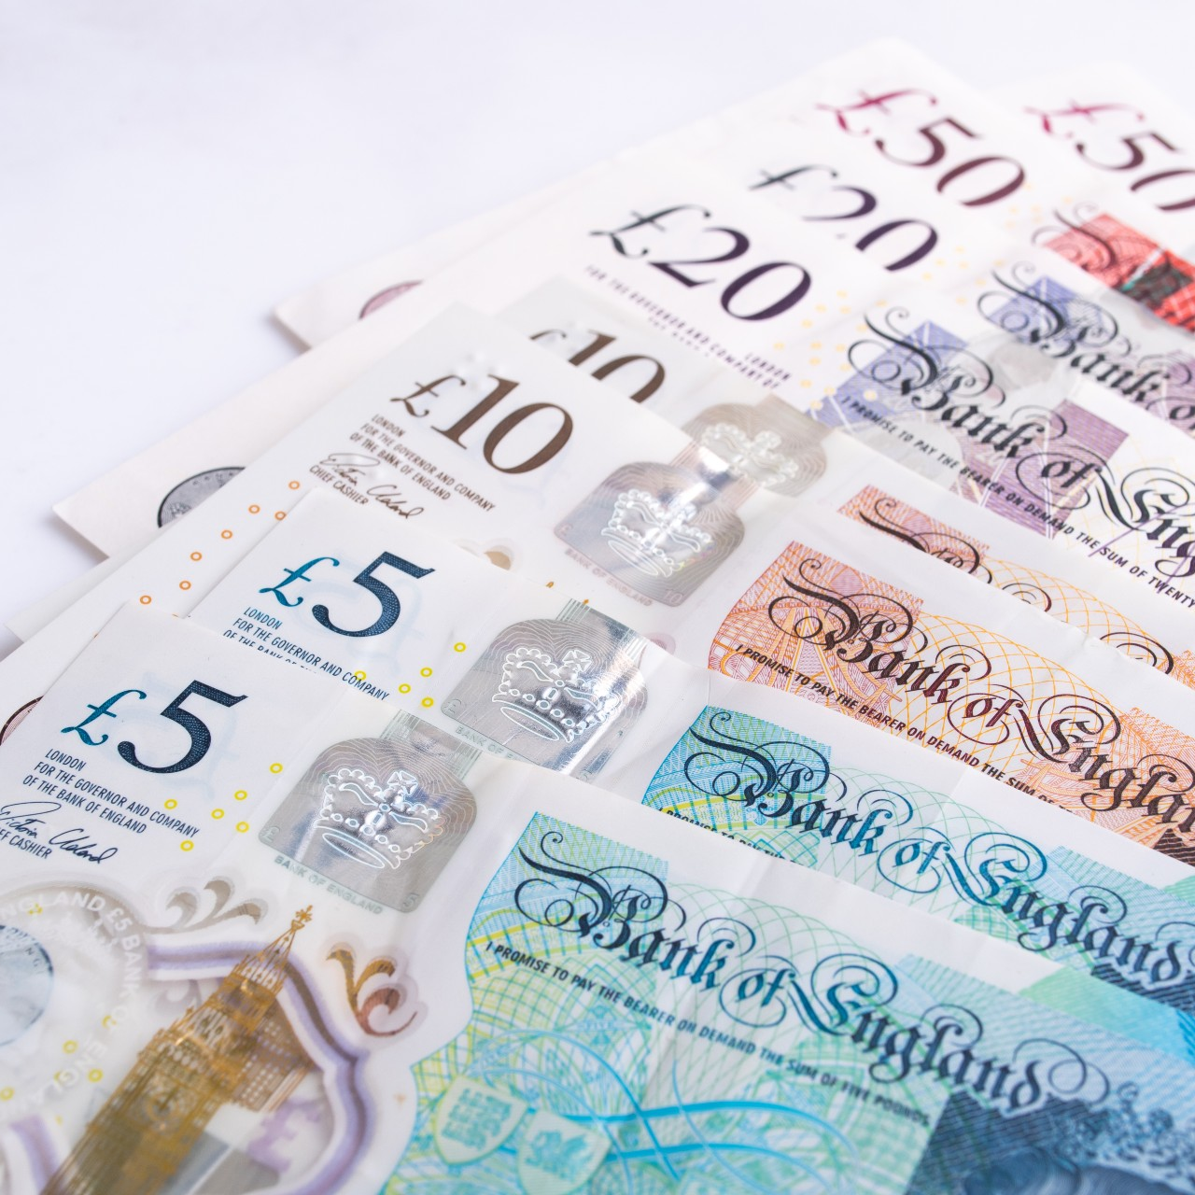


MY EXPERIENCES
MONEY
GETTING HELP
FIRST AID
Earning & Budgeting
Learning how I can earn and strategies to save money.
Support Network
Exploring what support available in my local area.
Good Health
Exploring healthy mental, physical and emotional health.

Slide 4

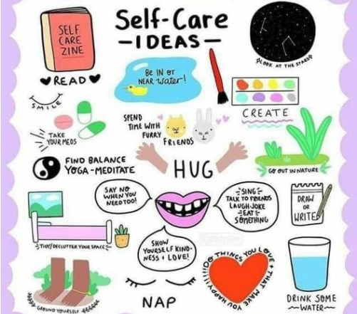
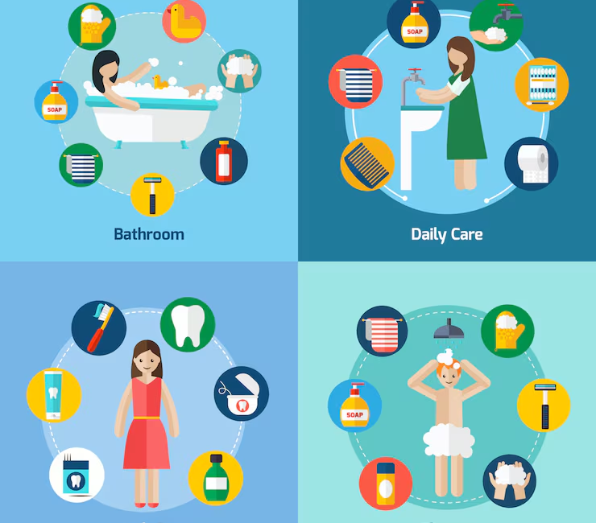
GETTING READY
BRONZE
GOLD
Morning/Afternoon routine
Practice zipping/buttoning
Sorting clothes based on weather
Personal self care mood board i.e. hygiene, sleep, mental health.
Morning routine/managing stress
SILVER
Hygiene stations
Self-care discussions
Personal space & boundaries
Emotional readiness

Slide 5




Transport
BRONZE
GOLD
Identify transport sounds
Recognising transport types
Follow a simple route in school
Plan a day out, using 2 transport methods.
Travel budgeting i.e. bus pass, train ticket, taxi
SILVER
Read a bus/train timetable and plan a journey
Visit local shops using pictures
Using an online map for directions to a place to visit

Slide 6


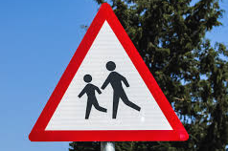
ROAD & STREET SAFETY
BRONZE
GOLD
Safely crossing a road.
Types of pedestrian crossings.
Role play (Lollypop lady/man)
Traffic light system
Stopping conflict
How to get help if someone is hurt or in an accident
SILVER
Being safe at night on the road
Stranger awareness, safe/unsafe scenarios

Slide 7
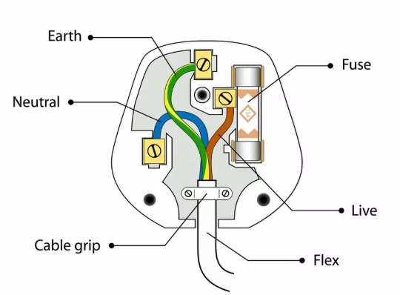
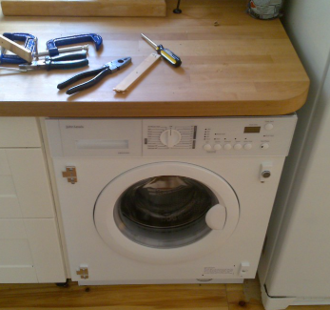
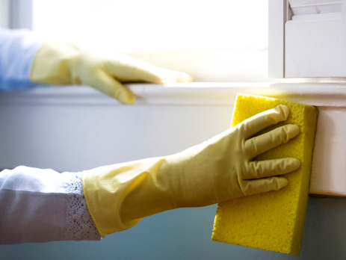
LIVING ON MY OWN
GOLD
BRONZE
Basic cooking i.e. breakfast, pasta, sandwiches
Using a washing machine.
Basic bills i.e. gas, electric, water
Changing a lightbulb
Wiring a plug
Class plant/teddy
Pretend play, i.e. setting a table
Using an oven/air-fryer.
Drying your clothes.
SILVER
Cleaning products and their use
Disposing of household waste
Simple chores i.e. wiping, sweeping, dusting

Slide 8



money
GOLD
BRONZE
Opening a bank account
How do benefits work?
School café/tuck shop
Budgeting for week i.e. food, transport, fun
Class shop/bakery
Coin/Note recognition
Budgeting/comparing
SILVER
How to Budget
Understanding income, payslips, taxes
Need vs Want activity

Slide 9


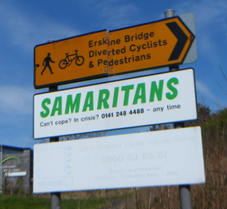
Getting help/First Aid
GOLD
BRONZE
Making appointments and going to the doctors.
Accessing and visiting external services
How to call 999 correctly
Who helps us? i.e. police, firefighters, teachers
Who can I ring when I need help?
Problem solving scenarios
SILVER
Recognises dangers i.e. hot, sharp, chemical
Mental & physical health.
Recognising when I need help.

Slide 10
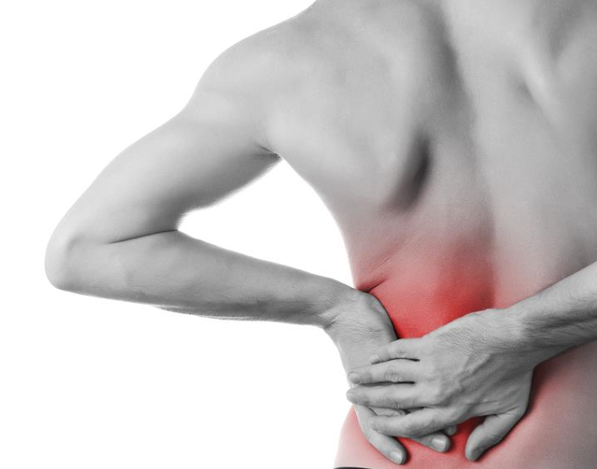

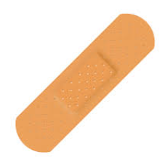

FIRST AID
BRONZE
GOLD
Bumps and Bruises
Cuts & Scrapes
First Aid Kits
Ringing 999
Helping someone who is choking
Trauma
SILVER
Muscle & Bone Injuries
Heatstroke & hypothermia

