Slide 1
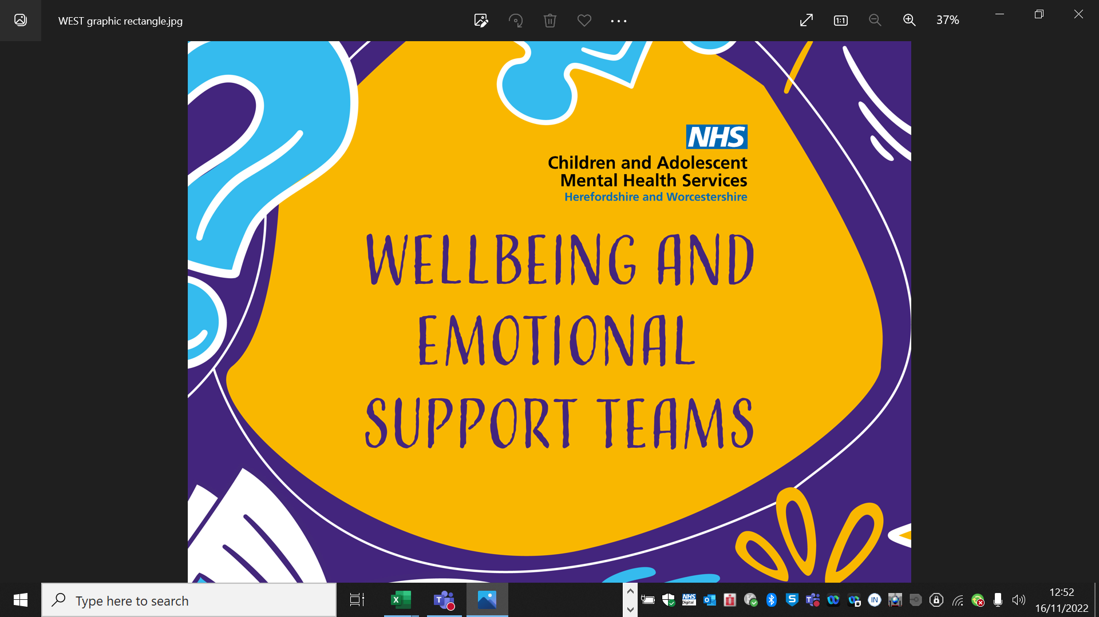
Managing the stress and anxiety of tests and exams
Parent/Carer Workshop

Slide 2



Common Mental Health Difficulties
Feeling Anxious
Panic Attacks
Fears & Phobias
Low Mood
Sleep Problems
We work in primary, secondary schools and colleges across
Herefordshire & Worcestershire
We support children and young people who experience mild–moderate “common mental health difficulties”
We provide early intervention to prevent symptoms becoming more severe
Notes:
Introduce yourself to the workshop
Elaborate depending on the audience

Slide 3
Agenda
Understanding exam stress and the impact on wellbeing
Understanding maintenance cycles
How to support
  Validation
  Stress bucket and 5 ways to wellbeing
General tips
Additional signposting

Slide 4
Our Group rules!
Confidentiality
Respect
Listen
Our group rules
Notes:
Don’t share in playground, etc
Insert new group expectations from last week and remind group of what we expect in sessions.
You can advise children and young people to come and see you at the end of the session if they would like to talk to you in private about anything they are worried about.

Slide 5
Understanding exam stress and the impact on wellbeing

Slide 6

Quick Quiz about exam stress!
96%
What percentage of students felt anxious about exams?
What percentage said they felt pressure from parents to do well?
59%
66%
What percentage said they had problems sleeping due to exam anxiety?
What percentage would like more support with exam stress?
64%
THE CHILDLINE NATIONAL EXAM STRESS SURVEY
Notes:
Icebreaker – show of hands
https://www.mentalhealthy.co.uk/news/321-pressure-of-exams-causing-worrying-levels-of-anxiety-in-students.html

Slide 7
Understanding stress and anxiety

Slide 8

UK-EN | D9655 | Clutter everywhere Sandra | Multi | Seller | 16x9 | 6s | .mp4
Notes:
Conquering exam stress: lessons from our bodies
www.youtube.com/watch?v=-RZ86OB9hw4

Slide 9
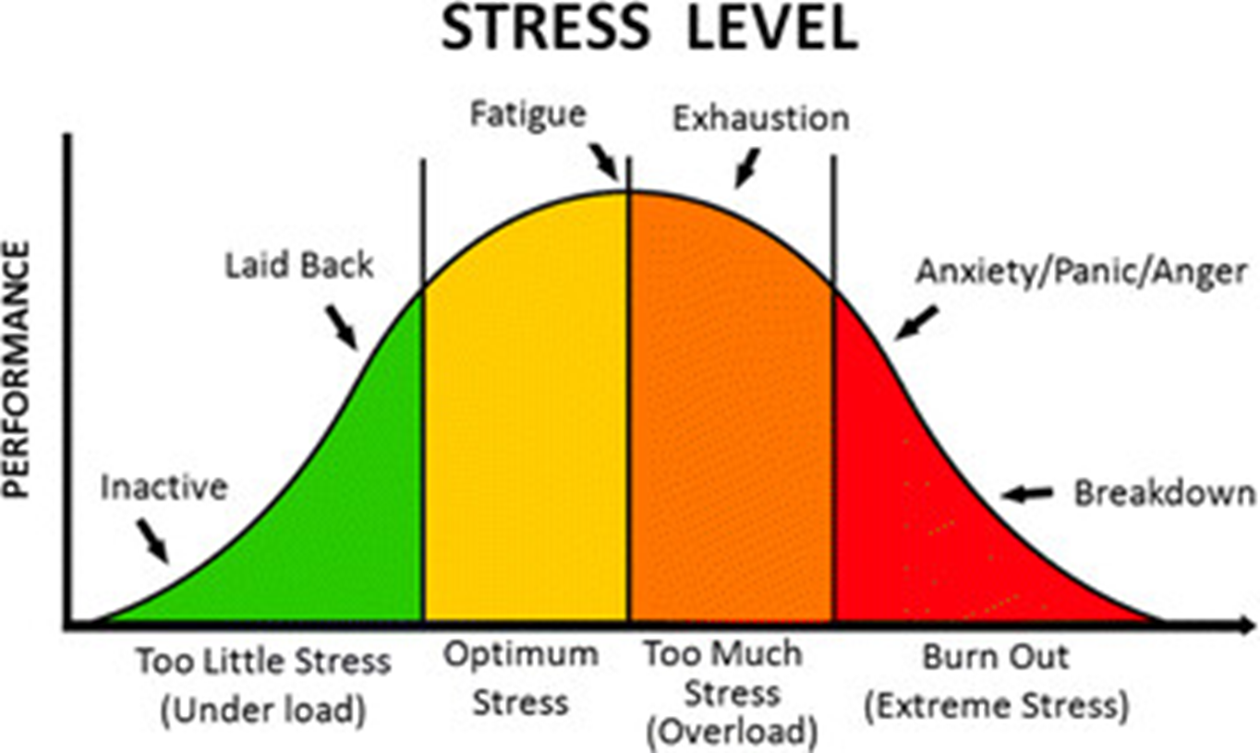
It is normal to worry about exams and some stress can be helpful…
Notes:
Talk about how we need a balance of stress and how some stress is good. Optimum amount of stress - with exams we need a certain level of stress to ensure that we do something about it like revise or ask for help. Perhaps give an example eg a elite athlete needs to be a little stress about a competition so that they train and practise their skill. If they don’t feel stressed at all, they may lack the motivation to train etc.
Too much stress however, is unhelpful and can mean that we achieve less. Feeling overwhelmed and stressed is not helpful to learning or even just concentrating. Even if you do manage to focus the information you are studying, if you are stressed, the information is likely to bounce around in your brain, not being processed properly or stored in your long-term memory.
So, while stress can sometimes be useful to enhance our performance and even protect us, occasionally it can become a problem and that is when we might need some extra help.

Slide 10


How do we recognise stress in our body?
Fast breathing
Heart pounding
Excited
Stomach ache
Butterflies in tummy
Shaking/jelly legs
Keen
Notes:
How our body tells us we’re in FFF
Activity – Hands up, point to your body, post-its, flip chart paper

Slide 11

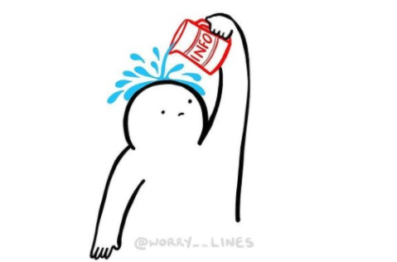
Why do we need to deal with stress?
Trying to take in information when you are relaxed
Trying to take in information when you are feeling stressed
v
Notes:
Another visual for why supporting this is important for learning/revision

Slide 12
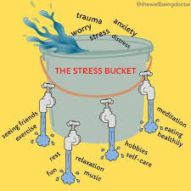
Be aware that parents may feel under pressure too!
https://www.youtube.com/watch?v=I9vYqbWB1FA
Notes:
Stress is the body’s natural response when it senses danger. We all experience it.
Too much stress, left unchecked for too long, can interfere with our lives and make us ill.
We all experience stress differently
Stress can be caused by both positive and negative events in our life
The more stress we are under the faster our bucket will fill up.
When our buckets are full and start to overflow this is when it can impact on your emotional health.
Parents have their own stress bucket too.

Slide 13
Anxiety maintenance cycle
Anxious expectation: I am going to fail these exams, I can’t revise
Behaviour: Feels unable to revise, spends time alone in bedroom on their phone
Physical Response: Feels shaky and sick

Slide 14
Example of how parents can unintentionally contribute to a child’s maintenance cycle.
Anxious expectation: I've not seen them do any revision, what if they fail. If I bring it up, they will just get angry at me
Behaviour: Keep asking how revision is going, get cross that they don’t appear to be taking it seriously
Physical Response: Feels stressed, worried, irritated
Anxious expectation: There’s so much pressure, even mum / dad thinks I will fail. I clearly can't do this, what's the point in trying? No matter what I do people keep asking me to do more.
Behaviour: Feels unable to revise and avoids revision, becomes irritable, doesn’t want to talk about exams at home, feels unable to ask for help, spends more time alone on phone.
Physical Response: Feels shaky and sick.

Slide 15
So what can we do?

Slide 16
Parents – you can help by using validation skills
VALIDATION communicates to another person that their feelings, thoughts, and actions make sense and are understandable to you in a particular situation.
It does not necessarily mean that you like or agree with what the other person is doing, saying, or feeling. It means that you understand where they are coming from
(Linehan, 2014)
Notes:
[Rathus, Jill H. /Miller, Alec L. / Linehan, Marsha M.. DBT� Skills Manual for Adolescents]

Slide 17
Why Validate?
Validation improves relationships.
It can de-escalate conflict and intense emotions.
Validation can show that:
We are listening.
We understand.
We are being non-judgmental.
We care about the relationship.
We can disagree without having a big conflict.
(Linehan, 2014)

Slide 18
Which of these responses would you prefer?
At least it’s not…
Thank you for sharing this with me
It could be worse….
What a frustrating/ upsetting situation
I’m not surprised you feel this way when…
You’ll get over it
I can understand why you feel that way
It will be okay
I can tell this is important to you
We’ve been over this before
Don’t think about it, just get on with it
What you’re saying makes sense
Notes:
Green = validating
Orange = invalidating

Slide 19

Responding with curiosity and validation
Pause and consider your response and tone
Check your understanding
Be curious and ask questions
Try not to show judgement
Show empathy – validate their experience
Avoid solution giving – problem solve together instead

Slide 20
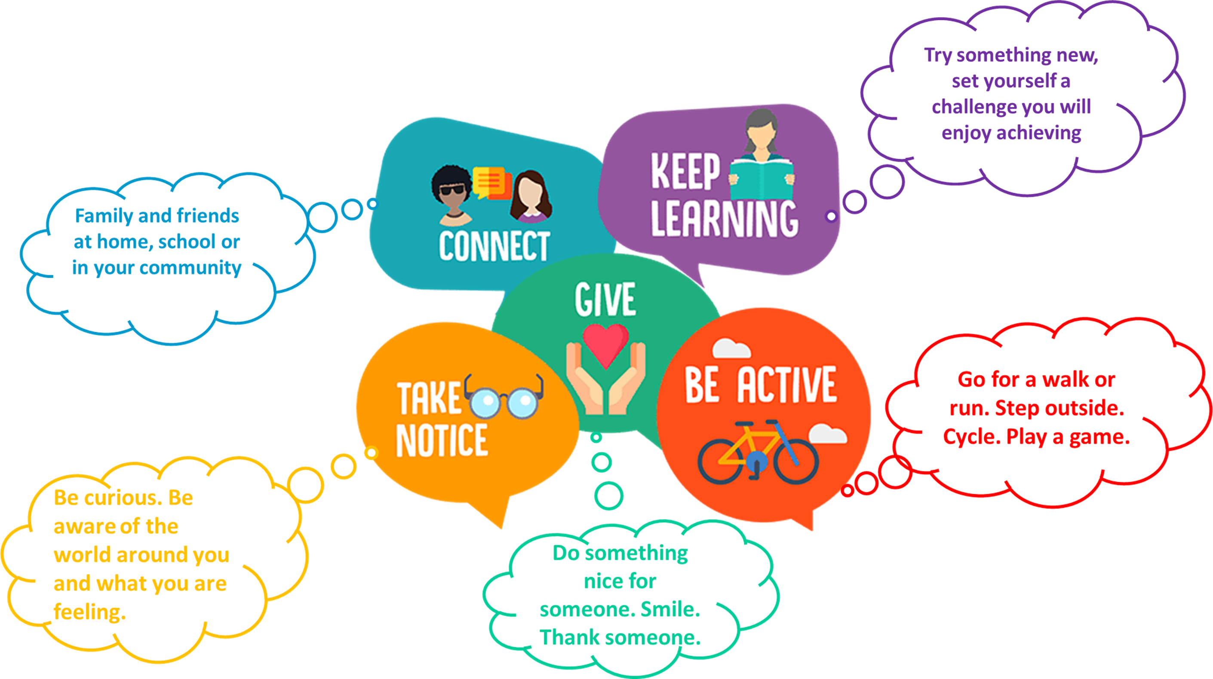
5 ways to wellbeing – important at any time, especially around exam time

Slide 21
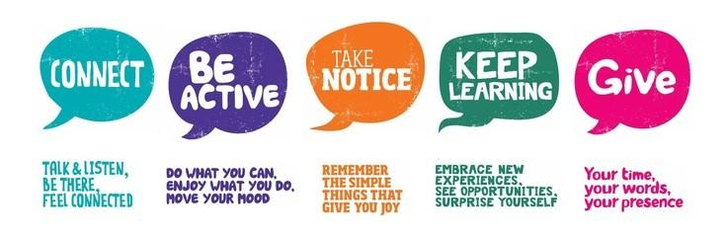
5WW MENU
Talking to friends & family.
Take a deep breath.
Talking to teachers.
Going to a club.
Play iSpy.
Do a dance.
Grounding cards.
Play with someone new.
Go on a walk.
Write down your thoughts and feelings.
Listen to others.
Yoga.
Eat a meal with friends or family.
Football, gymnastics, PE.
Listen to some calm music.
Advice to others.
Read a new book.
Your time – help around the house or if someone is stuck with their work.
Learn a new language.
Find a new hobby. Baking, running, football, music.
A hug or a smile.
Your kindness – words, pictures, letters etc.
Learn about people around you – fun facts?

Slide 22
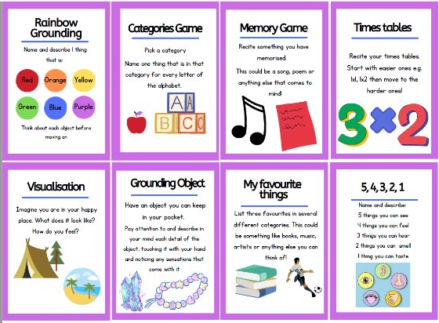
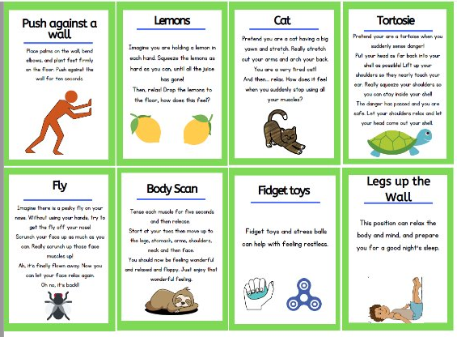
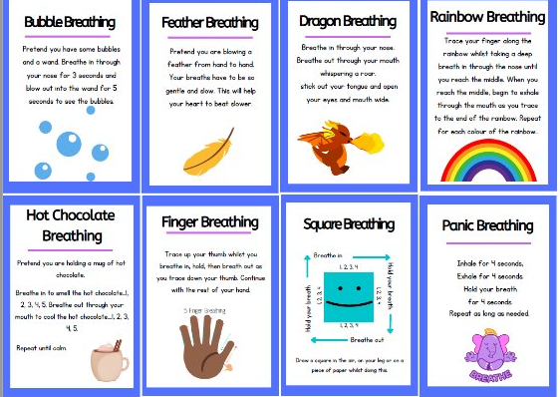
Breathing / grounding ideas

Slide 23
Extra Tips

Slide 24
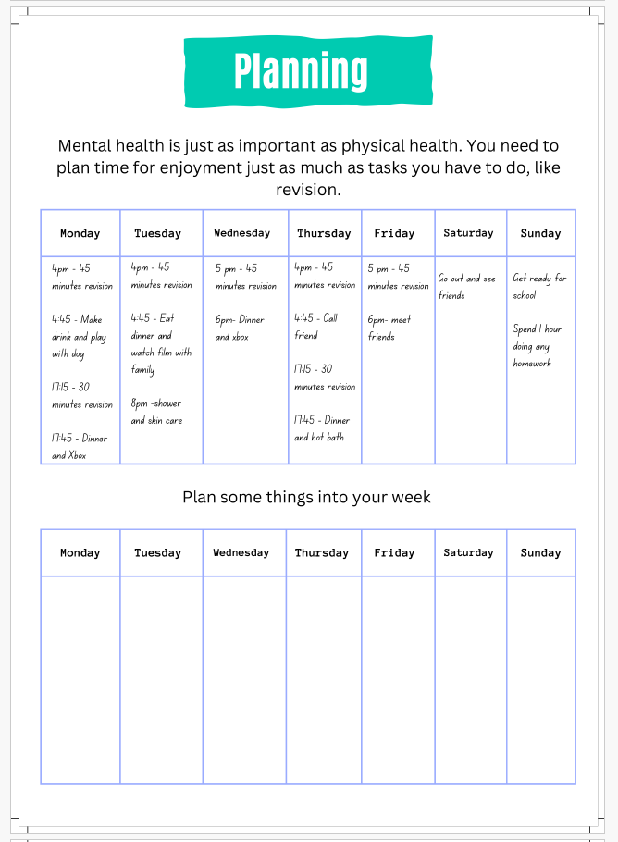
Planning for success
Devise an Exam Plan
Build in breaks and rewards around revision

Slide 25
How can I support my child?
Every young person is different and what works for one might not be helpful for another. Here are some things that might be useful:
Go to any meetings the school invites you to about exams
Make sure your child eats well
Help your child get enough sleep
Be flexible during exams
Help them to study and prioritise breaks and time away from study
Encourage exercise during exams
Make time for treats
Don’t add to the pressure – now’s not the time to worry about tidy bedrooms etc
Notes:
Go to any meetings the school invites you to about exams.
These can be a great opportunity to learn more about what will happen, and how you can support your child. Feel involved.
Make sure your child eats well
A balanced diet is vital for your child’s health, and can help them to feel well during exam periods.
Some parents find that too many high-fat, high-sugar and high-caffeine foods and drinks (such as cola, sweets, chocolate, burgers and chips) make their children hyperactive, irritable and moody.
Help your child get enough sleep
Good sleep will improve thinking and concentration. Most teenagers need between 8 and 10 hours of sleep a night.
Allow half an hour or so for kids to wind down between studying, watching TV or using a computer and going to bed to help them get a good night’s sleep.
Cramming all night before an exam is usually a bad idea. Sleep will benefit your child far more than a few hours of panicky last-minute study.
Be flexible during exams
Family Lives advises parents to be flexible around exam time. When your child is revising all day, don’t worry about household jobs that are left undone or untidy bedrooms.
Remember, exams don’t last forever.
Help them to study and prioritise breaks and time away from study.
This improves mental wellbeing and helps your child focus and learn.
Help your child revise by making sure they have somewhere comfortable to study. Help them draw up a revision schedule or ask the school for one.
Encourage exercise during exams
Make sure your kids are active. Exercise can help boost energy levels, clear the mind and relieve stress.
Make time for treats
When the exams are over, help your child celebrate by organising an end-of-exams treat.
Don’t use rewards as bribes. Instead, encourage your child to work for their own satisfaction, offering small, frequent treats.
Don’t add to the pressure
Support group ChildLine says that many of the children who contact them feel that the greatest pressure at exam time comes from their family.
“Keep things in perspective,” says Rosanne Pearce, a senior supervisor. “Listen to them, give support and avoid criticism.”
Before they go in for a test or exam, be reassuring and positive. Make sure they know that failing isn’t the end of the world, and that if things don’t go well they may be able to take the exam again.
After each exam, encourage your child to talk it through with you. Then move on and focus on the next test, rather than dwelling on things that can’t be changed.
Staying calm yourself can help.

Slide 26
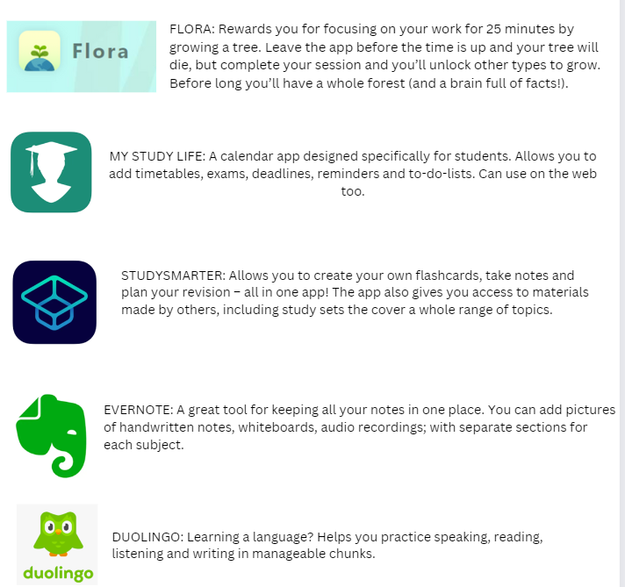
Study Apps!
Notes:
Apps to practically help

Slide 27
Get Extra Support
If your child doesn’t want to talk to you, try helping them identify a trusted friend or adult to check in with. Make sure your child knows they can also access support from professionals and peers online.
The Mix offers a helpline, advice and a forum for under-25s.
Shout text service offers support to anyone who’s struggling. Text 85258.
Childline has a helpline, chat and email service. Call 0800 1111.
Kooth app has an online community, articles, 1:1 chat and journal feature.
If you’re worried about your child, contact your GP/WEST to explore extra support.

Slide 28





Other places for support:
Kooth: https://www.kooth.com
Home - Calm Harm App
https://youngminds.org.uk
Childline | Childline
  Text Shout
Get Self Help
https://www.getselfhelp.co.uk/

Slide 29
Thank you and Good luck
We hope this has been interesting and useful.
Please could you complete our
very short evaluation form.
www.camhs.hacw.nhs.uk/west
If you feel your child would benefit from a referral to our WEST team to support them with their mental wellbeing, please speak to your child and school
Notes:
FINAL SLIDE FOR PARENTING WORKSHOP
Please ask the group to complete the evaluation form, it’s just 3 questions. This helps us to evaluate the service we provide and hopefully demonstrate it’s effectiveness.
If any parents feel their child would benefit from support from WEST to help them address their menta wellbeing, they can speak to school ataff about whether a referral to us would be useful. Schools don’t always recognise things if a yp is functioning ok at school so they may need you to share with them any concerns..
Direct to our website to watch these presentations again if they wish!

Slide 30
Additional information and slides

Slide 31
Why and When to provide support

Slide 32
Exam stress is normal, so when should I be worried about my child?
Changes in behaviour
  Refusing to go to school/college or to engage with studies or revision.
  Difficulty sleeping.
  Sudden increase or decrease in appetite.
  Paying less attention to personal hygiene.
  Isolating from others.
Changes in mood
  Unusually tearful or angry.
  Flat, uninterested mood.
  Expressing hopelessness.
  Obvious stress and anxiety about unimportant things.
  Loss of interest in regular hobbies.
Notes:
Can make interactive – ask parents to suggester first what they may deem as worrying behaviours first
Help understand what is a valid response and when support is needed.

Slide 33
How we can support?

Slide 34
Supporting your Child
Understand the source of stress
Messages of stress and pressure can come from many places. It might be something a teacher has said, or a well-meaning comment from relatives or friends. News and social media can also play a part. You child might struggle to cope with feelings of pressure because of these things.
Take time to speak to and observe your child. It can help to:
  Ask them how they feel and what’s making them feel that way.
  Share any concerns you have for how they are – tell them what you’ve noticed.
  Find ways to empathise – reflect on what pressure feels like, or ask how they’re looking after themselves.
Don’t feel you have to find solutions straight away. Making sure your child knows that you are listening and there to offer support can be a good start.

Slide 35
Trouble shooting

Slide 36
My child isn’t worried about exams – is that a problem?
No, not necessarily. Some young people enjoy taking exams – the build-up, preparation and completion of exams can be an extremely satisfying experience. Exams are usually a long time in coming, so the relief that they are finally approaching can often neutralise any fears or worries.
The most helpful thing my parent/carer said to me was not to waste energy on events outside of my grasp - control the controllables!
This can obviously quickly change if your child feels a particular exam hasn’t gone well or they run into difficulties whilst revising. Keep a close eye on how they’re doing but avoid trying to make your child worried in the hope it will make them work harder; it’s counterproductive and won’t help anyone.

Slide 37
My child isn’t worried about exams – is that a problem?
If your child appears ambivalent about exams and isn’t engaging in the process, it may also be a symptom of anxiety. By opting out and choosing not to revise, they may appear not to care. However, this is probably a defence mechanism to help them manage impending failure; it’s easier to cope with bad grades if you haven’t tried hard.
How to deal with this:
  Avoid shouting – it’s a waste of time and energy and rarely makes a difference.
  Don’t remind them of the consequences of not taking exams, because, in reality, exams can usually all be re-taken at a later date.
  Approach the situation without judgement - it's not necessarily because they're being 'lazy' or not taking exams seriously. They need reassurance and encouragement not nagging and pressure.
  Contact the school as soon as possible.

Slide 38
How to manage a 'disappointing' exam results day
If your child is unhappy with their exam results it can be tough to deal with. Here are some things that can help:
If your child is happy to show you their results statement, you might find it helpful to have a look, just in case they have misread or misunderstood, or overlooked something.
Accept their feelings, whatever they are – disappointment, anger, embarrassment, bravado. Their feelings are neither right nor wrong, they just are. Don’t offer immediate judgement, or solutions, or even reassurance – there will be plenty of time for conversations later.
Reflect back how they are feeling to show you have understood, for example, “I can see you’re disappointed with the Maths result.”
Let them know you love them through highs and lows. Big hugs are good (although probably very embarrassing in public).
Show you’re on their side - it could be something small like getting their favourite snack.
Give yourself some breathing space and time to reflect.

Slide 39
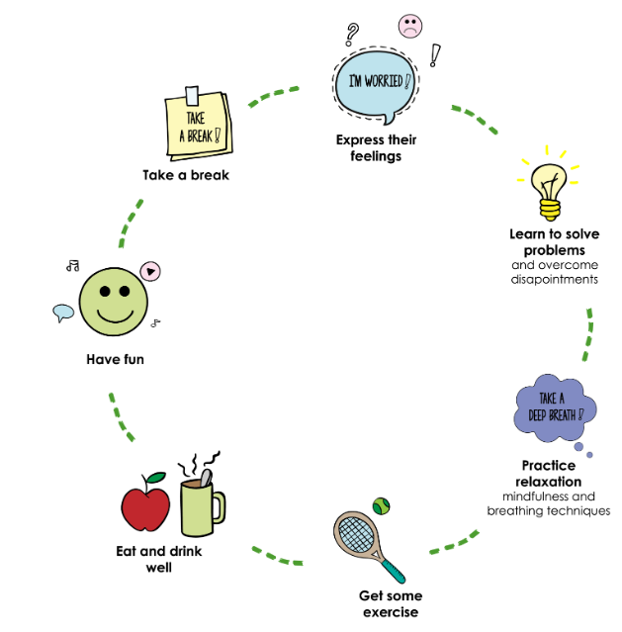
Summary - Three key things
There are three key things you can remind your child about to help them keep a healthy perspective:
Remember exams only assess what an individual has learnt. Whilst that’s important, so too are other things like their personality, integrity and how they treat others, none of which will be measured in a standardised exam.
Doing their best is enough, and once an exam is done, ask how they feel it went. Don’t keep going over it because it won’t change anything. Say well done and let them move on.
Exams can be tough, but they are soon over. Any stress or worry is short term and manageable and will soon be in the past. Hang on!

Slide 40
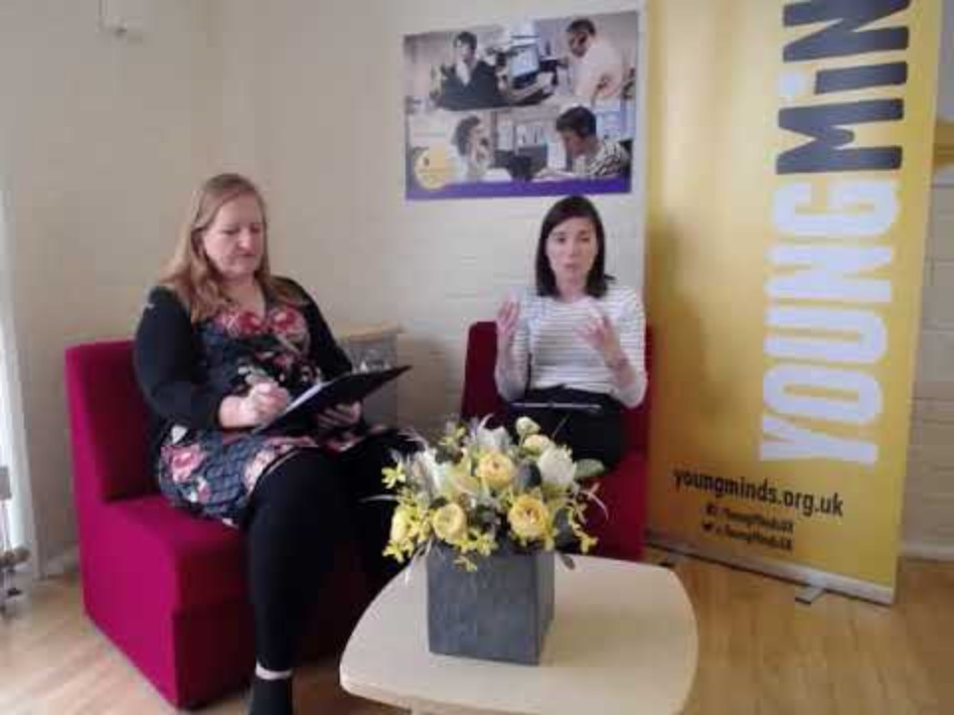

Slide 41
Encourage your child to learn skills to help them manage their own exam stress
Grounding/relaxation/breathing techniques?
Mindful Breathing Exercise (youtube.com)

Slide 42
Sources:
https://www.youngminds.org.uk/parent/parents-a-z-mental-health-guide/exam-time/
https://www.charliewaller.org/mental-health-resources/mental-wellbeing/exams-supporting-your-child
https://www.nhsinform.scot/healthy-living/mental-wellbeing/stress/coping-with-exam-stress/
https://parents.actionforchildren.org.uk/school-life/school-work-homework/exam-stress/
Exam Time & Exam Stress | Parents Guide To Support
Exams are a stressful time for any young person, if you're worried about how your child is coping read our tips and advice on how to help.

