Slide 1



Slide 2


Slide 3


Slide 4
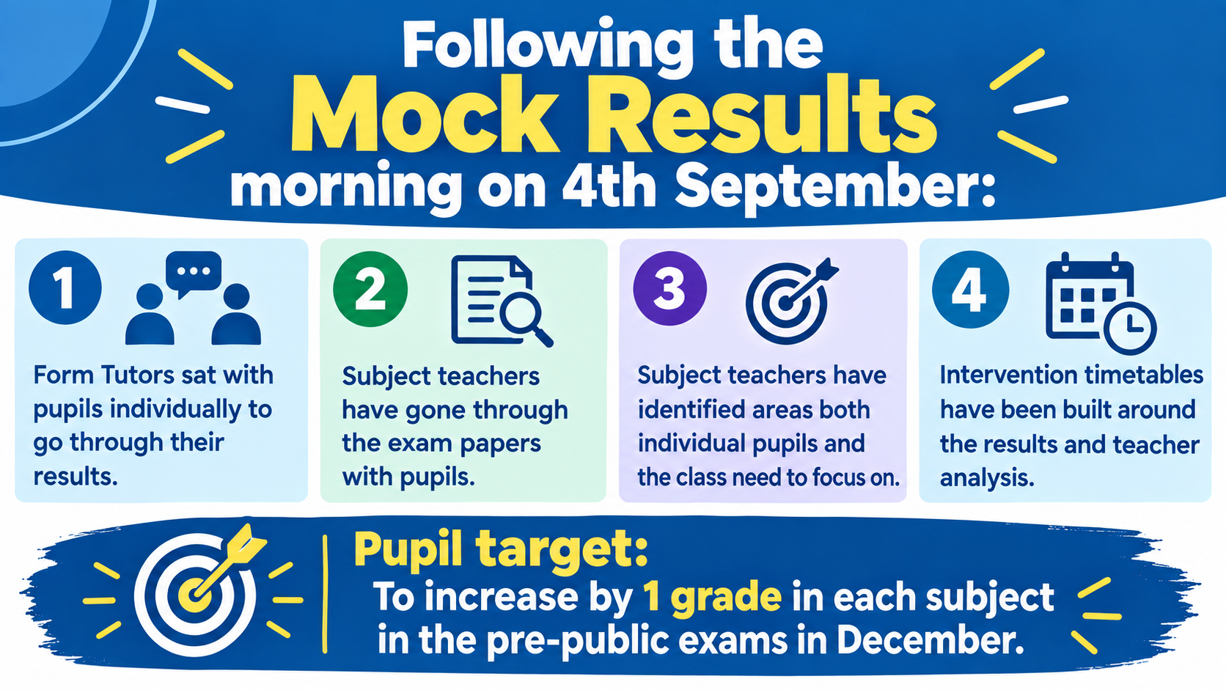
Mocks

Slide 5

Interventions

Slide 6
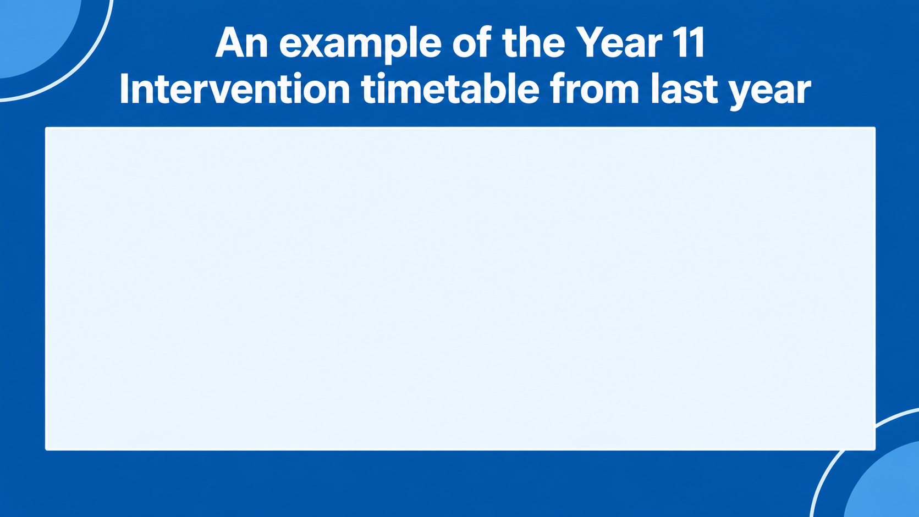
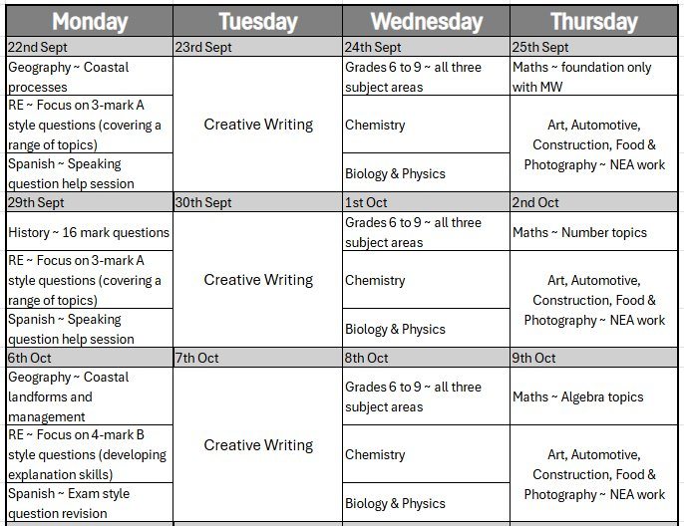

Slide 7


Slide 8
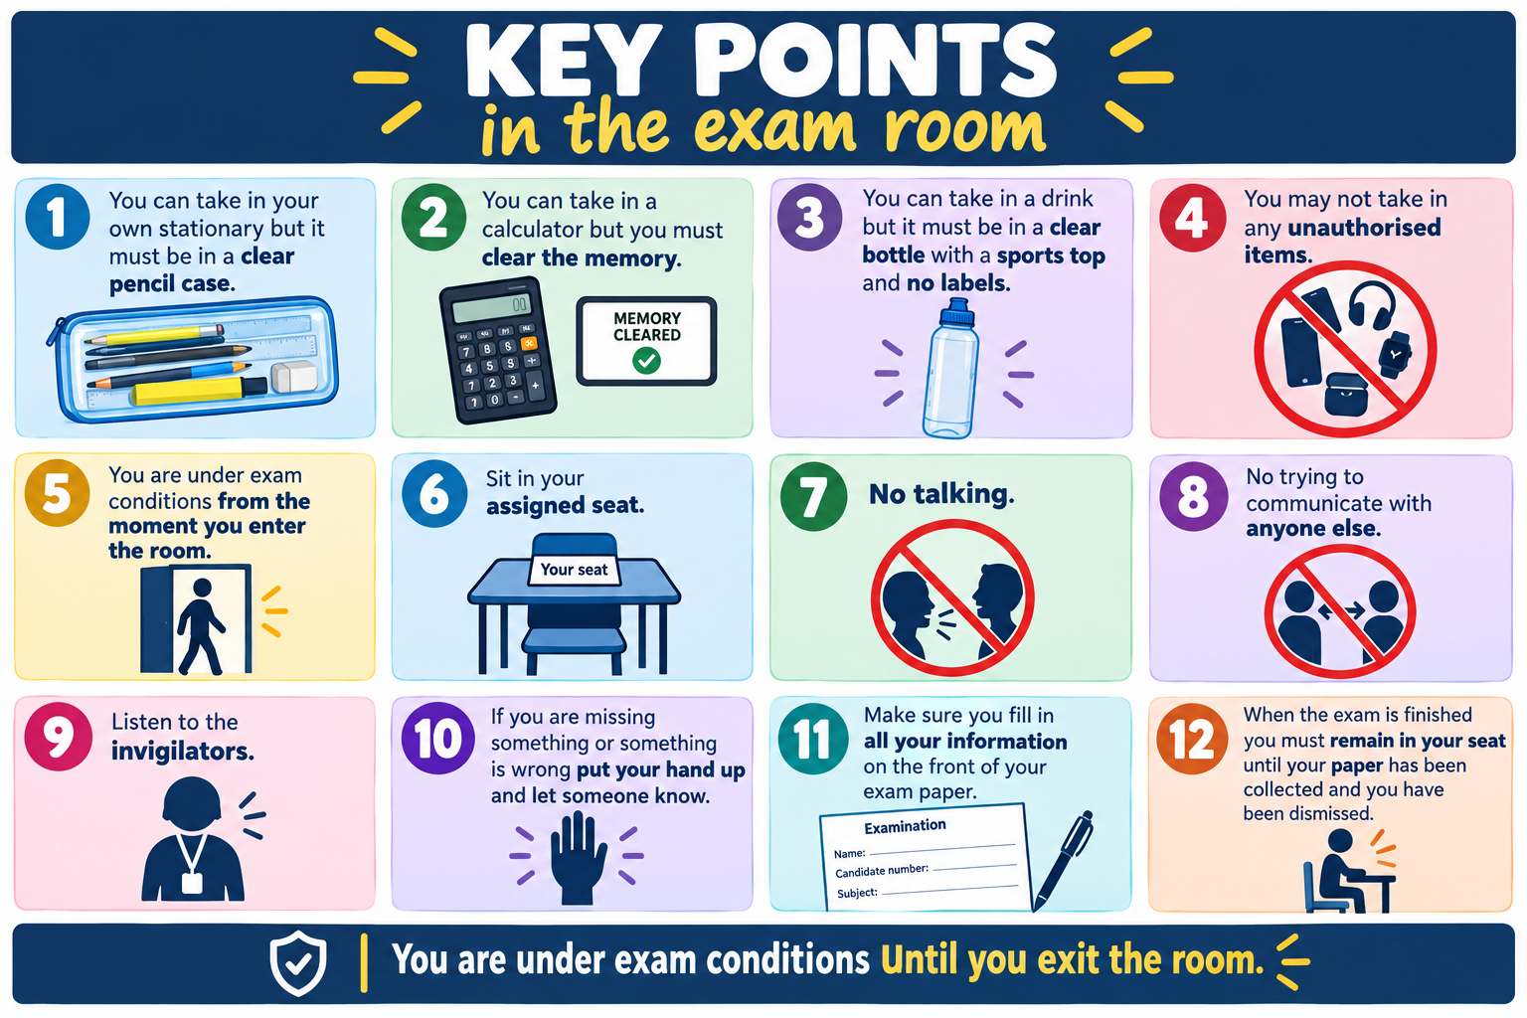

Slide 9

