Slide 1

Year 9
Options Evening
6th March 17:45

Slide 2
School Leadership Team
Welcome
William Cartwright
Ruby Rogers

Slide 3
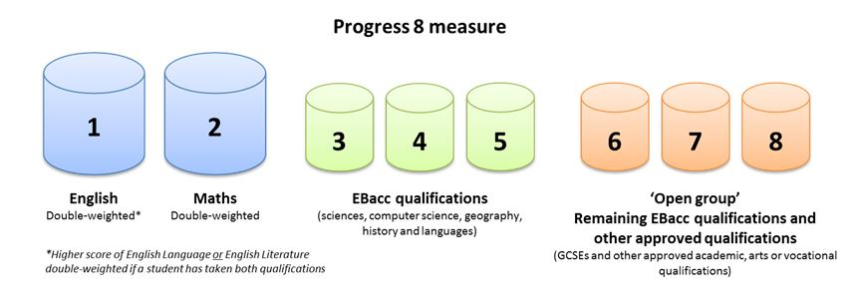
GCSE Government measures
All schools are required to deliver a balanced curriculum to pupils that meets the demands of Progress 8
Progress 8 is a measure of the progress children make between the end of primary school and the end of secondary school.
It is based on pupils’ performance in eight qualifications

Slide 4



English Language
History
Art, Childcare, RE, Food & Nutrition, Sport, Photography, Business, Animal Care, Automotive, Drama
English Literature
Geography
Maths
Science
Spanish
Computer Science

Slide 5
What will pupils study in Year 10?
Core Subjects: 17 Lessons Per Week
English
Maths
Science
5 Lessons
5 Lessons
5 Lessons
PE
PSHE
1 Lesson
1 Lesson

Slide 6
What will students study in Year 10?
2) Options Subjects: 8 Lessons
Option
A
Option
B
Option
C
Option
D
2 Lessons
2 Lessons
2 Lessons
2 Lessons

Slide 7
The Option Blocks are:
Block A | Block B | Block C | Block D
GCSE Geography | GCSE Geography | Art | Animal Care
GCSE History | GCSE History | Automotive Studies | Child Development
GCSE RE | GCSE Spanish | Business & Enterprise | Computer Science
 | Asdan/Lit/Num | Food Prep & Nutrition | Photography
 |  | Performing Arts | Sport Science

Slide 8
Year 9 Options Timeline
Date | Activity
12.01.25 | Assembly (during form time) This is to introduce pupils to the process and explain the difference between core & options subjects
13.02.25 | Options Survey Students tell us what they would provisionally like to study. We use this information to create options blocks.
06.03.25 | Parents Information Evening & Options Marketplace To help parents stay informed about the process and have dedicated time for options discussions with Senior Leadership Team and teachers.
27.02.25 – 03.04.25 | Drop ins with Mrs L Stevens Carers Advisor
21.03.25 | Option Form Released to Parents/Guardians/Pupils
02.05.2025 | Options Forms Submitted This is the deadline for the final forms to be submitted.
23.05.25 | Individual Pupil Interviews & Confirmation of Choices Pupils are interviewed 1 to 1 and options choices are discussed with a senior leader. Final confirmation letters are sent to parents / carers

Slide 9
Other items to note
If selecting Geography please be aware it is a requirement that pupils attend Year 11 Field Trips to facilitate the examination at a cost of approximately £100
In some cases, a member of SLT may speak with a pupil as to their choices, or indeed may call a parental meeting to work through choices or issues with choices
Pupils can not study both GCSE Art and GCSE photography
All pupils will follow 100% of the Core Offer, including the core PE and the PSHE offer as they are statutory
Parents/Carers will always hold the final agreement to the options formally offered by signing the offer letter return slip, pupils asking for changes etc will not be granted without parental/carer discussion and permission

Slide 10
How do you make a decision?
The Options Evening and Marketplace
Read the Options Booklet you will be given
Talk to your tutor, Teachers, or a member of the Senior Leadership Team
Talk to your parents/guardians and older students
Think about what careers you might be interested in
Mrs Lydia Stevens, our Independent Careers Adviser
Options and career research on the internet
www.nationalcareersservice.direct.gov.uk

Slide 11
Common Questions and Answers
Do I have to pick a subject in every option block even if there are none there I am interested in?
Yes, you must be timetabled at every point of the school day
Do I have to study Spanish?
We will advise you if we think you should be studying Spanish and have not selected it, as a general rule you should consider taking Spanish if the majority of your subjects have Minimum Expected Grade Targets in Band 3, but you are also free to choose to study Spanish if you wish
Are the vocational courses the same standard as GCSE?
All of the vocational courses attract the same level as a GCSE but they are sometimes graded differently. For example a GCSE in a subject will return a grade of 1-9 (Grade 1 is the lowest Grade 9 is the highest), whereas on many of the vocational courses they are graded as Pass, Merit, Distinction and Distinction* at either Level 1 or Level 2.
What is the difference between Level 1 and Level 2?
A Level 1 course means the equivalent of a GCSE at grades 1-3, a Level 2 course means the equivalent of a GCSE at grades 4-9. All vocational courses are Level 1 and 2 depending on ability except Automotive Studies which is only at Level 1

Slide 12
Common Questions and Answers
Can I change my options after I have accepted them?
Yes, but we really do not like to do it as our staffing is set up based on the offers, even then we would only consider it for a very short time so please choose wisely and do your research before hand
Are the dates outlined firm deadline dates?
Yes we need to stick to these deadlines so that we can do all of the things we need to behind the scenes
Are there any combinations of subjects I am not allowed to take?

Slide 13
Thank you
I am available for your questions, alternatively email me at options@queenelizabeth.hereford.sch.uk

Slide 14
